Slide 1
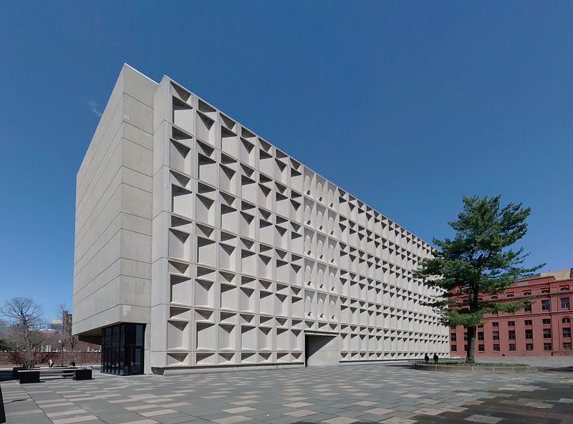
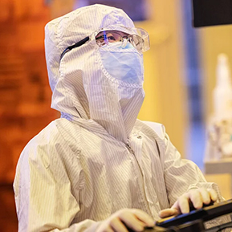
Yale University Cleanroom (YUC)
Cleanroom Facility Overview
Built in 2008 with $8M investment
2,600 SQFT, 5 Bay/Chase, ISO 5-6
3 ½ technical staff
100 users per year
Located on the 5th floor
Avian
Outdoor Seating
Yoga Studio
Main Entrance

Slide 2
Yale University Cleanroom Capabilities
Updated
Oxford 100 ALE
Autoglow Asher
XeF2 Etcher
Oxford Etcher
180 Cryo DRIE
80plus ICP-RIE
100 ICP-RIE
Reflectometer
Filmetrics F54-UV
Profiler
Bruker ContourX-500
KLA P-7
Ellipsometer
Woollam M-2000
Microscope
ZETA Z-20
Functional
Need Upgrade
Dry Etch
Heidelberg
MPO100
3D Printer
Metrology
LPCVD
Tystar TYTAN 4600
PECVD
Samco PD-220NL
ALD
Veeco Fiji
Optical Lithography
Heidelberg
DWL66fs
Laser Writer
CAD
Design
Suss MJB4
Contact Aligner
Thin Film
Growth
Dicing
ADT 7122 Dicer
Wire Bonding
Hesse BJ855
Scribing
Latticegear Ax300,
Flipscribe, Flexscribe
Critical Point Dryer
Autosamdri
Annealing
Solaris 150 RTA
Heidelberg MLA150
Maskless Aligner
ebeam Evaporator
PVD Products
Denton
Plassys JJ
Angstrom Engineering
Sputtering System
2 Angstrom Engineering
Lesker CMS-18
Thermal Evaporator
Lesker Nano38
Back End Processing
Deposition

