Slide 1


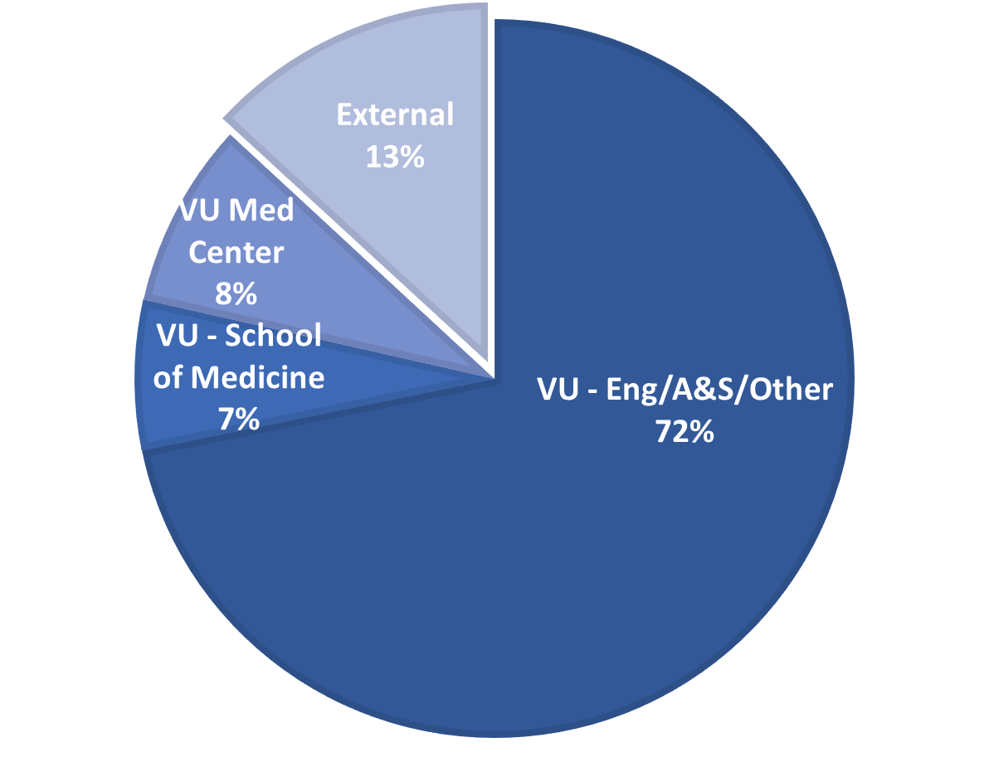
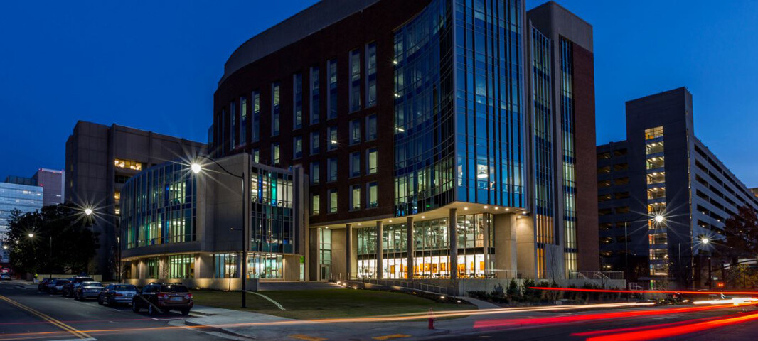
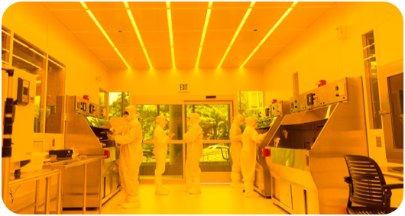
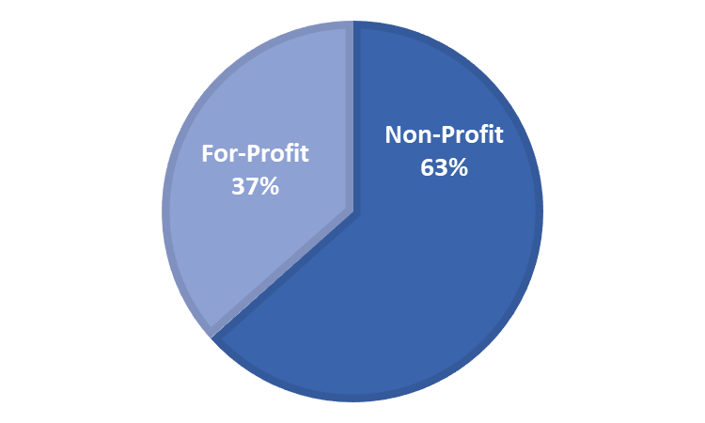
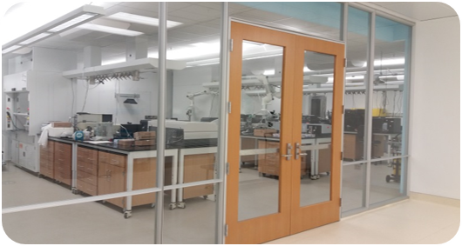

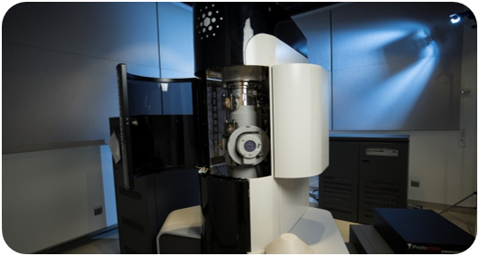
Vanderbilt Institute of Nanoscale Science and Engineering
Core Metrics
Located in Nashville, TN
Original facilities built 2003 (6,000 sq.ft.)
New facilities built 2017 (13,000 sq.ft.)
84 total tools
5 Technical Staff, 3 Administrative Staff
~15 Superusers + Undergrad Staff
50% cost recovery goal through user fees
Office of Vice Provost of Research and Innovation
Engineering and Science Building
355 Current users
39 External users
10,000 sq.ft.
ISO 5/6 Cleanroom
Characterization
Advanced Imaging
www.vanderbilt.edu/vinse

Slide 2
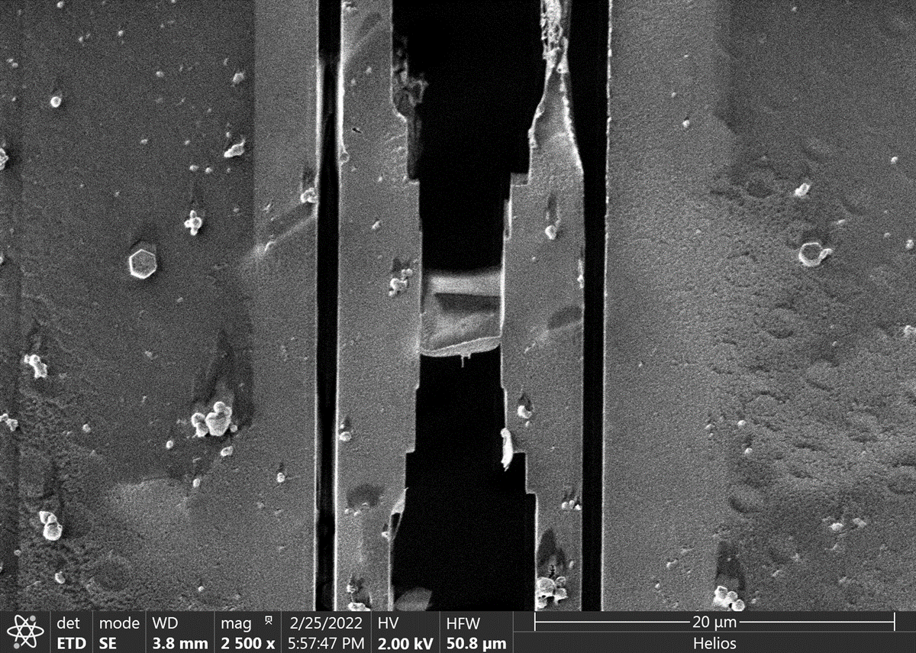
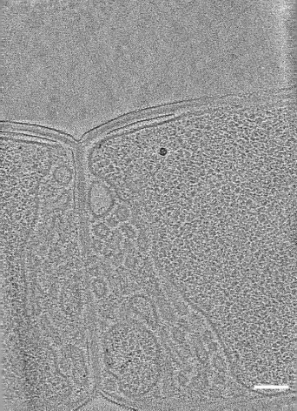
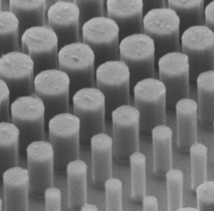
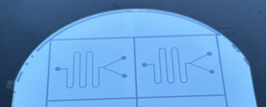
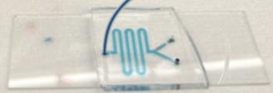

Key Capabilities & Features
Recent Additions/Initiatives
XeF₂ Vapor Etch - SPTS Xactix e2
Parylene Coater - SCS Labcoter 3
Grinder/Polisher – Buehler Ecomet 30
AFM Nanolithography Upgrade – Bruker Dimension Icon
Industrial Affiliates Program – Launching Fall 2024
Strengths
Tool availability (e.g., EBL and electron microscopes)
Amenable to trying new materials, processes
Built with room to grow
Weaknesses
Toolset sized mainly for chips up to 100 mm wafers
Top-5 Equipment/Capability Wishlist
Enhanced lithography capabilities
Enhanced support for III-V materials
Enhanced support for biotech materials
Enhanced liftoff capabilities
Optical profilometer
Nanoscience community beyond core facilities
Nano-bio
  Cryo-FIB/SEM for cryo-TEM prep (*VU Center for Structural Biology)
  Microfluidic devices, microelectrode arrays
Nano-optics
  Si metamaterials
Nano/micro-electronics
  GaN HEMT devices
Nano-energy
  2D materials
Cryo-lamella of C. diff bacteria
Cryo-ET slice*
Si Pillar Array
100 nm
H. Pi et al. Nature, 623, (2023)
Microfluidics
Talk to me about…
XPS and surface analysis
Cycling across Iowa
www.vanderbilt.edu/vinse

