Slide 1
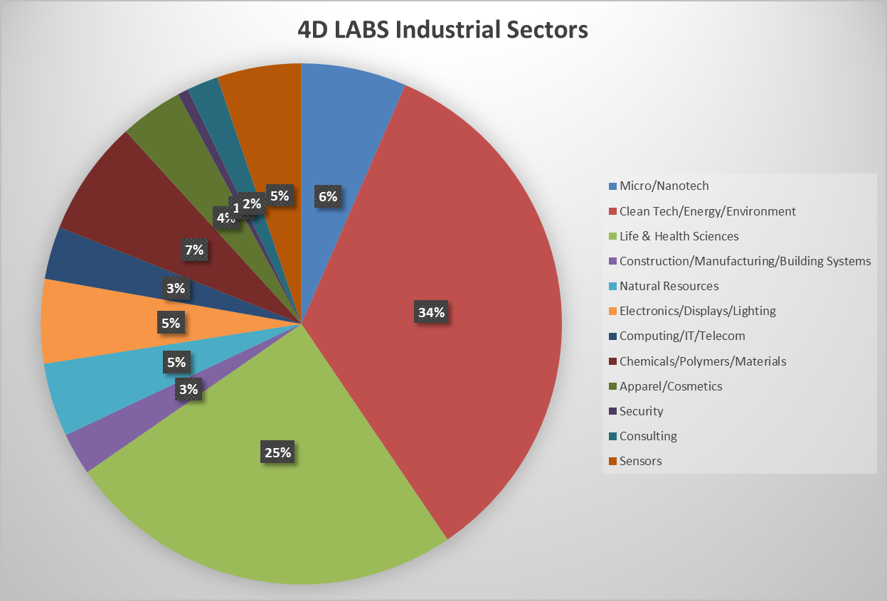
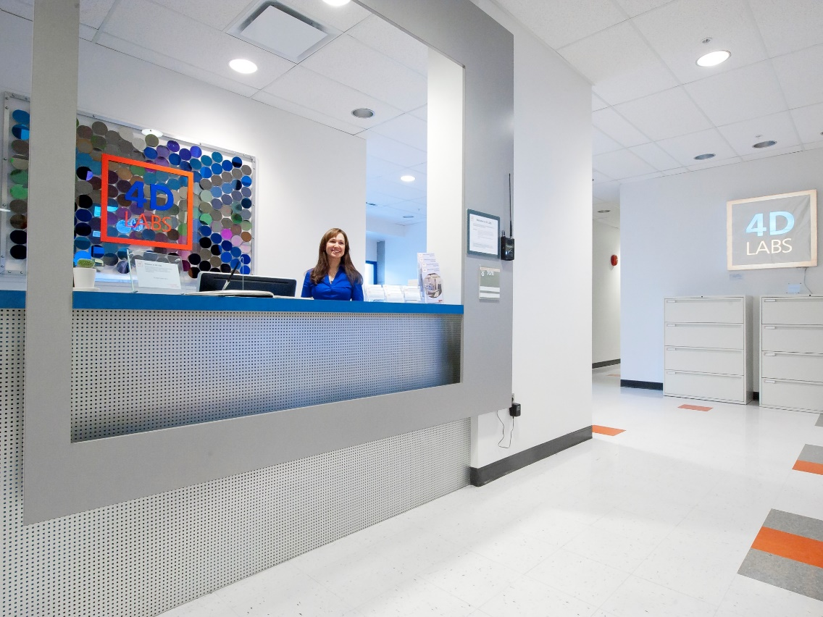
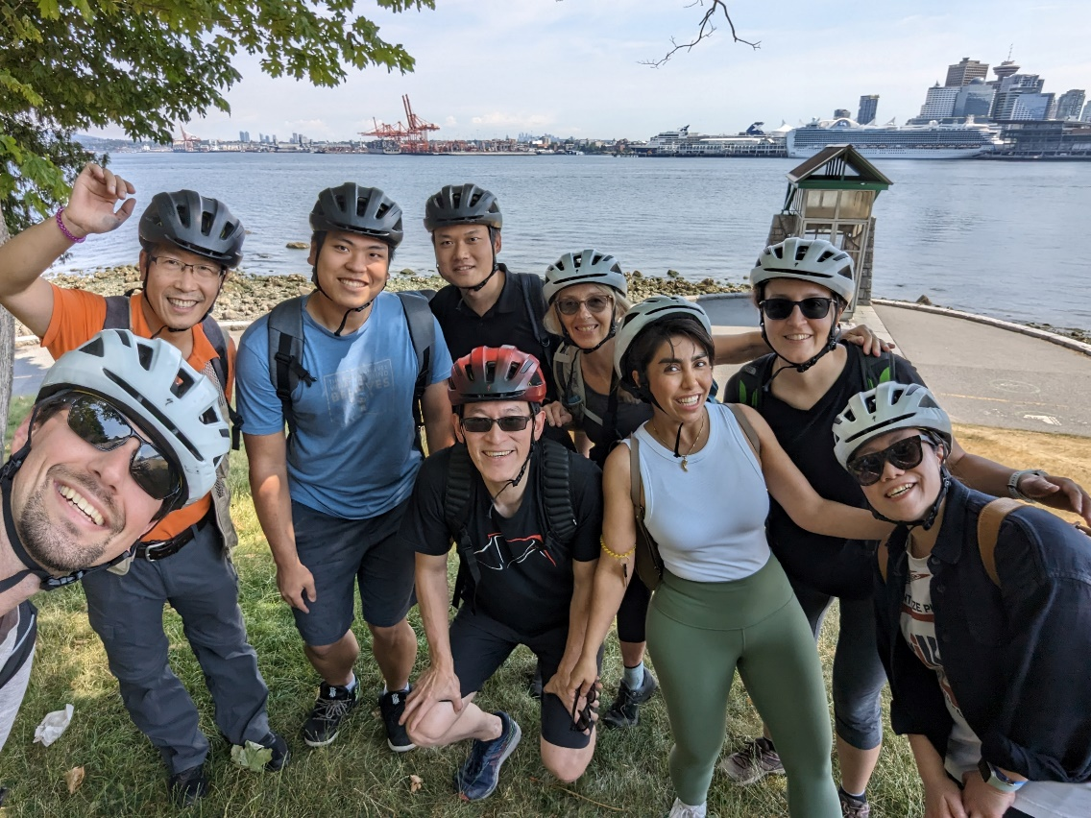
4D LABS at Simon Fraser University
Facility Metrics
open-access facility for Materials Science in Vancouver, BC, Canada
opened in 2010 and reflects an investment of $85mil to date
~30,000 sq-ft facility with 5000 sq-ft of ISO5 space (bay and chase)
>100 tools in both a fabrication and characterization facility
10 staff including scientists, engineers, and admin
25,000 tool hours/year
250 unique users/year including 140 being trained/year
>1,700 users to date, 1/3 industry and 2/3 academic
>190 companies to date
technology agnostic
$1.9mil annual operating budget
  85% external, 10% internal, 5% subsidy

Slide 2
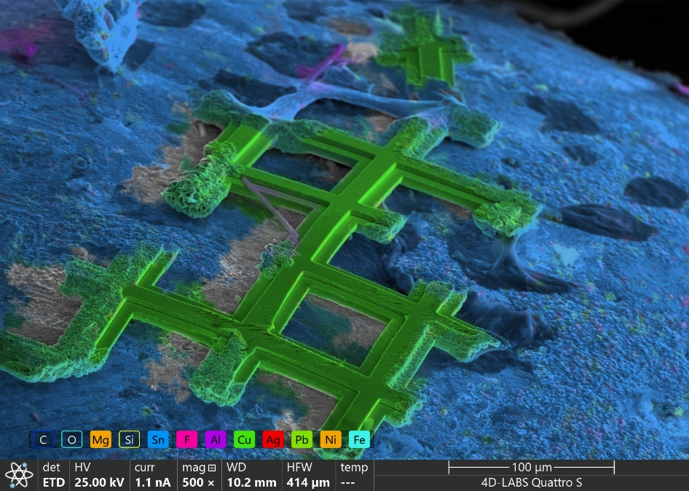
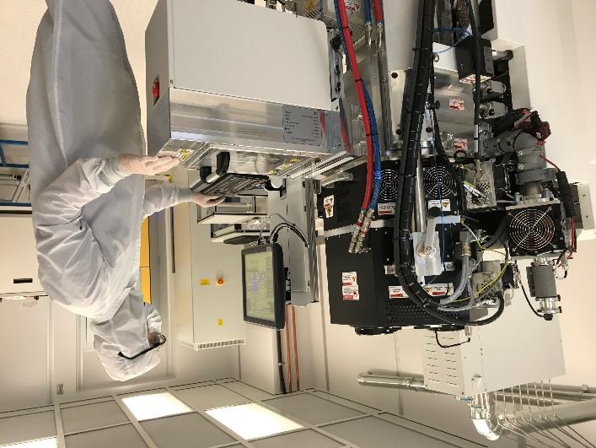
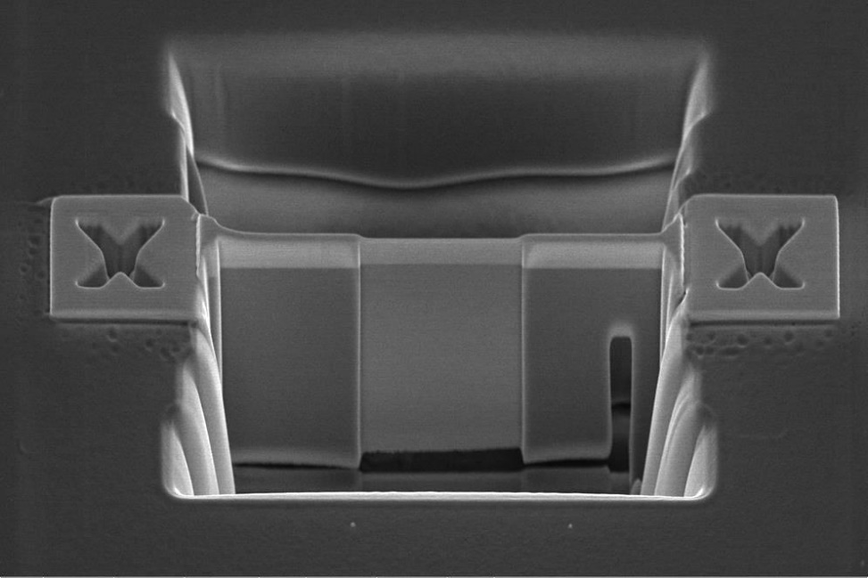
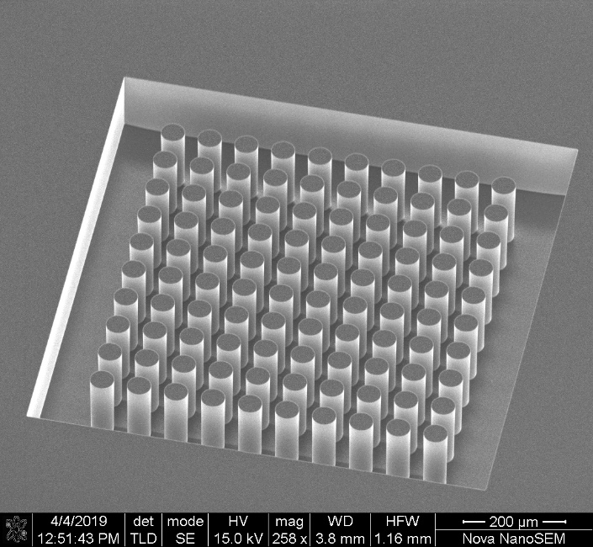
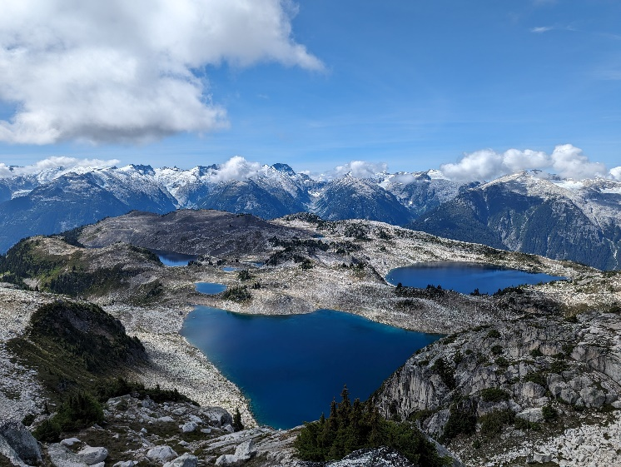
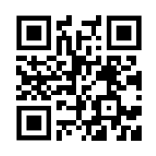
Key capabilities
DRIE
multiple PVD systems
wafer bonder
SEM/FIB and analytical TEM
Recent additions
environmental SEM
XRF
particle size analyzer
fuel cell test station
New funding announced!!
$8.6mil project funding for major tool upgrade for quantum fabrication (lithography, deposition, etching, packaging)
5 µm
Talk to me about
laundry
hiking
Top 5 wish-list
XPS replacement
TEM replacement
mechanical testing capabilities
porosimeter
micro-CT
https://www.4dlabs.ca/

