Slide 1


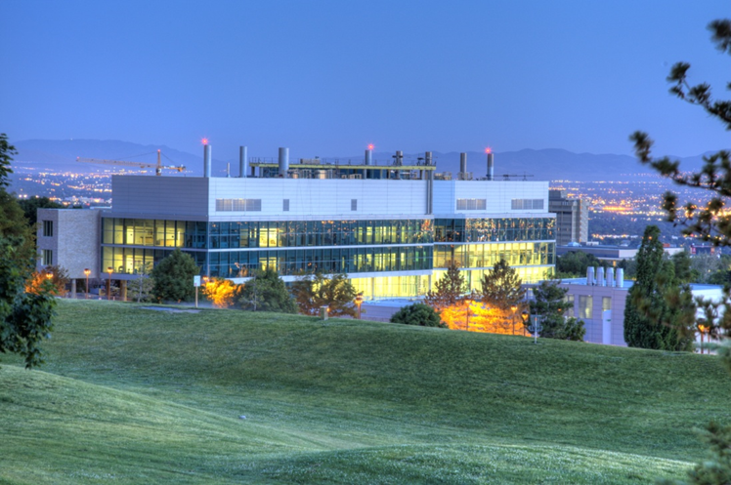
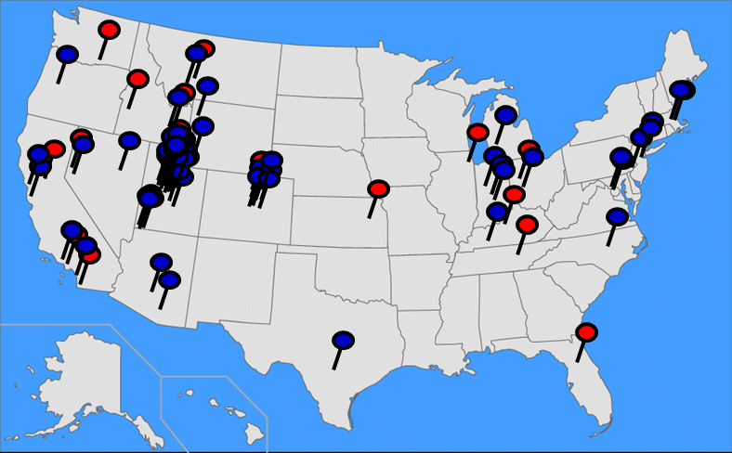
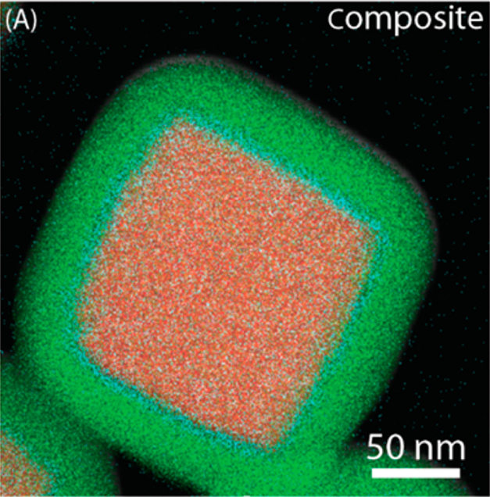
Utah Nanofab – Electron Microscopy & Surface Analysis Lab
Brian Van Devener, Lab Manager
EMSAL
External users
Facilities Metrics
Built in 2011 @ a cost of ~$25M
(cleanroom + EMSAL)
5,300 sq ft characterization & microscopy
4 technical staff – including lab manager
2 support staff
50 major tools – $11.3M
199 unique internal users/year
64 unique external users/year
Tool usage 7879 hours / year
(52% external by
revenue)
$554k operating expense FY2023
Revenue $447k: 38% internal, 62 % external
Subsidy: $448k* includes coverage
for deficits from previous years
Avian
Outdoor Seating
Yoga Studio
Main Entrance

Slide 2
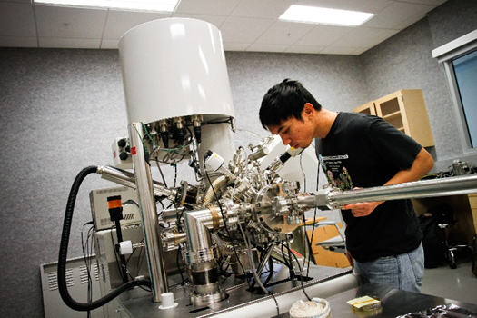
Key Capabilities & Features
Analytical TEM with environmental in-situ (gas or liquid) cells
NanoCT – Zeiss Xradia Versa 620
Micromechanical testing
Wide variety of materials and surface characterization
Recent Tool Additions (past 12 or 24 months)
NanoCT - Zeiss Xradia Versa 620
Hi-res XRD: Bruker Discover D8
Micromechanical Test Rig for SEM - MicroTest
Strengths
Staff, advanced analytical techniques, electron microscopy, surface analysis, micromechanical testing
Weaknesses:
Supporting cost of advanced instruments
Competing on-campus capabilities
Exploring Novel Anti-gravity Paperclips
Top-5 Equipment/Capability Wishlist
Replacement for ~20 yr. old XPS instrument
Replacement for “workhorse” FEG SEM
XAS/EXAFS/XANES
Time Resolved Photoluminescence (TRPL)
Aberration corrected STEM/4D-STEM
Other…
The Nuclear reactor at the U of U! TRIGA. Andrew Allison: andrew.allison@utah.edu

