Slide 1

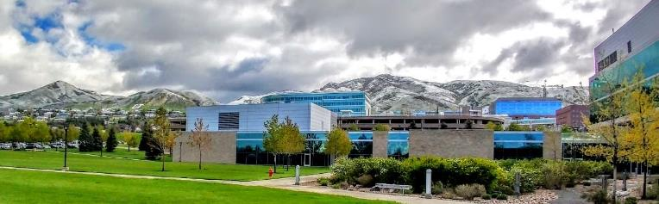

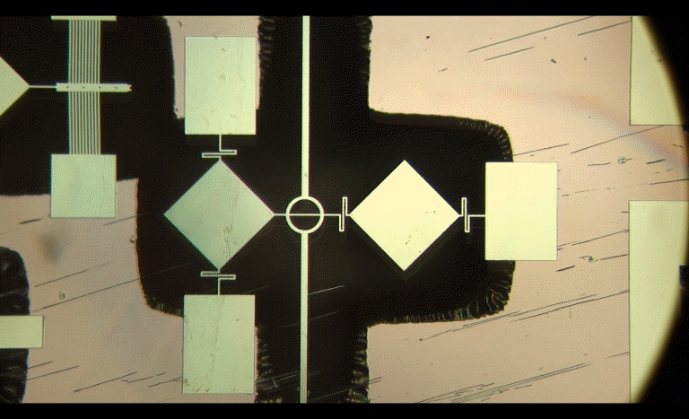
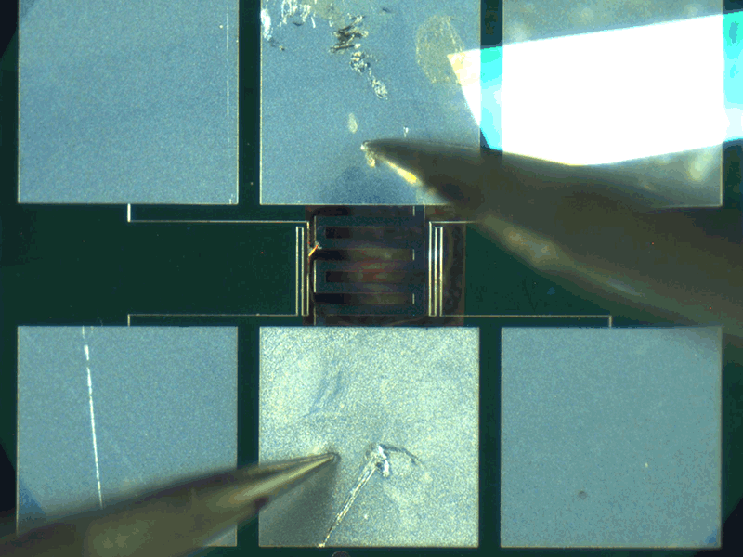
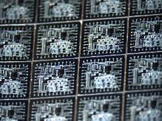
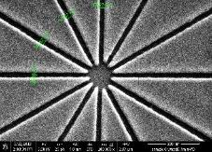
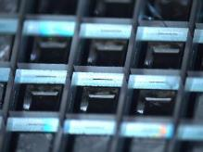
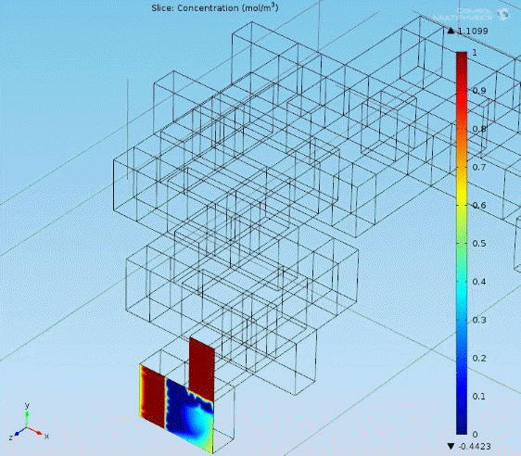
University of Utah Nanofab – Cleanroom
Brian Baker, Lab Manager
Facilities Metrics
$25M (cleanroom + EMSAL) completed in 2011
18,000 square feet, class 100/1000 spaces
4.5 technical staff, 2 support staff, 3 students
40 major tools ~$11M
Cleanroom Usage
117 unique internal users/year
40 unique external users/year
Tool usage 16,500 hours / year
8 Lab Courses/115 students annually
Cleanroom Financial Information
Annual revenue: ~$500k
57% on campus/43% off campus
Monthly on-campus researcher cap: $2,500
Operating expenses: $1.07M
Shared subsidy: $500k/$50k PCE/VPR
Avian
Outdoor Seating
Microactuators Lab Course
Micromachining Class
IC Manufacturing Lab
Nanofabrication Class
Microsensors Lab
Microfluidics Course
Yoga Studio
Main Entrance

Slide 2
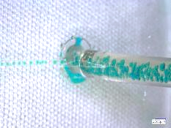
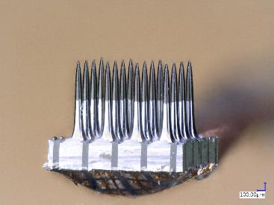
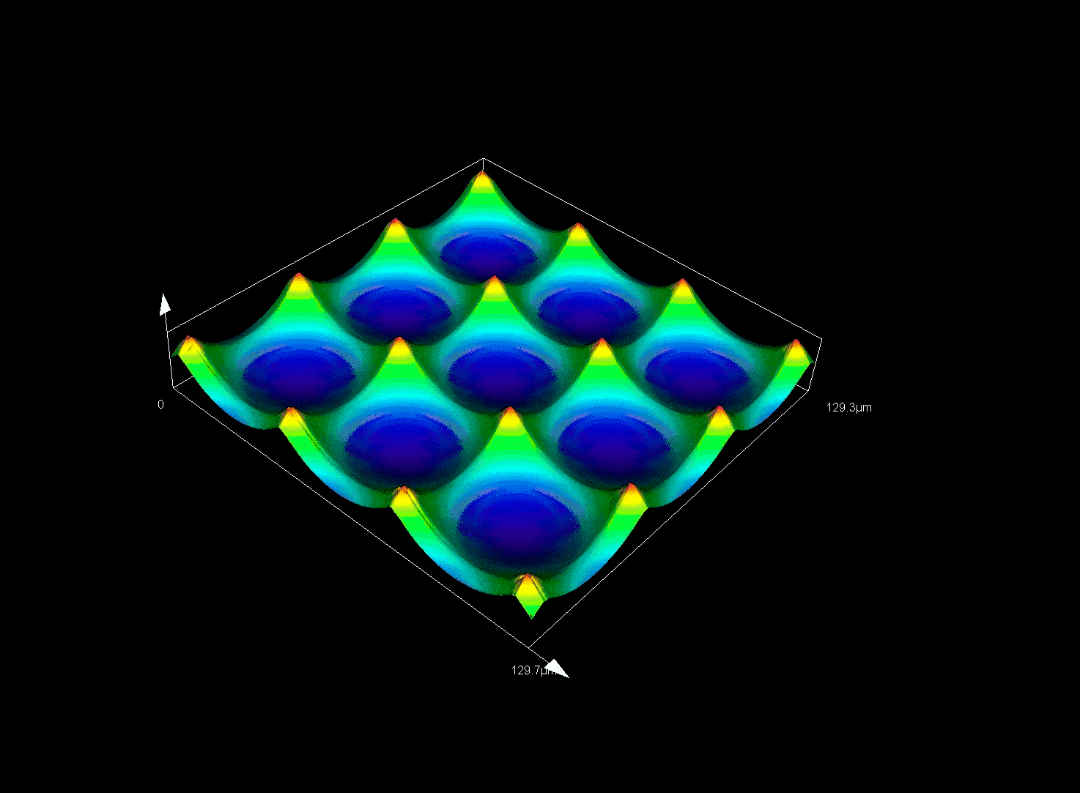
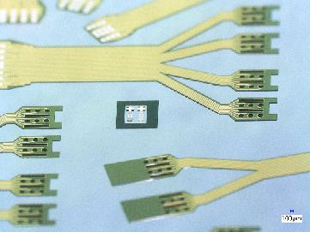
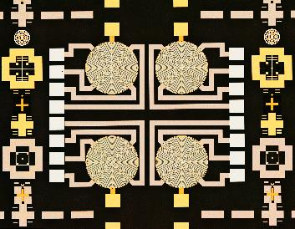
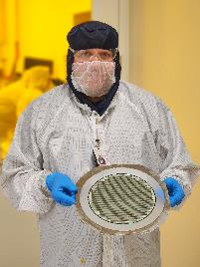
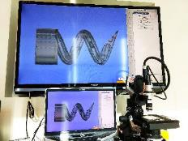
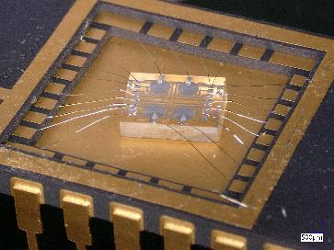
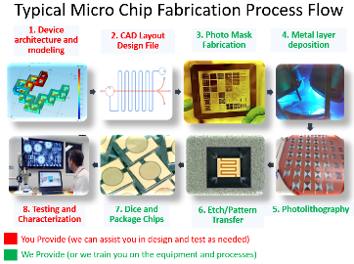
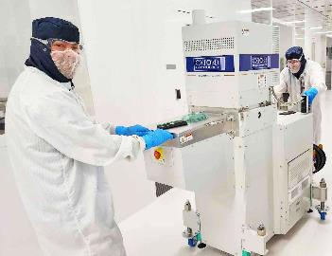
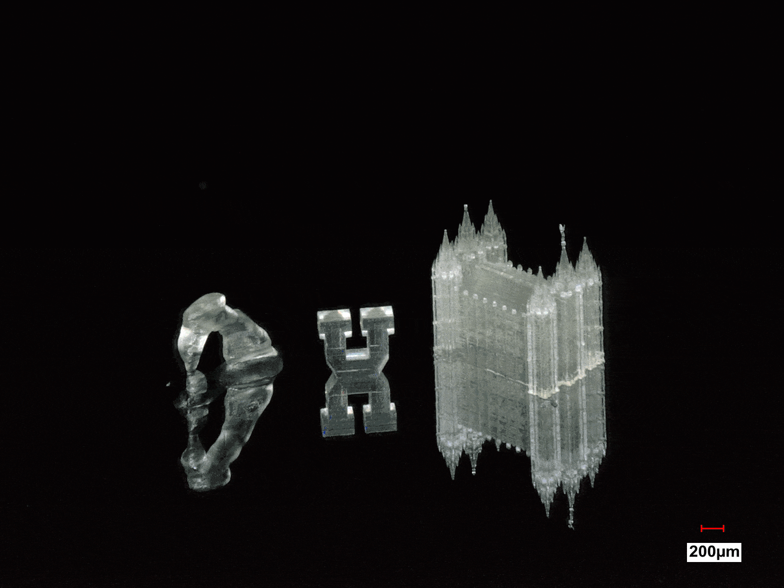

Microfluidics
Neural Interfaces
Grayscale Lithography
Flexible Electrodes
Microsensors
200mm Processing
3D Microprinting
MOCVD:Ga₂O₃, GeO₂
Professional Services
Room to Grow
Recent Tool Additions
Oxford Cobra 200mm ICPCVD
LPKF PCB manufacturing toolset
Talk to Me About: Vacationing in Utah
Top-5 Equipment Wishlist
Electron beam Lithography
Fast direct-write lithography
Fast & stitchless 3D printing
Atomic layer etching system
Wafer backgrinder
Weaknesses:
Large annual deficit
Funding for equipment >$200k
No fast nanolithography tool
www.nanofab.utah.edu
Notes:
Key capabilities and strengths:
Grayscale lithography/Diffractive Optical Elements
200mm wafer processing capabilities: DRIE, PECVD, PVD, Litho to 300nm, ALD, dicing
Next door to EMSAL, many collaborations
Neural biointerfaces/biomedical microdevices and implants: Polyimide flexible electrodes, Silicon Utah Electrode Array, Pt, Au, Ir, IrOx coatings
MOCVD: gallium oxide, germanium oxide

