Slide 1
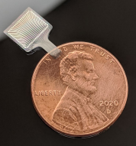
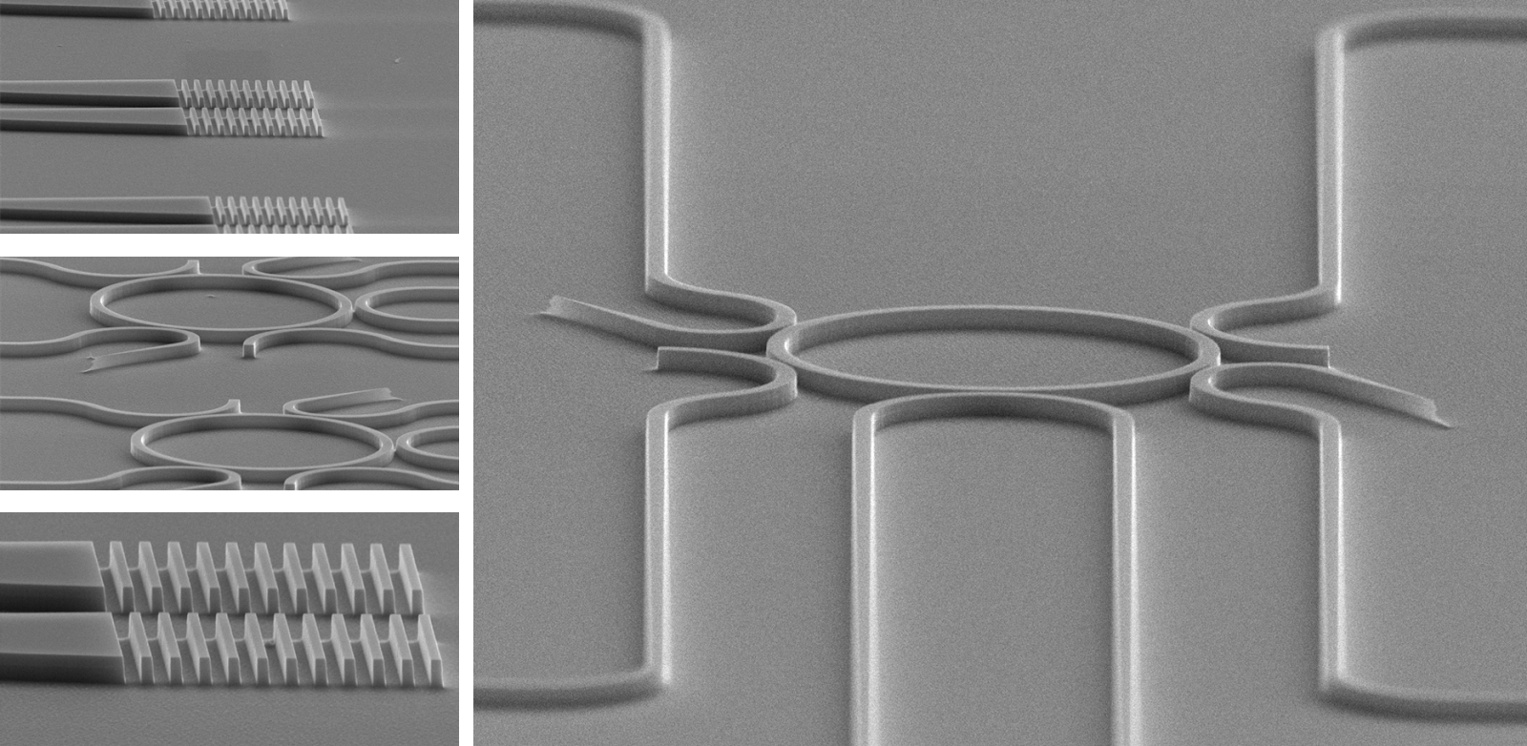
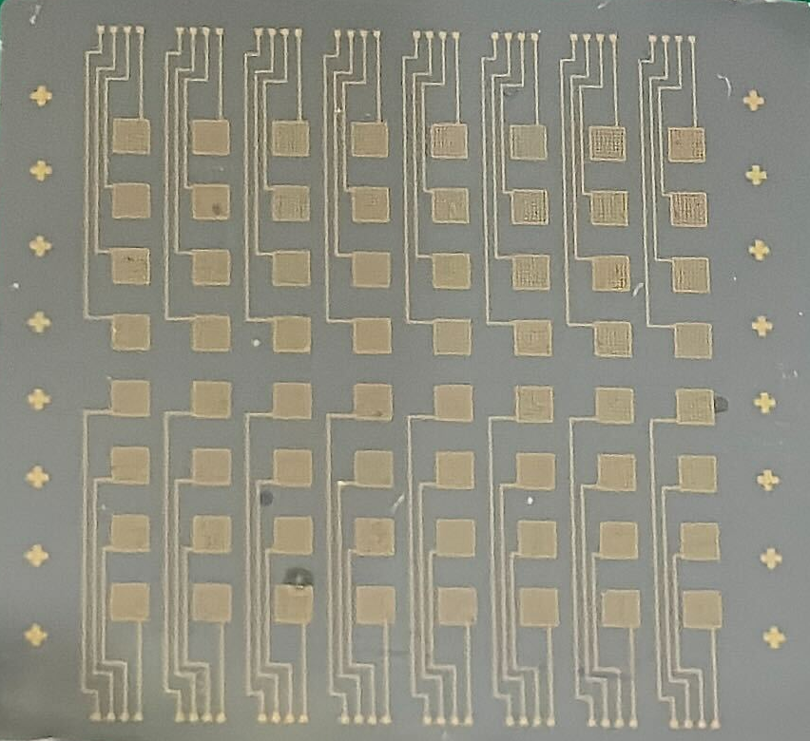
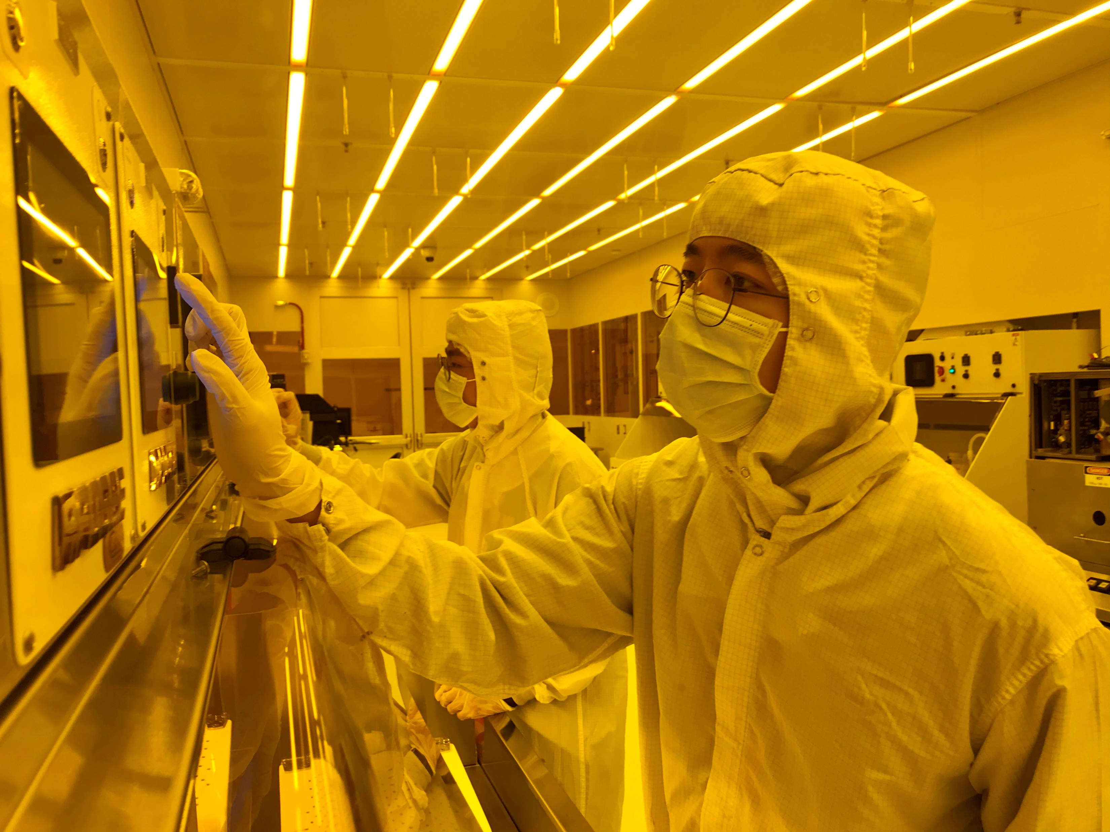
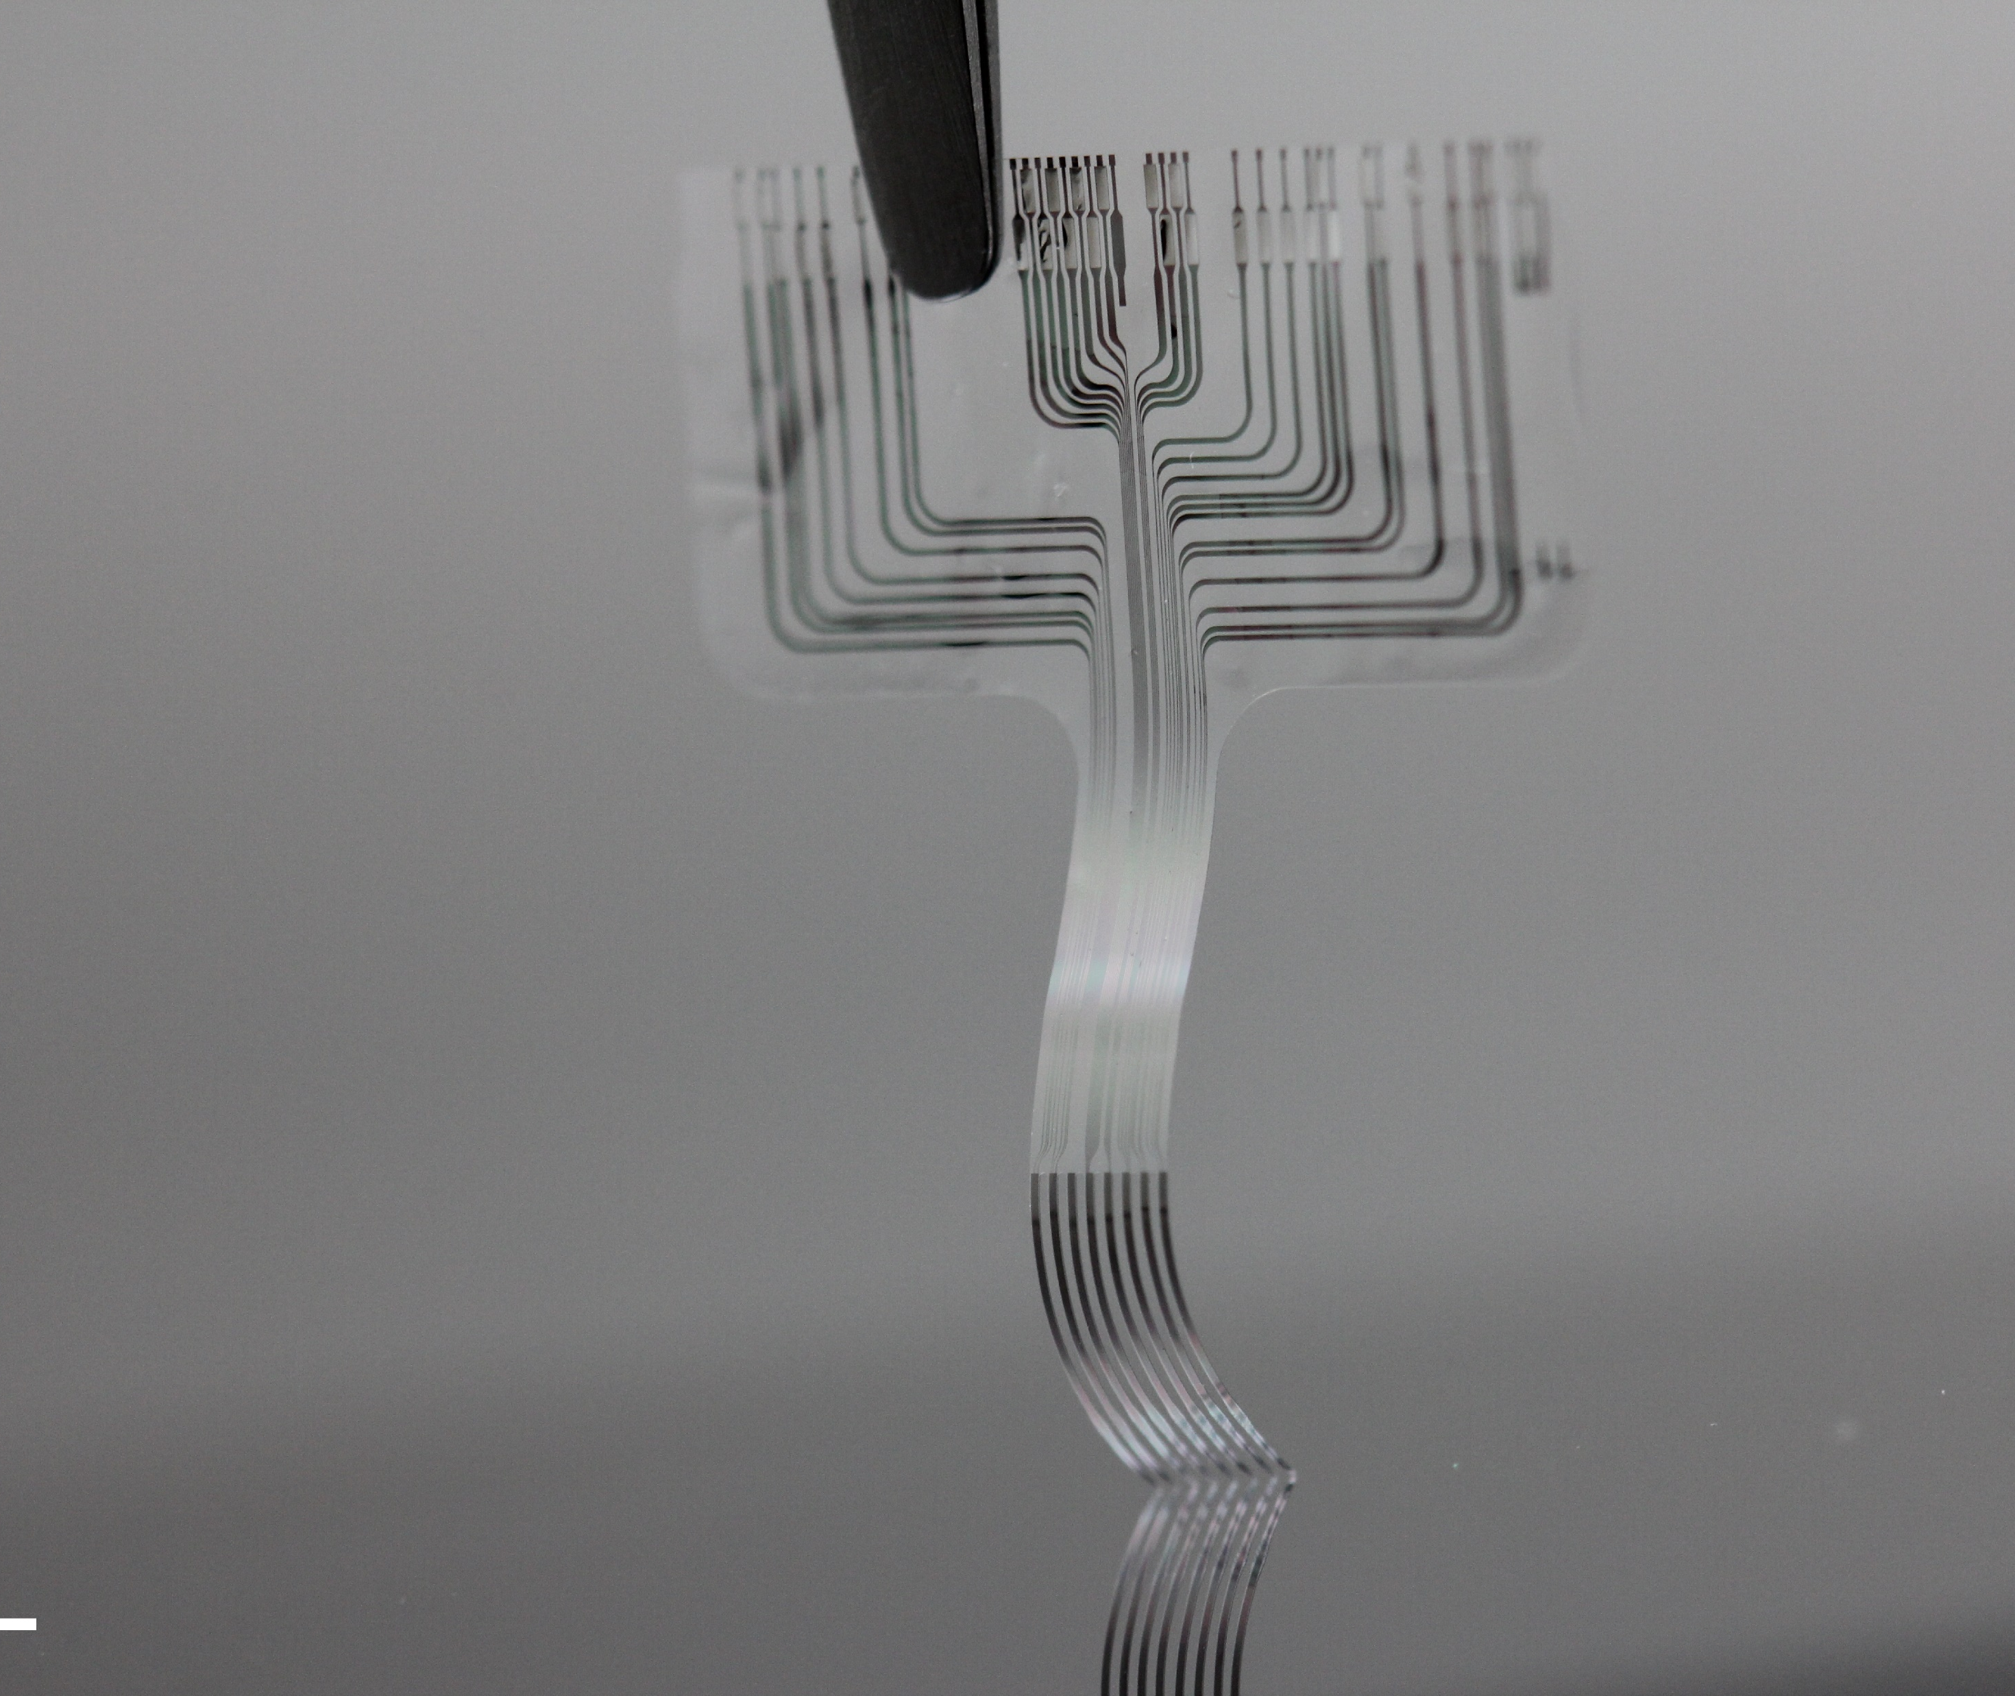

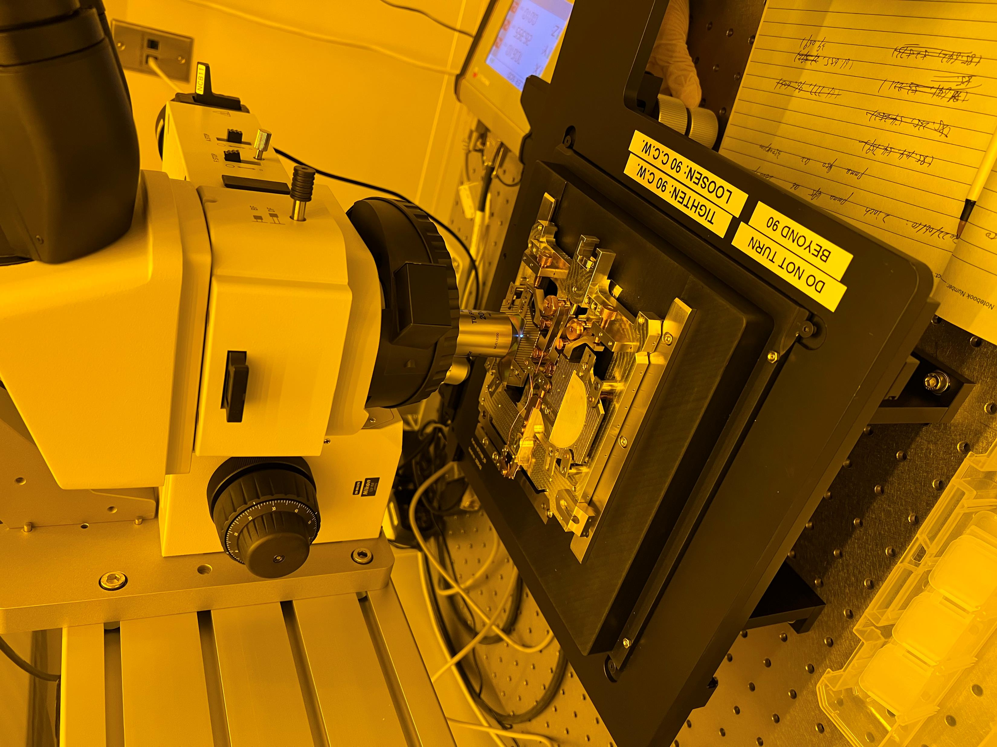
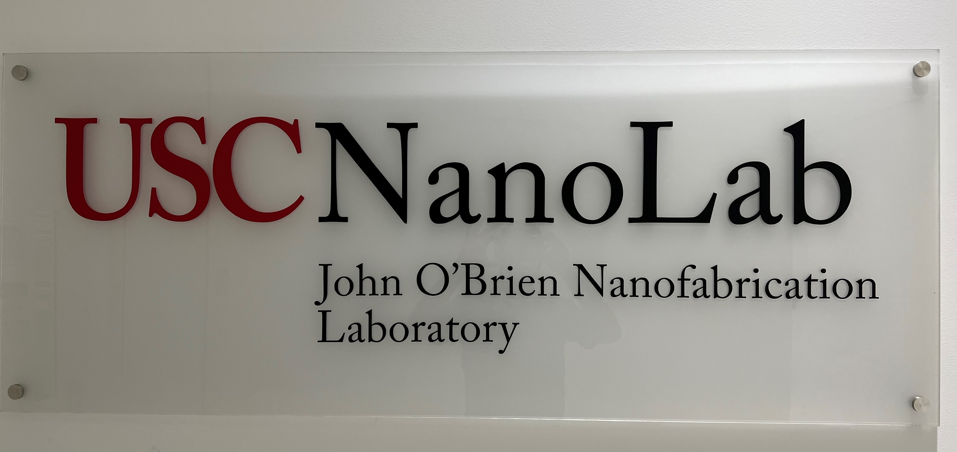
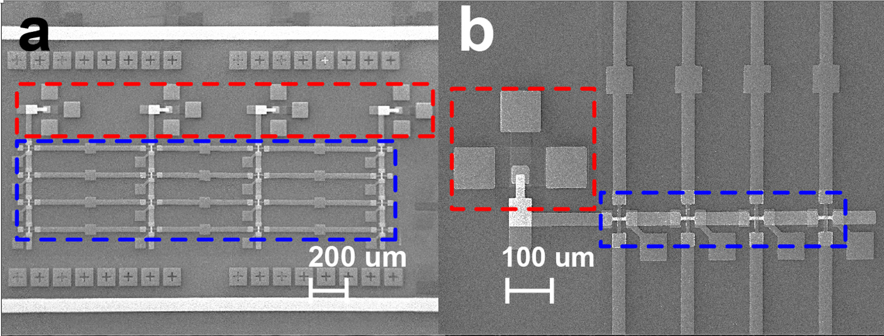
Flexible electronics
InP Photonic Circuits
Graphene/Si Oscillators
Associate Director: Shiva Bhaskaran
Memristor and Memcapacitor Arrays

Slide 2
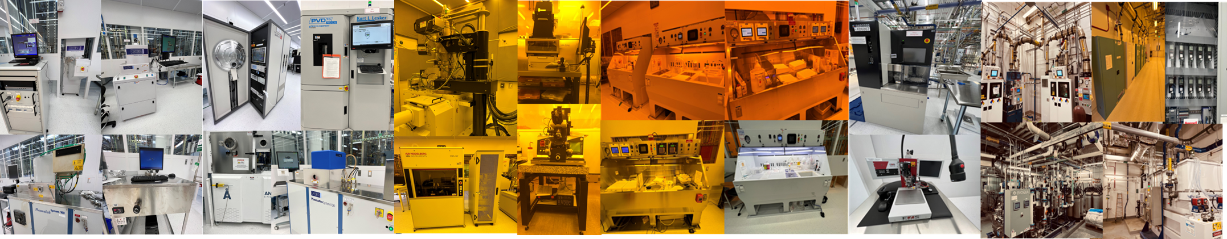

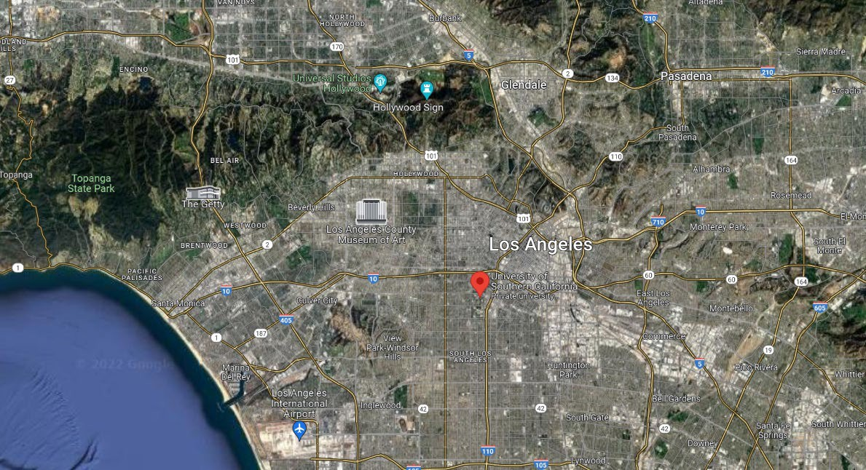


John O’Brien Nanofabrication Laboratory
Etch
Deposition
Lithography
Wet Processing
Packaging
Infrastructure
$50M 12,000 Sq. ft. facility – Construction completed in 2021
+24,000 sq. ft. automated facility for facilities, gases, and support systems
35+ state-of-the-art cleanroom tools including e-beam and direct write tools, Si and compound semiconductor processing
Sample size from pieces to 100mm (min) and 150mm (subset – but all III-V)
Caltech
UCLA
USC
UCSB
(90min)
“Si Beach”
UCSD
(2hr)

Slide 3
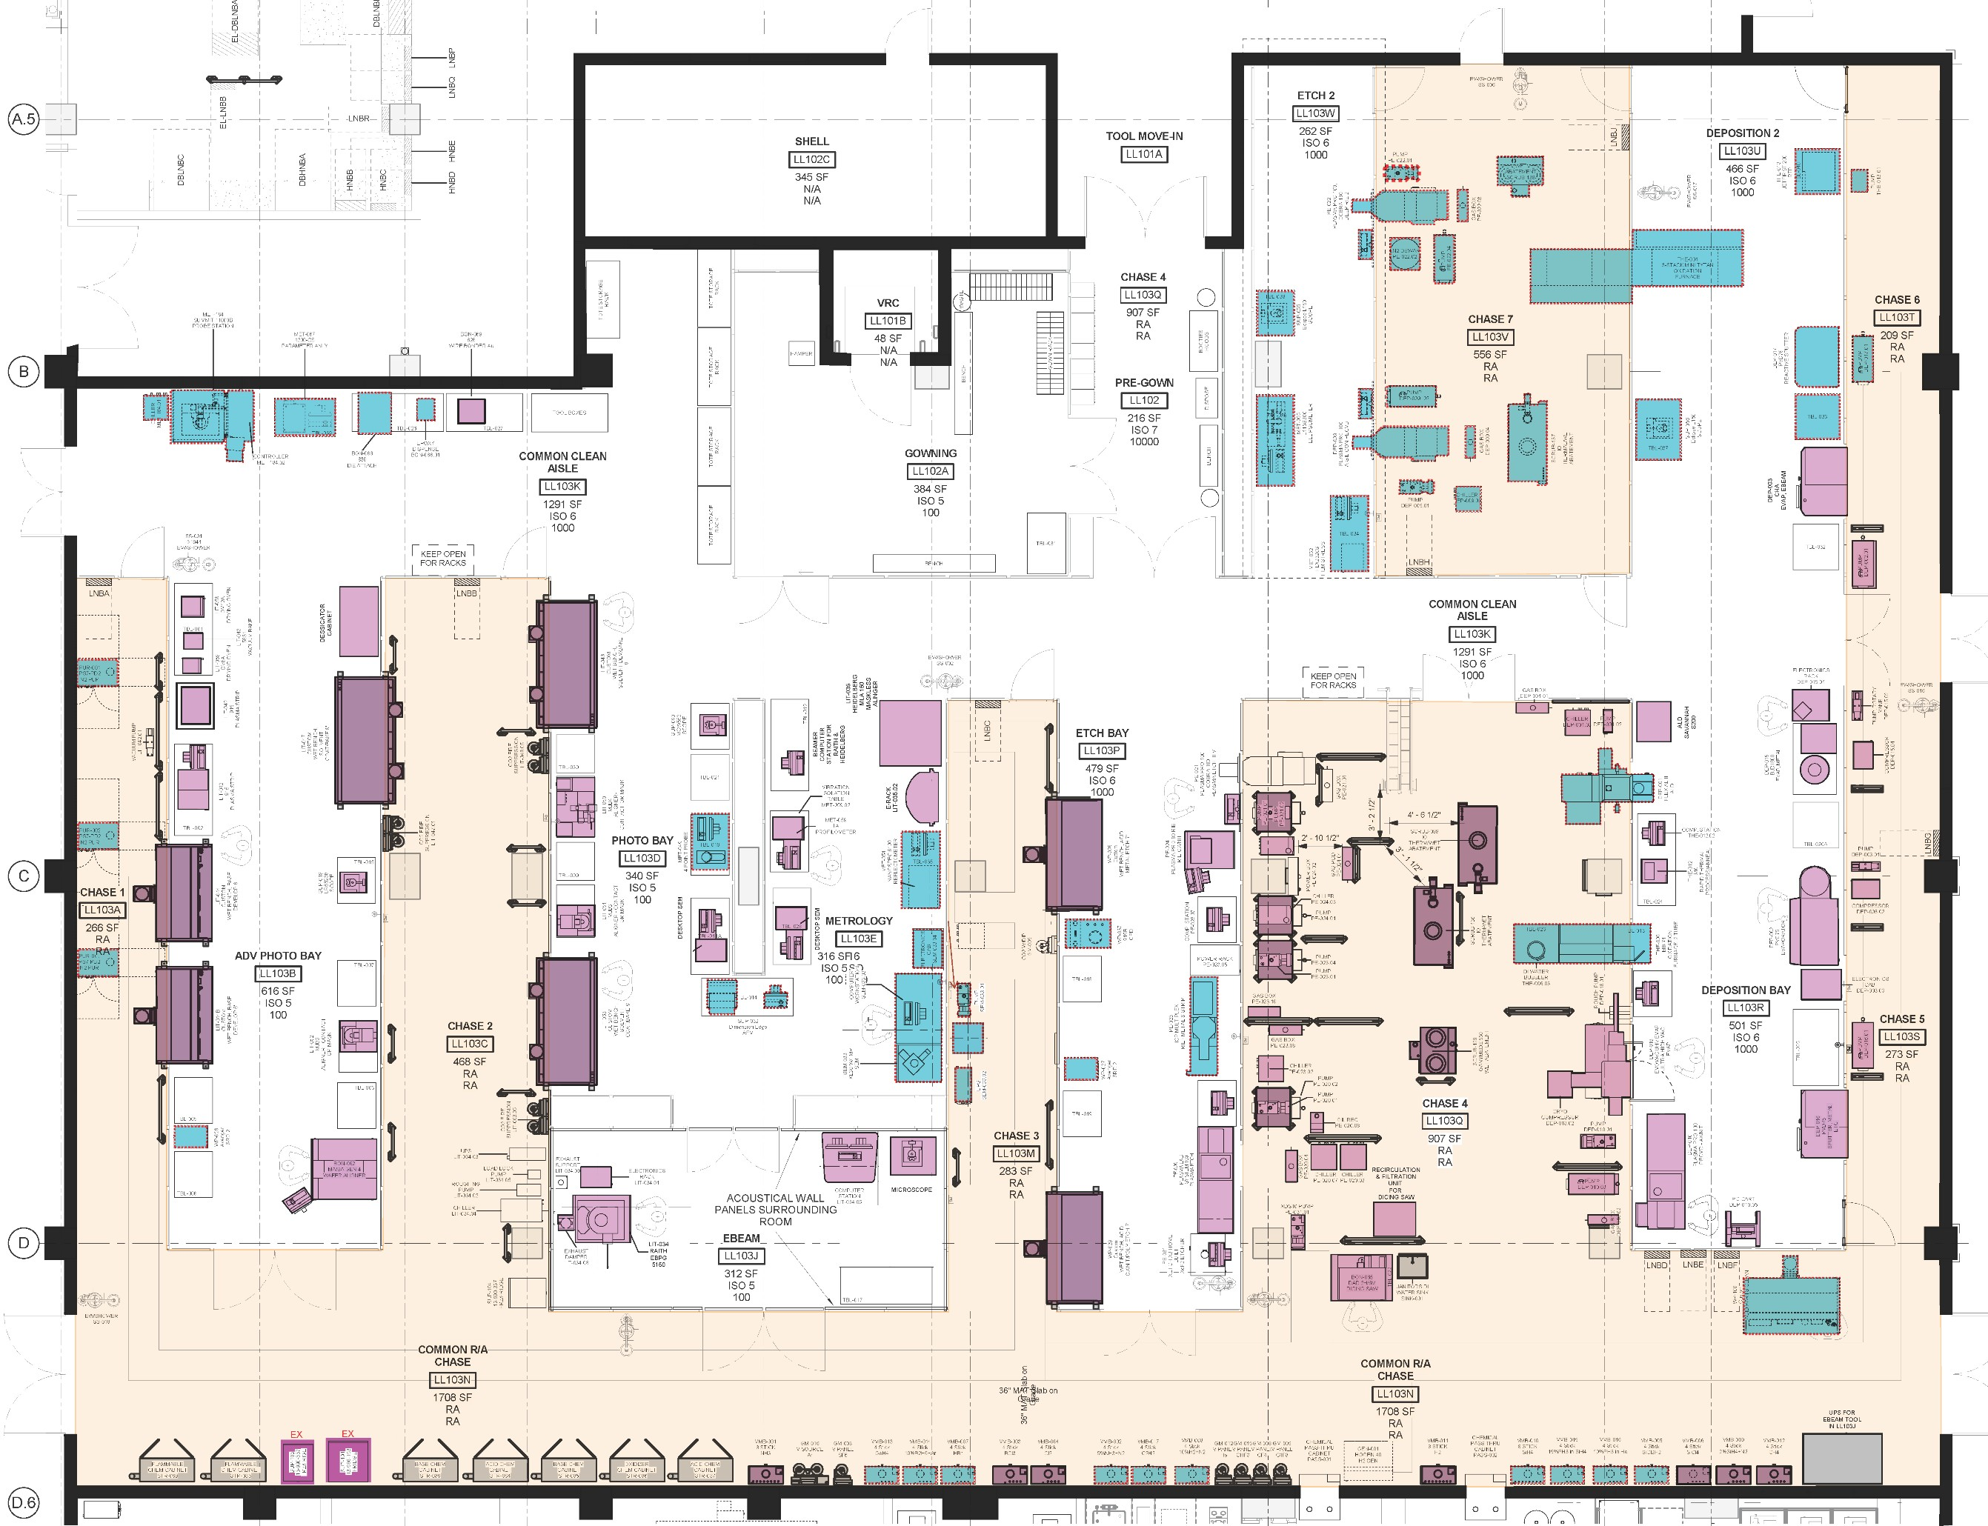


John O’ Brien Nanofabrication (2021)
Etch
Deposition
Scalability:
+160 users (2023) with expansion to +500 users planned. The lab can handle 100 active users.
Space available within current facility for additional capacity and capability
Adding two new tools every year (20% space for future expansion)
Challenge:
User base in increasing – understaffed
Currently training student interns to develop process calibration.
Photolithography
Photolithography
Metrology
Deposition
Etch
E-beam litho
Existing Future
Chase

