Slide 1

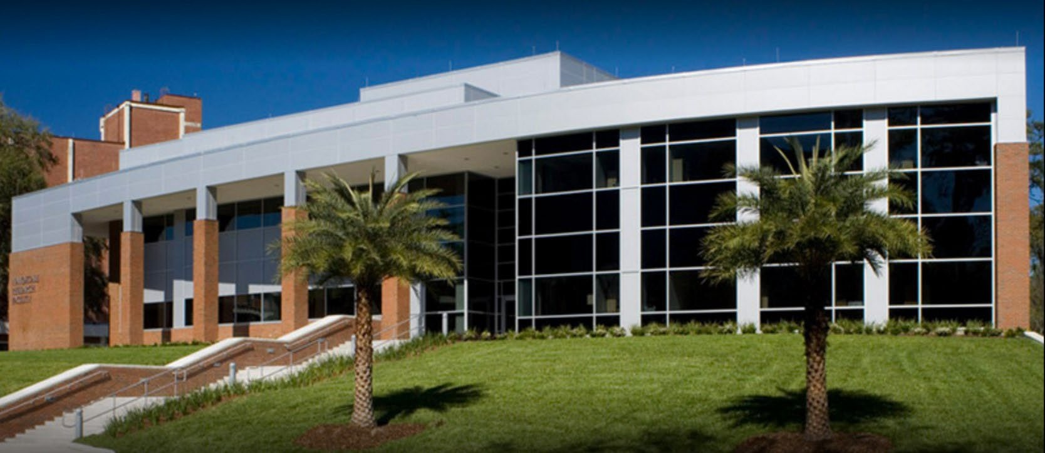


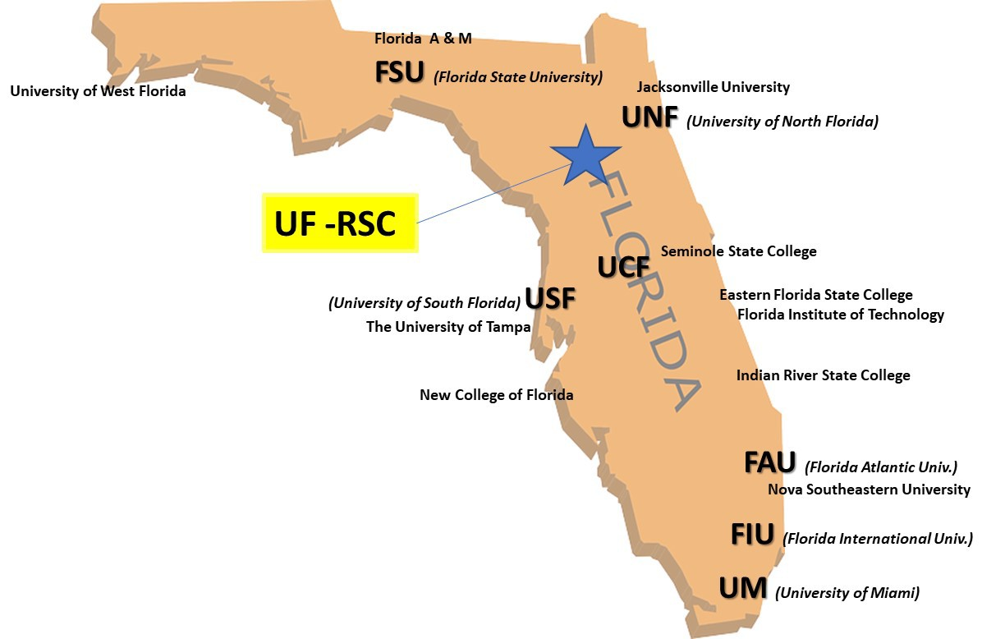
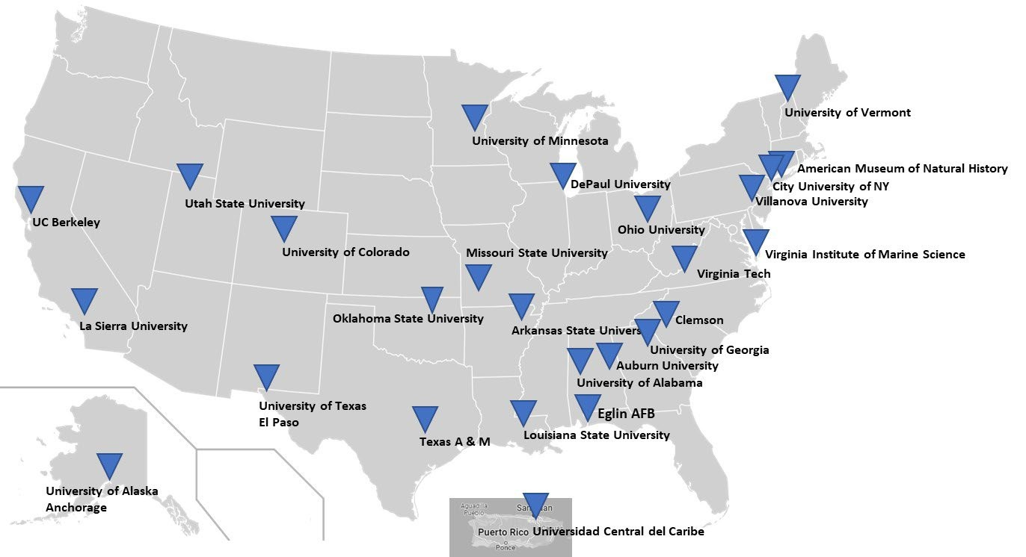

FACTS & FIGURES FY23 – FY24
UF users from
10 Colleges
1 Museums
49 Departments
rsc.aux.eng.ufl.edu
7500 sq. ft.
CLASS 100-1000 CLEANROOM
1
2
STAFF ENGINEERS
474+
FACILITY USERS
86+
CHARACTERIZATION
INSTRUMENTS AND FABRICATION TOOLS
± $900,000/year in user fees
(last 4 years average)
External Users
33 Universities & Colleges . 50 Industry & Businesses
1
UGIM 2024

Slide 2
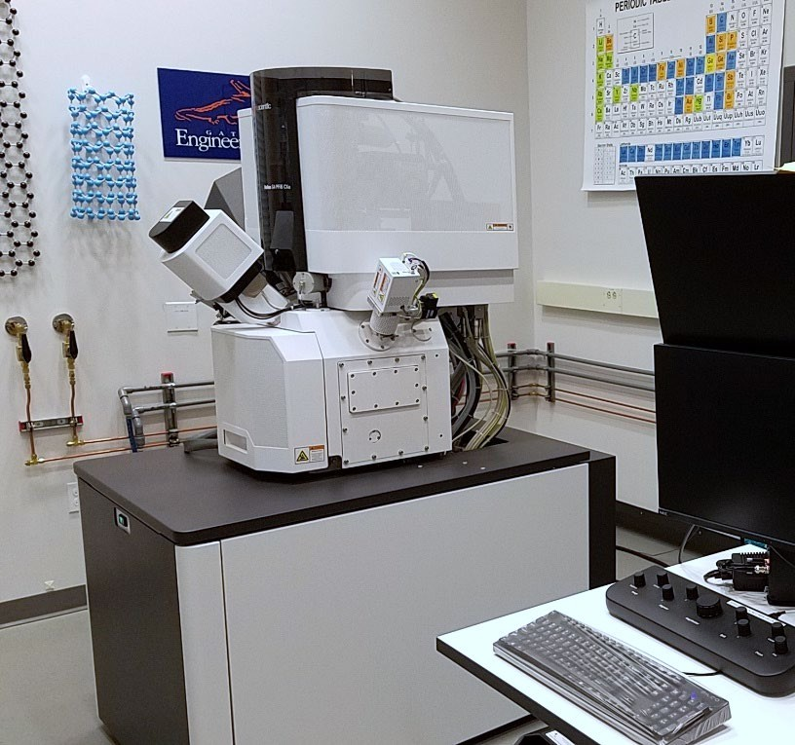
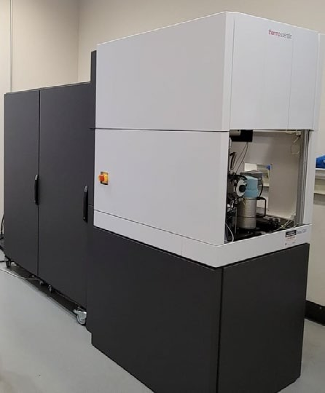
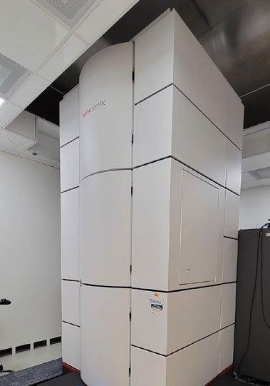
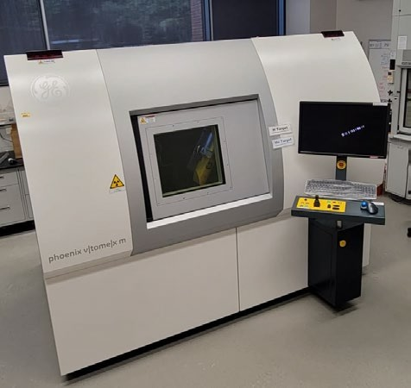
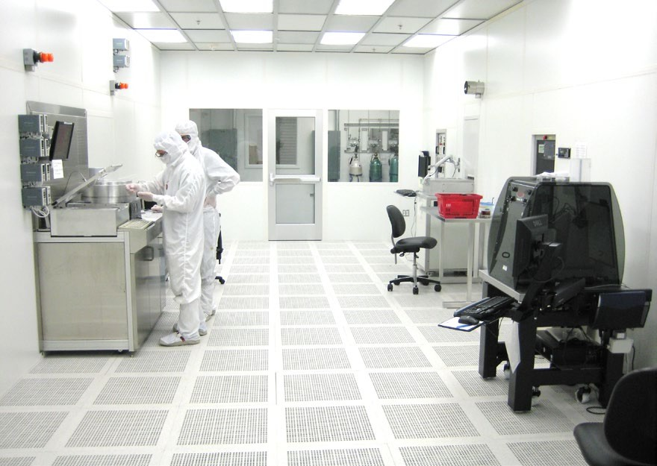
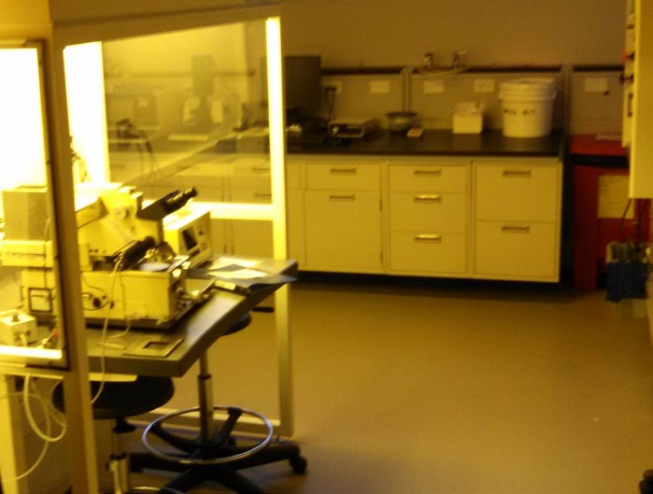
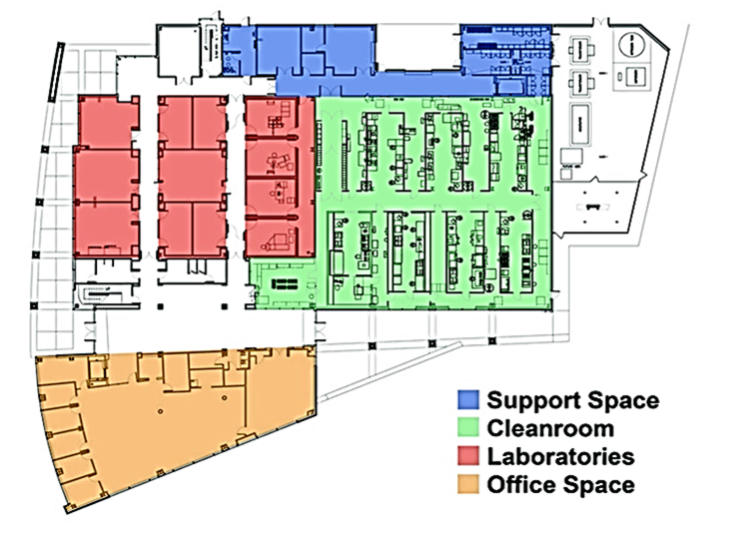

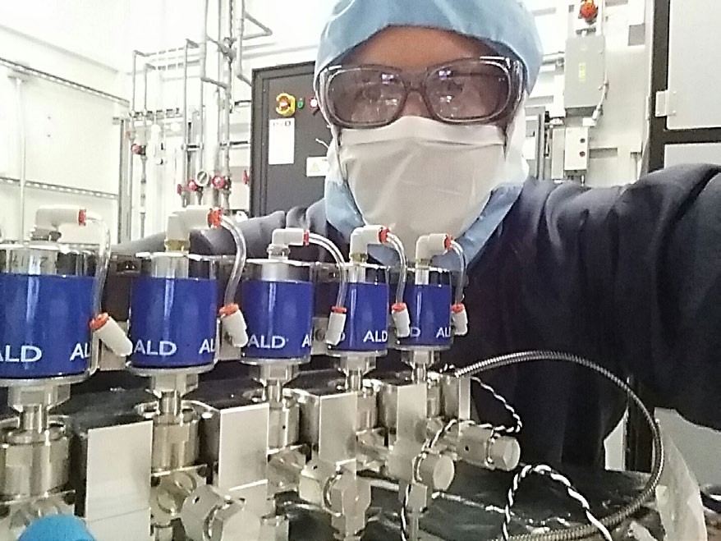
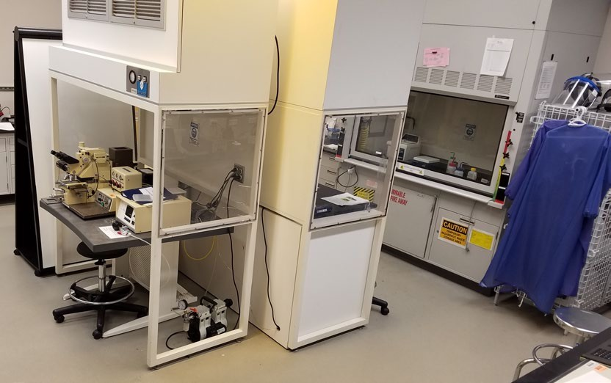
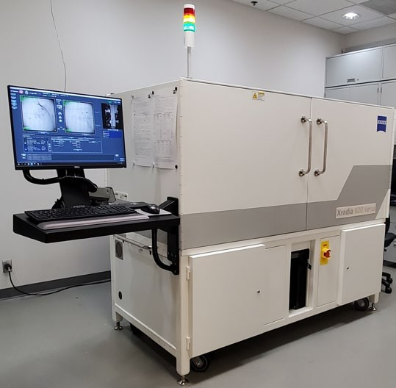
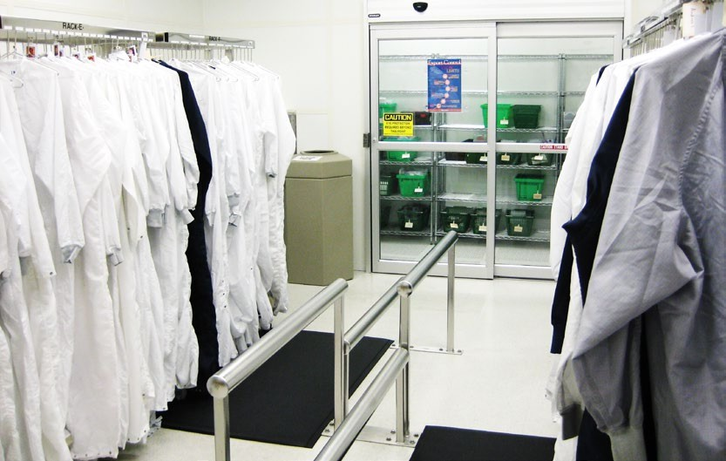

State-of-the Art Electron Microscopy
Cleanroom Nano-Fabrication
X-Ray Tomography
Teaching Labs
X-Ray Tomography
86+
TOOLS & INSTRUMENTS
UGIM 2024
2

