Slide 1
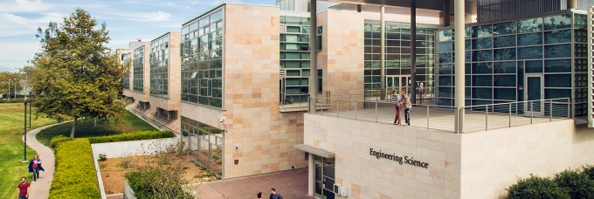
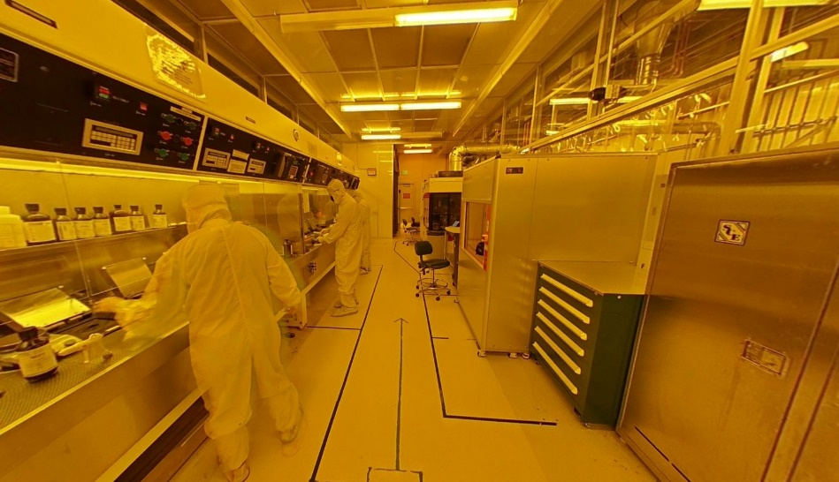
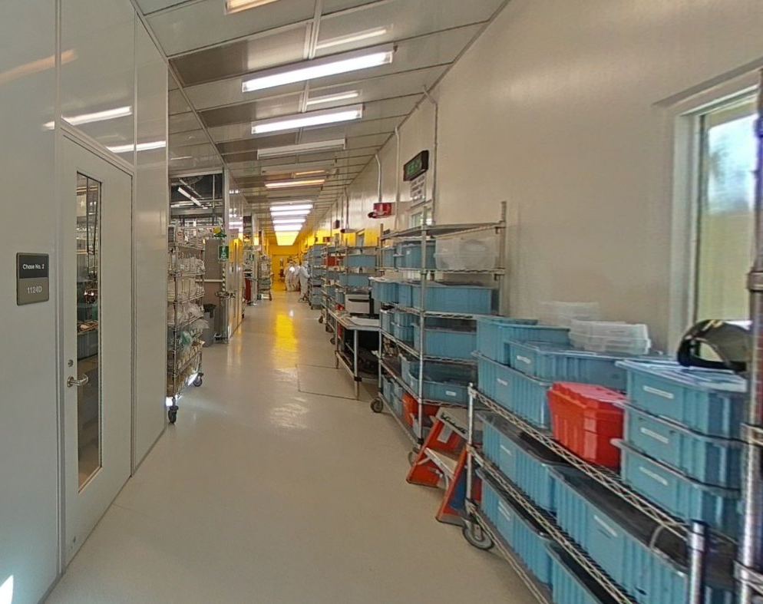
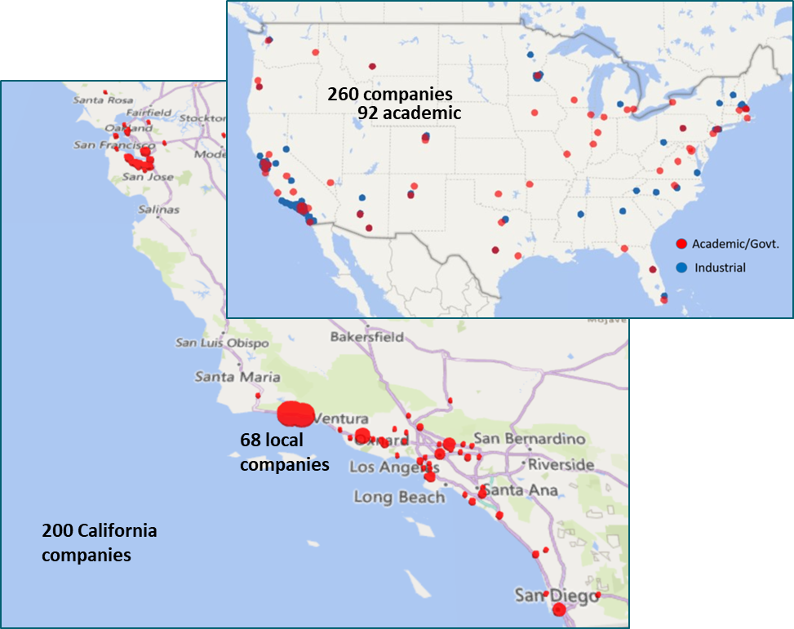
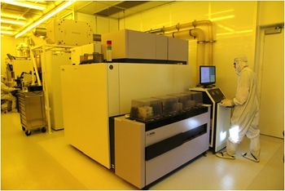
UCSB Nanofabrication Facility
Facility Metrics
Established 1988
Current Facility:2005 @cost of ~$20M
Main CR 12,000 gross sqft (bay & Chase) ISO 5,6
21 technical staff
2 Support Staff, 3-6 Undergrad Interns
Full tool list: https://wiki.nanofab.ucsb.edu/wiki/Tool_List
~$60M in equipment
~260 unique internal users/year
~250 unique external users/year
Lab usage ~72000 hours / year (57% external)
~105 new users/year (~40 external)
Photonics, Electronics, Materials, Physics
~$6.5M operating budget
  20% internal, 80% external, 0% subsidy
Avian
Outdoor Seating
Yoga Studio

Slide 2
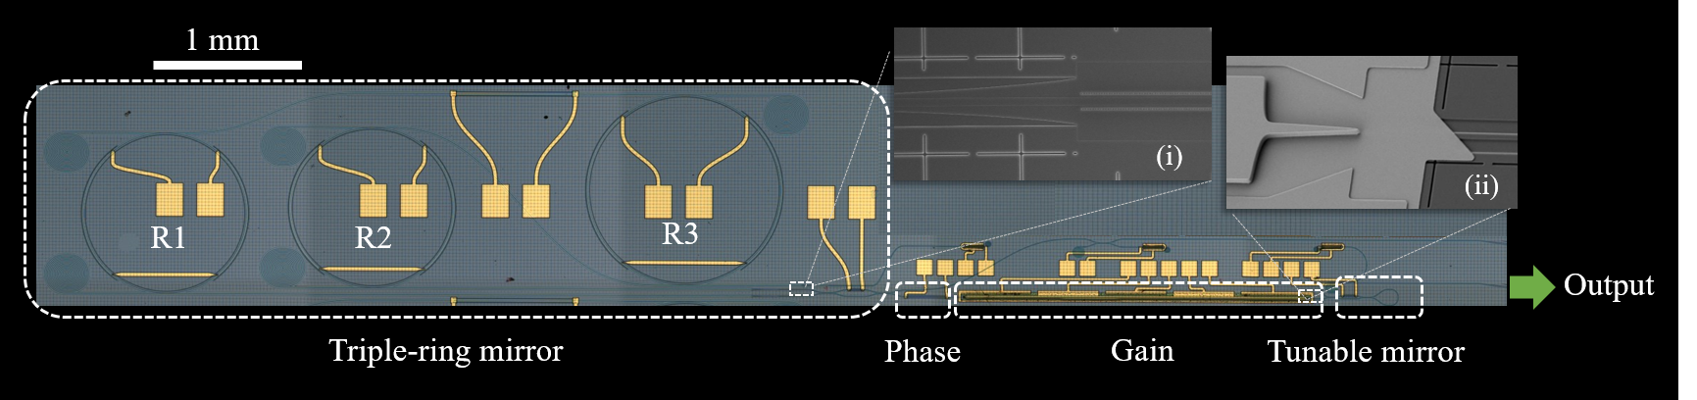
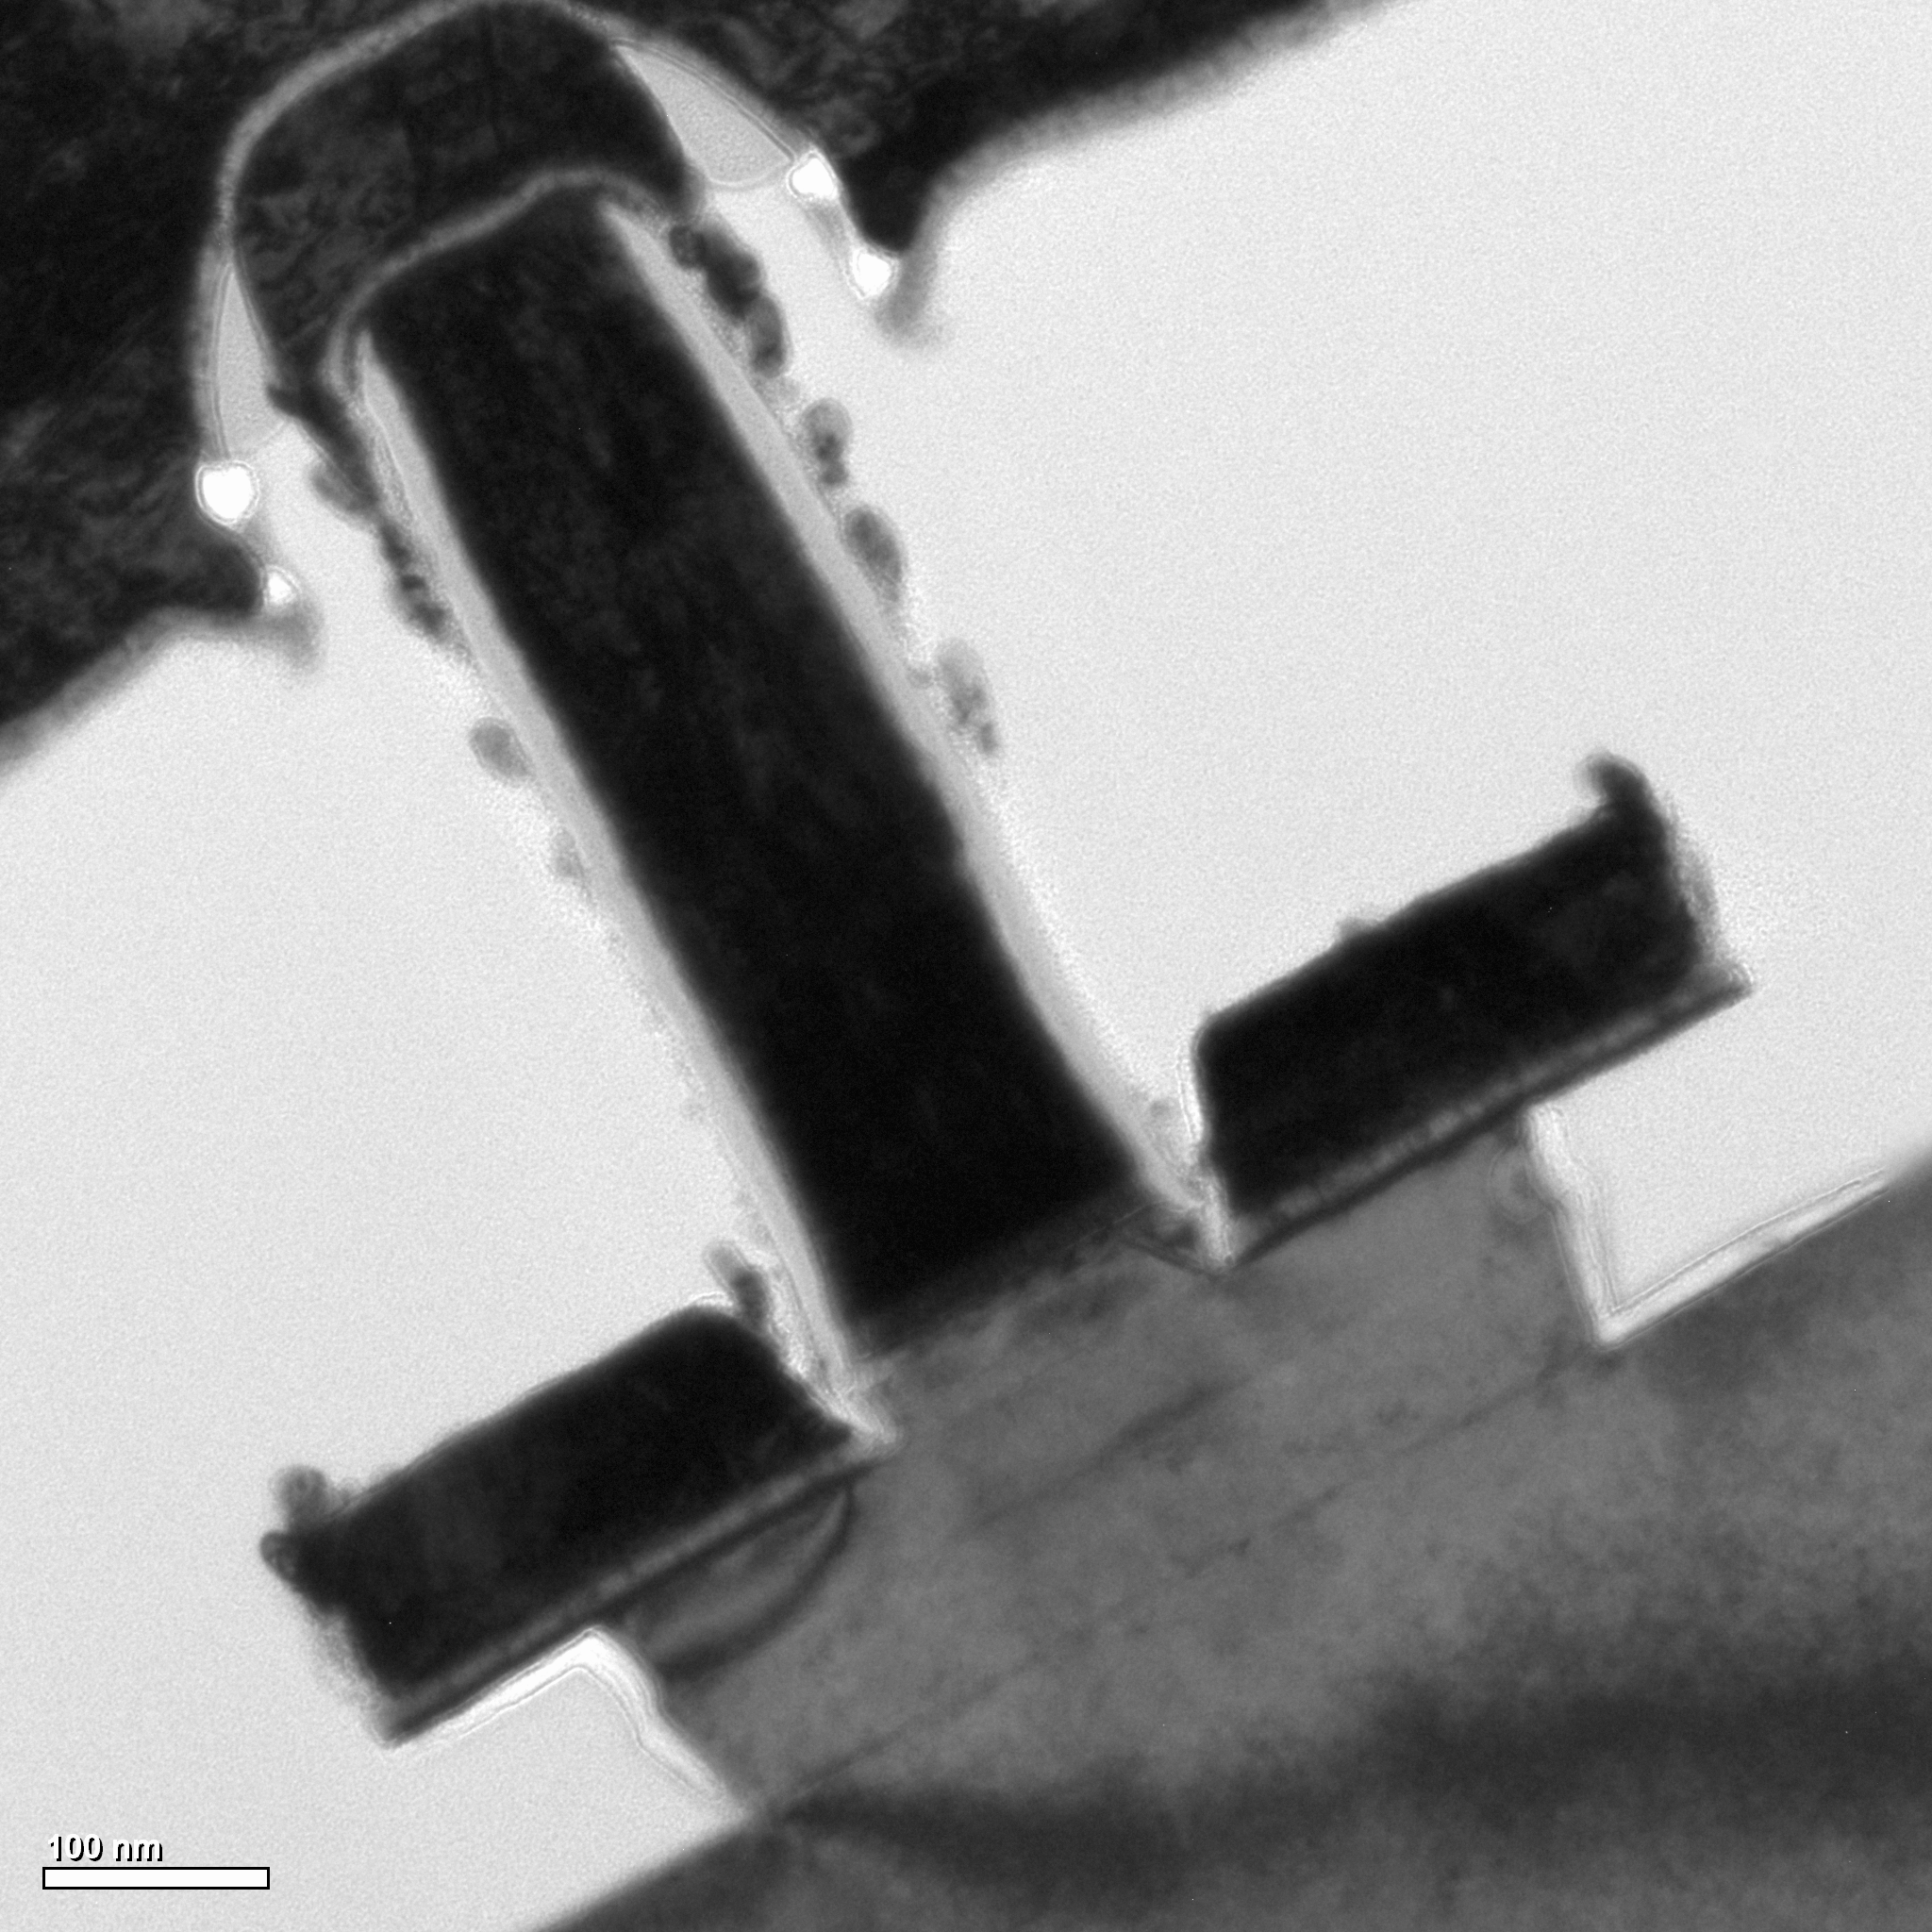
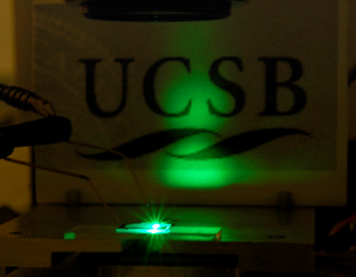
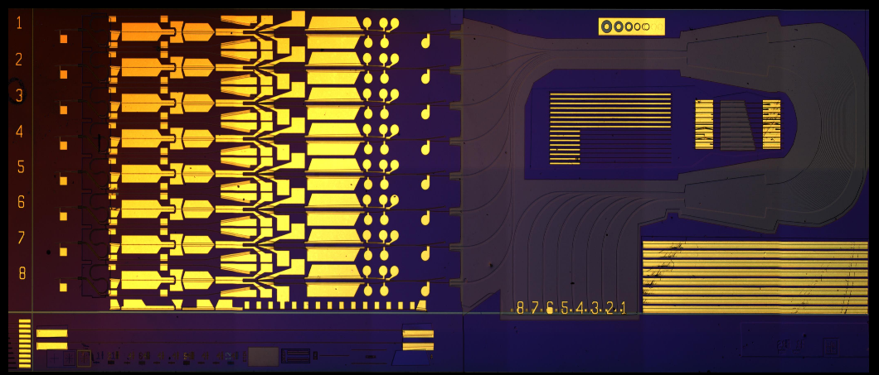
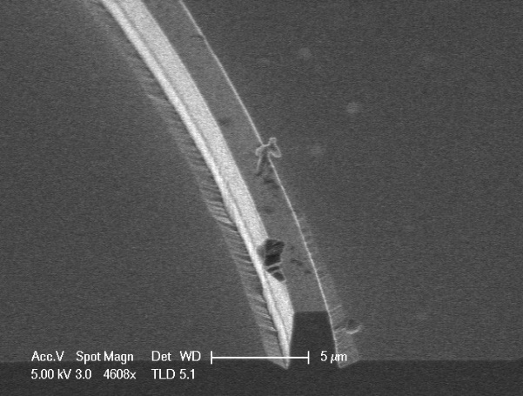
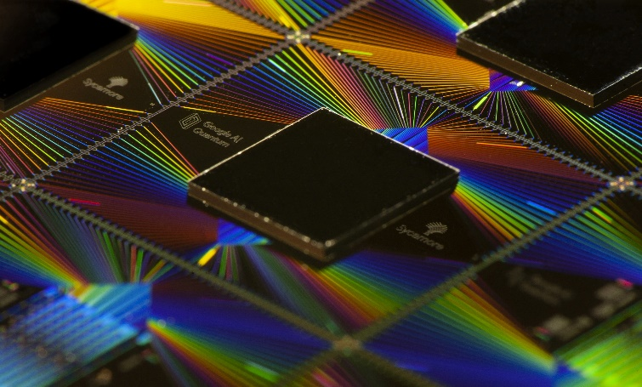
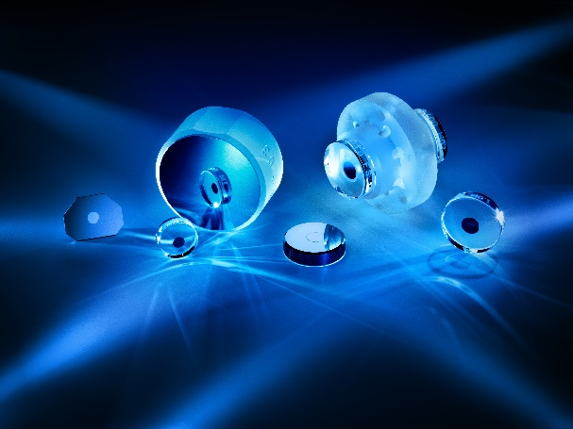
UCSB Nanofabrication Facility
Key Capabilities & Features
ASML DUV Stepper – 4” wafers
Extensive III-V Compound Semiconductor Experience
III-V Heterogeneous Integration
Recent Tool Additions (past 12 or 24 months)
Raith EBPG 5150 ordered – delivery early 2025
Loomis Scribe and Break
Two JEOL IT800SHL systems – one with EDX
Strengths
Strong balance of process/equipment expertise
Very accommodating with new materials.
Remote Processing
Weaknesses:
Daytime use is near capacity, leading to scheduling challenges for users
Talk to me about…
Anything!
Nano-Sasquatch!
Contact
Brian Thibeault : thibeault@ece.ucsb.edu
https://nanofab.ucsb.edu/
Google
ThorLabs

