Slide 1


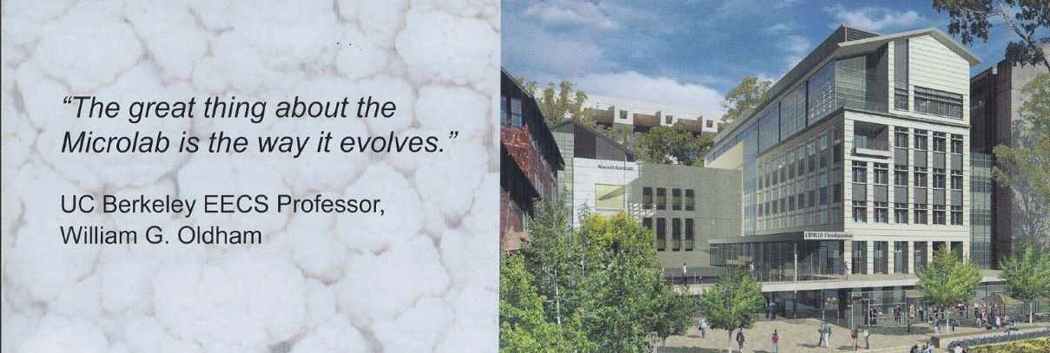
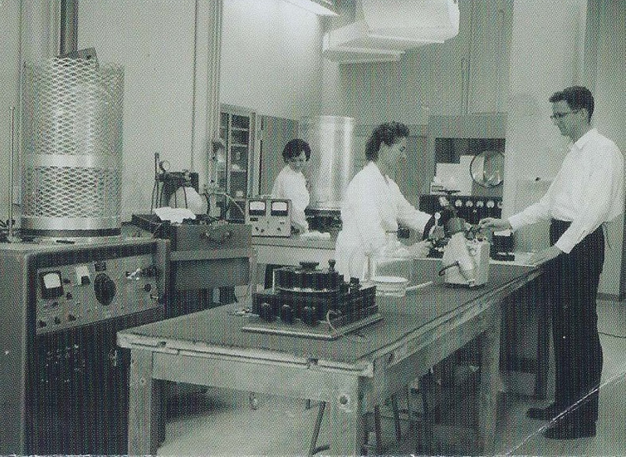
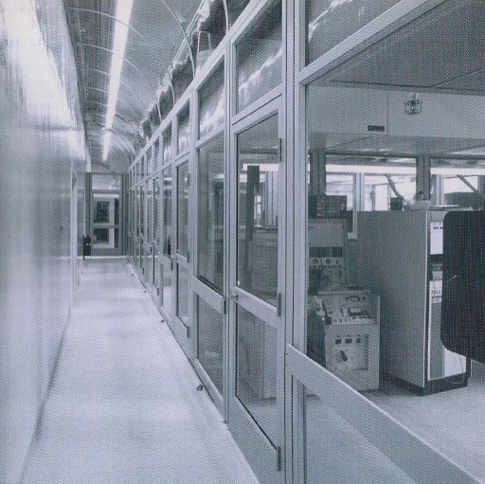
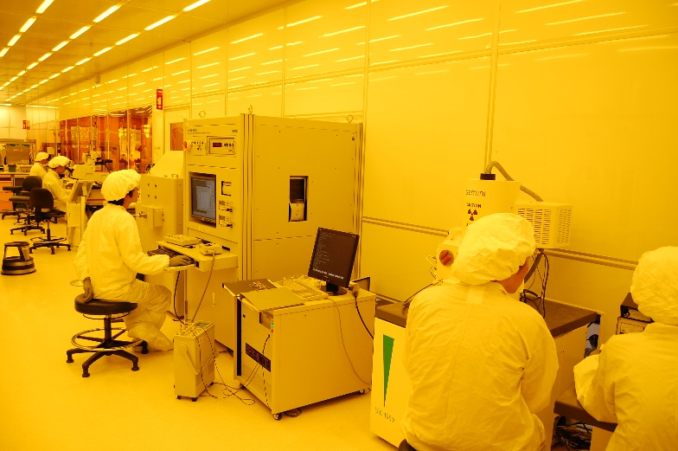
The Berkeley Marvell NanoLab
EECS Prof Kris Pister Faculty Director
Dr. Michael Helmbrecht Exec Director
Dr. Bill Flounders Exec Director, Ret.
Yoga Studio
Avian
Outdoor Seating
The Integrated Circuits Lab 1962 - 1982
The Microlab 1983 - 2009
The Berkeley Marvell NanoLab 2009 -
EE faculty share equipment in the
first University IC research lab.
The shared equipment model expands.
Recharge model is established.
Faculty base grows with MEMS / BSAC.
Custom lab management system SW developed, external use is opened.
All led by R&D Manager: Katalin Voros
A larger purpose built cleanroom is built
after faculty critical mass achieved.
Commercial use growing to 50% of cost
recovery, but only 25% of use

Slide 2
The Berkeley Marvell NanoLab
Facility Metrics
15,000 ft2 Class 100 (Bay and Chase)
$5M/yr Ops, $1M /yr Invest
100% Recharge Recovery; 0% Subsidy
~70 academic Pis; ~400 researchers/yr
~24 external companies; ~70 researchers/yr
~60,000 use hours/yr
Capabilities
Lithography
Contact aligners, i-line and 248nm stepper, backside capable,
130 kV e-beam to 7nm, 5 coat /develop tracks, UV hard bake
Deposition
ALD, PECVD, LPCVD: SiO2, Si3N4, poly-Si and SiGe, epi Si and Ge
Unique: LACVD, SiC, AlN, diamond, Mo, Ru. 6 evap, 7 sputter
Etch
16 plasma systems including DRIE Si, ICP 3/5, ICP metal,
XeF2, HF vapor, KOH, TMAH, Critical Point Drying
Planarize, Package
Si, SiO2, metal CMP; dicing, wafer bond, flip chip bond, die bond,
Au and Al wire bond, parylene encapsulation
Metrology
SEM, AFM, XRD, EDX, reflectometer, contact + optical profilometer,
interferometer, FTIR, spectroscopic ellipsometer, Raman scope
Strengths
100% Recharge Recovery; 0% Subsidy
Weaknesses:
100% Recharge Recovery; 0% Subsidy
Exploring Novel Anti-gravity Paperclips

