Slide 1


TAU.nano
Tel Aviv University Center for Nanoscience and Nanotechnology
TAU.nano
Research Facility Quick Intro
UGIM 2024
Alice Polacsi-Segev
June 2024

Slide 2
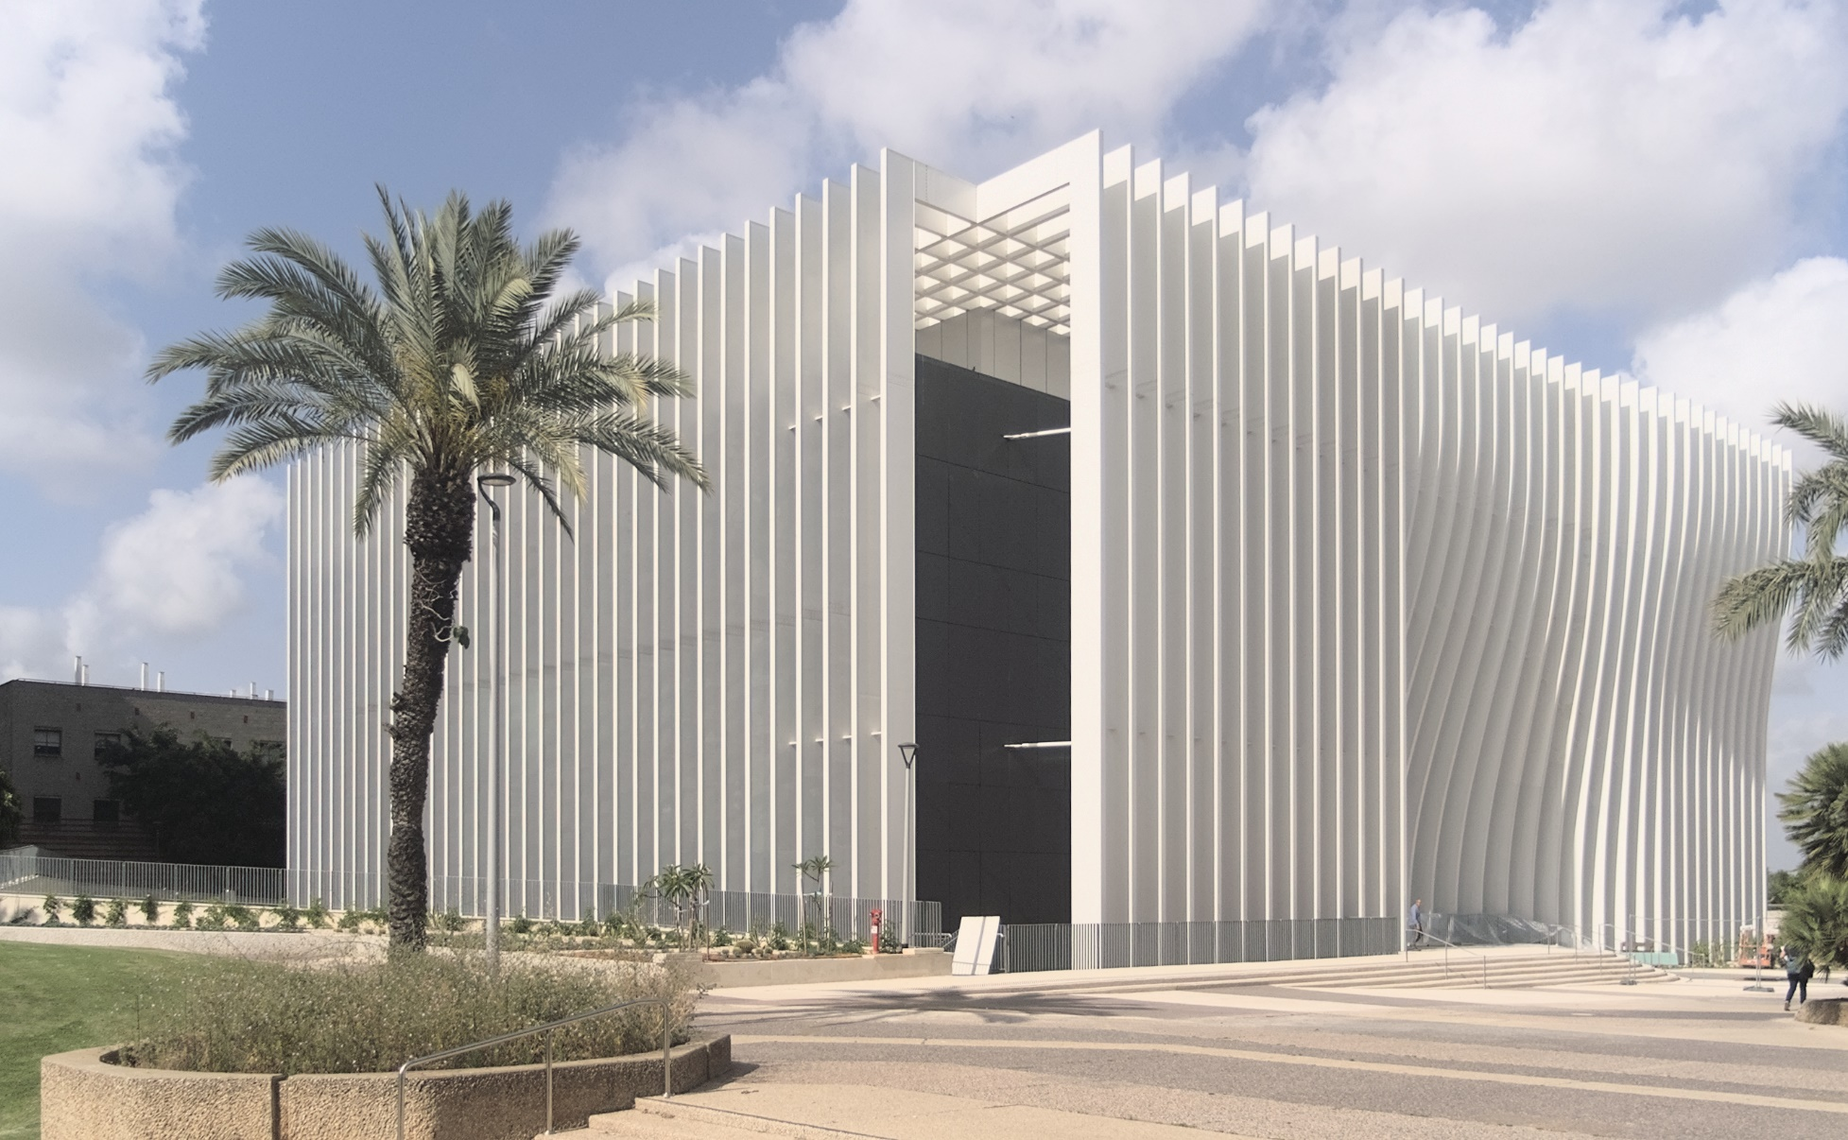
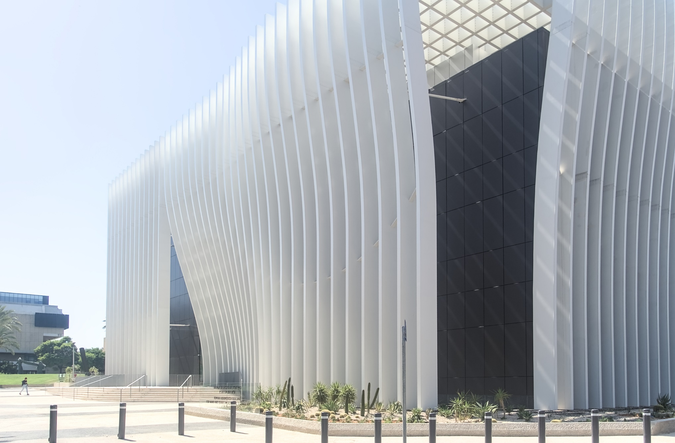

TAU.nano –
New Nanotechnology Facility at Tel Aviv University
An exclusive, interdisciplinary structure of 7200sqm
Building launched in May 2024; tool installation project starts on Oct 2024
Equipped with SEMI standards facilities
  600 sqm Class100/1000 Clean Room
  10 Characterization Labs
  >40 fabrication and analysis equipment
  >20 high-end central utility systems
Provides advanced technology capabilities and one-stop-shop for Nanofabrication, Characterization and Analysis
Collaborates with 80 research teams and 60 companies
Facility accommodates 14 PI’s research labs
Features spectacular public spaces, including a visitor center, conference rooms, study lounge and a generous lobby
An independent P&L unit within the campus

Slide 3
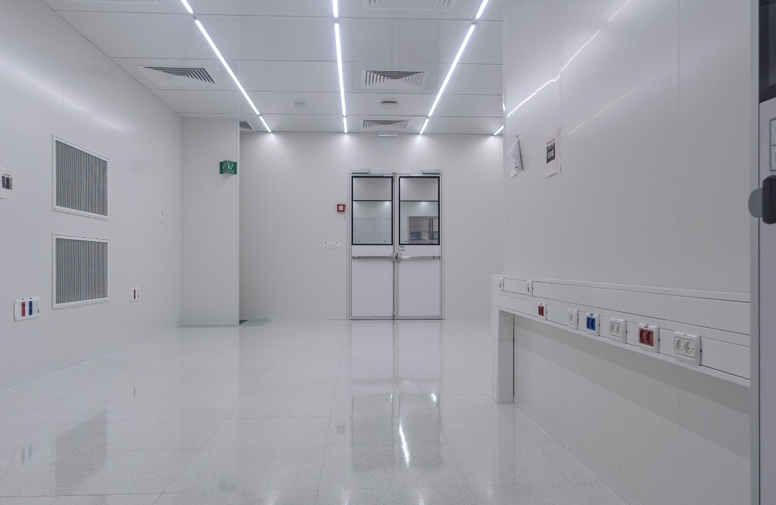
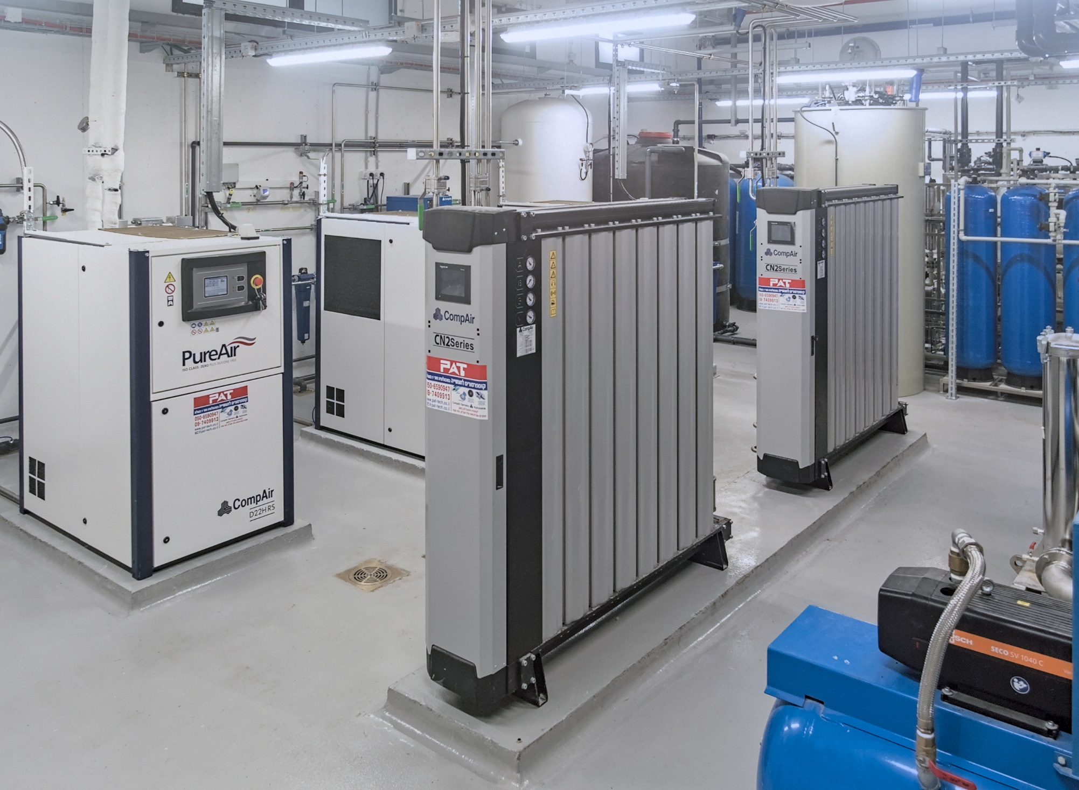
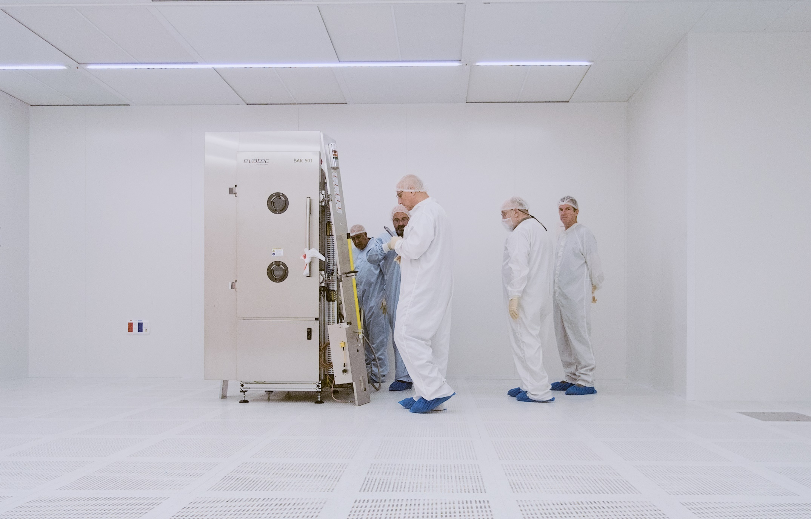
Recent New Tools Additions:
2xICP-RIE (Corial)
ICP PECVD (Corial)
2xMask/Bond Aligner (Suss)
Deep RIE (PlasmaTherm)
Ebeam Evaporator (Evatech)
2xTEM (ThermoFisher)
CL HRSEM (ThermoFisher)
FIB (ThermoFisher)
XPS (ThermoFisher)
2xAFM (Park)
Strengths:
Complete production line, from mask design to device bonding
Process development and prototype fabrication for industrial customers
Weaknesses
No CMOS capability
Limited to 4”-6” wafers

