Slide 1
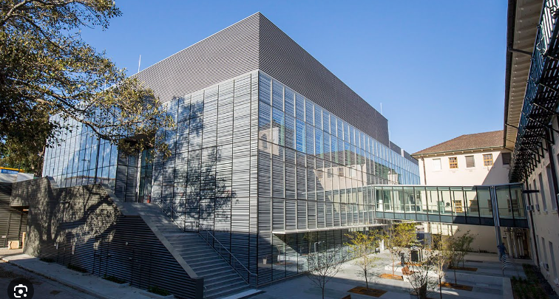
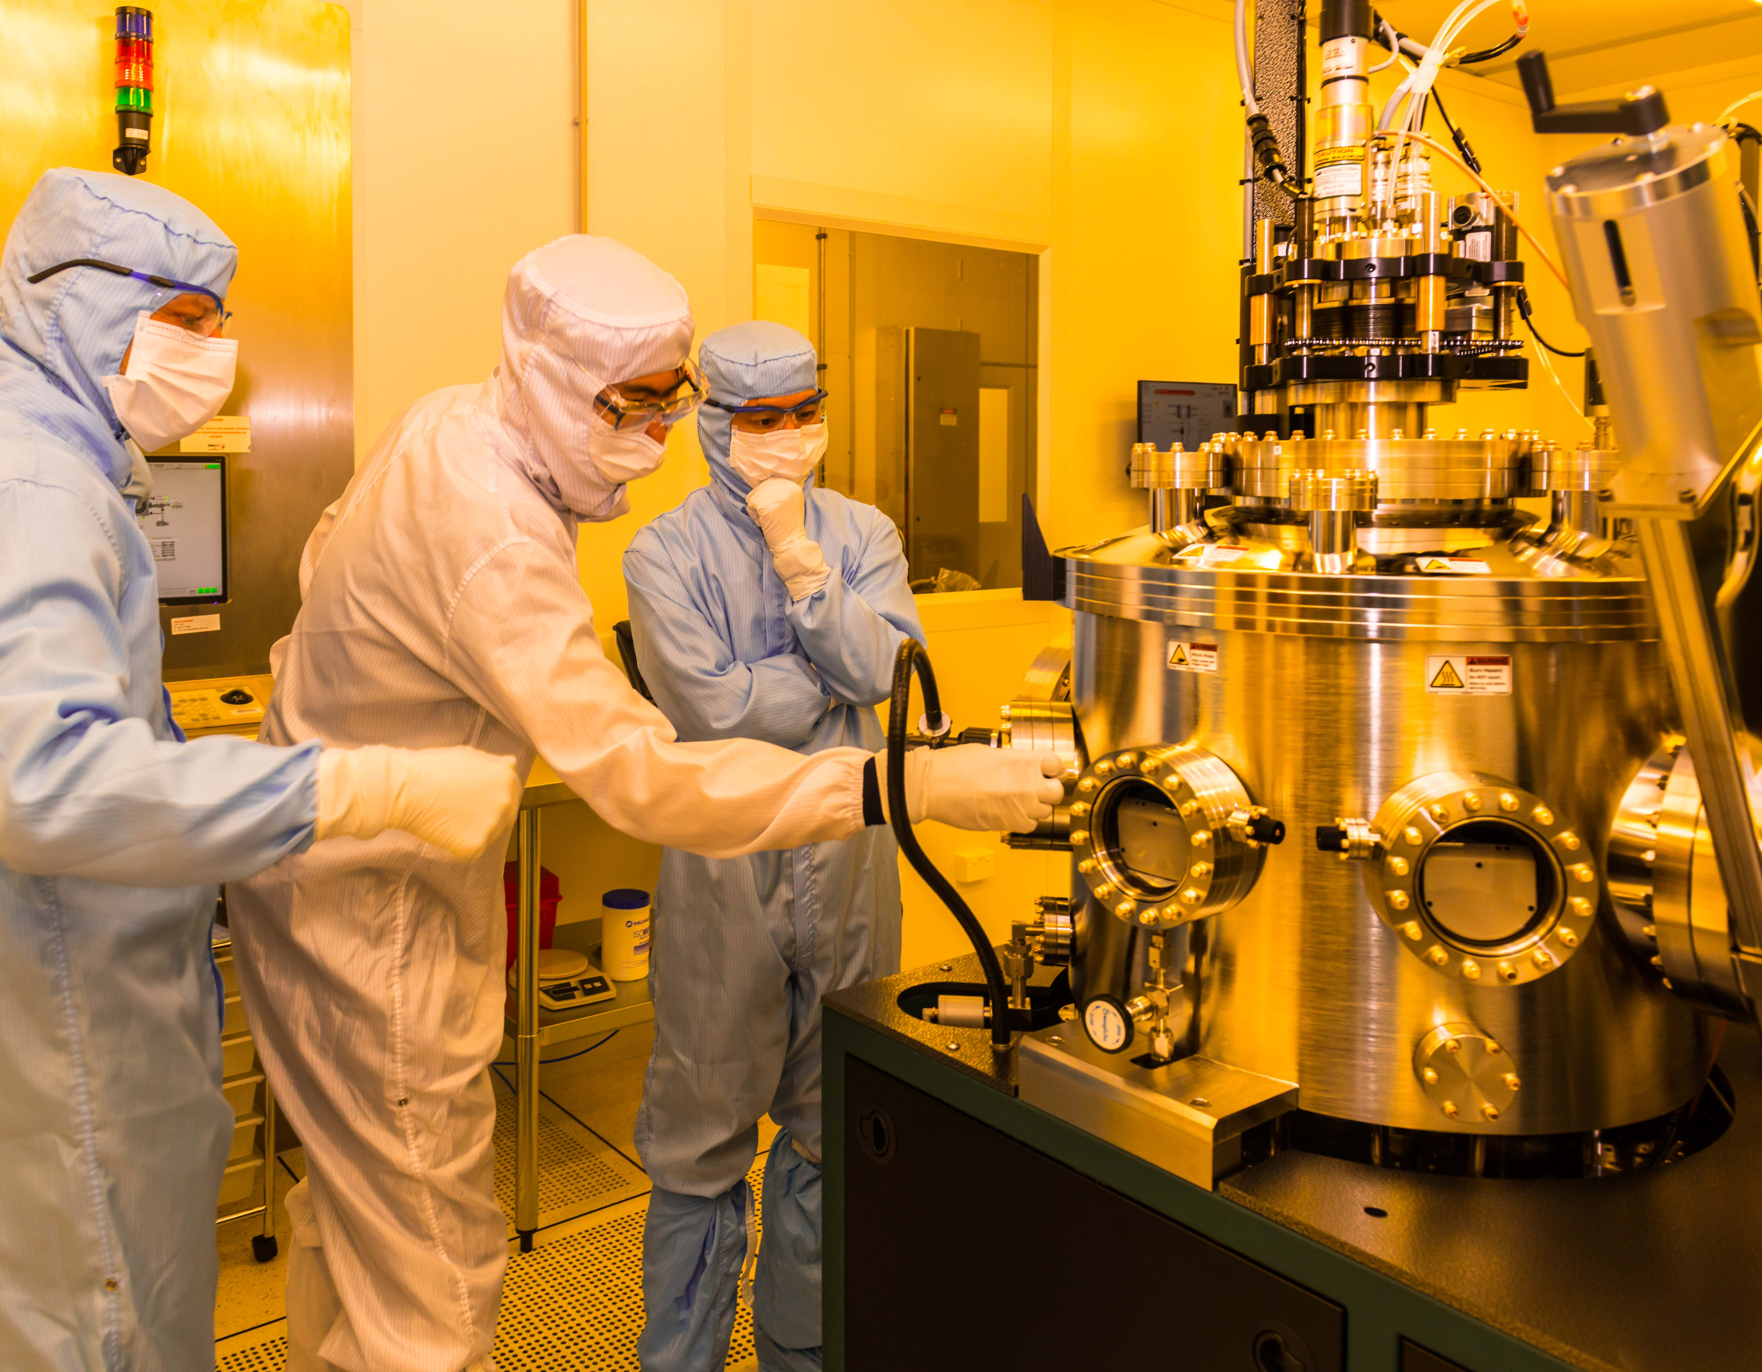





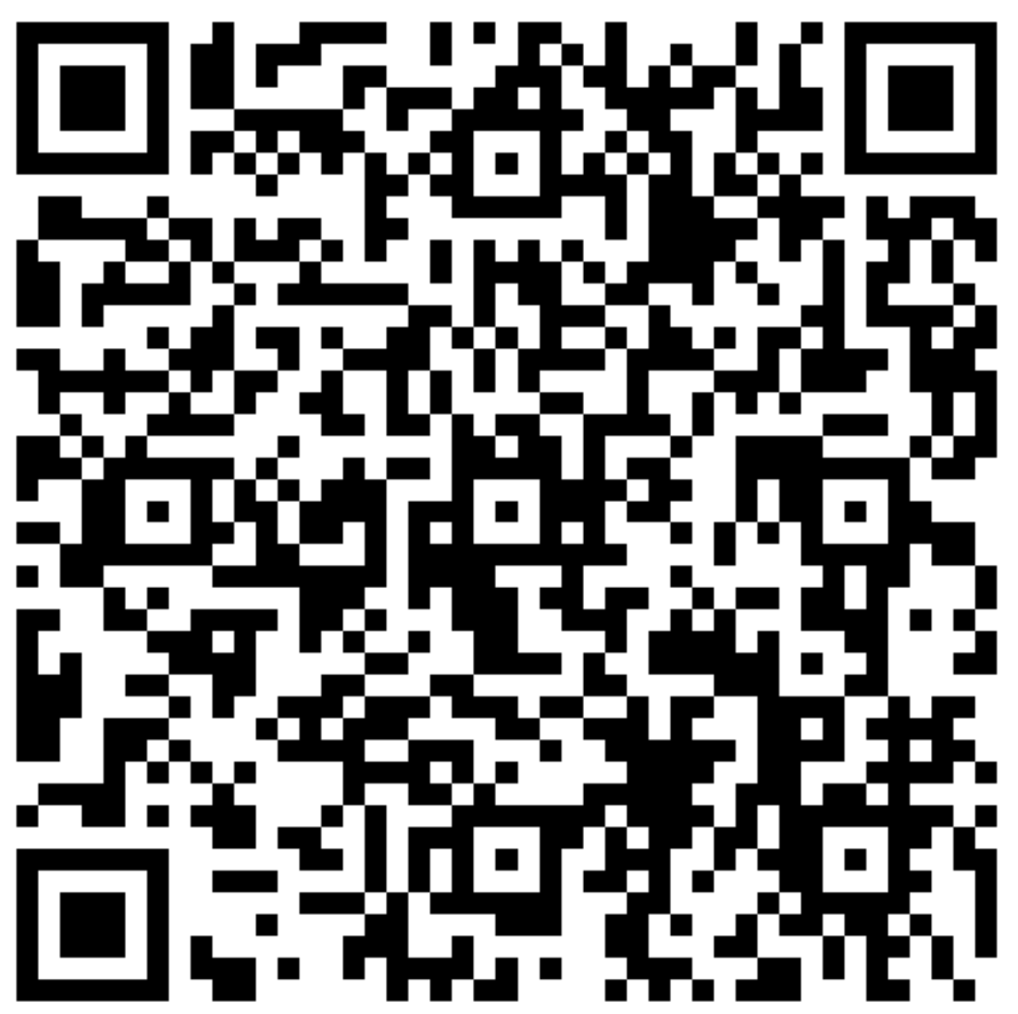



Who we are
Research & Prototype Foundry
University of Sydney - Core Research Facilities
Providing R&D communities with open access to micro and nano fabrication capabilities.
1x 500 m2 ISO 5 Cleanroom
1x 40 m2 ISO 8 Precision Labs
1x 40 m2 ISO 8 Dry Labs
3x 30 m2 Optical Labs
Fiber Draw Tower
Hydrogenation Facility
675 facility users
151 active projects
25 academic institutions
38 industry clients
Find out more
sydney.edu.au/research-and-prototype-foundry

Slide 2
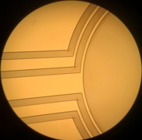
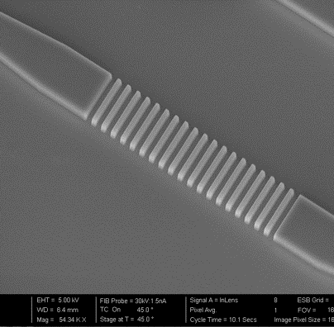
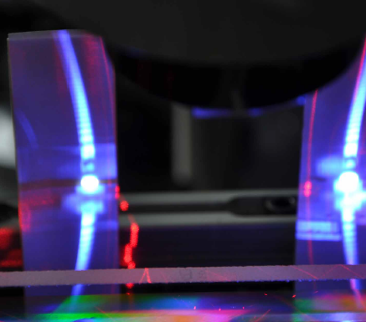
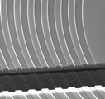
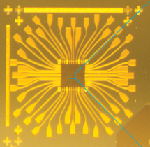
What we do
Nano Bio
Microfluidics
Medical devices
Wearables
Nano Materials
Structured surfaces
Novel materials
Optical Fiber
Fiber drawing
Advanced Fiber Bragg Grating
Nano Photonics
Sensing
IoT
Nano Electronics
Quantum technologies
Low power electronics
Find out more
sydney.edu.au/research-and-prototype-foundry

