Slide 1
Stanford Nano Shared Facilities (SNSF)
Tobi Beetz, PhD
Associate Director
Tobi@stanford.edu
snsf.stanford.edu

Slide 2
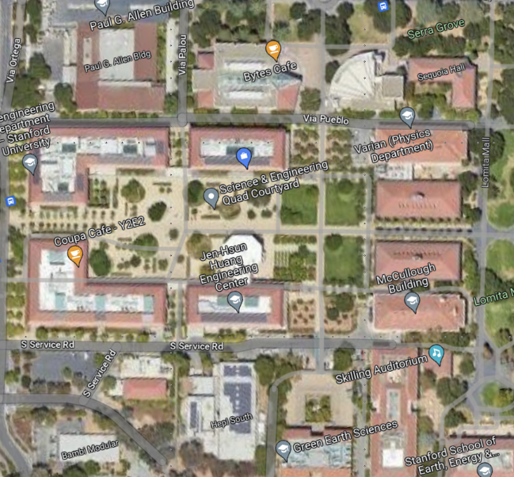
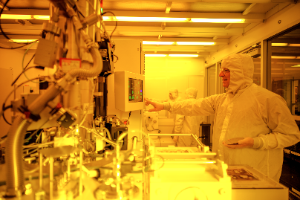
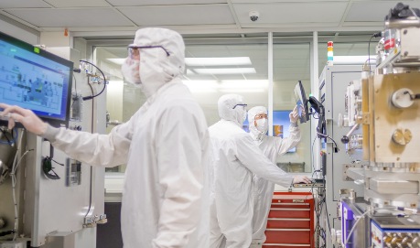
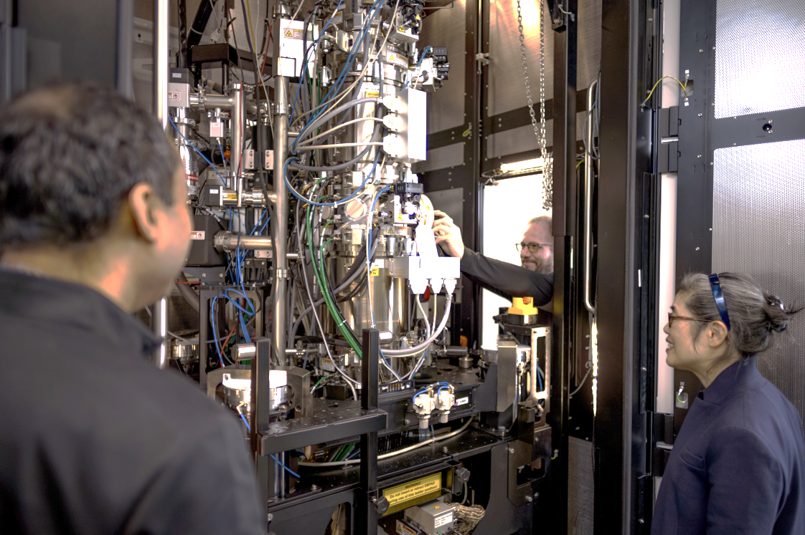
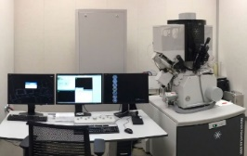
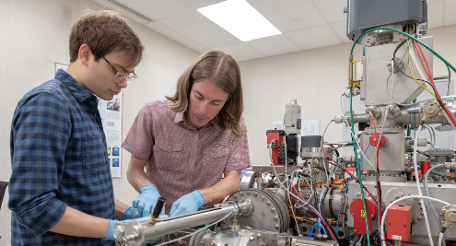
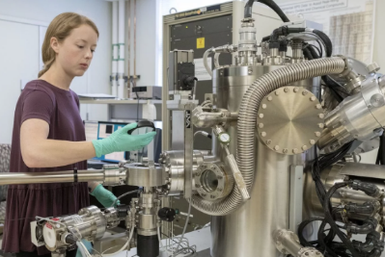
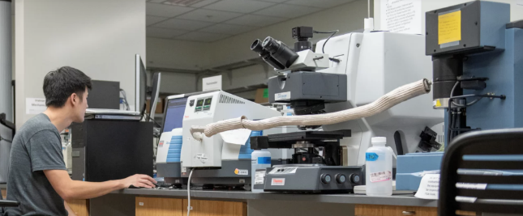





Stanford Nano Shared Facilities (SNSF)
4 Research Cores
Current
Nanofabrication
Two cleanrooms (EBL, flexible materials …)
Electron & Ion Microscopy
TEMs, SEMs, FIB, PFIB …
SNF
Future
Shriram
Spilker
Moore
McCullough
X-ray & Surface Analysis
XPS, XRD, Auger, AFM, NanoSIMS, Raman..
Soft & Hybrid Materials Facility
TGA, DSC, DMA, Rheometer, FTIR, …
ES3
Yearly Researchers:
~900 internal
~300 external
Yearly User Fees
~$3M internal
~$1.3M external
22 Technical Staff
3 F&A Staff
~100 Companies
~30 other Univ., Govt. Labs
>50 major tools
>$45M tools

Slide 3
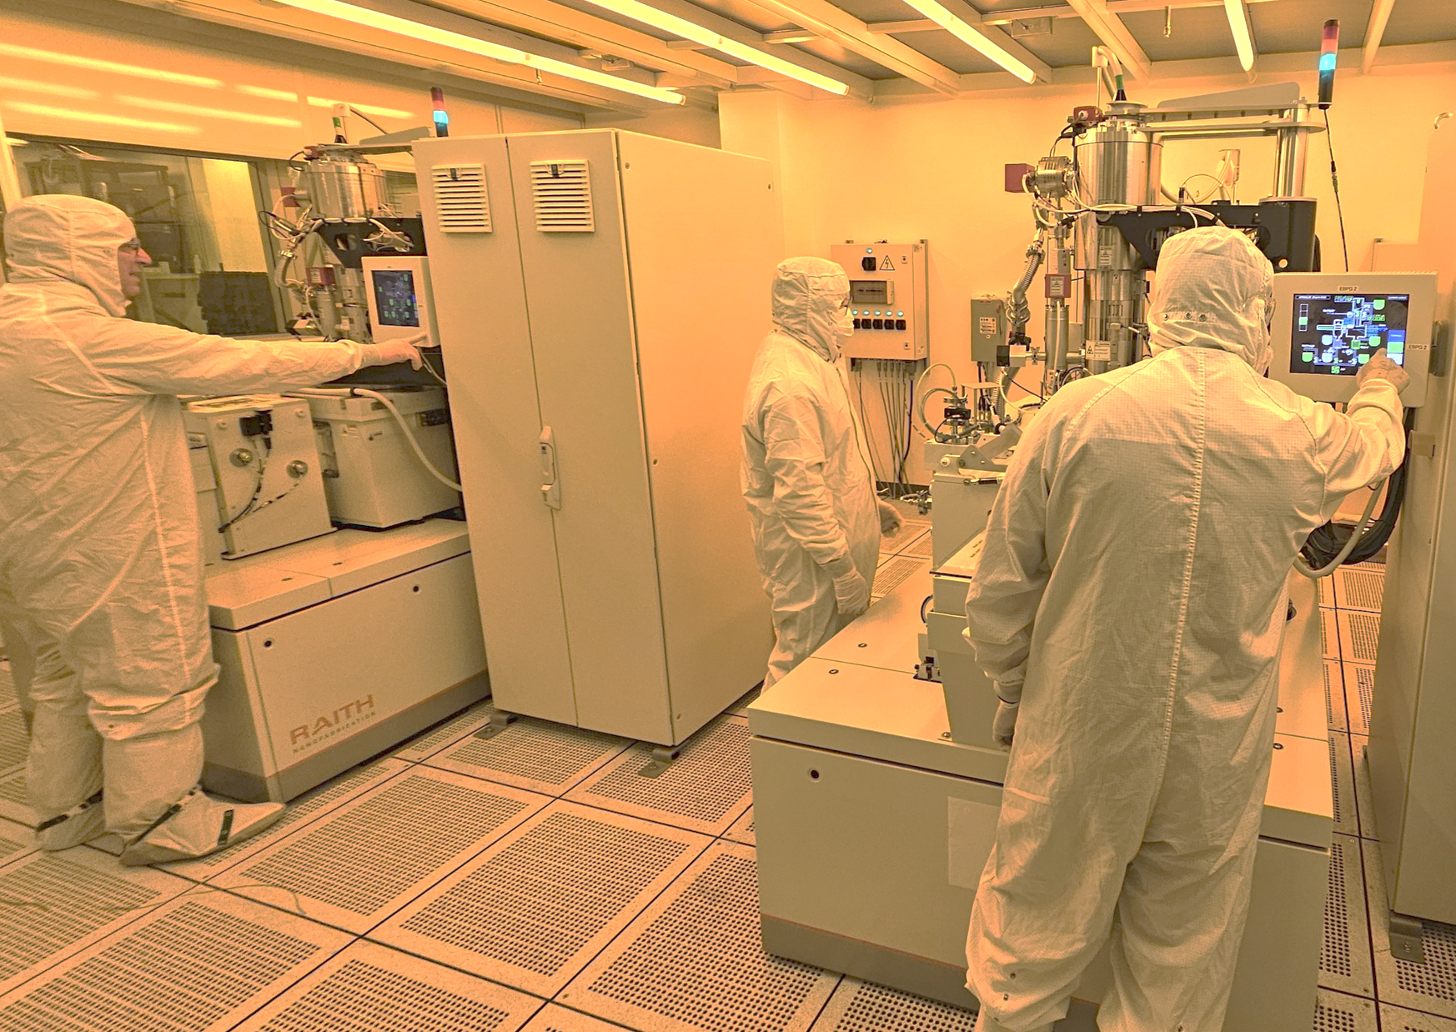
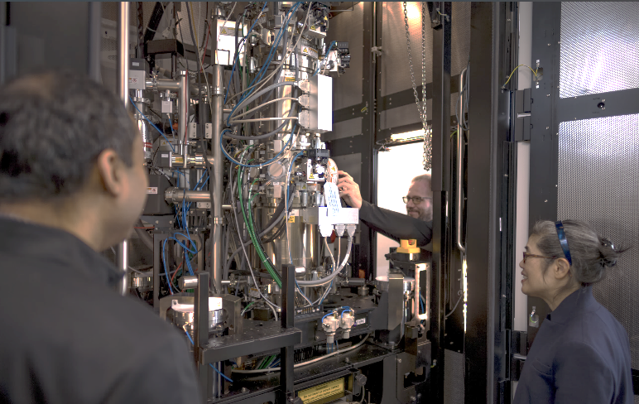
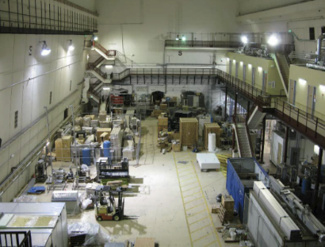
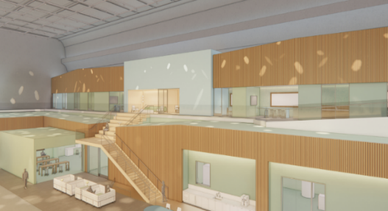
Stanford Nano Shared Facilities (SNSF)
E-beam Lithography Revamp
replaced JEOL6300 with two Raith EBPG5200+
Key outcomes
  saved University >1M in upfit fees
  Ability to easily switch if issues
  Shared holders, alignment microscope, etc.
  >700 billed hrs/month after just 6 months
TEM Expansion
Added Thermo Spectra 300 (double Cs corrected & monochr.)
Game changer for supporting emerging research areas
Drew new PIs into TEM
Staff consulting/service essential to success
~350 hrs/month billed
Expansion into Endstation 3
Convert old accelerator endstation into modern lab
Expansion of capabilities early 2026
Key tools
  TEM: Nion/Bruker with UHV peripherals (MBE, evaporator, …)
  Two basic/intermediate TEMs
  Raith Velion Ion Beam Lithography
  SAXS …

