Slide 1
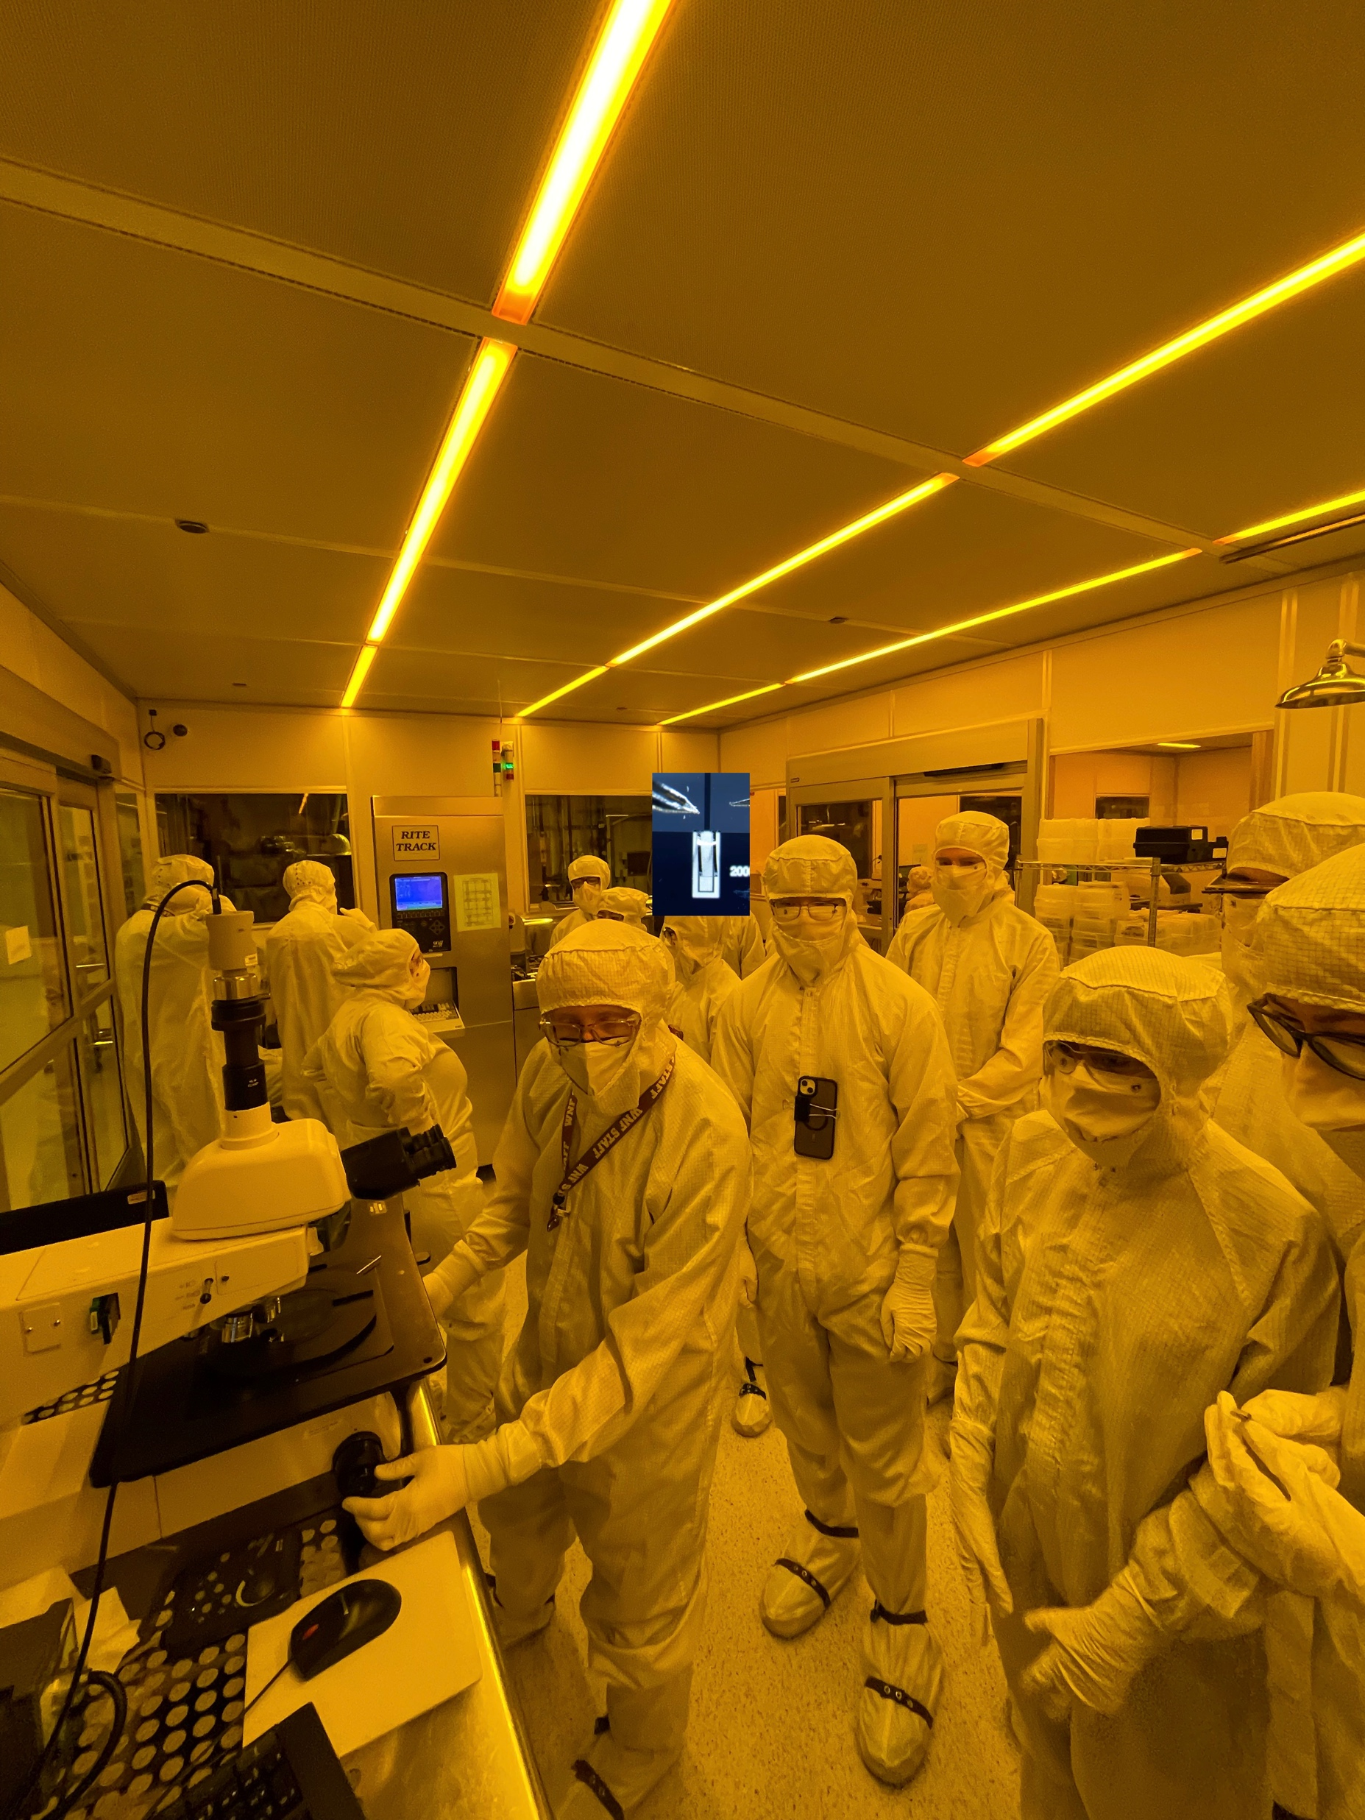
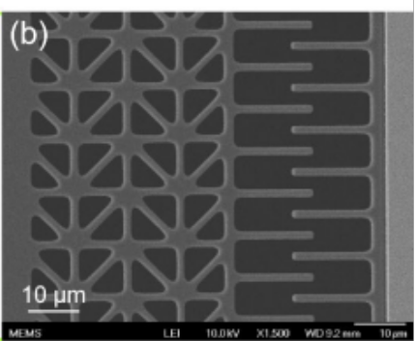
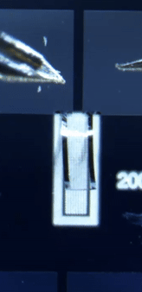
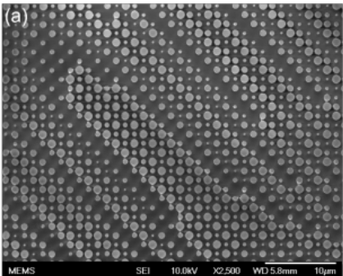
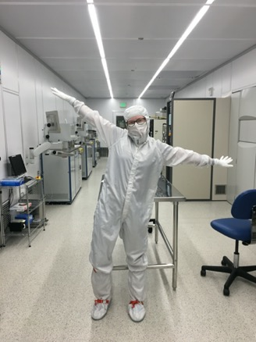
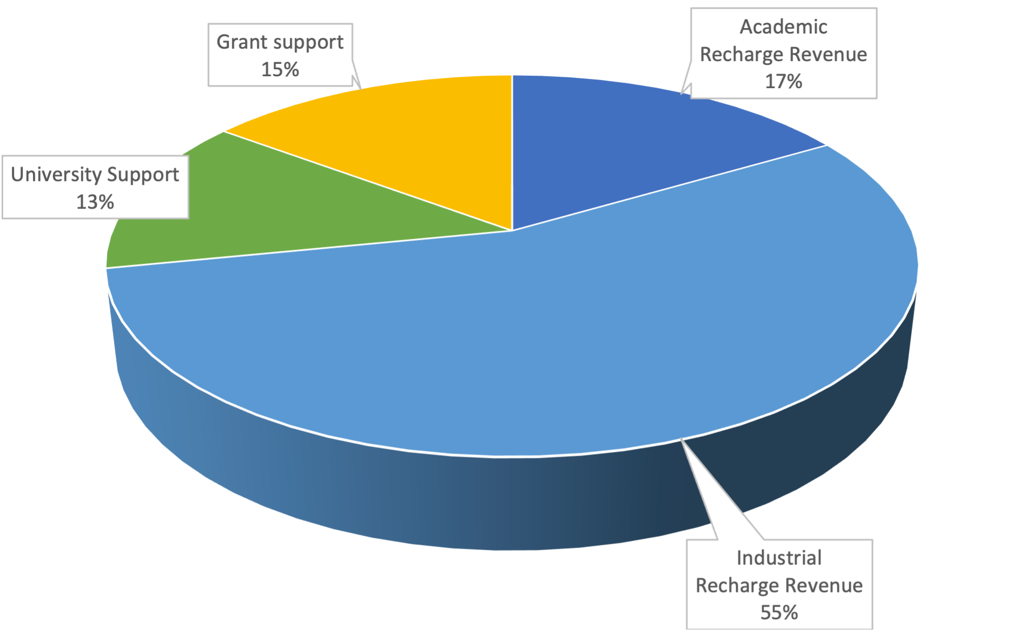
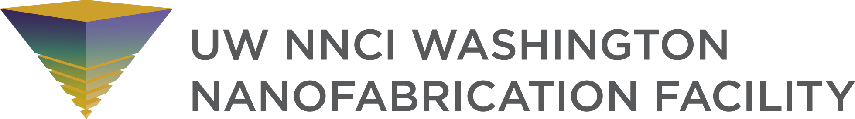

Washington Nanofabrication Facility
University of Washington
Underwent $37.5 million renovation in 2017
15,000 sq ft facility includes ISO Class 5-7 cleanroom spaces and chases
Bay and Chase layout
MEMS, Optics, Photonics, Quantum; no doping, minimal active devices
11 technical staff
4 Support Staff
15 Undergraduate Research Assistants
~140 unique internal users/year
~100 unique external users/year
Tool usage ~30k hours/year (~70% external)
  One external company ~50% of total hours
50 new users per year (30% external)
$4.2M operating budget
Income: University Support 13%, Grant support 15%, Recharge Revenue 72% (77% from industry, 23% from Academic)

Slide 2
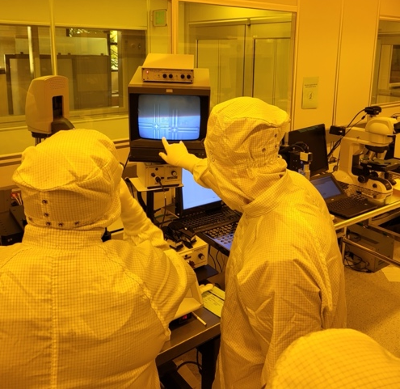
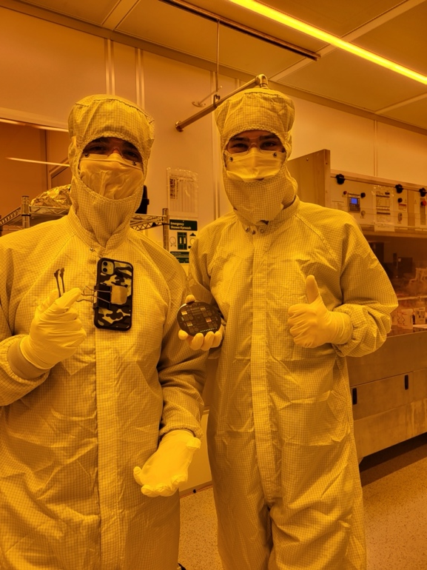
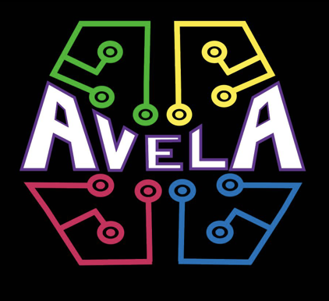
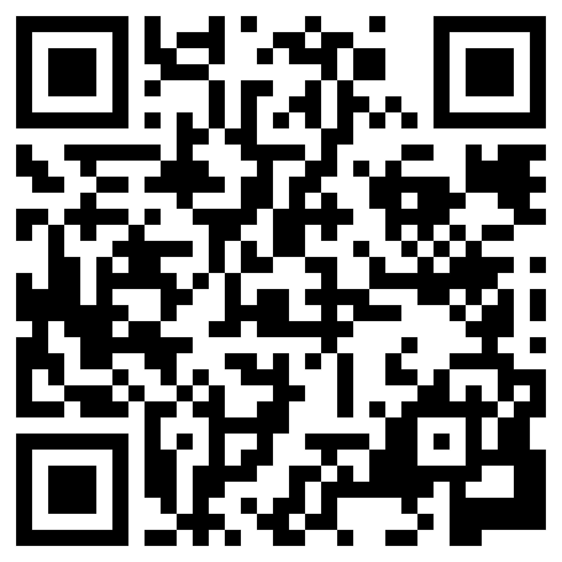
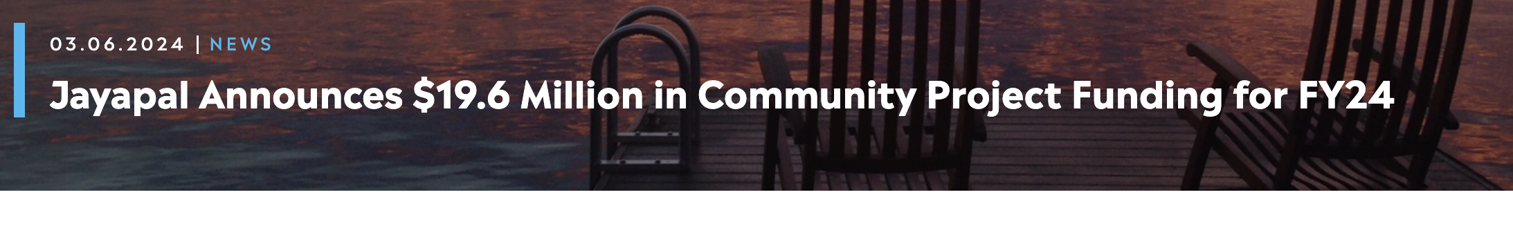
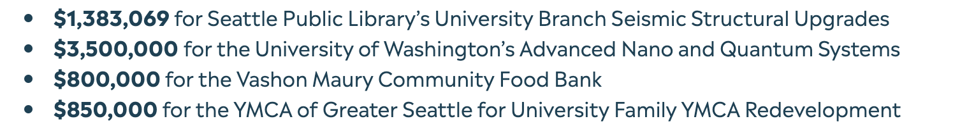
Recent Successes
Partnerships with Micron and Intel
  Short courses, tours, equipment
AVELA
  Undergraduate researchers
  Cleanroom VR tour
Federal Budget – partnering with UW government relations
Meta equipment donation
Wishlist
More Space!!!
Contact Aligner/Bonder
Coater/Developer Track
Deposition systems for quantum materials
Replace wet processing benches
Recent Tool Additions/Incoming Tools
Donations
  Raith Voyager
  SPTS Dielectric Etcher
  Intlvac Ion Beam Etcher
  OCA Contact Angle Goiniometer
Grants
  Angstrom evaporator
  Heidelberg MLA
  Oxford chlorine ICP/ALE
  Bruker Dimension FastScan AFM
Federal Money
  SEM (talk to me if you have opinions)
  PECVD (looking at options)
  Lithography Tools – track or aligner
Other Purchases
  Nanotronics nSpec
  SAMCO RIE
  Woollam RC2 Ellipsometer
Recent Challenges
DI in PCW loop
Gas distribution (including toxics)
Facilities system redundancy (makeup air)
Power Conditioning
Replace gas distribution (including toxics)
Facilities system redundancy
https://students.washington.edu/avelauw/index.html

