Slide 1


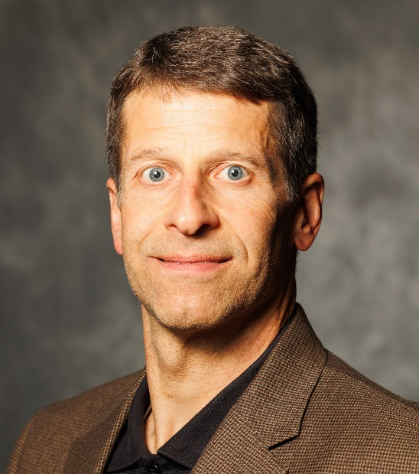
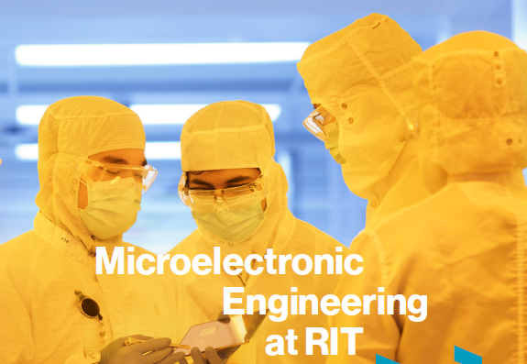
kdhemc@rit.edu

Slide 2
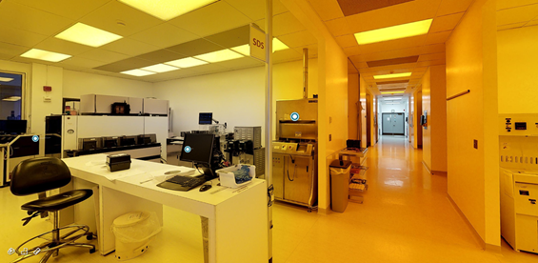
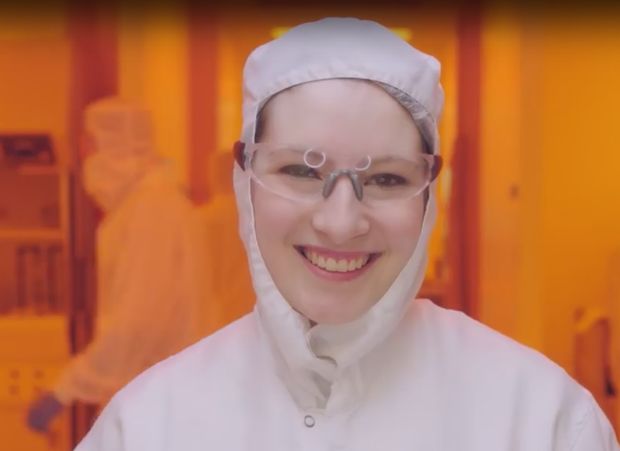
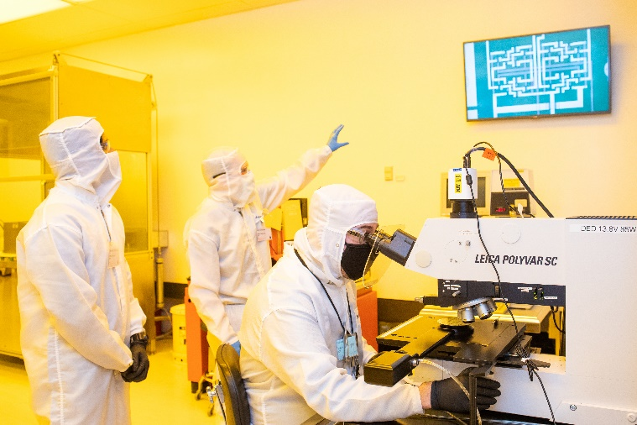
Facilities Metrics
Built in 1985-86
10,000 sq.ft. class 1000 cleanroom (bay & chase)
5,000 sq.ft. semi-clean space
5 Technical Support Staff
$1.2M annual expenses
Lab Users
Internal Users
  ~ 20 faculty PI’s, 50 researchers
  Microelectronic Engineering academic programs
External Users
  3-4 companies, ~ 10 users
Funding Support
$400K operating budget
$300K endowment support
$200K internal user lab fees
$150K external users
$150K subsidy
Avian
Outdoor Seating
Yoga Studio

Slide 3
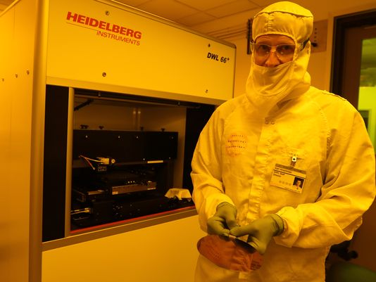
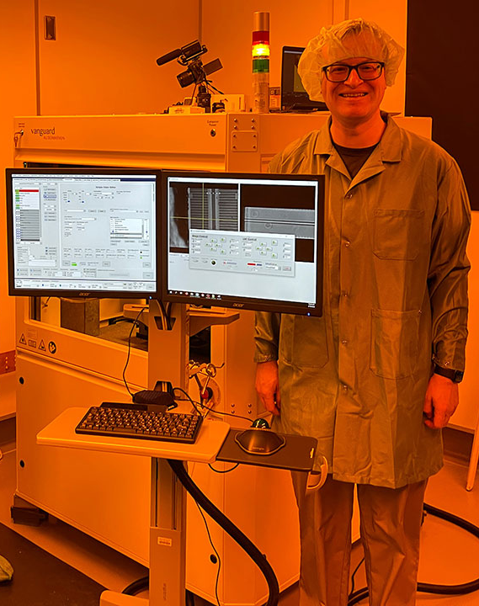
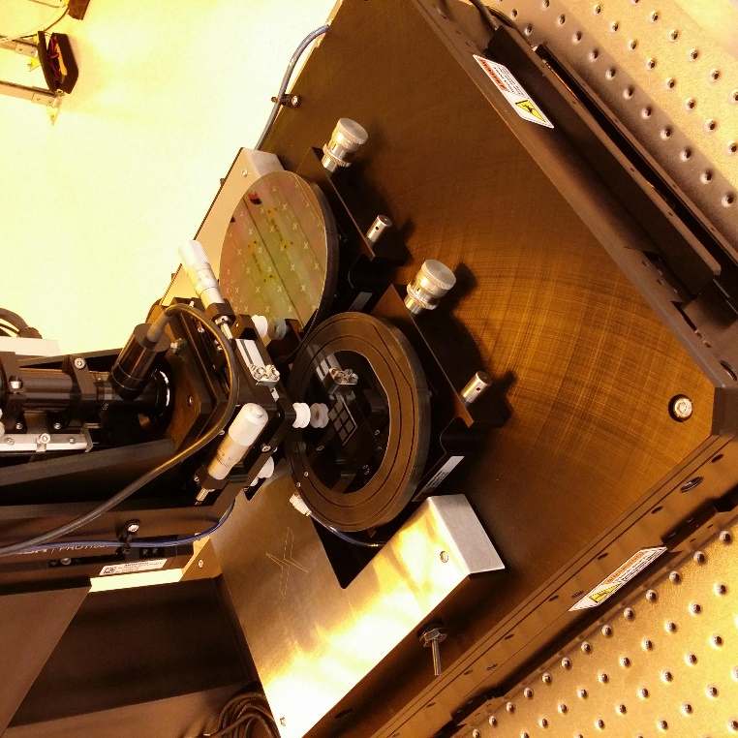
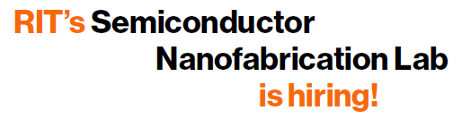
Key Capabilities & Features
Silicon CMOS
  Heidelberg DWL66+ Direct-Write Laser
  Varian 350D Ion Implanter
  ASML PAS5500/200 i-line stepper
Compound Semiconductor
  Aixtron MOCVD for III-V’s
  PlasmaTherm Apex ICP-RIE
Photonics & Heterogeneous Integration
  Vanguard Automation Sonata 1000
  XDC MTP-100X Micro-transfer print system (µTP)
Lab Upgrades
Tystar Mini-TYTAN Model 3600 3-tube LPCVD/oxidation furnace!
  Thanks for your patience Jim Smith! ☺
  Another system being ordered
Atlas Copco air compressor, process vacuum
Additional infrastructure upgrades in progress
  Exhaust abatement
  Vacuum pumps
  Wetbench upgrades
  More to come!
Karl Hirschman: kdhemc@rit.edu
Stefan Preble: sfpeen@rit.edu

