Slide 1

Shared Equipment Authority (SEA) at Rice University
Rice established the SEA in 2001 as a way to provide state-of-the-art research equipment capabilities for Rice researchers and the extended Rice community. SEA supports more than 130 instruments. (https://research.rice.edu/sea/)
BioSEA: Centrifuges, Flow Cytometry, & more
Nanofabrication: Cleanroom RNF
Mass Spectrometry
Electron and Optical Microscopy
Nuclear Magnetic Resonance
Spectrometers
Surface Analysis
Thermal Analysis
X-Ray Facilities

Slide 2
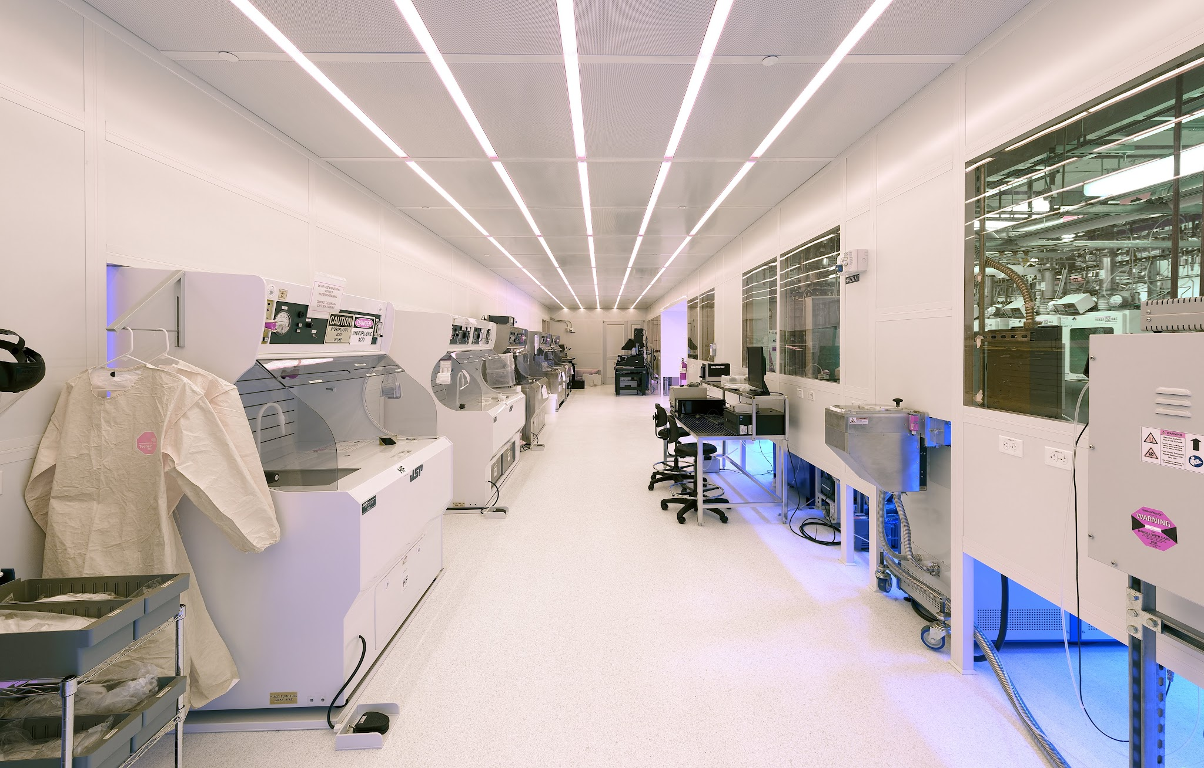
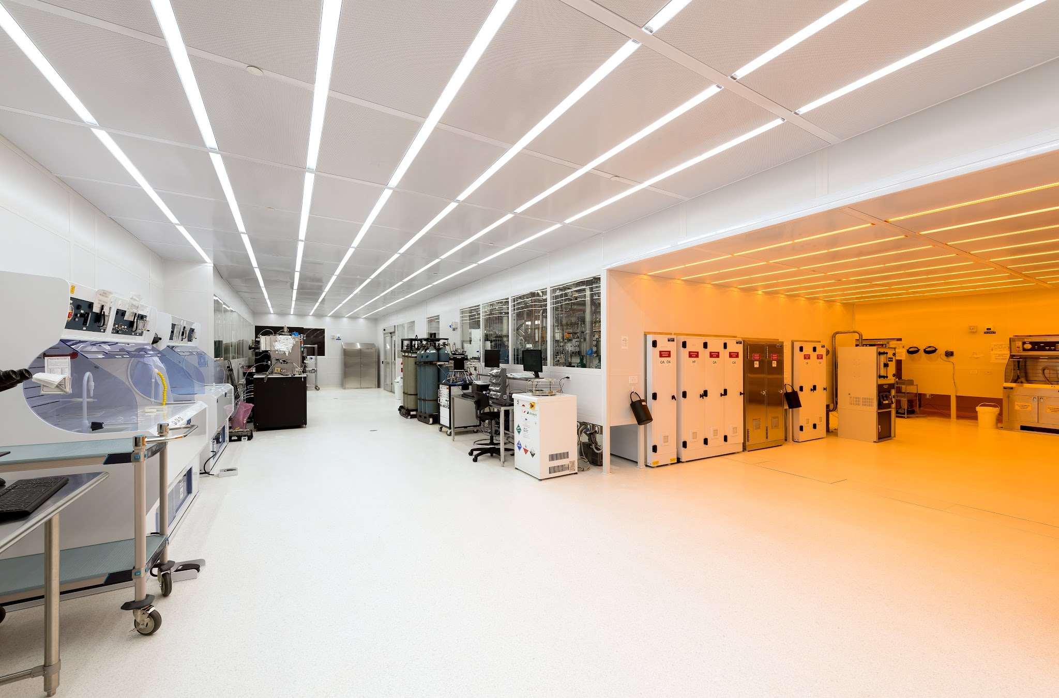
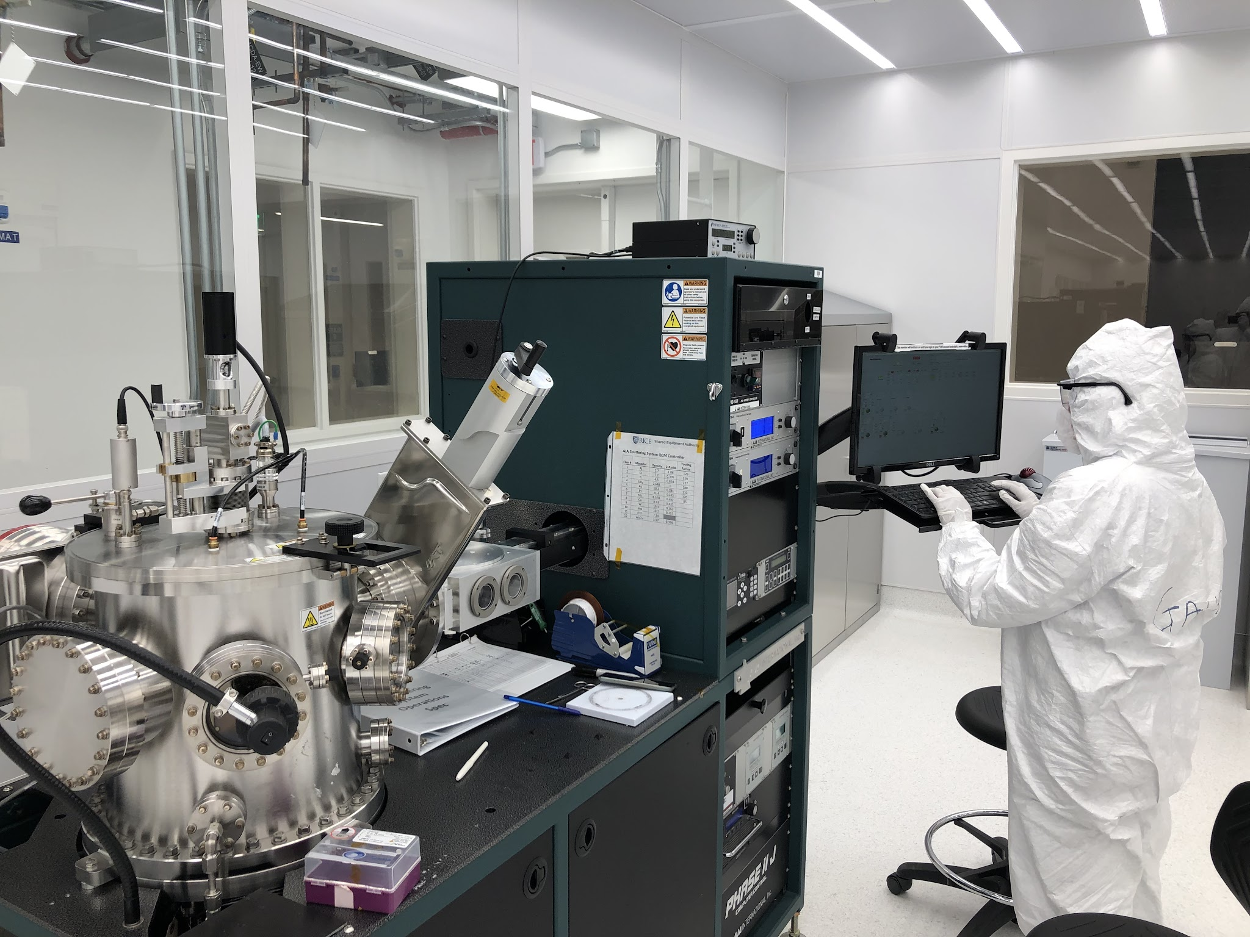
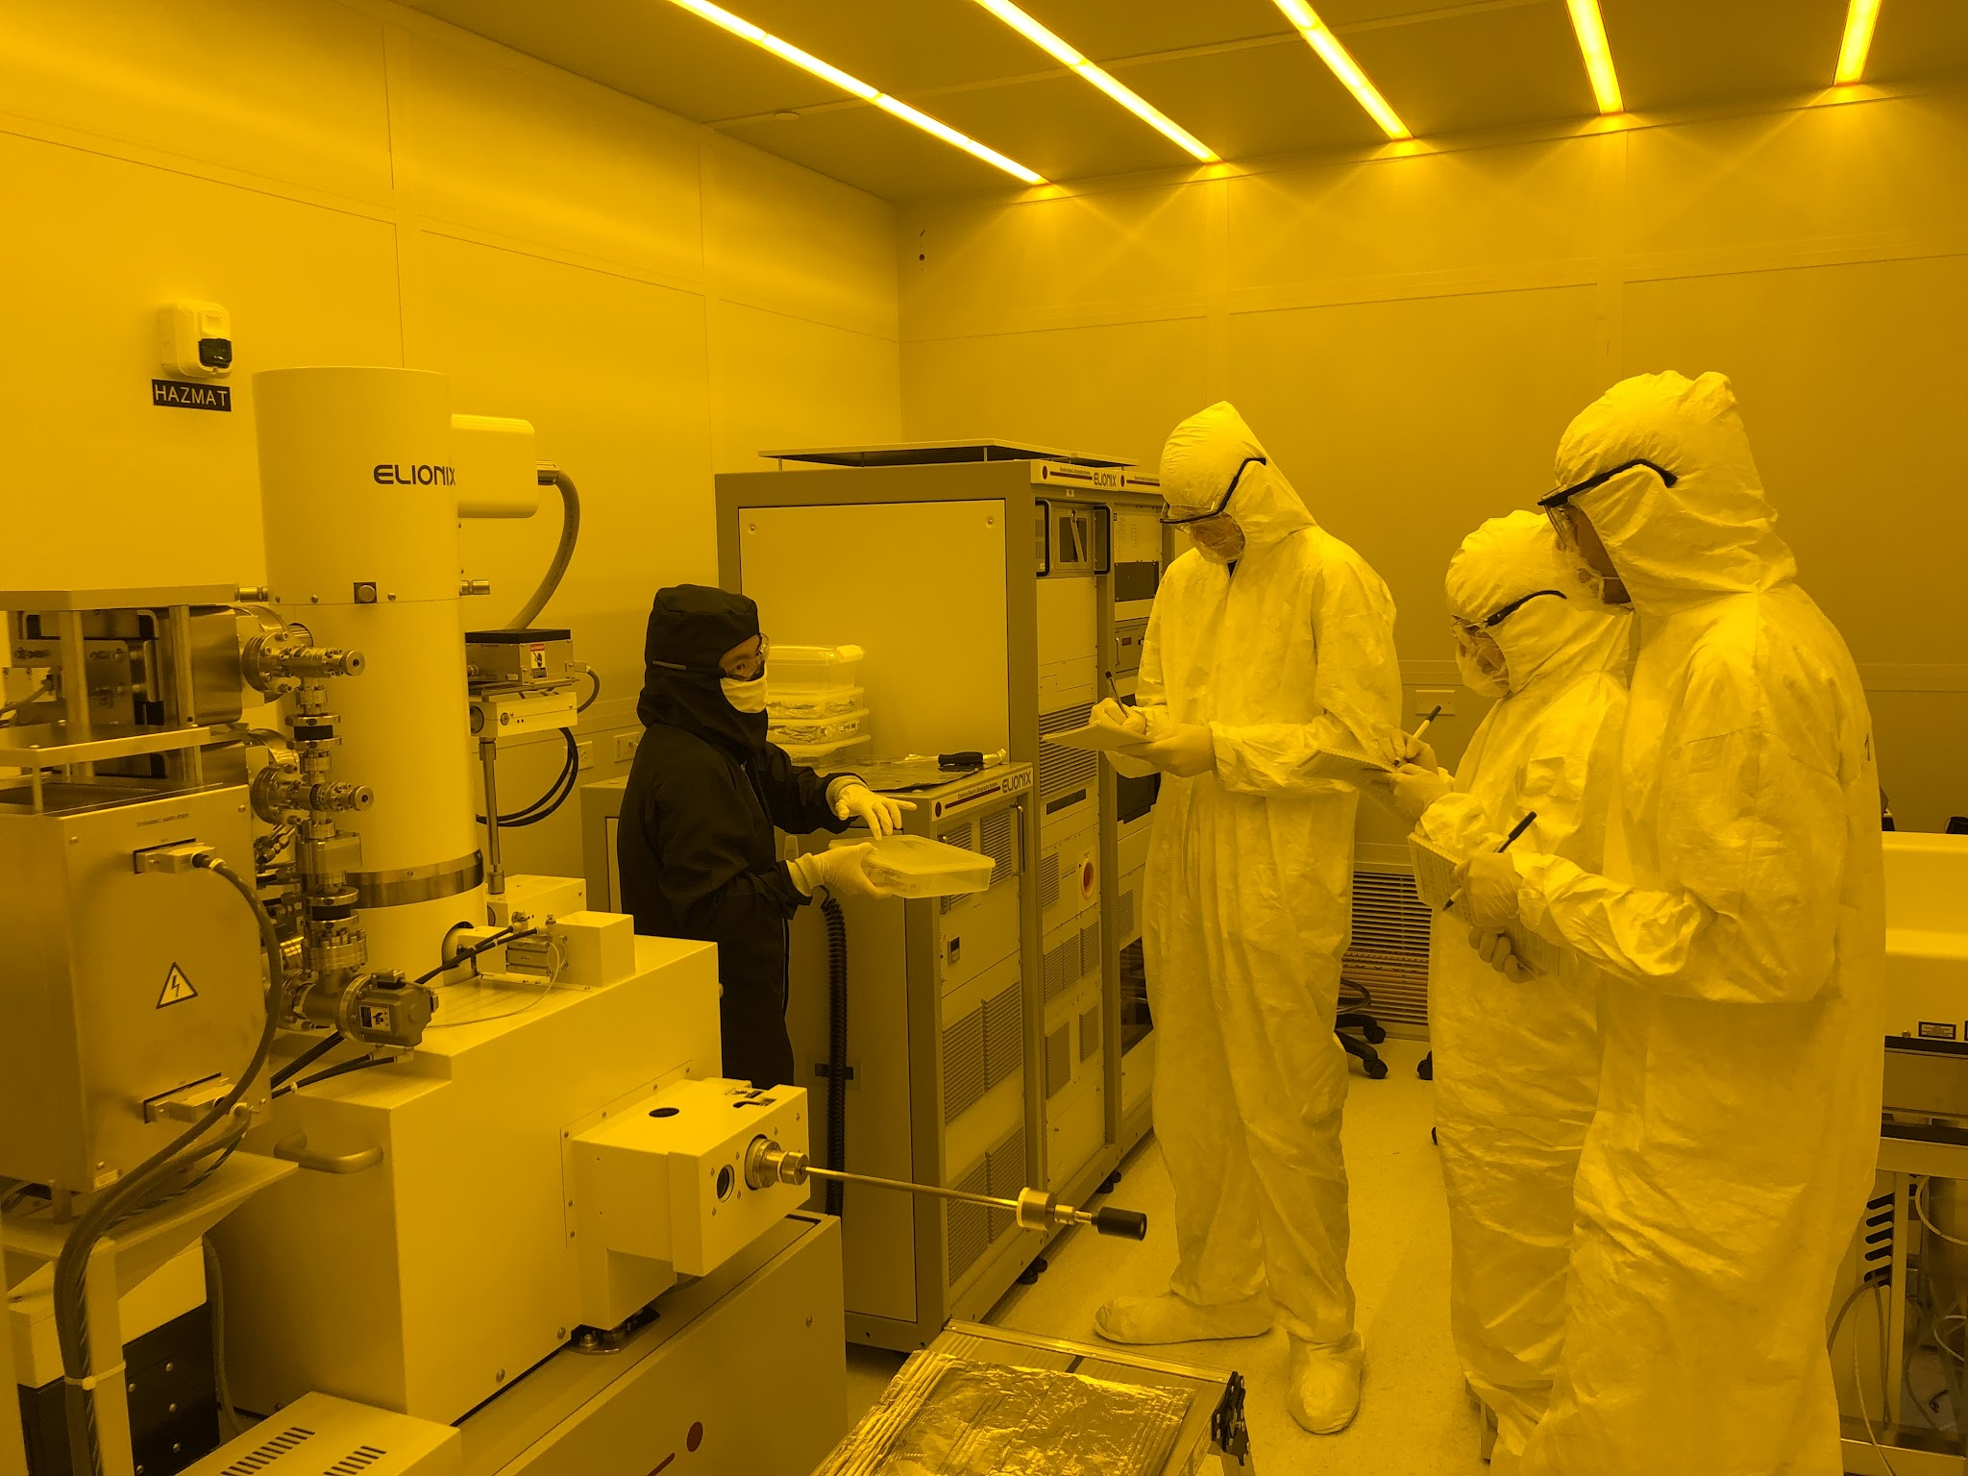
New 2800+ ft² Class 100 cleanroom opened in Jan 2019
7000+ ft² Support area(chase, HPM & MEP)
Infrastructure cost $ 20million+
3 scientists & 2 Tech staffs
Supports 250+ unique users from 12 departments per calendar year
80% internal users
User fee covers depreciation fee, maintenance, consumables etc., but not the staff pays

Slide 3
RNF supports processes in depositions, etching, lithography, metrology and back-end processes
Lithography:
EVG 620 Mask Aligner
Elionix E-beam Writer (100kV)
Nanoscribe 3D Laser Lithography
Rave/AMP Maskless System
Etching:
Oxford ICP RIE
Benchtop RIE
General Acid
General Base
HF Etch
Deposition:
E-beam Evaporators
AJA Sputtering system
Veeco/Ultratech ALD
Parylene Coater
General Info:
Certified: Class 100
(ISO 5) Operational
Clean Bays: 2867 ft²
Support Chases: 3219 ft²
MEP Rooms: 3459 ft²
Benches:
Base Develop
General Acid
General Base
HF Etch
PDMS Fume Hood
Solvent Develop
Spin/Bake Stations (photoresist & e-beam)
Metrology:
Stylus Profilometer
Optical Profiler
Ellipsometer
Microscopes
SEM (EDAX/Low Vac/Decel)
Back-end Post Process:
Dicing Saw
Wire Bonders
Die Bonder
400ºC Oven
RTP
Laser cutter Polisher
CPD
LatticeAx
High Temp. Furnace

