Slide 1

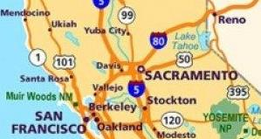
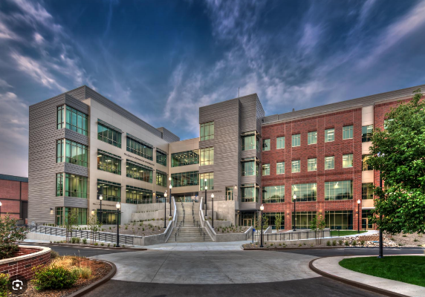
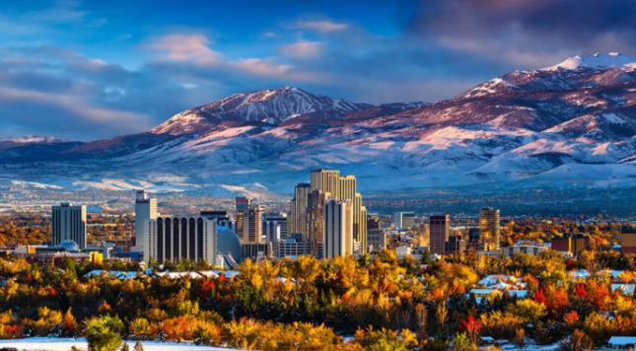
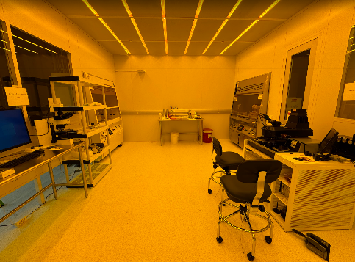
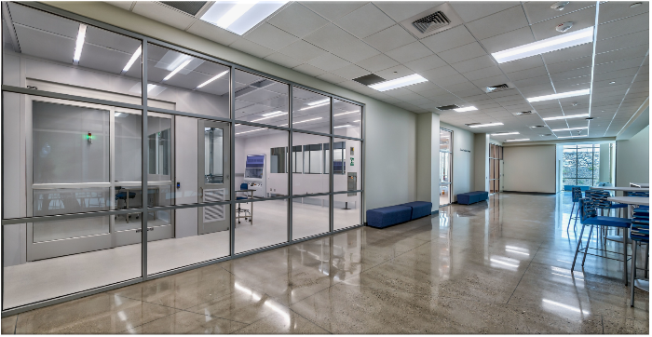
University of Nevada, Reno
- 4 hrs NE of SF
- 7 hrs NW of Vegas
Facilities Metrics
First academic fab in Northern Nevada
  Our congressional district is larger than Greece!
Built in 2020 as part of $92M building
  No funding available for tools, people, opex, pens, tables
Funded Fall 2023 with $3M, still starting!
3,000 sqft under filter, ISO 6
1 staff member (Russ Renzas, ex-Oxford)
Still ordering/installing tools, gowns arrive July-ish
Still setting up training/EHS infrastructure
No faculty do fab-related research (yet)
No fab-related courses (yet), no external users (yet)
100% funded by single $3M Dept. of Education grant
Yoga Studio
Main Entrance

Slide 2
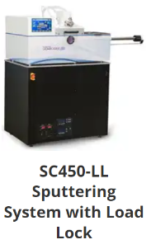
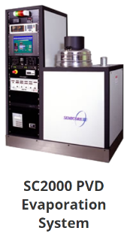
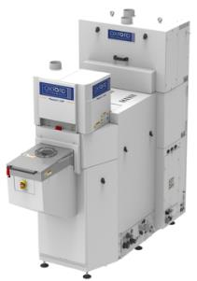
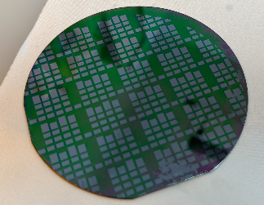
Key Capabilities & Features
Atomic layer etch: centerpiece of initial R&D
PCB printing + Pick n’ Place
Recent Tool Additions (past 12 or 24 months)
Oxford Instruments Cobra ICP RIE ALE w/ Cryo
Semicore Sputterer (3 mfcs, rf, pulsed dc)
Heidelberg uMLA (maskless aligner)
Literally everything
Strengths
Mostly new equipment, total freedom
Weaknesses:
Starting from zero, no history of fab, no oversight
First Litho Wafer
June 4, 2024
Top-5 Equipment/Capability Wishlist
Users and policies/procedures to manage them
PECVD
Class curriculum
Toxic gas delivery (likely waiting few years)
Very basic furnaces for diffusion/oxidation
Talk to me about…
ANYTHING. Washing glassware, waste streams, gas regulators, ALE, research, policies, class curricula…

