Slide 1
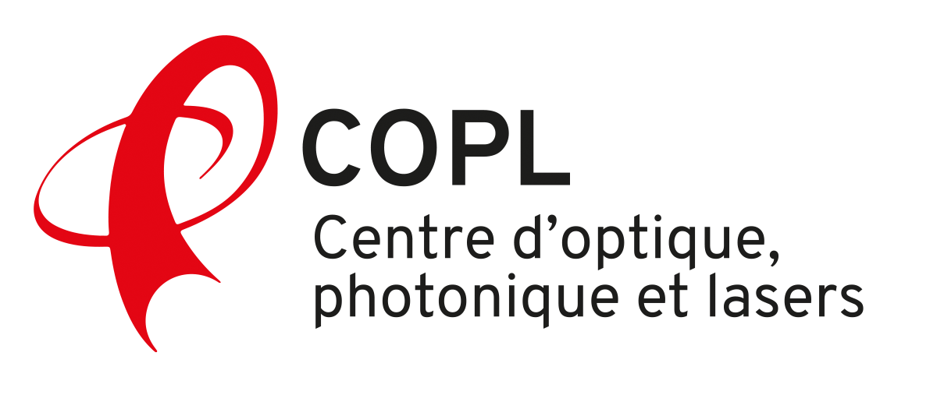
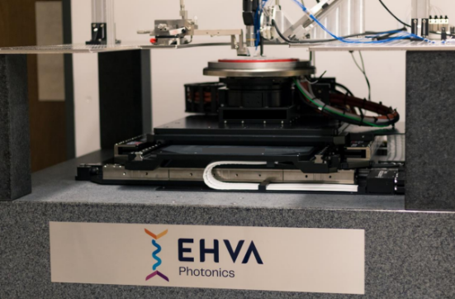
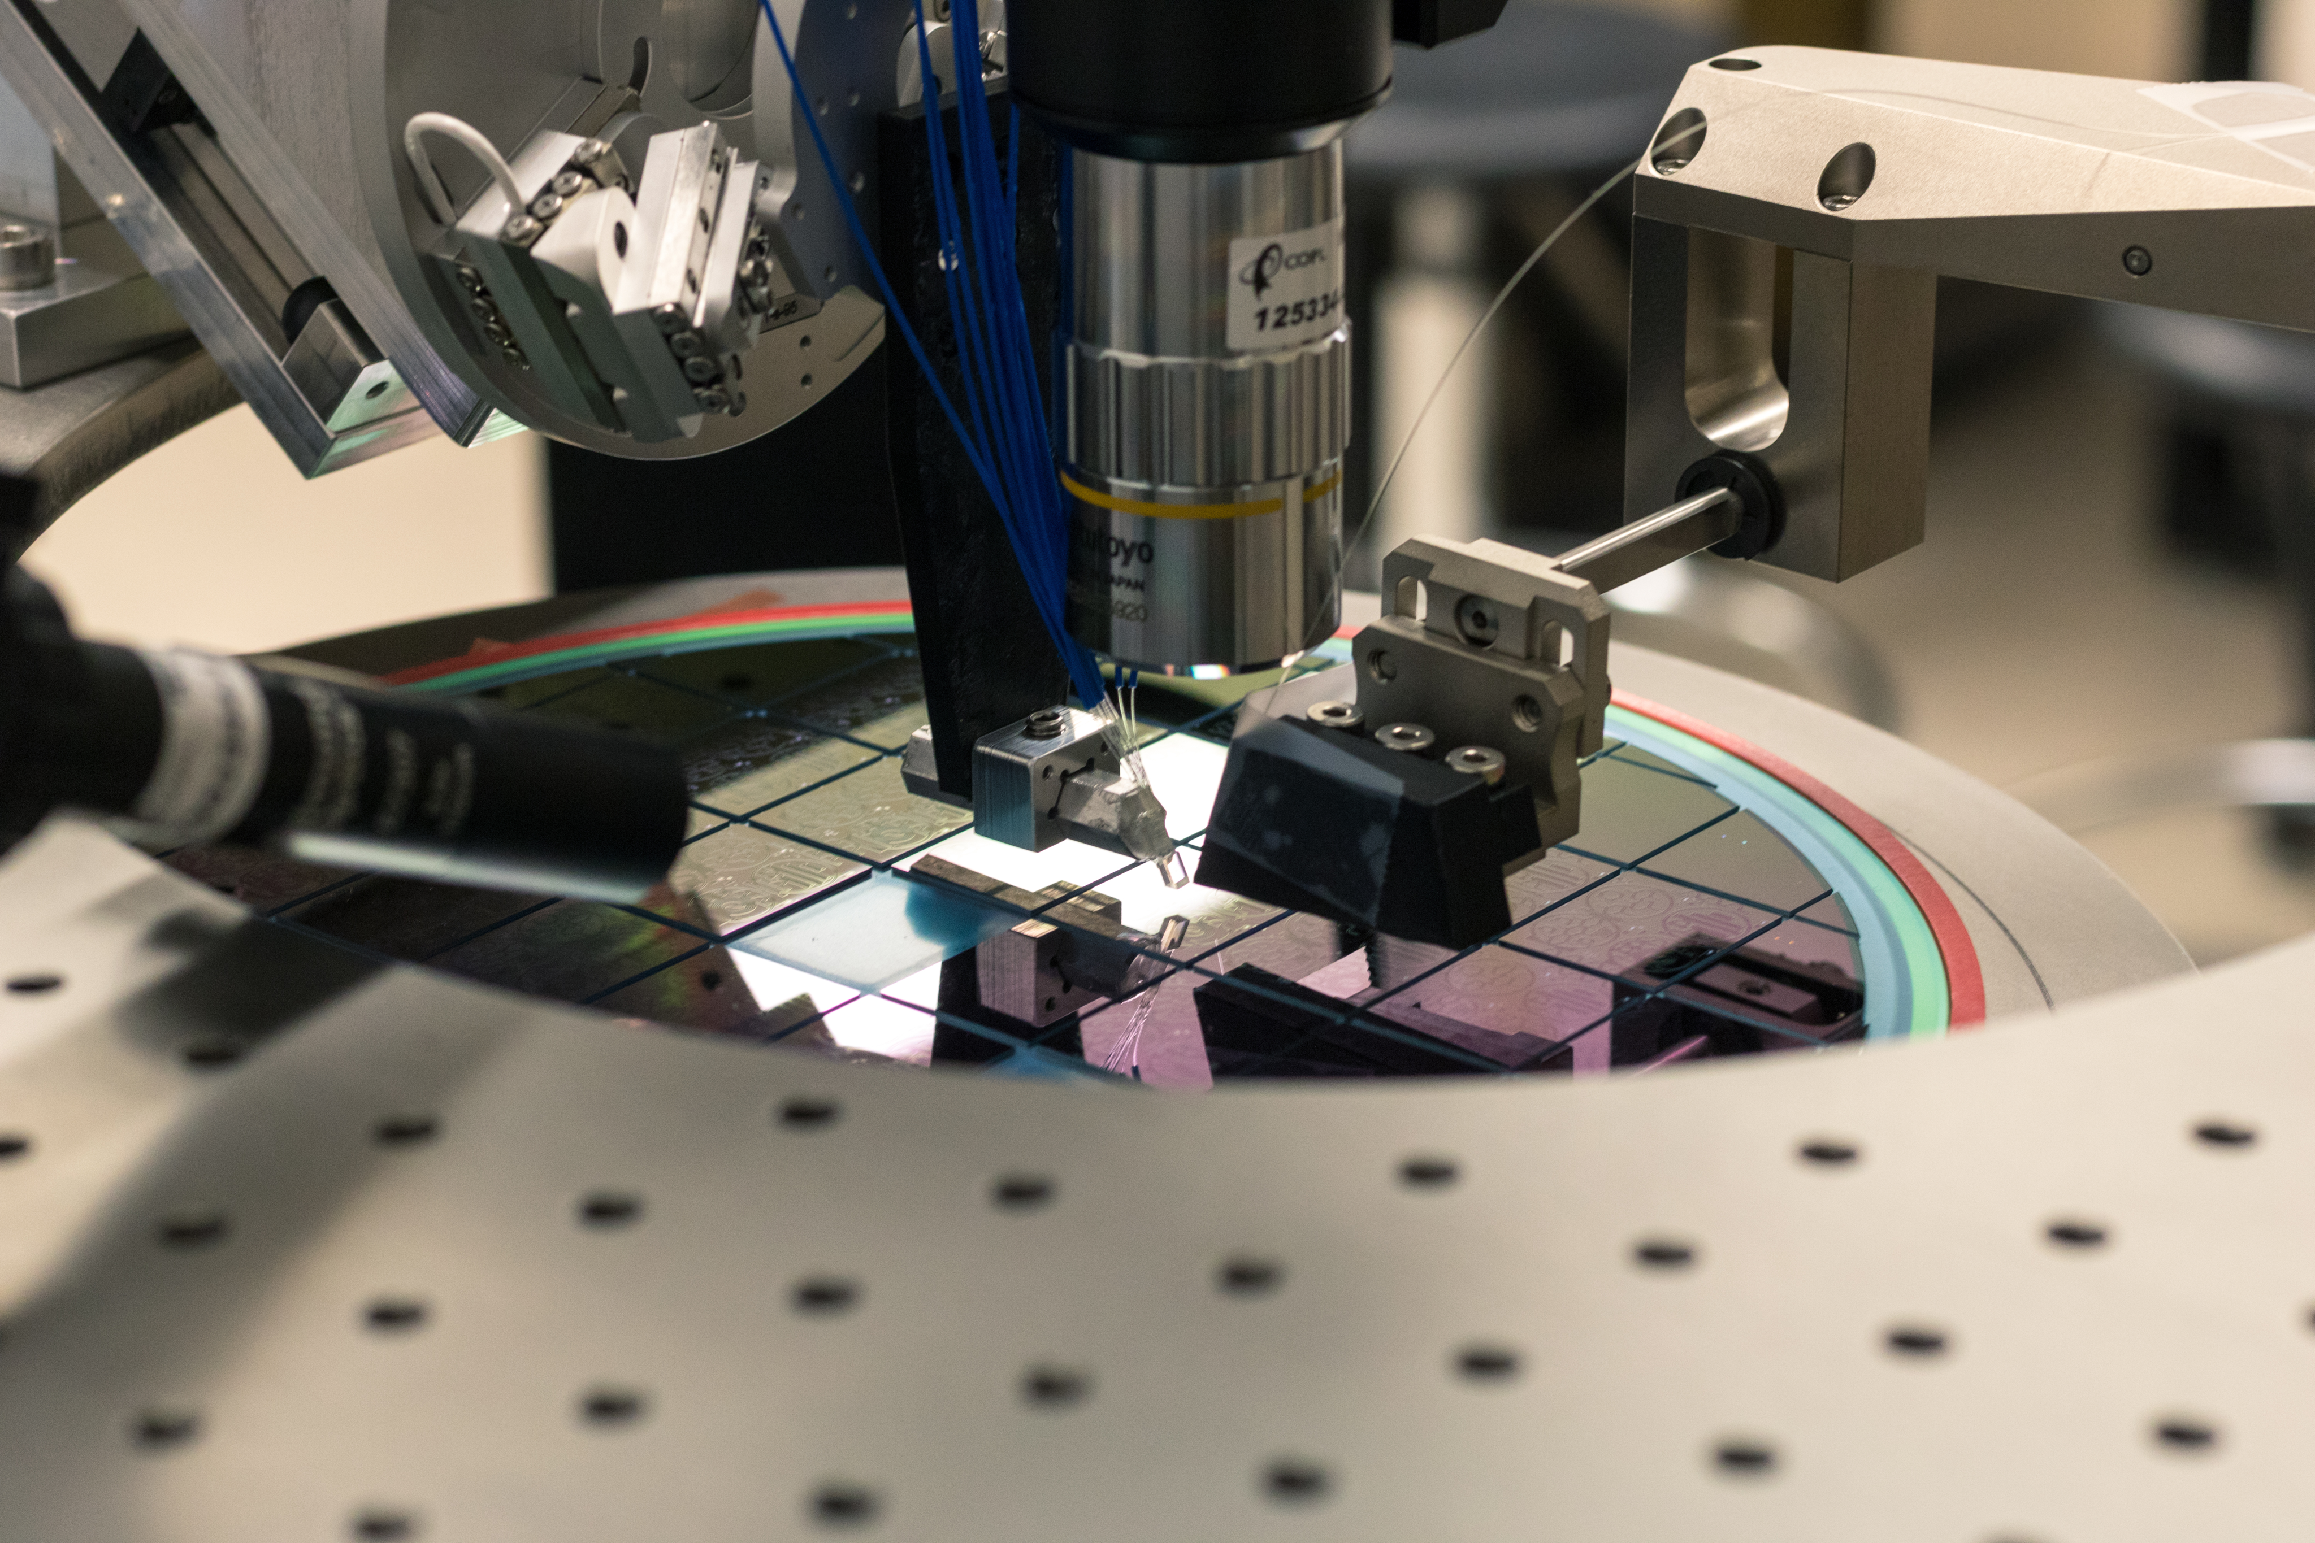
Center for Optics, Photonics and Lasers
Québec’s Strategic Photonics Cluster
56 University and 2 College professors
10 institutions in Montréal, Québec, Sherbrooke and Trois-Rivières
> 70 support and research staff
> 500 trainees (masters, doctorate, post-doctorate)
> 10 M$ in yearly funding for collaborative projects
20 start-ups in the past 10 years
New capabilities at Laval University
Automated wafer-scale Photonic IC testing
Up to 12’’ wafers
Nanometer-scale precision
  Support both edge and surface coupling
Integrated with advanced testing capacity
  Fast spectrum sweep: Up to 200 nm/s
  Broadband: covering O, S, C, U, L bands
  Polarization and optical delay measurement
  RF: up to 67 GHz (110 GHz under development)
Compatible with EXFO’s OPAL-Pilot system
Research thrusts
Lasers and light-matter interactions
Optical fibers and devices
Optical communications
Biophotonics
Photonic Materials
Quantum Photonics
Photonic systems and microsystems
https://coplweb.ca/

Slide 2
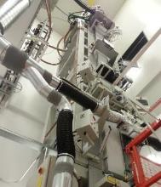
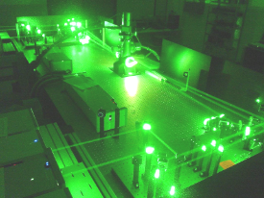
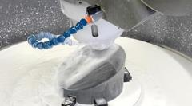
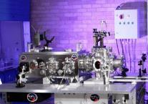
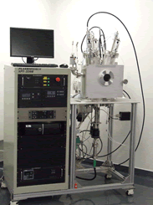
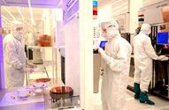
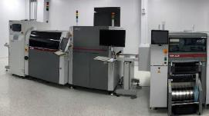
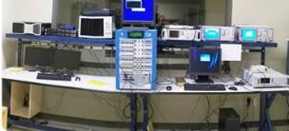
OUR LABORATORIES
Our capabilities are unique in Canada
World-class facilities
Open for collaboration
Université Laval - POP
Fabrication of optical fibers and photonic components
INRS - ALLS
High power pulsed laser sources
ÉTS Montréal
Microelectronics and printable materials
Université de Sherbrooke – 3IT
Microfabrication
Notes:
Ulaval – DanieCôté interim director, copl@copl.ulaval.ca
High quality laboratory space to optics and photonics research with several shared test and measurement capabilities. The optical fiber fabrication facility is unique in Canada and one of the few world wide.
ÉTS – Sylvain G. Cloutier – Printable hybrid materials for optoelectronic and electronics
Communications and Microelectronic Integration Laboratory
https://www.etsmtl.ca/unites-de-recherche/lacime/accueil
INRS –ALLS – François Légaré
The Advanced Laser Light Source Laboratory (ALLS) is a laboratory facility accessible to Canadian researchersh with radiation sources ranging from high-nergye short pulse infrared to very-high-energy and ultrashort-pulse X-rays. It opens new frontiers in the dynamic imaging of molecules and complex systems such as proteins.
https://inrs.ca/en/research/research-facilities/find-a-research-facility/advanced-laser-light-source-laboratory/
U de Sherbrooke – Paul Charrette
The 3IT (interdisciplinary instittue for technological innovation) has laboratory facilities for nano and microfabrication of devices and microsytesms, from lmaterial desposition and lithography process to packaging activities.
Interdisciplinary Institute for Technological Innovation

