Slide 1
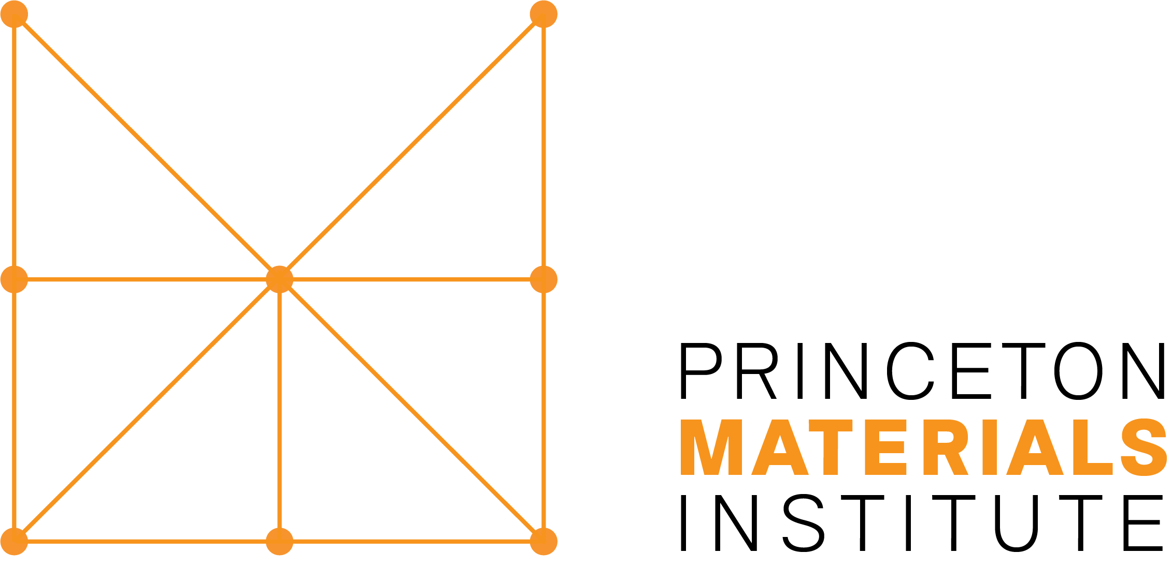
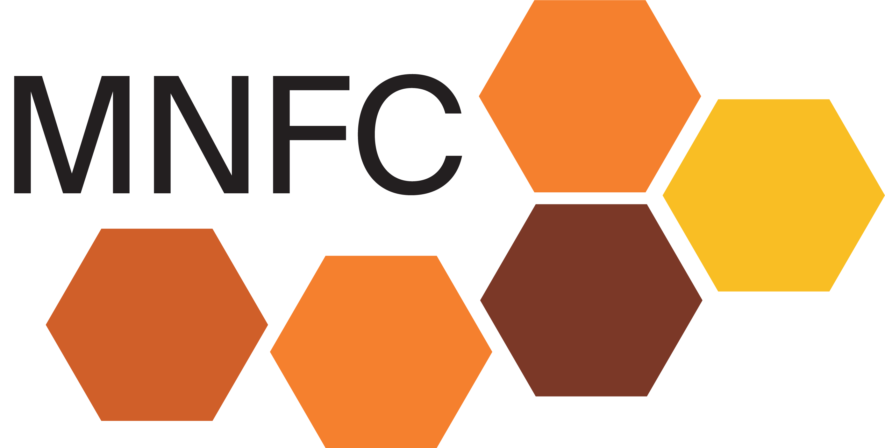
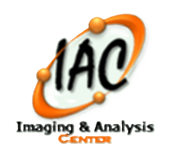
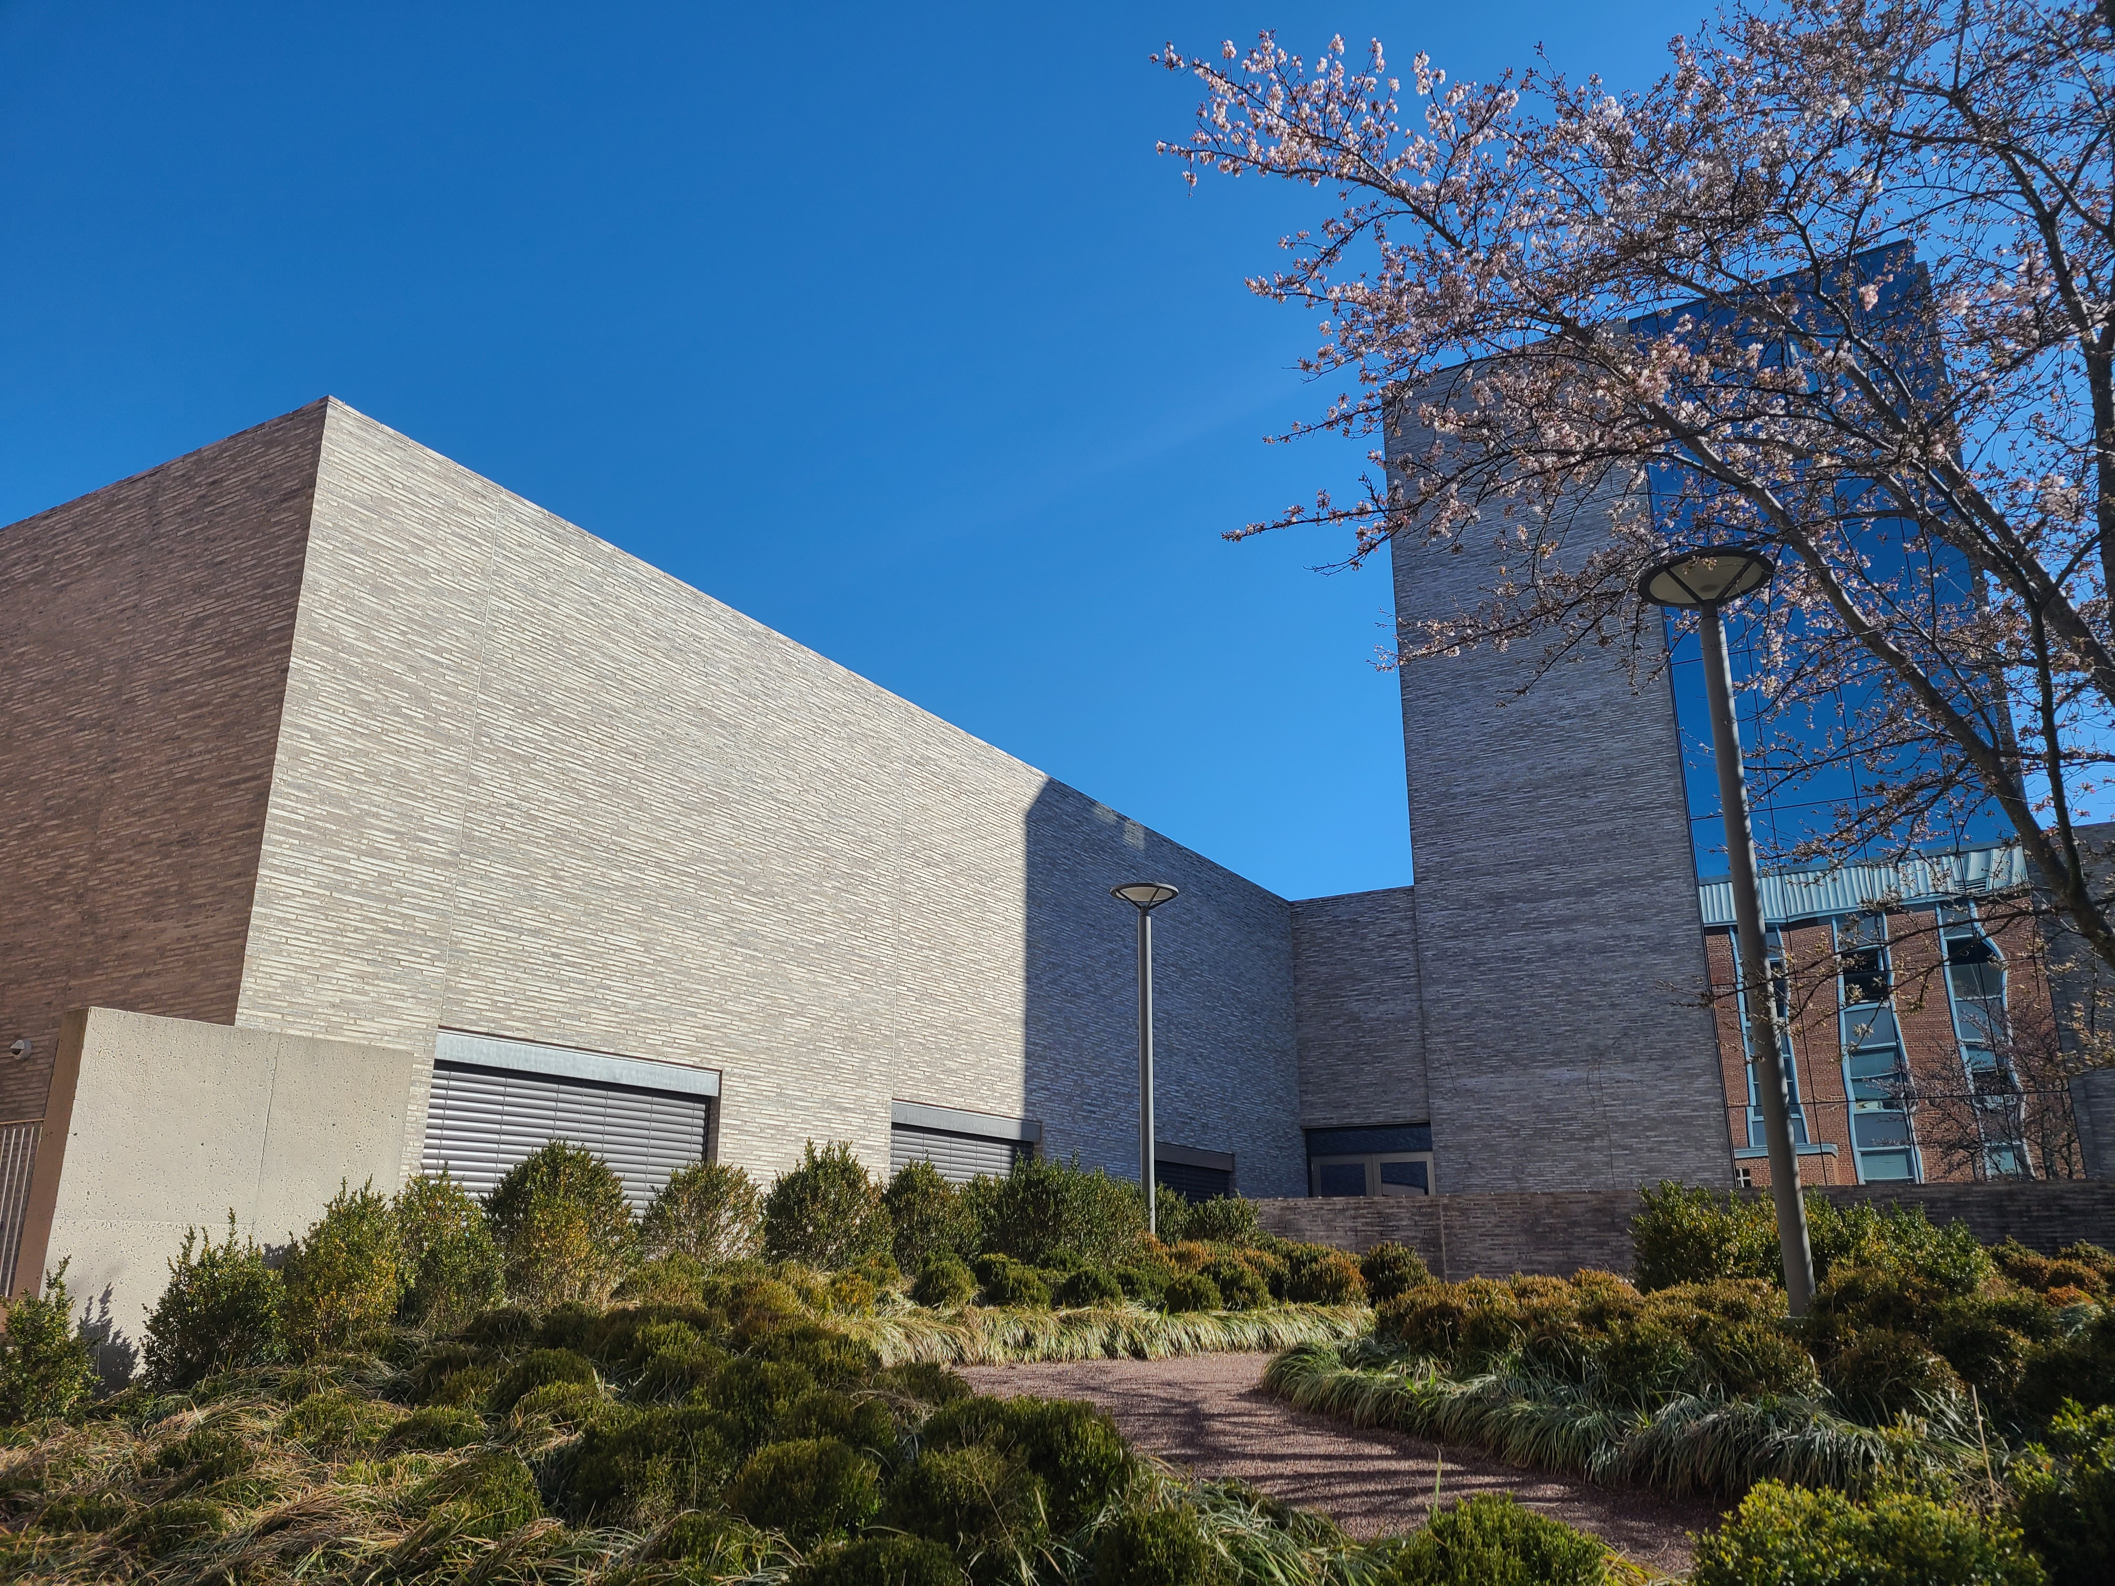
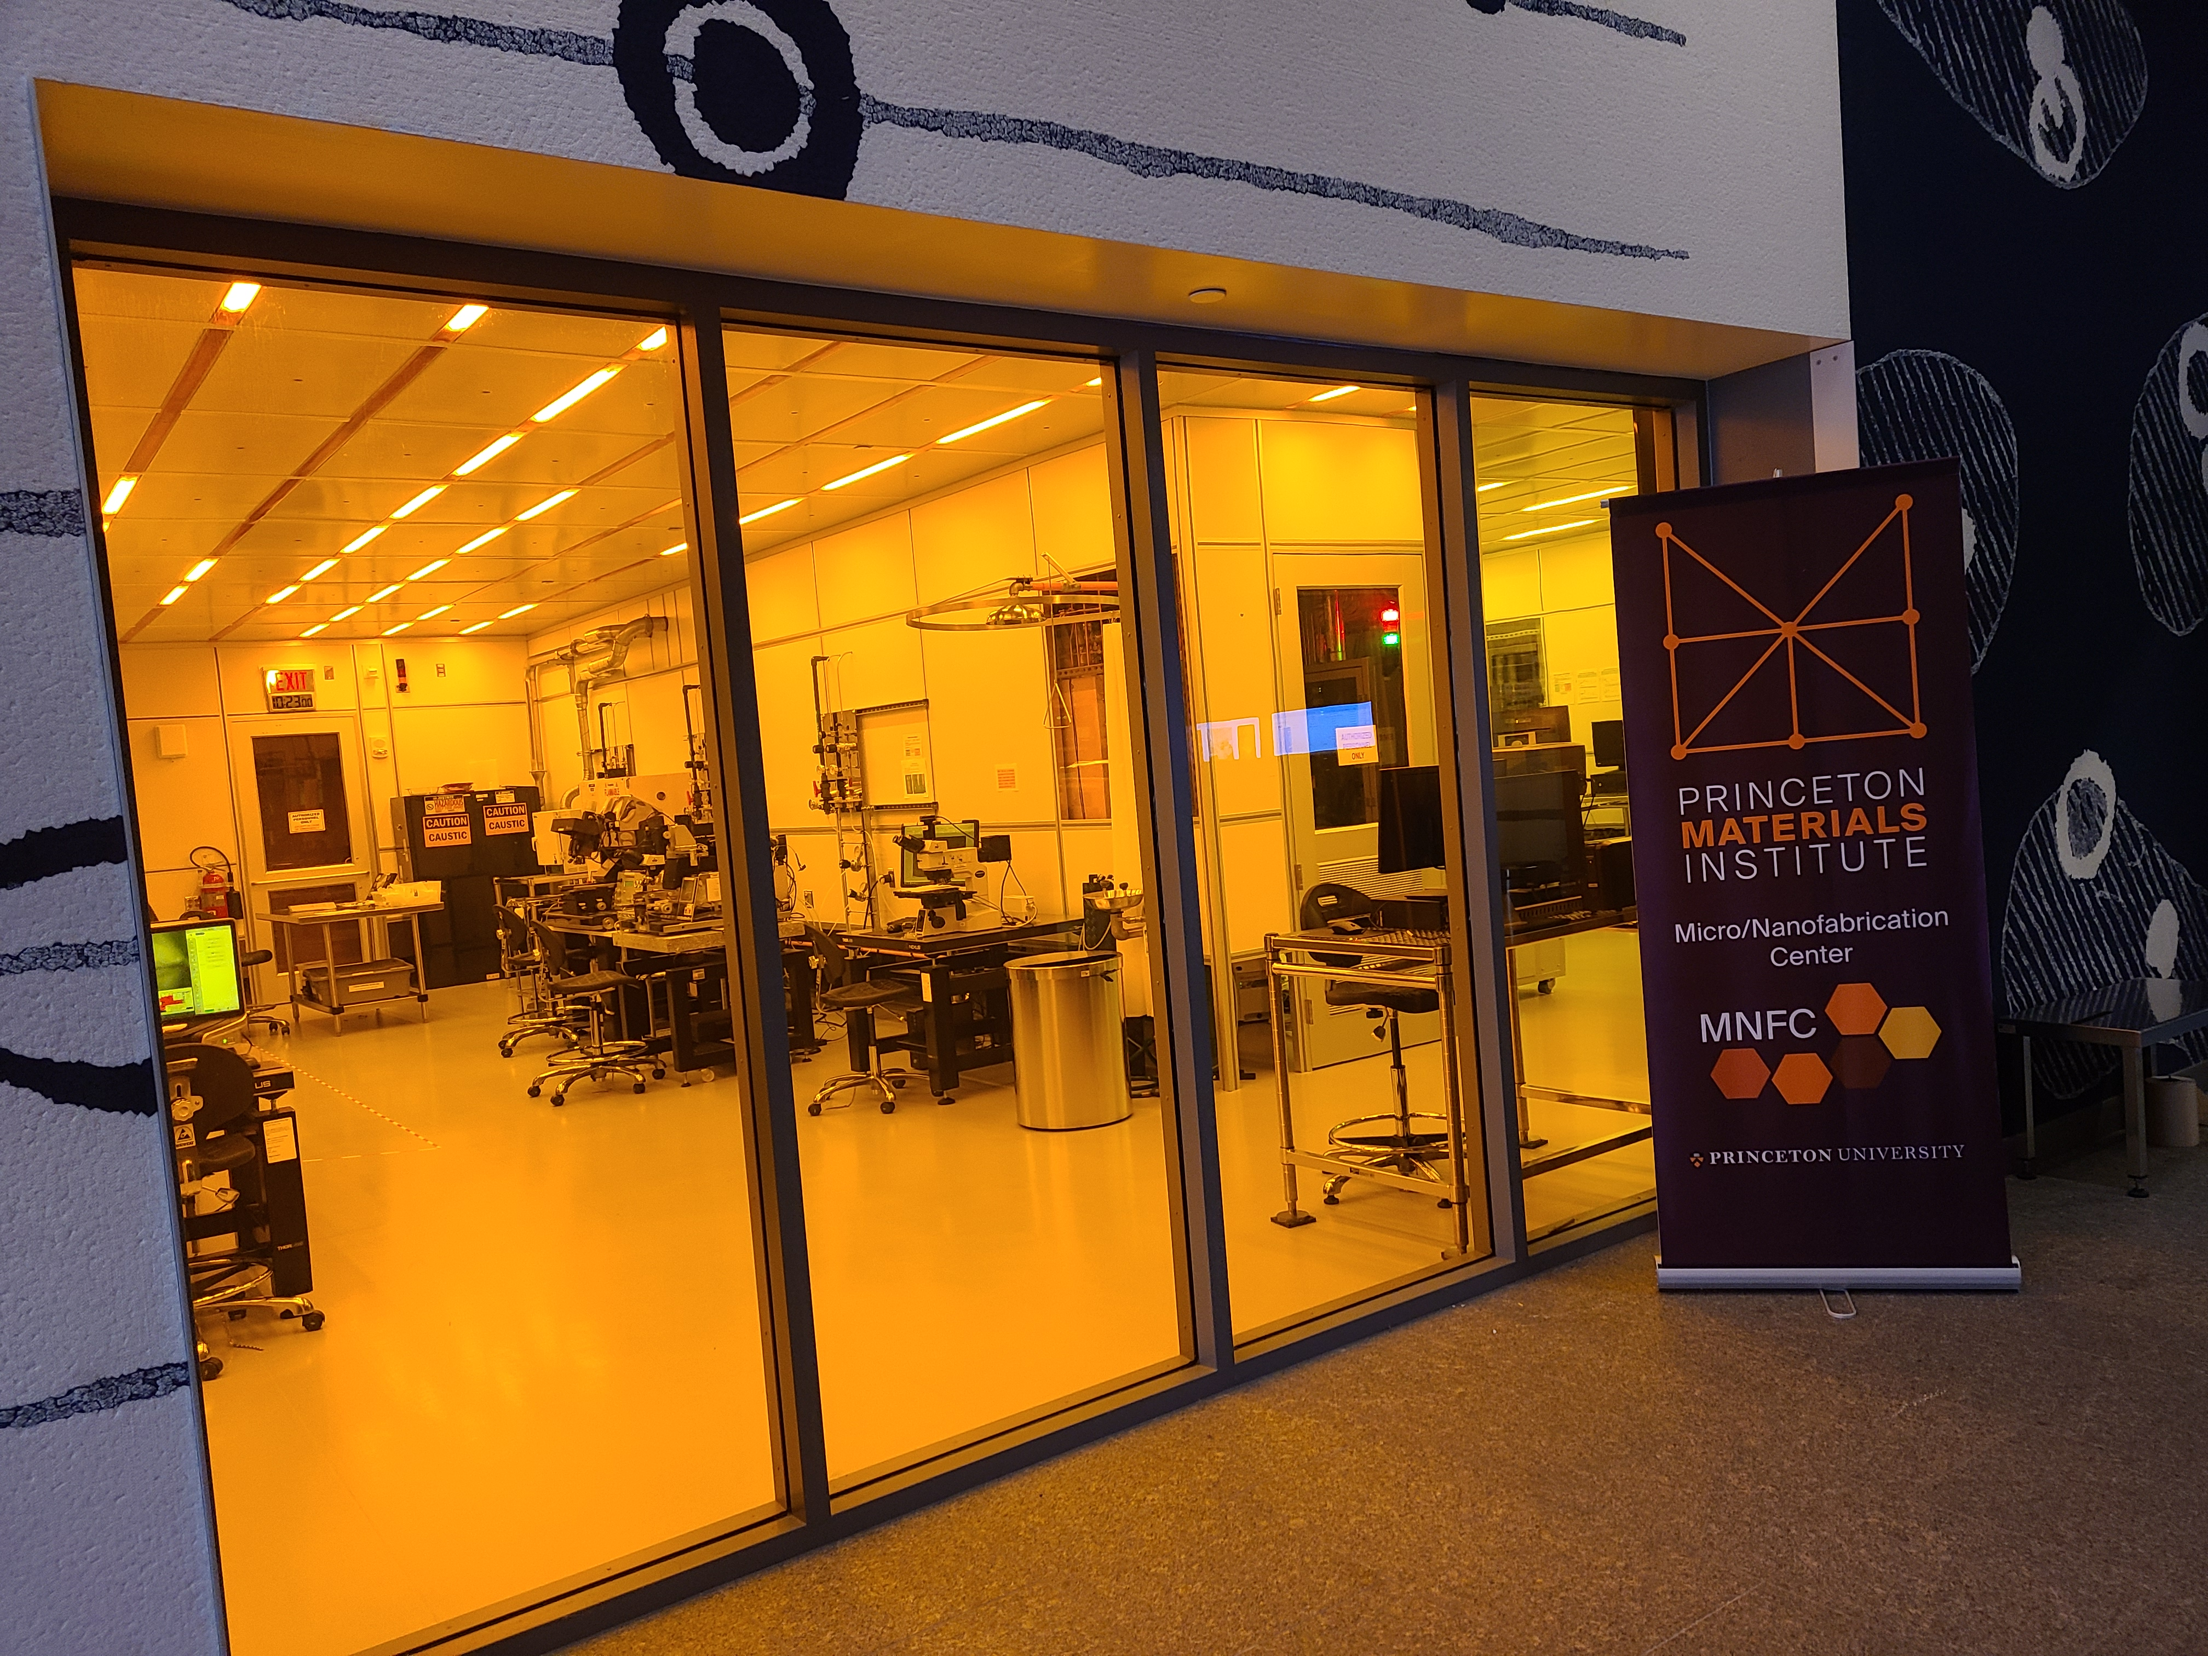
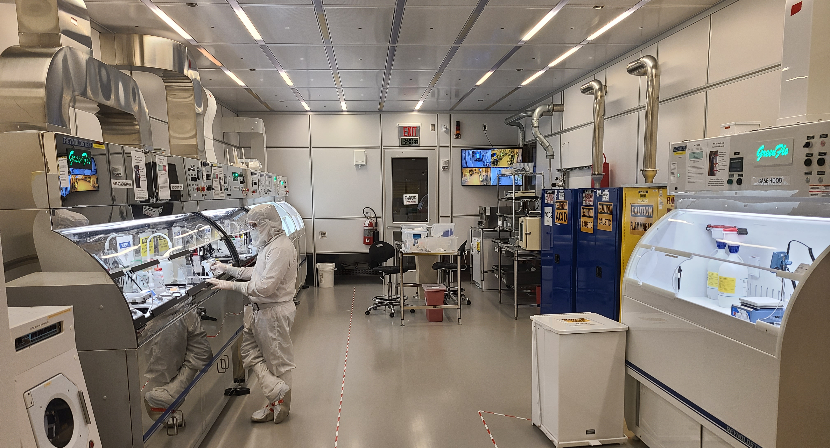
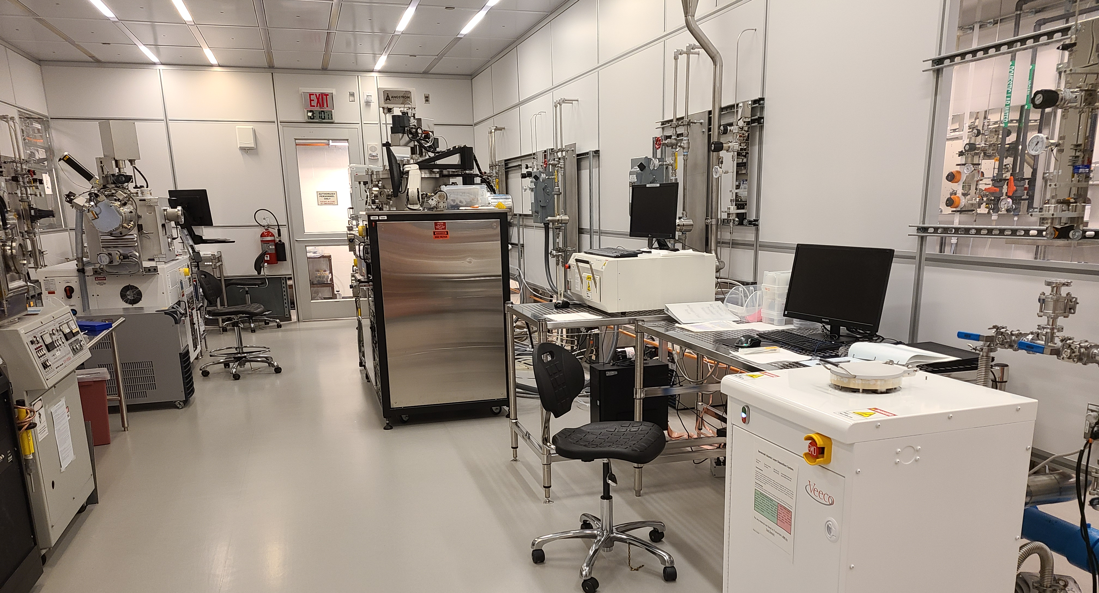
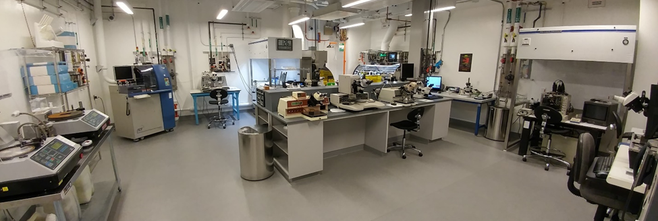
Micro/Nano Fabrication Center, Princeton University
35+ year history, moved into existing facility in 2016
~15k sq.ft. ISO 5-7 cleanroom (2 story!)
~ 65 tools / 8 staff / 150+ years of processing experience
  Photolithography (Contact / Direct Write) – 4 tools
  Electron Beam Lithography (High and Low Voltage) – 2 tools
  Film Deposition (sputtering, evaporation, ALD, ICP-CVD) – 9 tools
  Etching (RIE, DRIE, ICP-RIE, ALE) – 9 tools
  Metrology – 8 tools
  Packaging – 11 tools
>175 users / 90 projects / ~ 50% Princeton Internal Use
NJ Commission on Science, Innovation, and Technology (CSIT) grants for core facility use by small NJ-based companies.
Packaging Lab
  Full packaging toolset for dicing, lapping, polishing, wire bonding, flip-chip, and ball bonding your devices.
  Staff with 20+ years of expertise in packaging to help advise you with your process challenges or perform remote work.

Slide 2
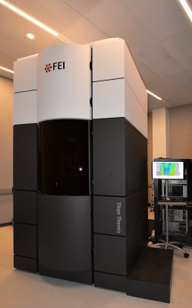
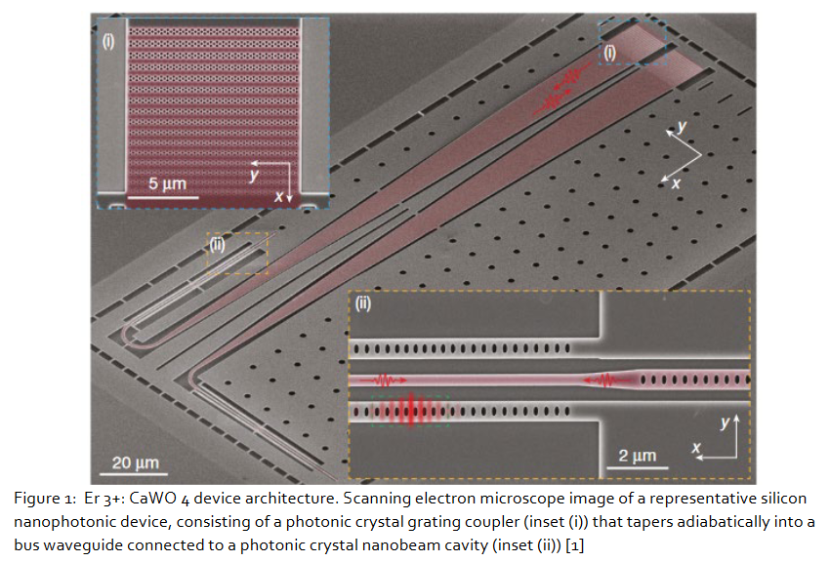
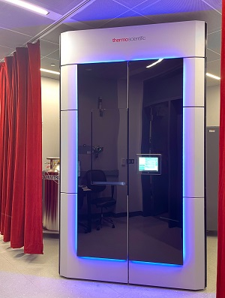
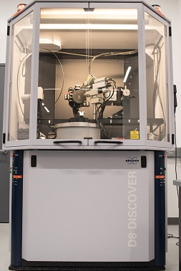
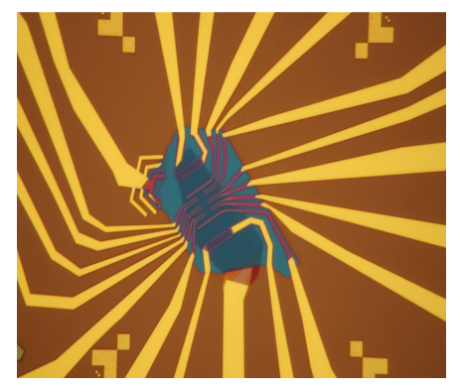
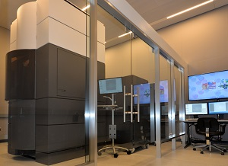
Processing Expertise
  III-V etching
  Quantum Diamond work
  2D Materials
  Complex Packaging work
Tools of interest
  PECVD
  AlN deposition / etching
  CMP
  Stepper
  Resist spinners
Talk to me about:
  Hazardous Gas Infrastructure
  IBC H-code requirements / MAQ Calcs
  NEMO
  FIRST LEGO League
Imaging & Analysis Center (IAC)
7.5k sq. ft. meeting the highest NIST standards for environmental control
Over 35 tools for state-of-the-art imaging and analysis including:
  Titan Cubed Themis 300 double Cs-corrected Scanning/Transmission Electron Microscope (S/TEM)
  5 S/TEMs including two cryo units
  Two dual-beam FIBs
  Two SEMs (High resolution & environmental)
  XRDs, X-ray Tomography, SPM
5 Staff
Many awards
Image Courtesy of the Thompson Group
Image Courtesy of the Ong Group

