Slide 1



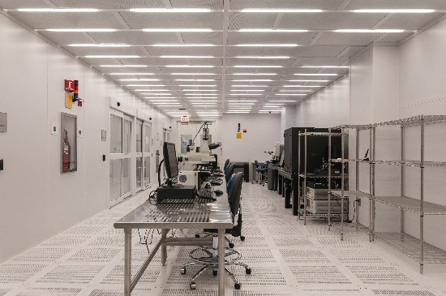
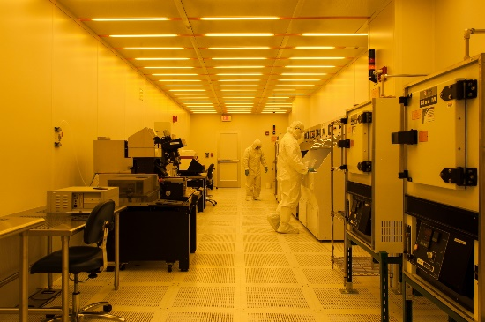
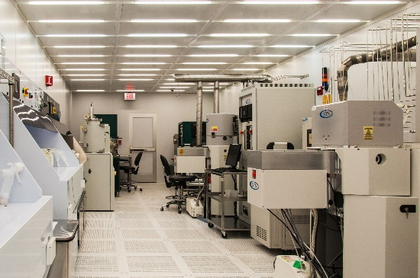
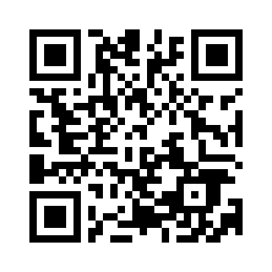
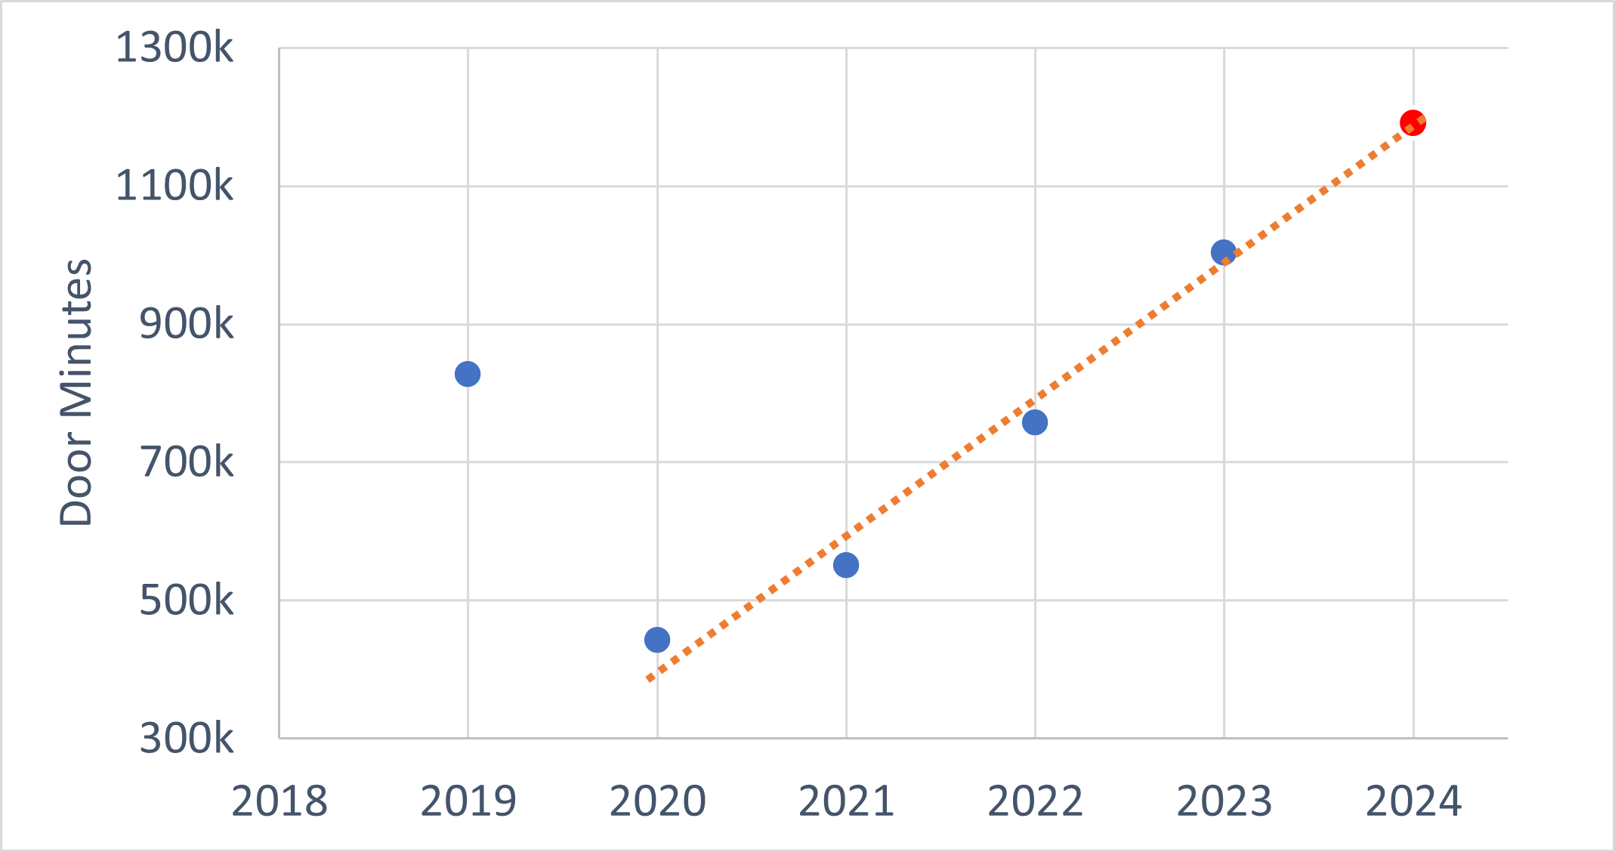
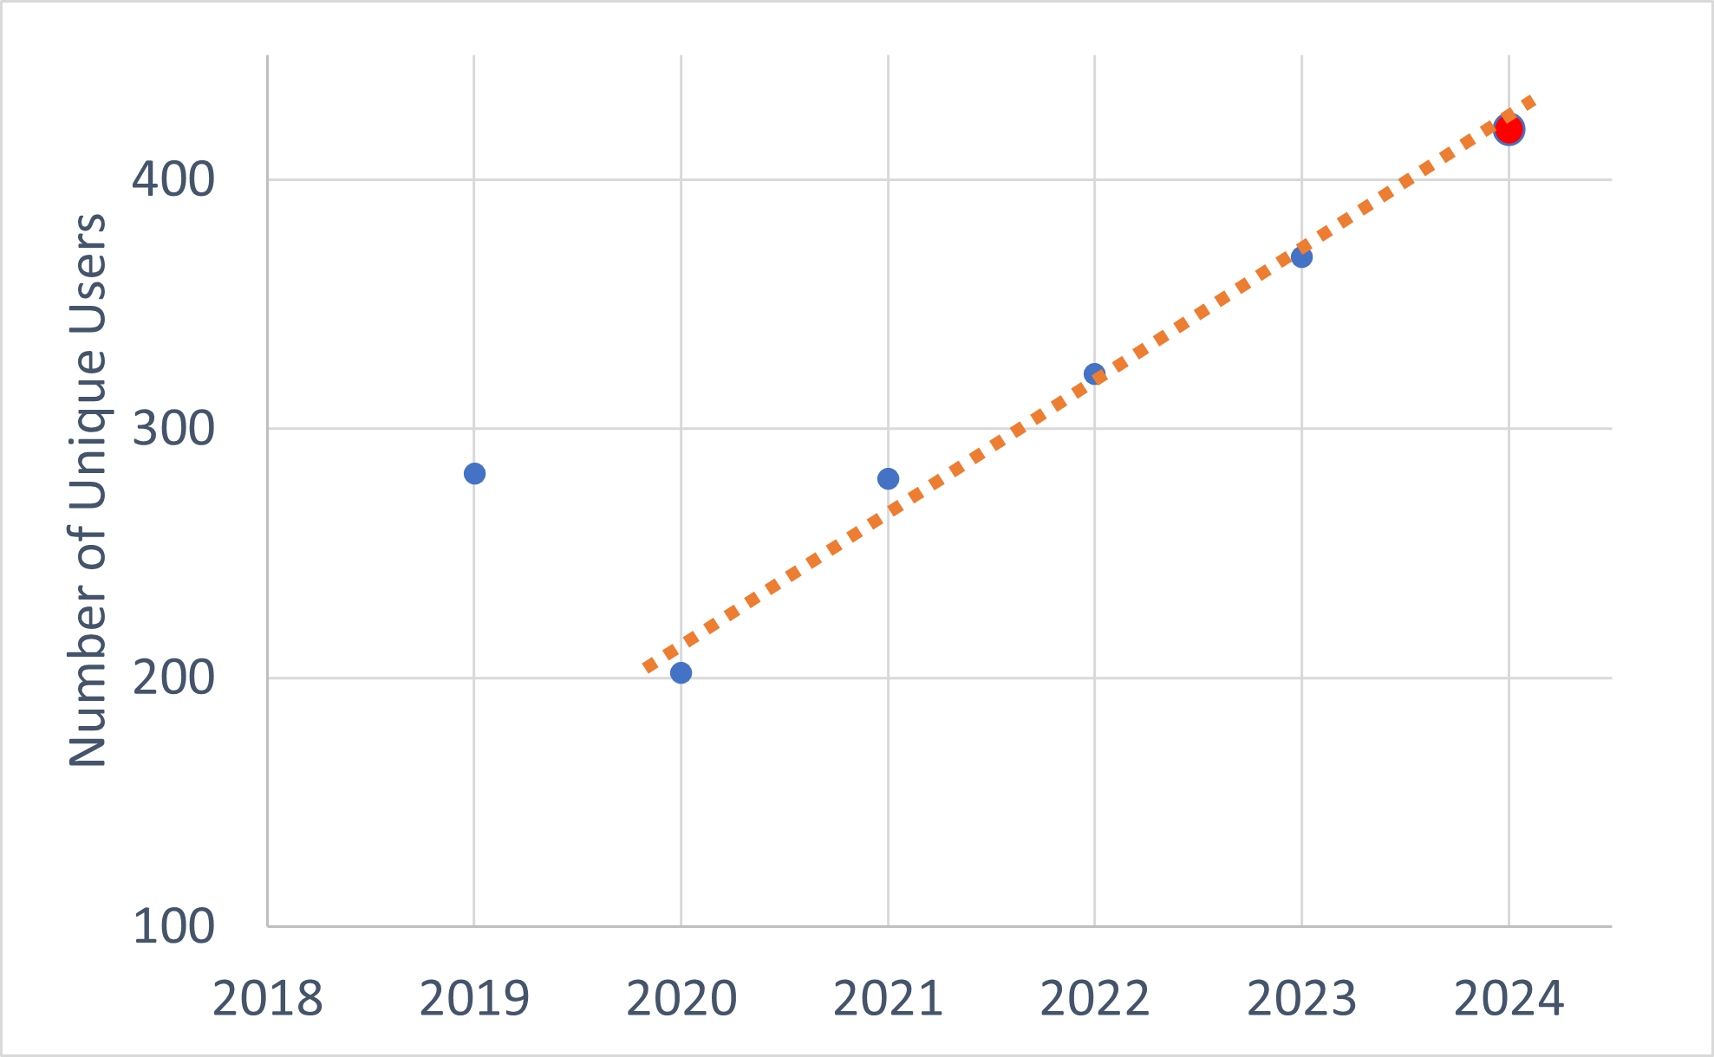






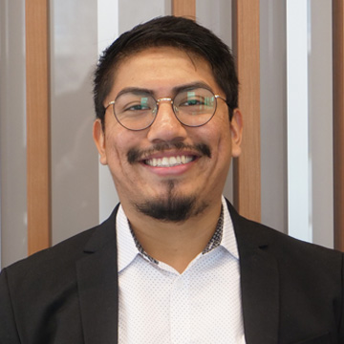

Northwestern University
Micro/Nano Fabrication Facility
________________________________________________________
^{Exploring Inner Space}
NUFAB Facility
C
﻿CHARACTERIZATION
PHOTOLITHOGRAPY
C
C
C
DEPOSITION & ETCH
NUFAB is a central micro/nano fabrication facility at Northwestern University. It provides the whole range of nanofabrication equipment and technical expertise to Northwestern as well as other academic and industrial researchers. We support research in all areas of science, engineering, medicine, and interdisciplinary fields
A video tour of our facility is available here.
If you would like physical tour or have any questions, send us an email at nufab@northwestern.edu
NUFAB’s Characterization Bay allows for fine measurement of physical, electrical and optical properties of materials and devices.
NUFAB’s Photolithography Bay is configured for both mask and maskless lithography processes, including single micron scale optical lithography.
NUFAB’s Deposition Bay is suitable for a wide variety of deposition techniques, including both PVD and CVD methods.
Fluorescence/DIC Microscope
Nikon LV150
Reflectometer
Filmetrics F20
Stylus Profilometer
Veeco Dektak-8
3D Optical Profilometer
Zygo
IV/CV Probe Station
Ellipsometer
J.A. Woollam alpha-SE
Ball Bonder and Wedge Bonder
Contact Angle Measurement
VCA Optima XE
Thin Film Stress Measurement
Toho FLX-2320S
Mask Aligners
Suss MABA6, Suss MJB4
Laser Writer
Heidelberg MLA150, uPG 501
Convection Ovens
Blue M DCC-146-C-ST350
Microscope
Nikon LV150
Spinner Hood
Automatic Develop Hood
Osiris UNIXX
Ultraviolet Flood Exposure System
Inpro Technologies F300S
Ultrasonic and Megasonic Cleaners
Vacuum Oven (YES)
Automatic Acid Etcher
Annealing Tube Furnace
Lindberg/Blue M
Plasma Enhanced Chemical Vapor Deposition
STS LpX CVD
AJA E-Beam Evaporator
Thermal Evaporator
Denton Vacuum Explorer 14
Parylene Coater
SCS Labcoter2 Parylene Deposition System
Sputters
AJA Orion Sputter I & II
Deep Reactive Ion Etcher (DRIE)
STS LpX Pegasus
Reactive Ion Etcher (RIE)
Samco RIE-10NR
Xenon Difluoride Etcher
Xactix
Rapid Thermal Processor (RTP)
AW-610
P/N Doping Furnaces
Tystar Low Pressure CVD
Critical Point Dryer
Tousimis Automegasamdri – 915B, Series C
C
CLEANROOM USAGE
C
NUMBER OF USERS
Extrapolated (red dot) for 2024, it will reach 1200K minutes (20,000 hours)
The number of unique users has been increasing by ~50 every year since COVID
Dr. Vinayak P. Dravid
Professor, Materials Science & Engineering
NUANCE Center Director
Dr. Nasir Basit
Managing Director
Dr. Ying Jia
Equipment Manager
Dr. Serkan Butun
Equipment Manager
Dr. Shaoning Lu
Equipment Manager
C
NUANCE Center – NUFAB
Technological Institute, Suite FG70-99
NUFAB.Northwestern.edu
Dr. Anil Dhote
Equipment Manager
Diego Santiago De La Vega
Equipment Engineer
www.nuance.northwestern.edu
15 years of excellence

Slide 2
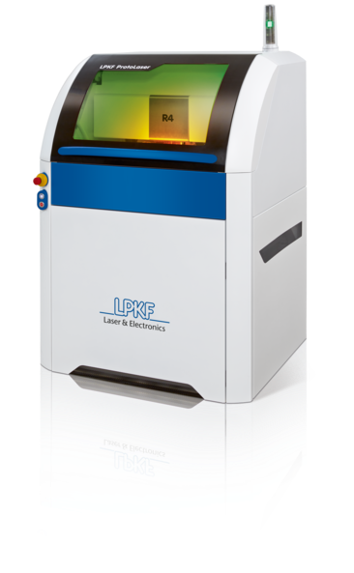
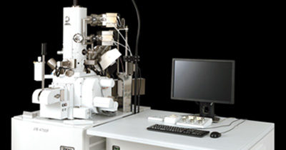
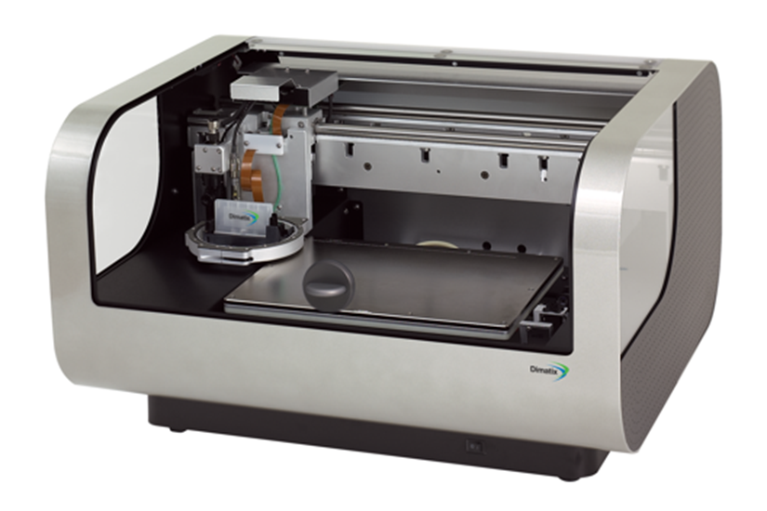
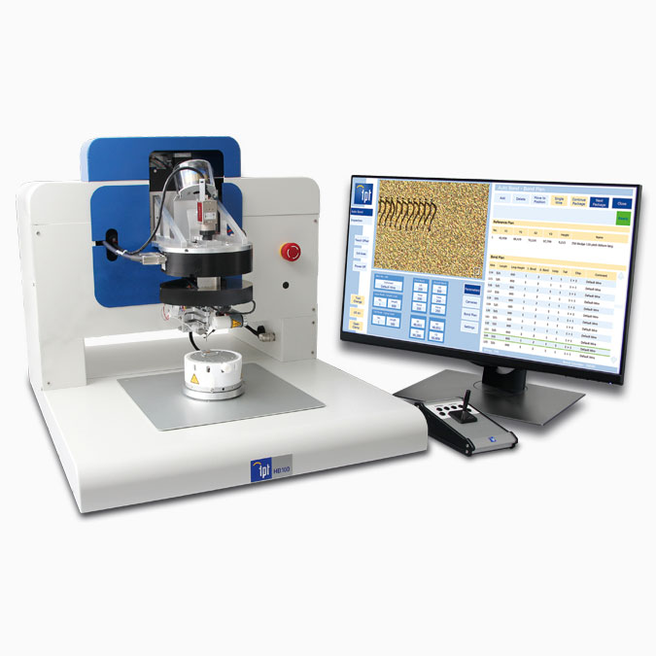
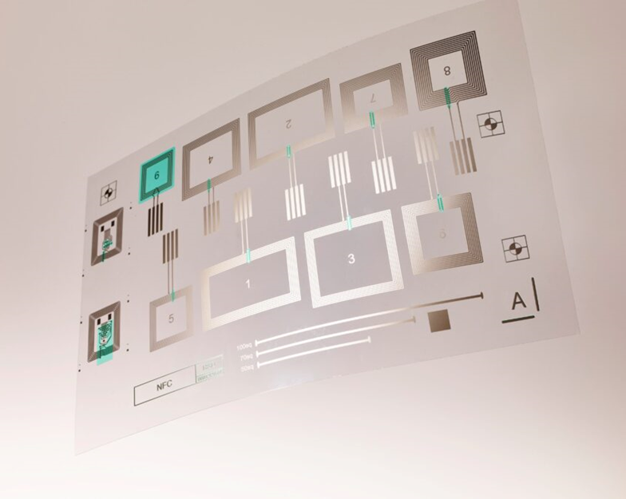
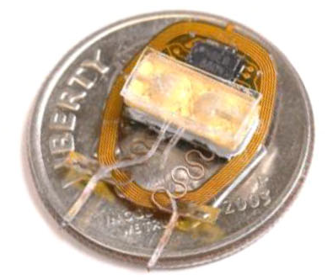
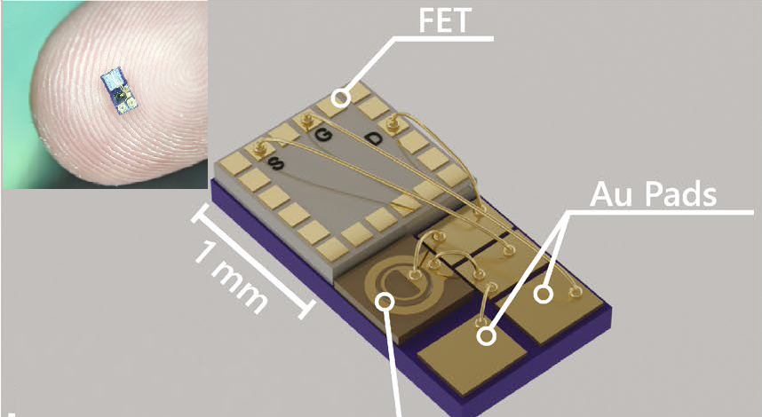
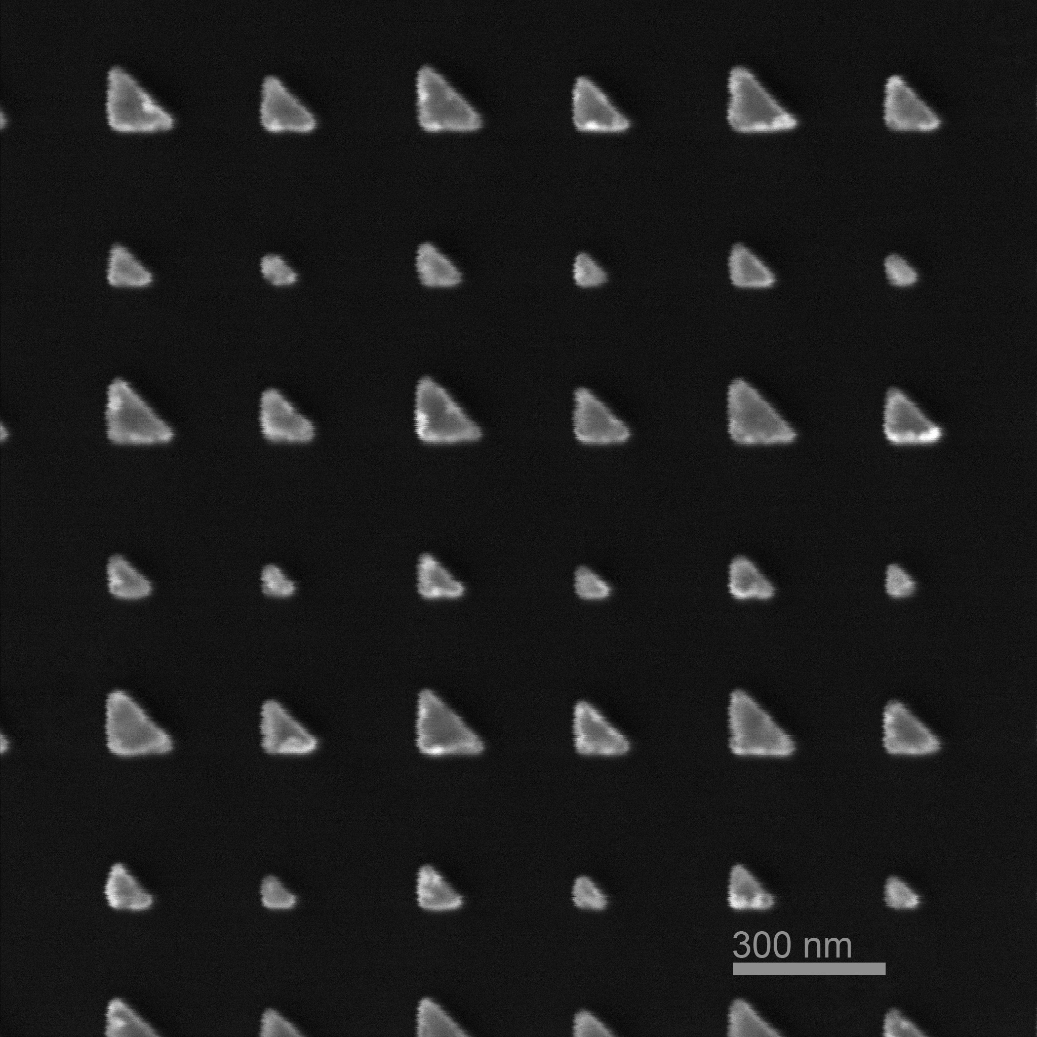
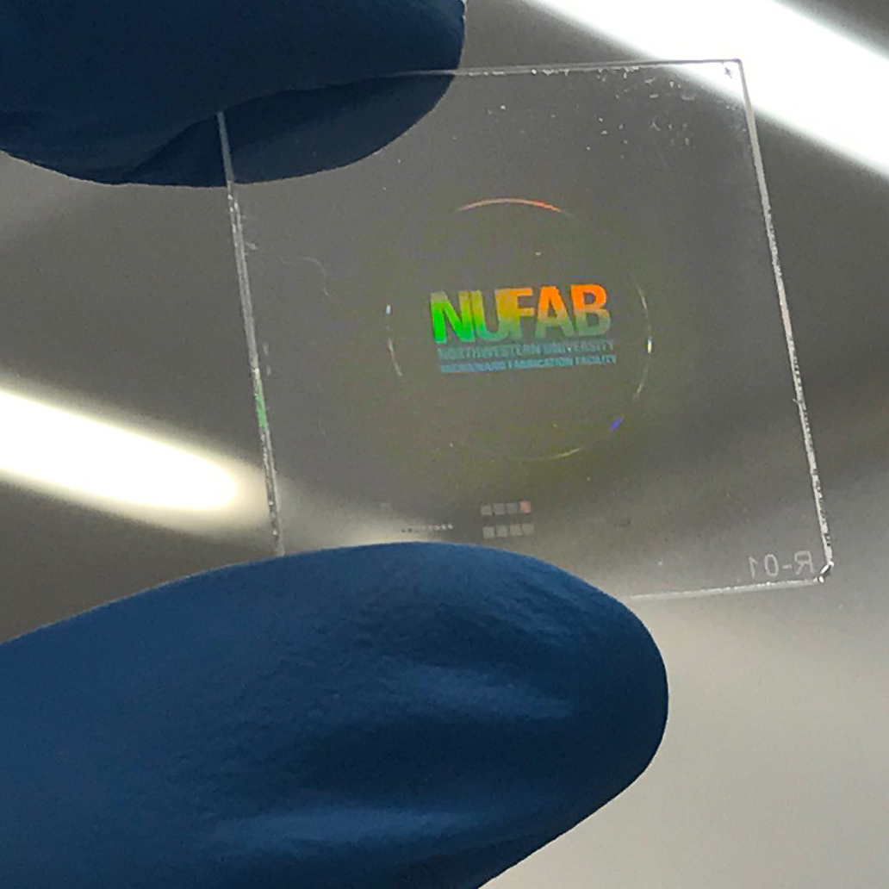
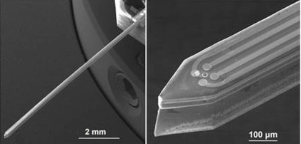
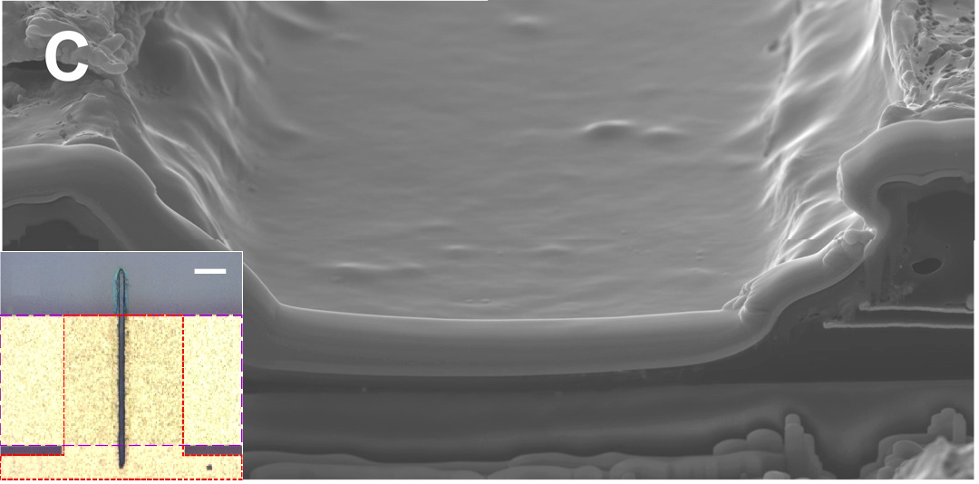
Northwestern University
Micro/Nano Fabrication Facility
________________________________________________________
^{Exploring Inner Space}
LPKF ProtoLaser R4
C
C
﻿JEOL 4700F FIB-SEM
DIMATIX MATERIALS PRINTER
C
C
TPT HB100 Automatic Wirebonder
FEATURES
• Laser wavelength: 515 nm
• Max. laser power: 8 W
• Laser pulse frequency: 50 – 500 kHz
• Diameter of focused laser beam: 15 ± 2 μm (0.59 ± 0.08 mil)
• Structuring speed: 5.5 cm2/min (0.9 in2/min) on laminated substrates 18 μm Cu
• Laser pulse length: 1.5 ps
FEATURES
C
High resolution SEM 1.6 nm at 1 kV
High resolution FIB 4 nm at 30 kV
Up to 90nA large ion probe current
Vector scan system
3 deposition cartridges (C, W and Pt)
Oxford Symmetry EBSD Detector
Oxford Ultimax EDS detector
In-situ lift-out system (Omniprobe 400)
RESEARCH at NUFAB
C
ELECRON BEAM LITHOGRAPHY
Below: A 3 pJ/bit free space
optical interlink platform
for self‑powered sensing
and opto‑spintronic RF‑to‑optical transduction
- Mohseni Group, Northwestern
Raith Voyager 100
<10 nm structures
cm scale exposure
High speed pattern generator
50 kV
With motorized Z-Y-X Axes and Bond Head Rotation
Direct ink-jet material deposition on various substrates
Position accuracy: 25 µm
Simplifies fabrication process as no lithography required
Above: Optofluidic micro-
Systems for optogenetics
and photopharmacology
-- Rogers Group, Northwestern
Automatic Thermosonic Wedge & Ball Bonder
SKU : HB100
- Capable of Ball, Wedge, Bump & Ribbon Bonding
- Capable of Bonding Gold, Silver, Aluminum, & Copper Wire
- Motorized X- Y- Z-Axis & Rotatable Bondhead
- Speed: 1 wire per 3 sec.
- 90mm X- & Y-Axis Travel / 0.1μ Resolution
- 100mm Z-Axis Travel / 0.5μ Resolution
- Simple conversion from Wedge to Ball Bonding (Tool and Program)
Above: Brain-Implantable Multifunctional Probe for Simultaneous Detection of Glutamate and GABA Neurotransmitters
– N. Moldovan, Alcorix Co
Above: Ambipolar inverters based on cofacial vertical organic electrochemical transistor pairs for biosignal amplification – Rivney Group, Northwestern.
nano-medicine, photonics, telecommunication, semiconductors, material science and more...
A real Office of Research survey comment
Definitely one of the best fab facilities in the world
www.nuance.northwestern.edu
15 years of excellence

