Slide 1

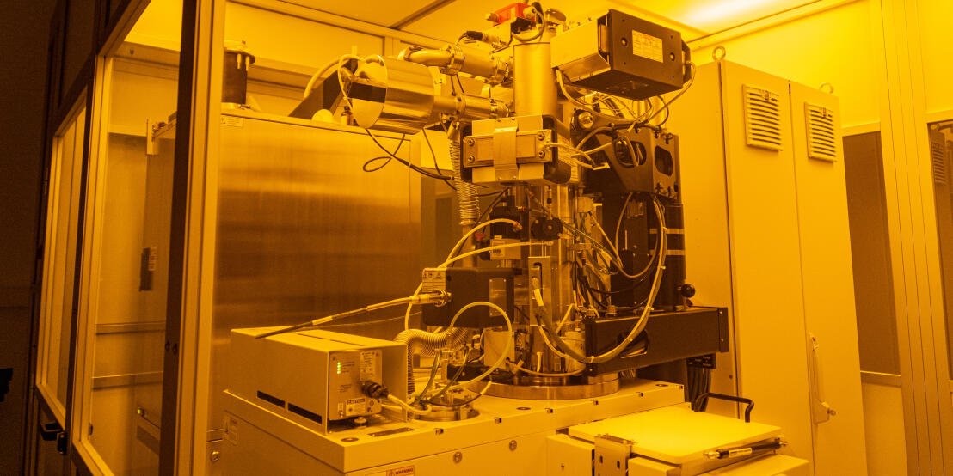
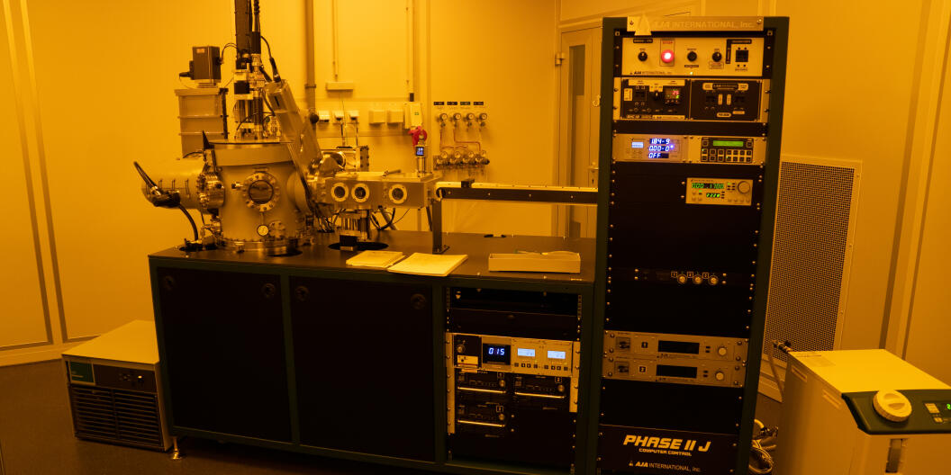
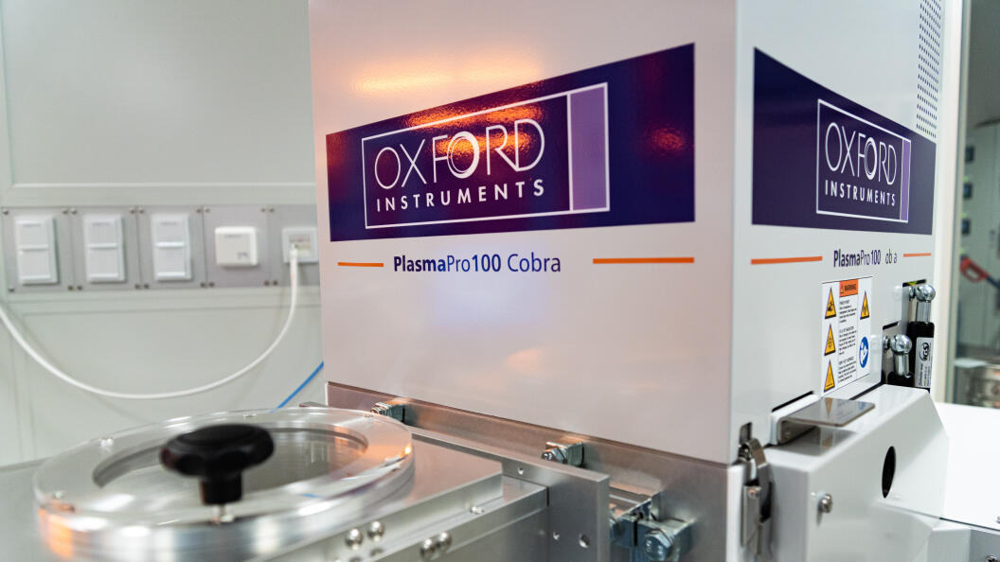
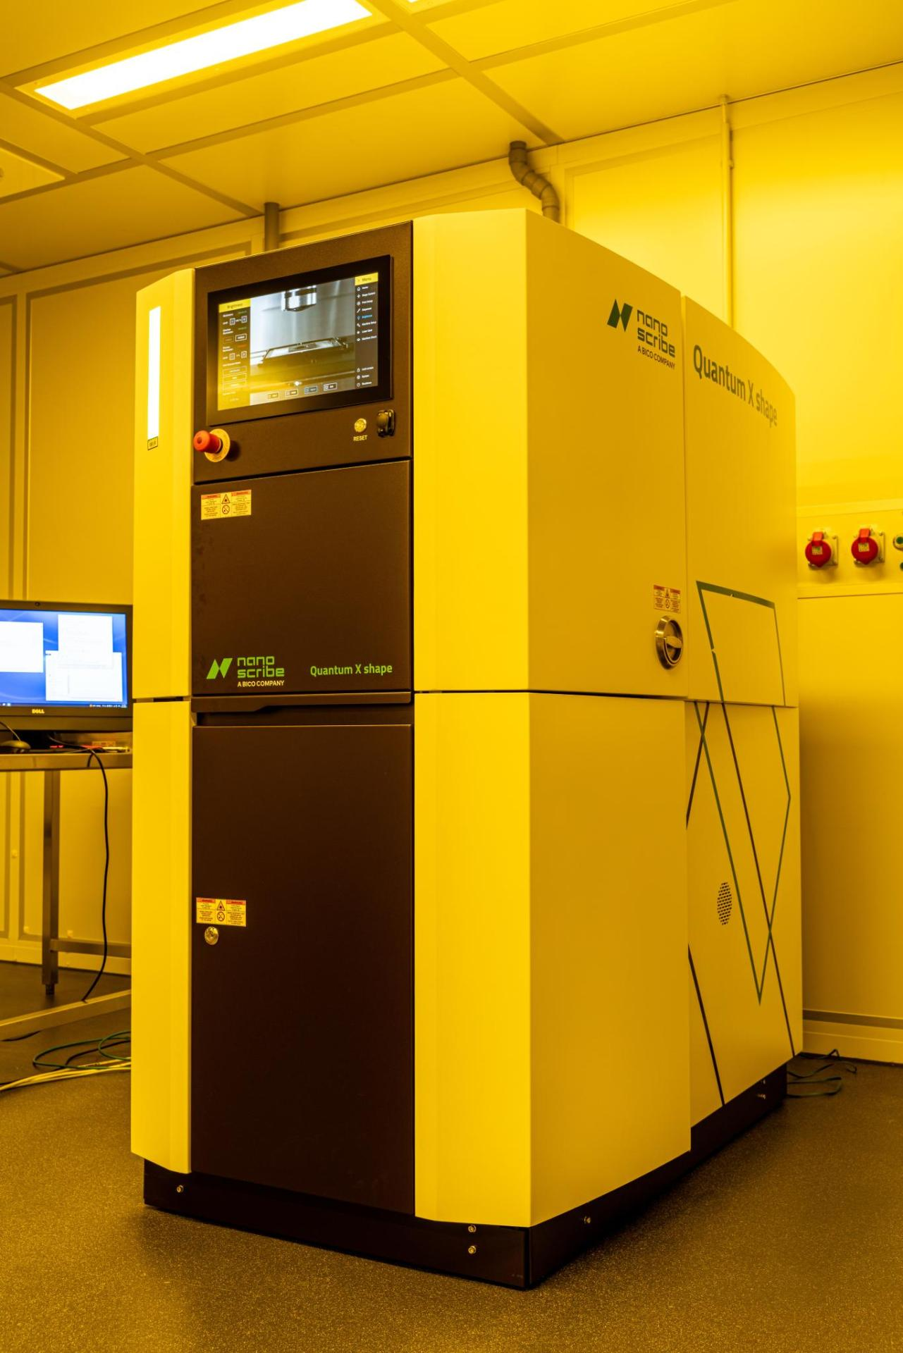
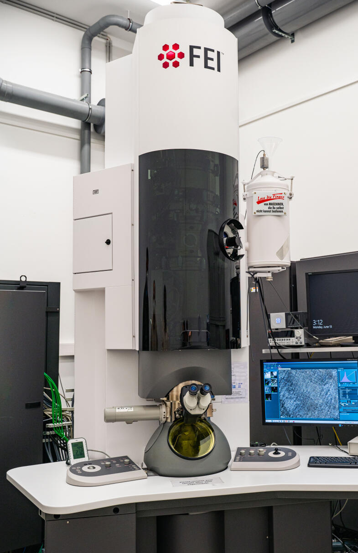
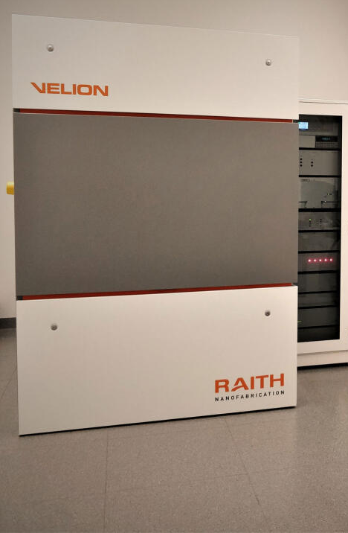
Münster Nanofabrication Facility (MNF)
Raith EBPG 5150 – Our workhorse
AJA Sputter tool for thin superconducting films
Facilities Metrics
Started in 2017 as lab of Prof. Pernice
Over 300 m² (3200 sft) Cleanroom area ISO 5-7 distributed over 2 Buildings
3 technical staff
2 Support Staff
>20 Instrument Managers (Ph.D. Students using the facility for their research)
7 major tools
88 unique internal users/year
  From Physics, Chemistry, Biology, Geology, Medicine
7 unique external users/year
  1 Successful Start-Up from the research at our facility
Tool usage 40800 hours / year (25% external)
Oxford PlasmaPro 100 – RIE/ICP
Avian
Outdoor Seating
Thermo Fischer Titan
300kV TEM
Raith Velion - Si/Au FIB
Yoga Studio
Main Entrance
Nanoscribe Quantum-X Align
- for everything 3D

Slide 2

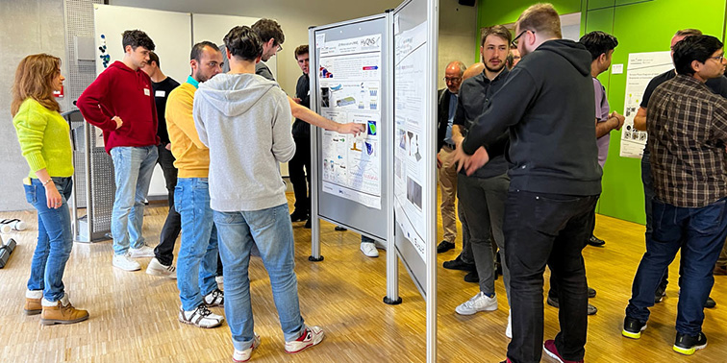
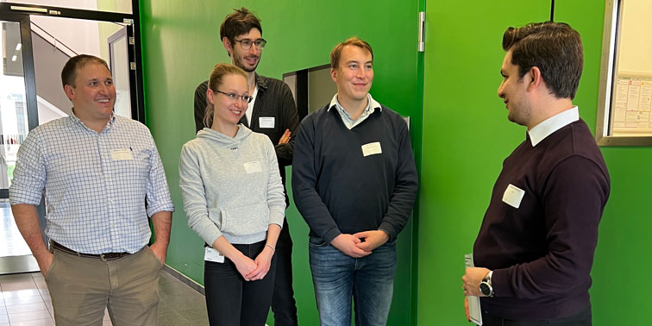
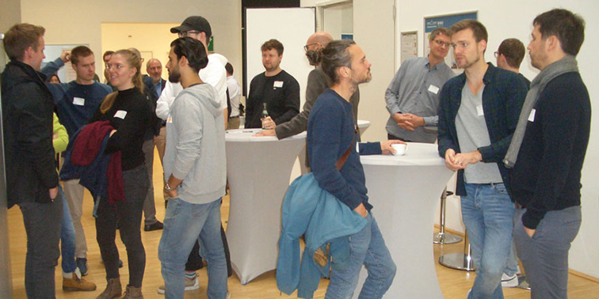
Key Capabilities & Features
Fabrication of Nanostructures on Si, SiN, LiNbO, TaO, Diamond, NbN, NbTiN and many more
  Using EBL and RIE
Nanoanalytics using TEM, SNOM, SEM, AFM
  Access to neighboring Cryo-EM Facility to analyze biological samples (atomic resolution in big molecules/proteins)
User driven facility – Each users learns all the techniques they need
Yearly MNF Day to foster discussion and connections between users
Recent Tool Additions
Nanoscribe Quantum X Align
Tempress LPCVD (soonTM)
UHV Depositioncluster (coming 2025)
(Magnetron-sputter, E-Beam PVD,
Ion Beam)
Oxford PlasmaPro 80 etcher for III-V Material (soonTM)
Top 5 Wishlist
High-end SEM (currently debating if Schottky or cold emitter)
Ar-milling tool for structuring and polishing samples
Laser-lithography tool
EDX (as a module for the SEM above)
XPS

