Slide 1
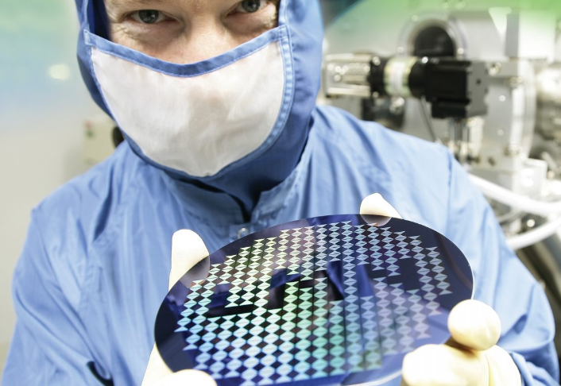
Institut National de la Recherche Scientifique
(National Institute of Scientific Research)
Énergie Matériaux Télécommunications Research Center
Laboratory of Micro and Nanofabrication
Amine Zitouni

Slide 2
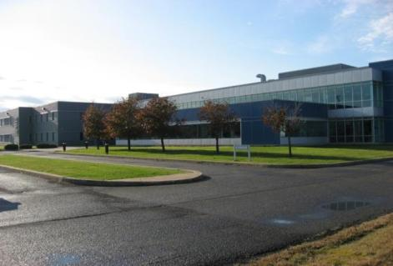

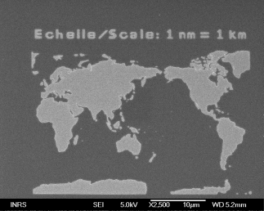
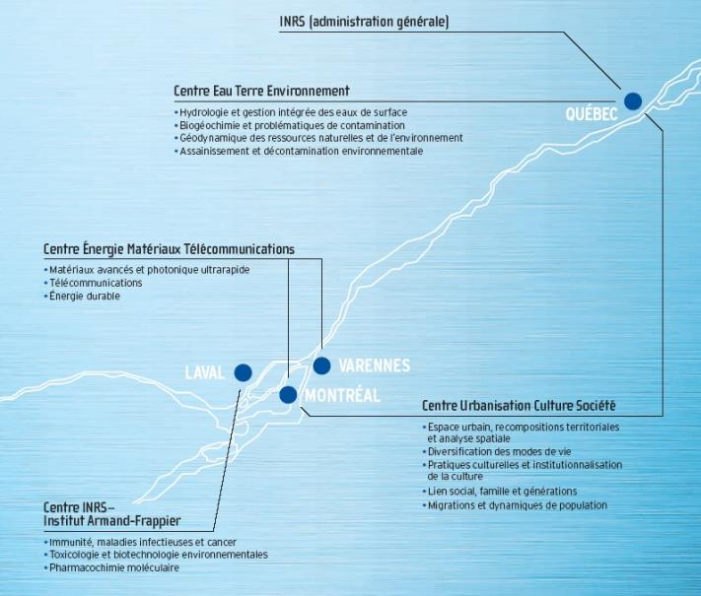

INRS - Énergie Matériaux Télécommunications Research Center
Énergie Matériaux Télécom. – center in Varennes
Énergie Matériaux Télécom. – center in Montréal
Research themes:
Nanomaterials and Advanced Manufacturing Processes
Sustainable Energy Sources and Applications
Ultrafast Science and Photonics
Telecommunications
Biotechnologies
Applied Artificial Intelligence and Computational Science Manufacturing Proc
47 Professors-Researchers
15 Research Associates
9 Research Officers
5 Research Technicians
52 Postdoctoral fellows
253 students (54 Masters. & 199 Ph.D.)
Proc
University of Quebec
INRS | Institut national de la recherche scientifique | Homepage

Slide 3

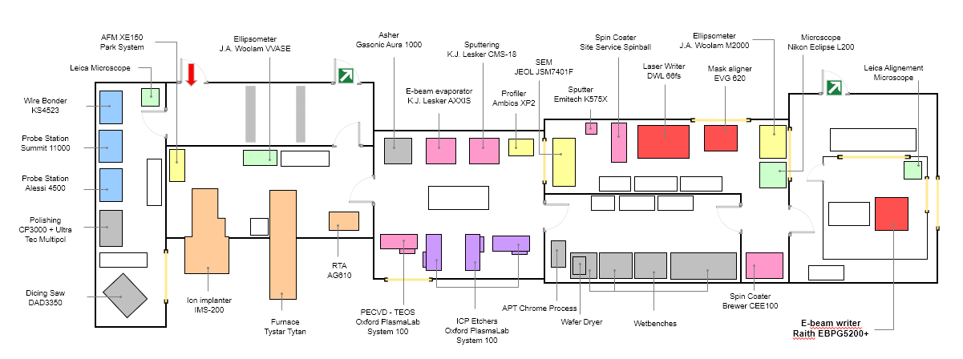
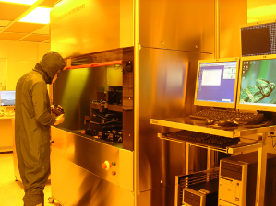
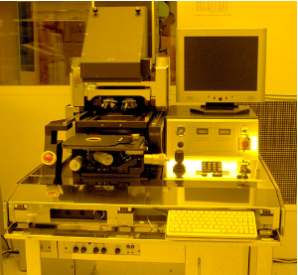
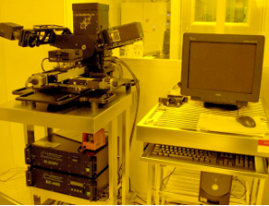
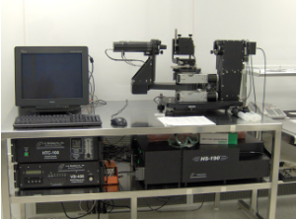
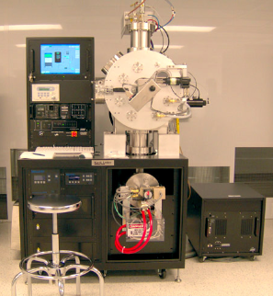
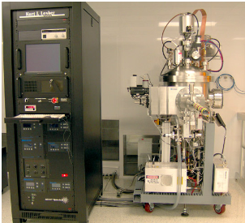
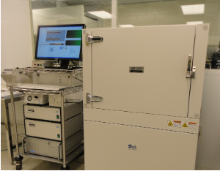
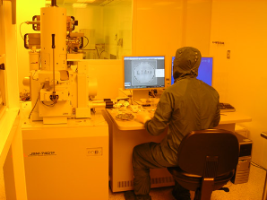
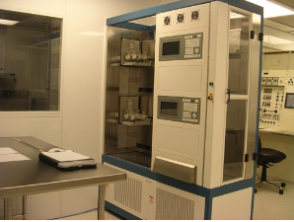
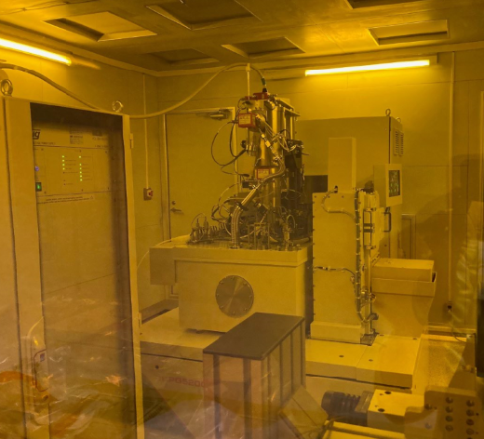
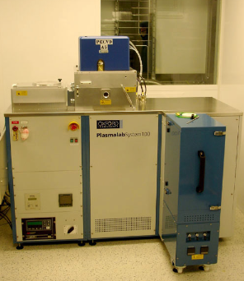
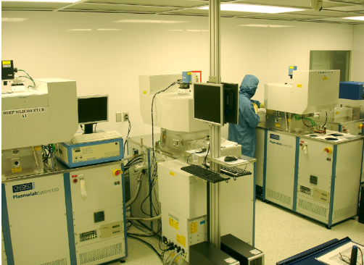
Laboratory of Micro and Nanofabrication
Built in 2004
250m² (2600ft²) cleanroom space (class 10 to 1000) - All tools are 6in compatible (some accept 8in wafer)
750m² (8000ft²) lab space for XRD, XPS, AFM, STM, ….
Total investment: + 50M$
Staff: 2 research professionals + 2 technicians
~ 265 academic and industrial users
Facility metrics
Recent additions:
Raith EBPG5200+ ebeam lithography system
PHI Quantes XPS-HAXPES system

