Slide 1
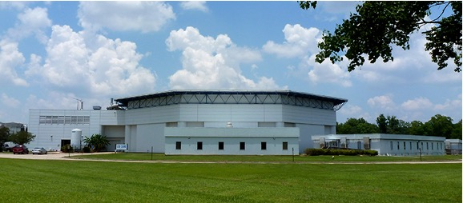
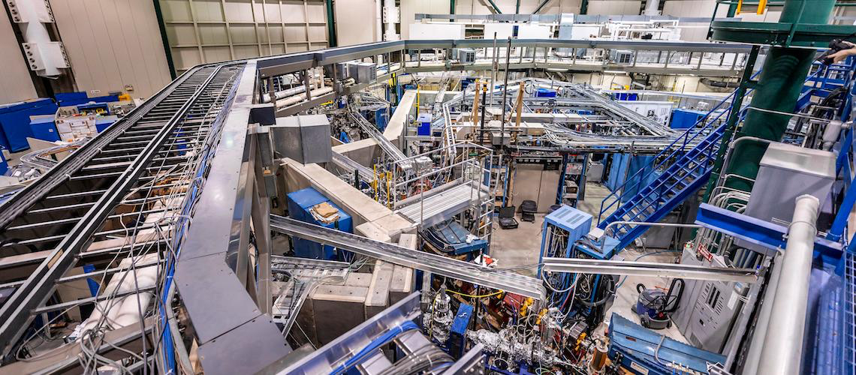
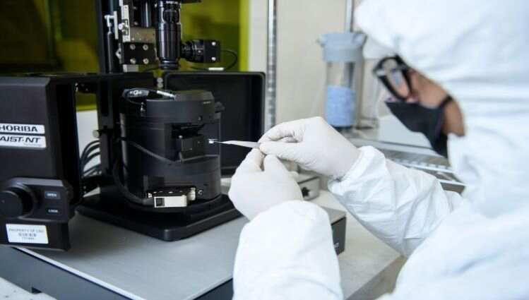
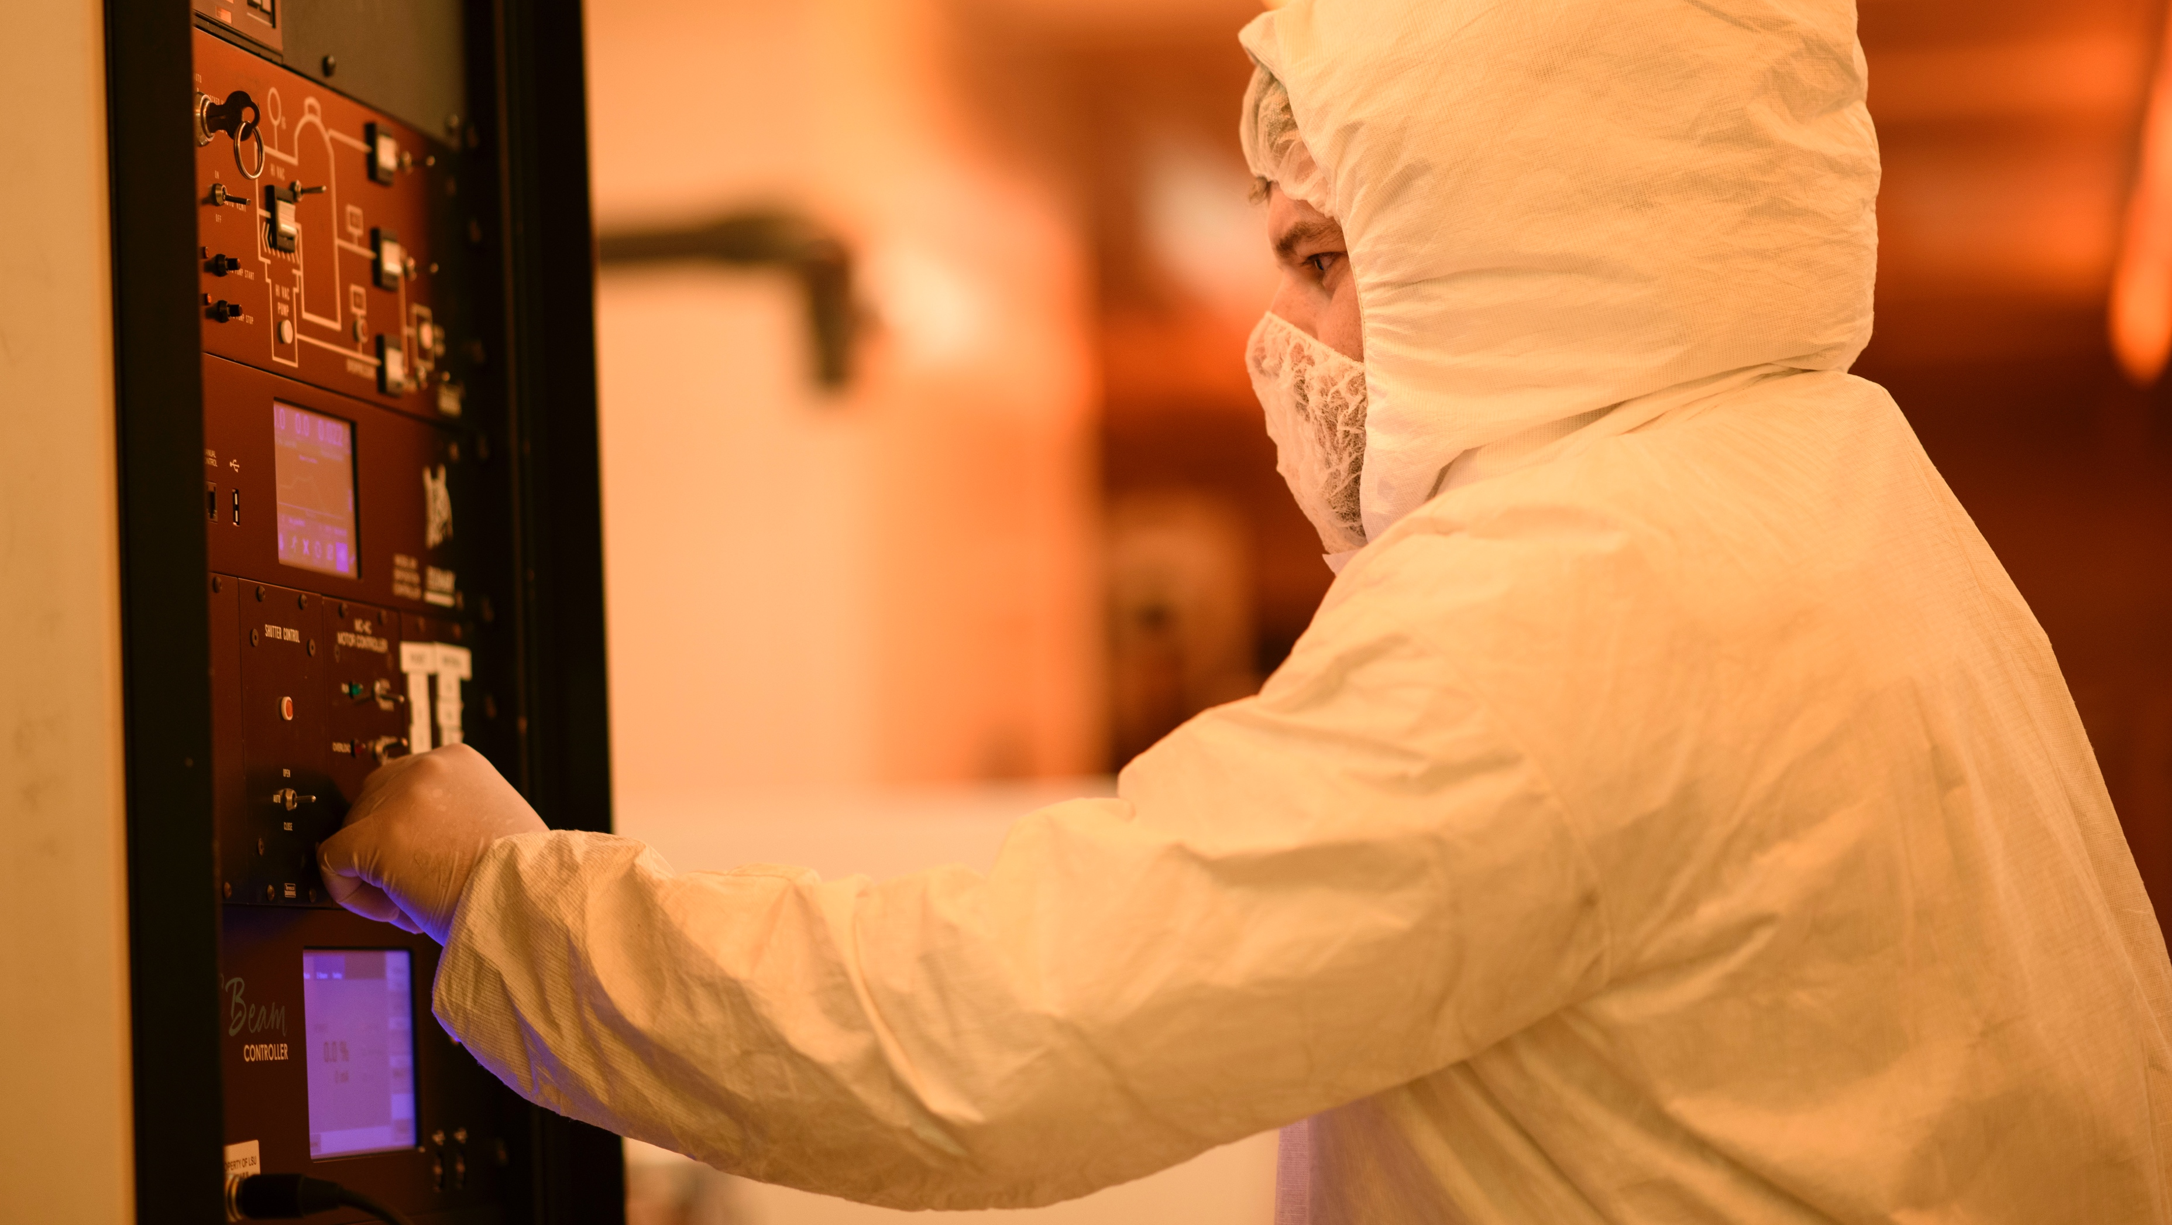
LSU Nanofabrication Facility
Facilities Metrics
Built in 1990s for LIGA process
Attached to synchrotron
2,500 sqft ISO 5
2 staff
10 major tools: fab and characterization
40 unique internal users/year
3 unique external users/year
5 new users/year (2 external)
Internal users are mostly grad students
External users from grad students
to gas industry
Funding through university and grants

Slide 2
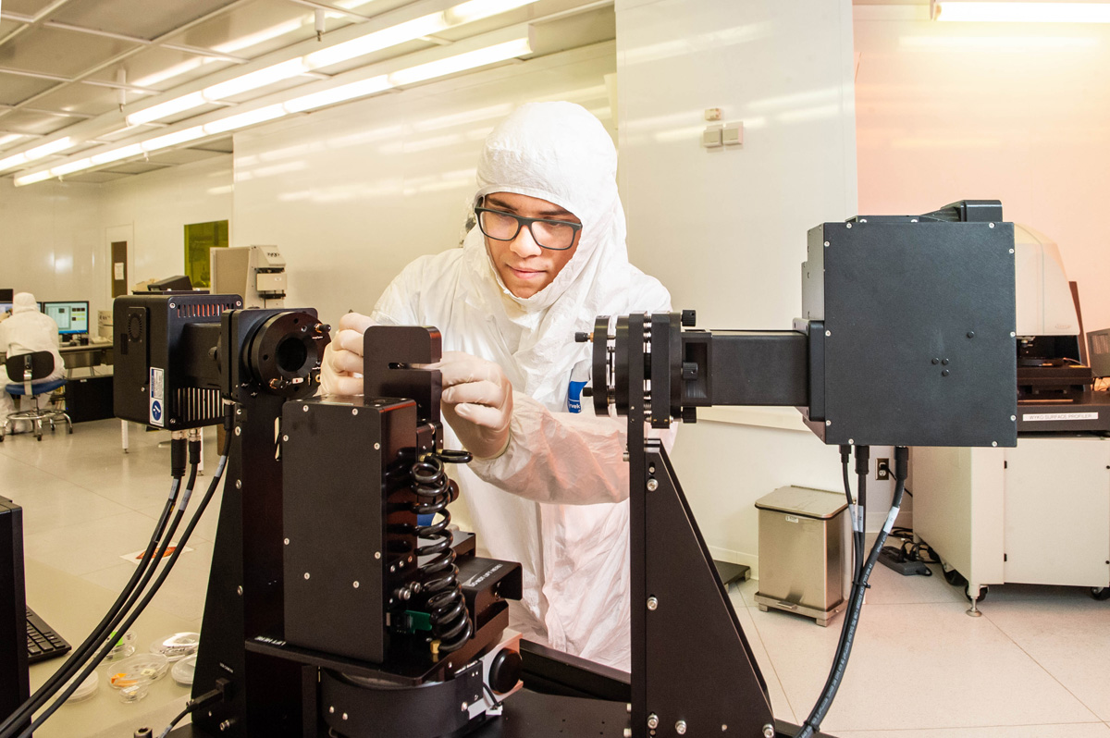
Key Capabilities & Features
Direct laser writer
Dual-Chamber Sputtering
neaSNOM
UV and IR ellipsometers
Recent Tool Additions
IR-VASE ellipsometer
neaSNOM
Bosch-process DRIE
X-ray Diffractometer
Strengths
Optical characterization
Weaknesses:
No lithography < 400 nm
Most-used Equipment
AFM
SEM
Laser writer
RC2 ellipsometer
Sputtering
Wish list
PECVD (coming)
Mask aligner (fix)
ALD (coming)
Chlorine ICP
Dicing Saw
Talk to me about…
The Eurocup
Climbing

