Slide 1
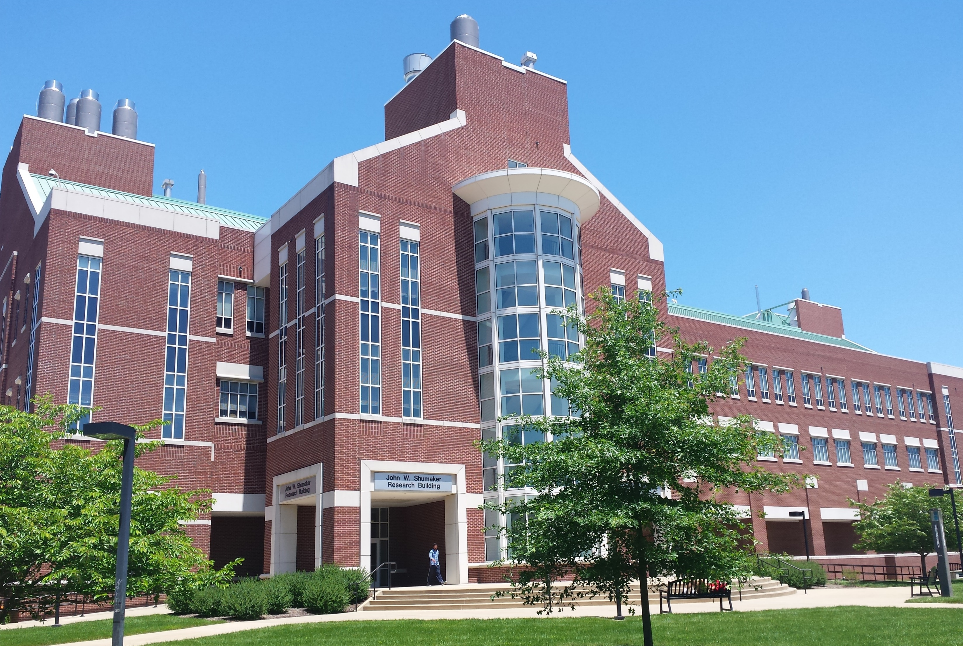
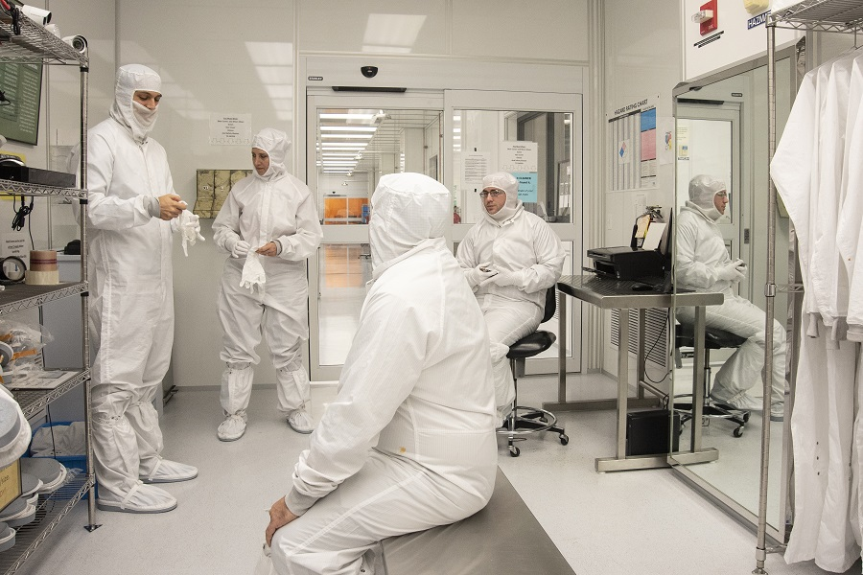
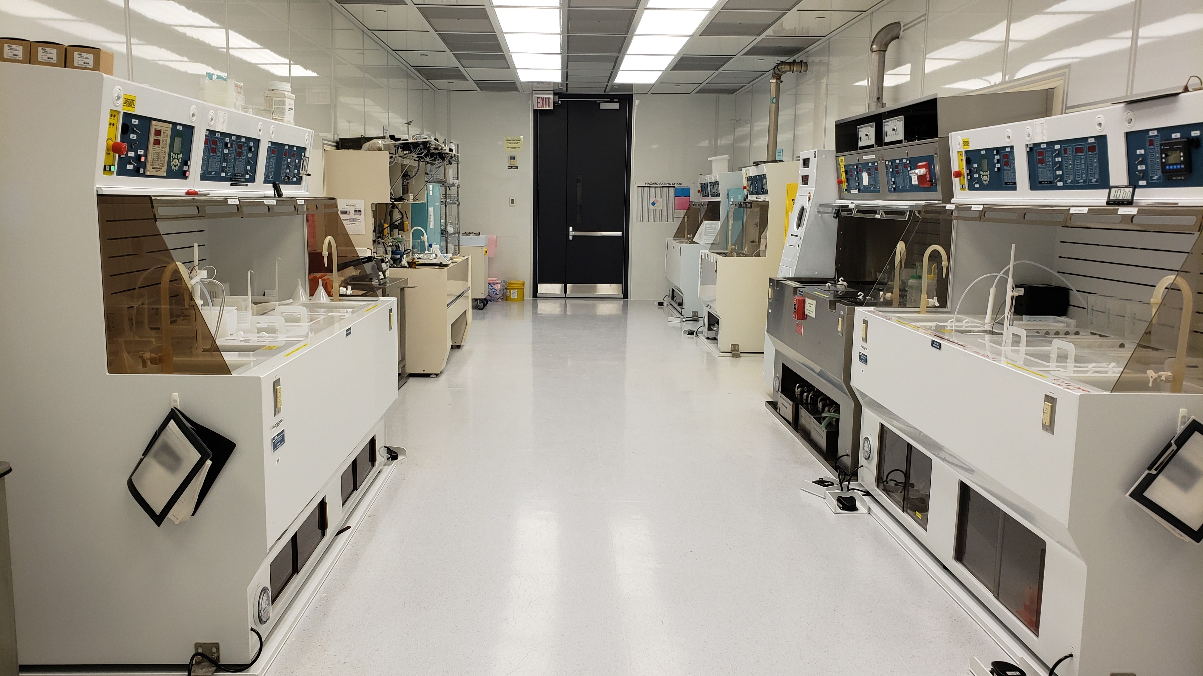
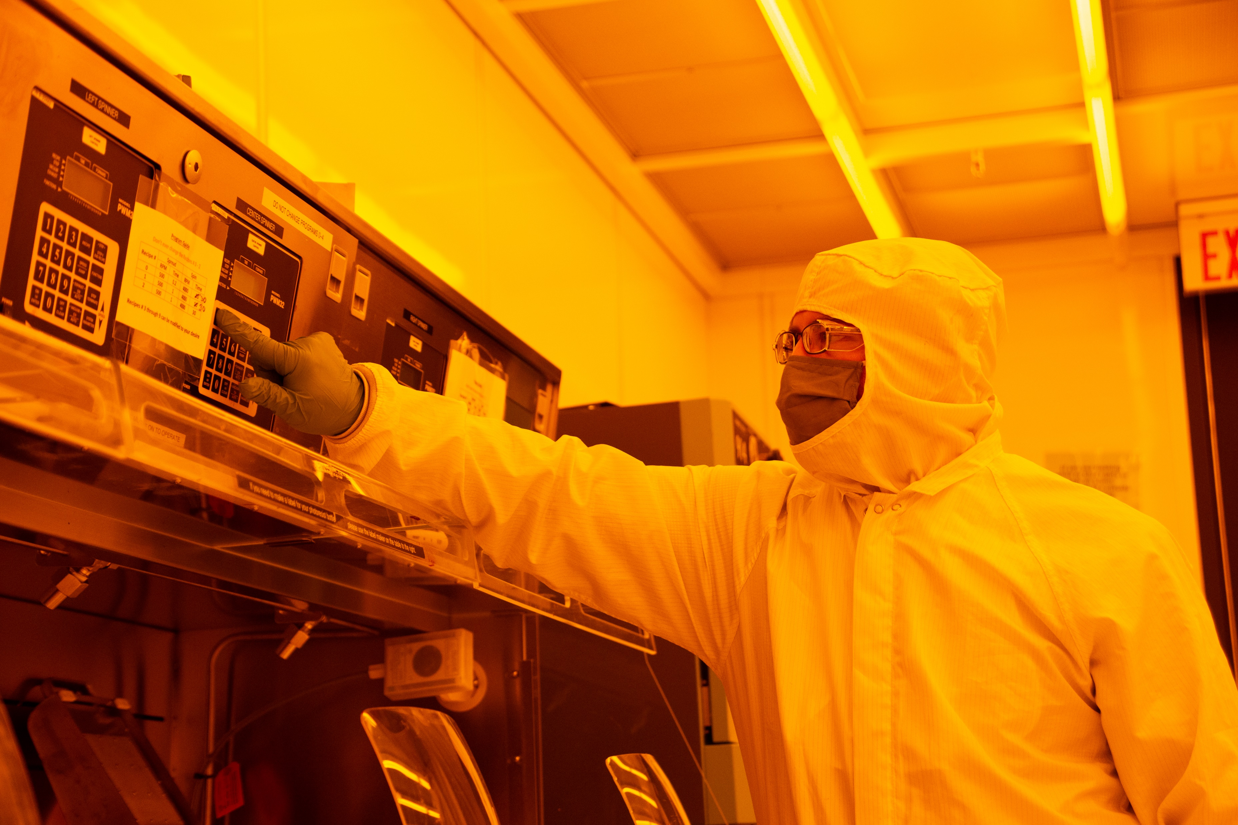
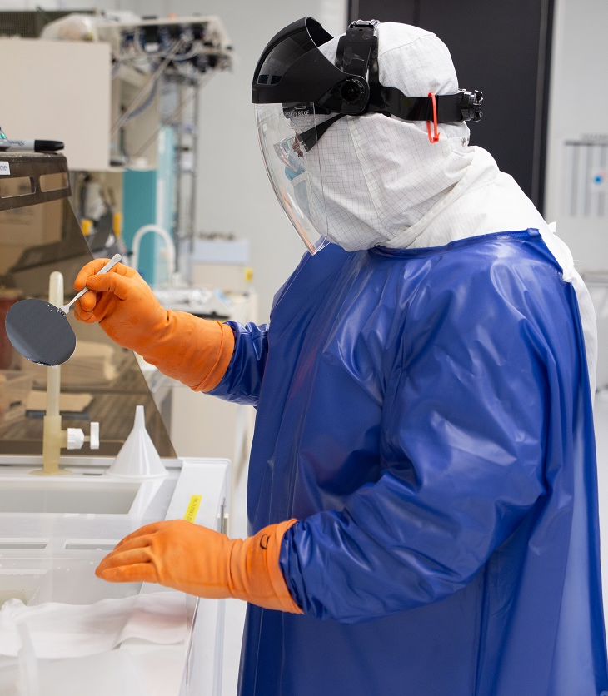
Facilities Metrics
Built in 2006 cost of $30M
Added SEM in 2016
Added bioEM in 2022
10,000 gross ft² (Bay/Chase) ISO 5/6
5 technical staff
2 Administrative Staff
52 major tools
85 unique internal users/year
20 unique external users/year
Tool usage: 5,268 hours / year
Internal User Base Profile:
  64% Engineering
  24% Medicine
  8% Chemistry/Physics
$800k operating budget
76% internal, 24% external, 70% subsidy

Slide 2
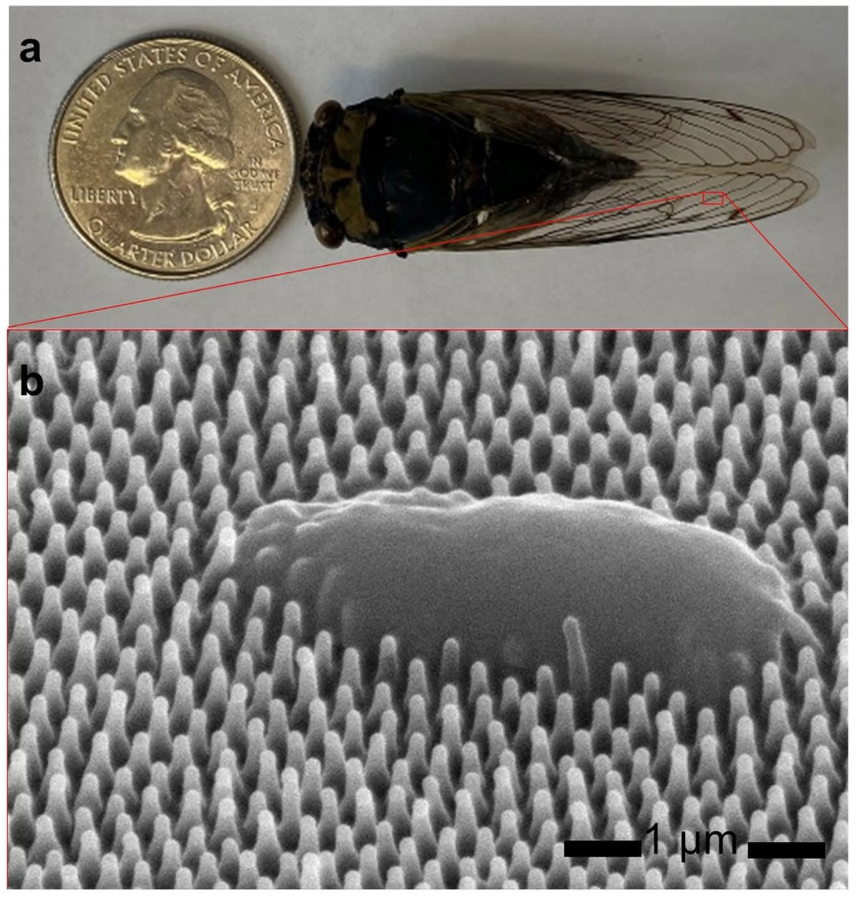
Key Capabilities & Features
Contact Lithography
Deposition (Sputtering, e-beam, PEALD)
Etching (Wet & Dry)
Hi Temp Thermal
Packaging
Electron Microscopy (SEM & TEM)
Recent Tool Additions (past 12 or 24 months)
Oxford Estrelas 8” DRIE
Goniometer
Cryo EM Sample & Grid Clipping Station
Strengths
8” DRIE
Lots of capabilities
Weaknesses:
Lithography for features below 800 nm
Too big (Cleanroom + Imaging. & Characterization + bioEM)
Bio-inspired antimicrobial surfaces fabricated by glancing angle deposition
Top-6 Equipment/Capability Wishlist
8” Direct Write System
6” Wet/Dry Oxidation Tube Furnace
New Profilometer
6” ICP/RIE metal etch system
FIB/SEM
New AFM
https://www.nature.com/articles/s41598-022-27225-4
Exploring Novel Anti-gravity Paperclips
Talk to me about…
8” DRIE
bioEM

