Slide 1
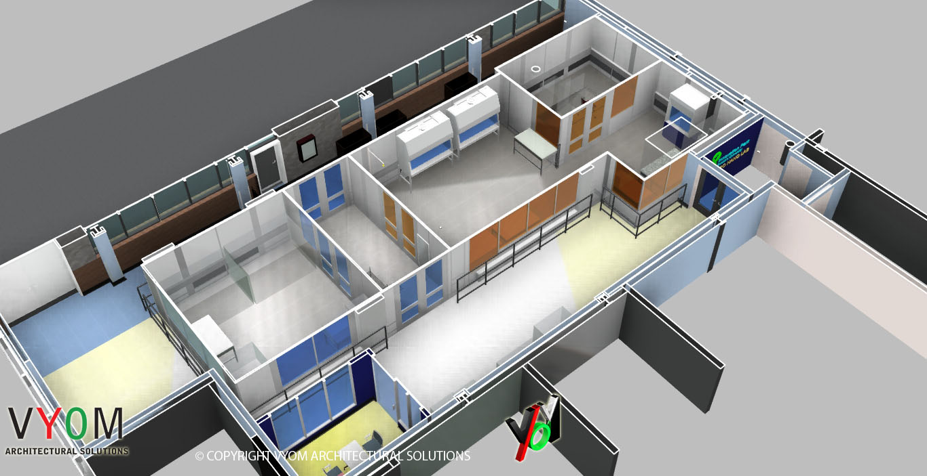
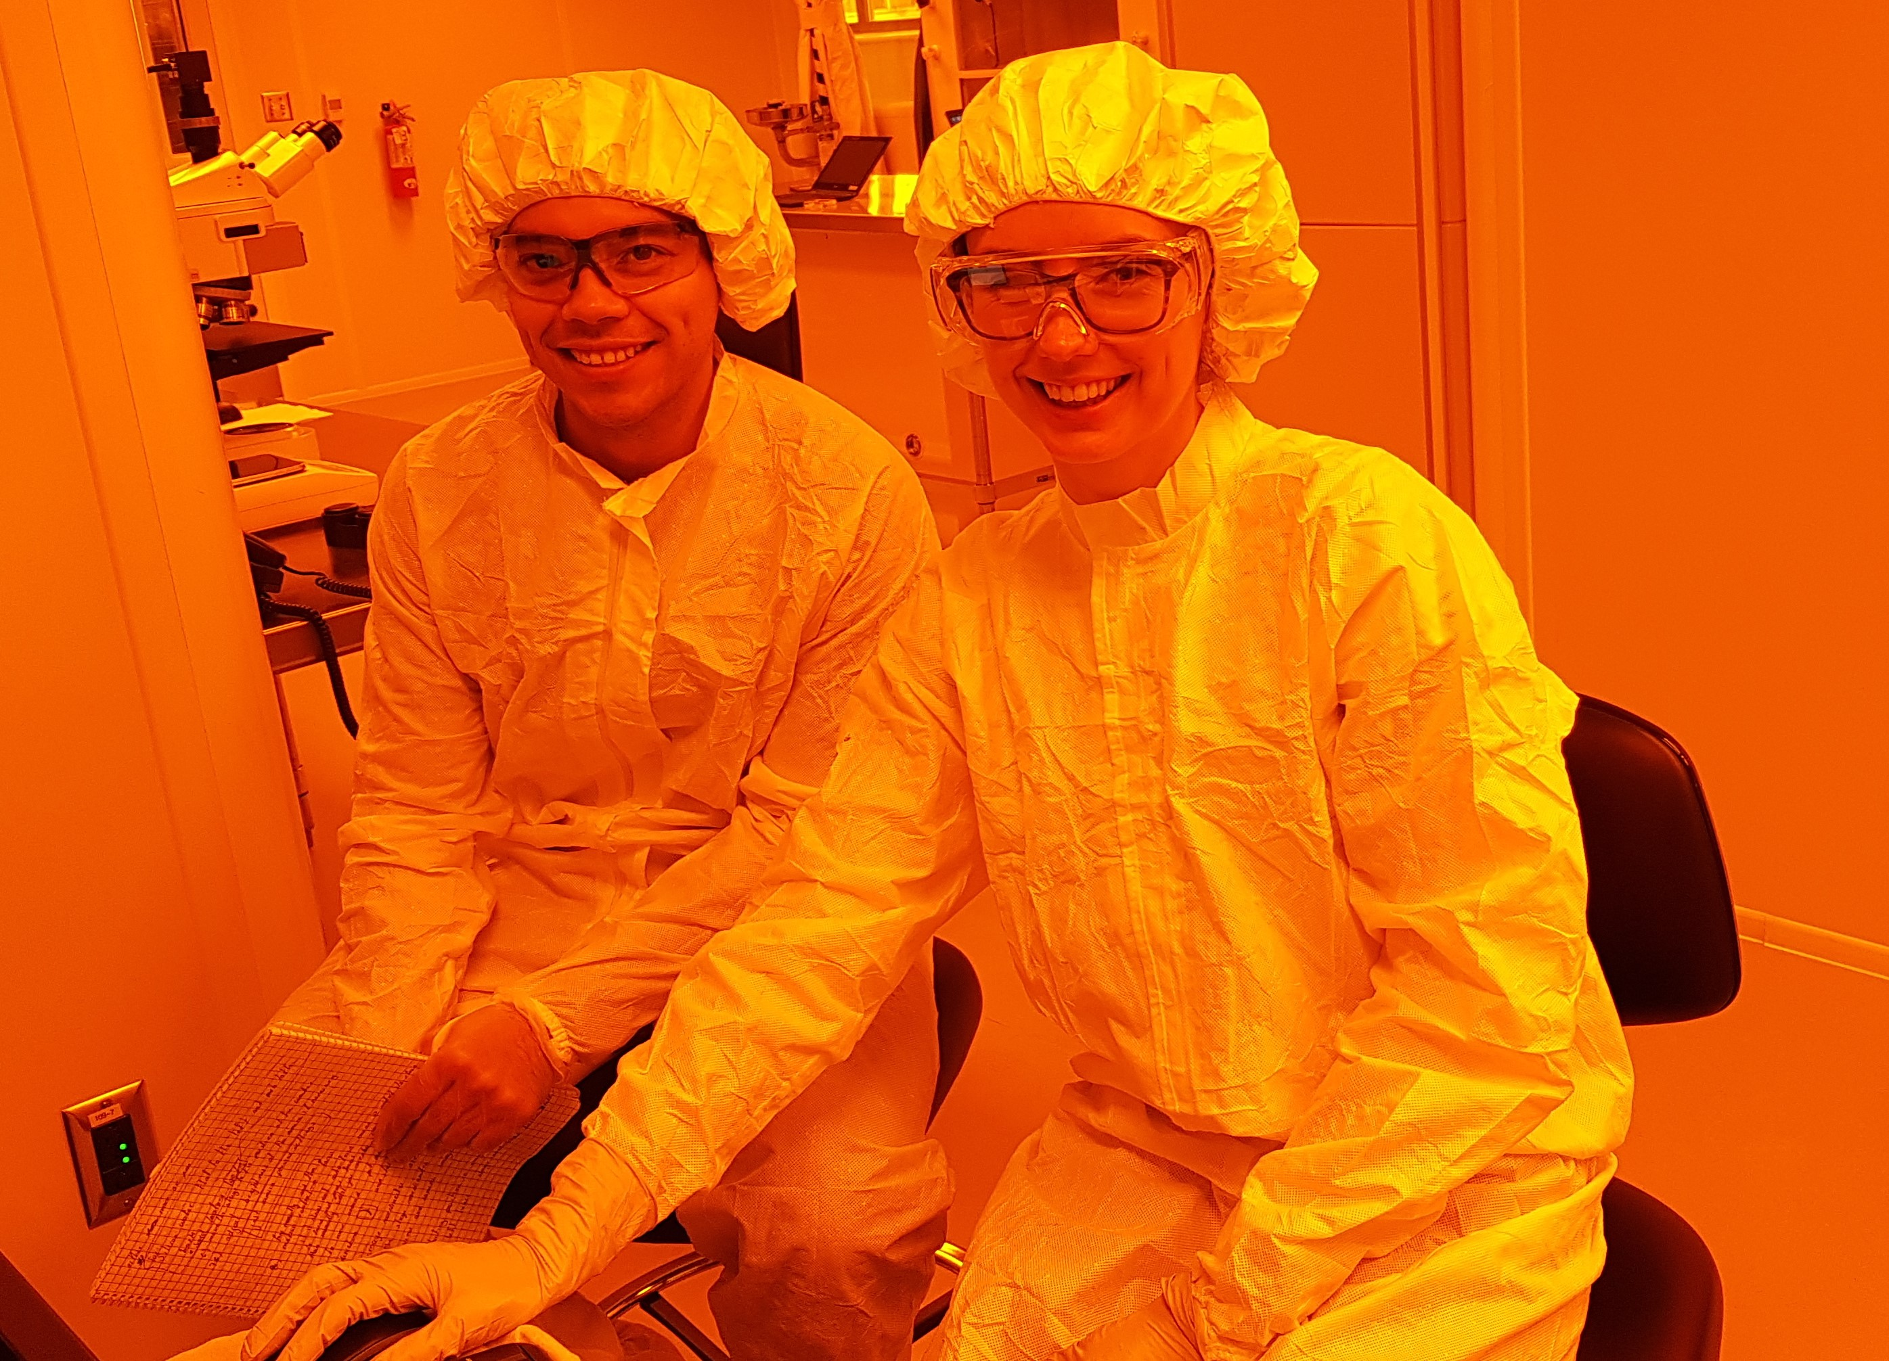
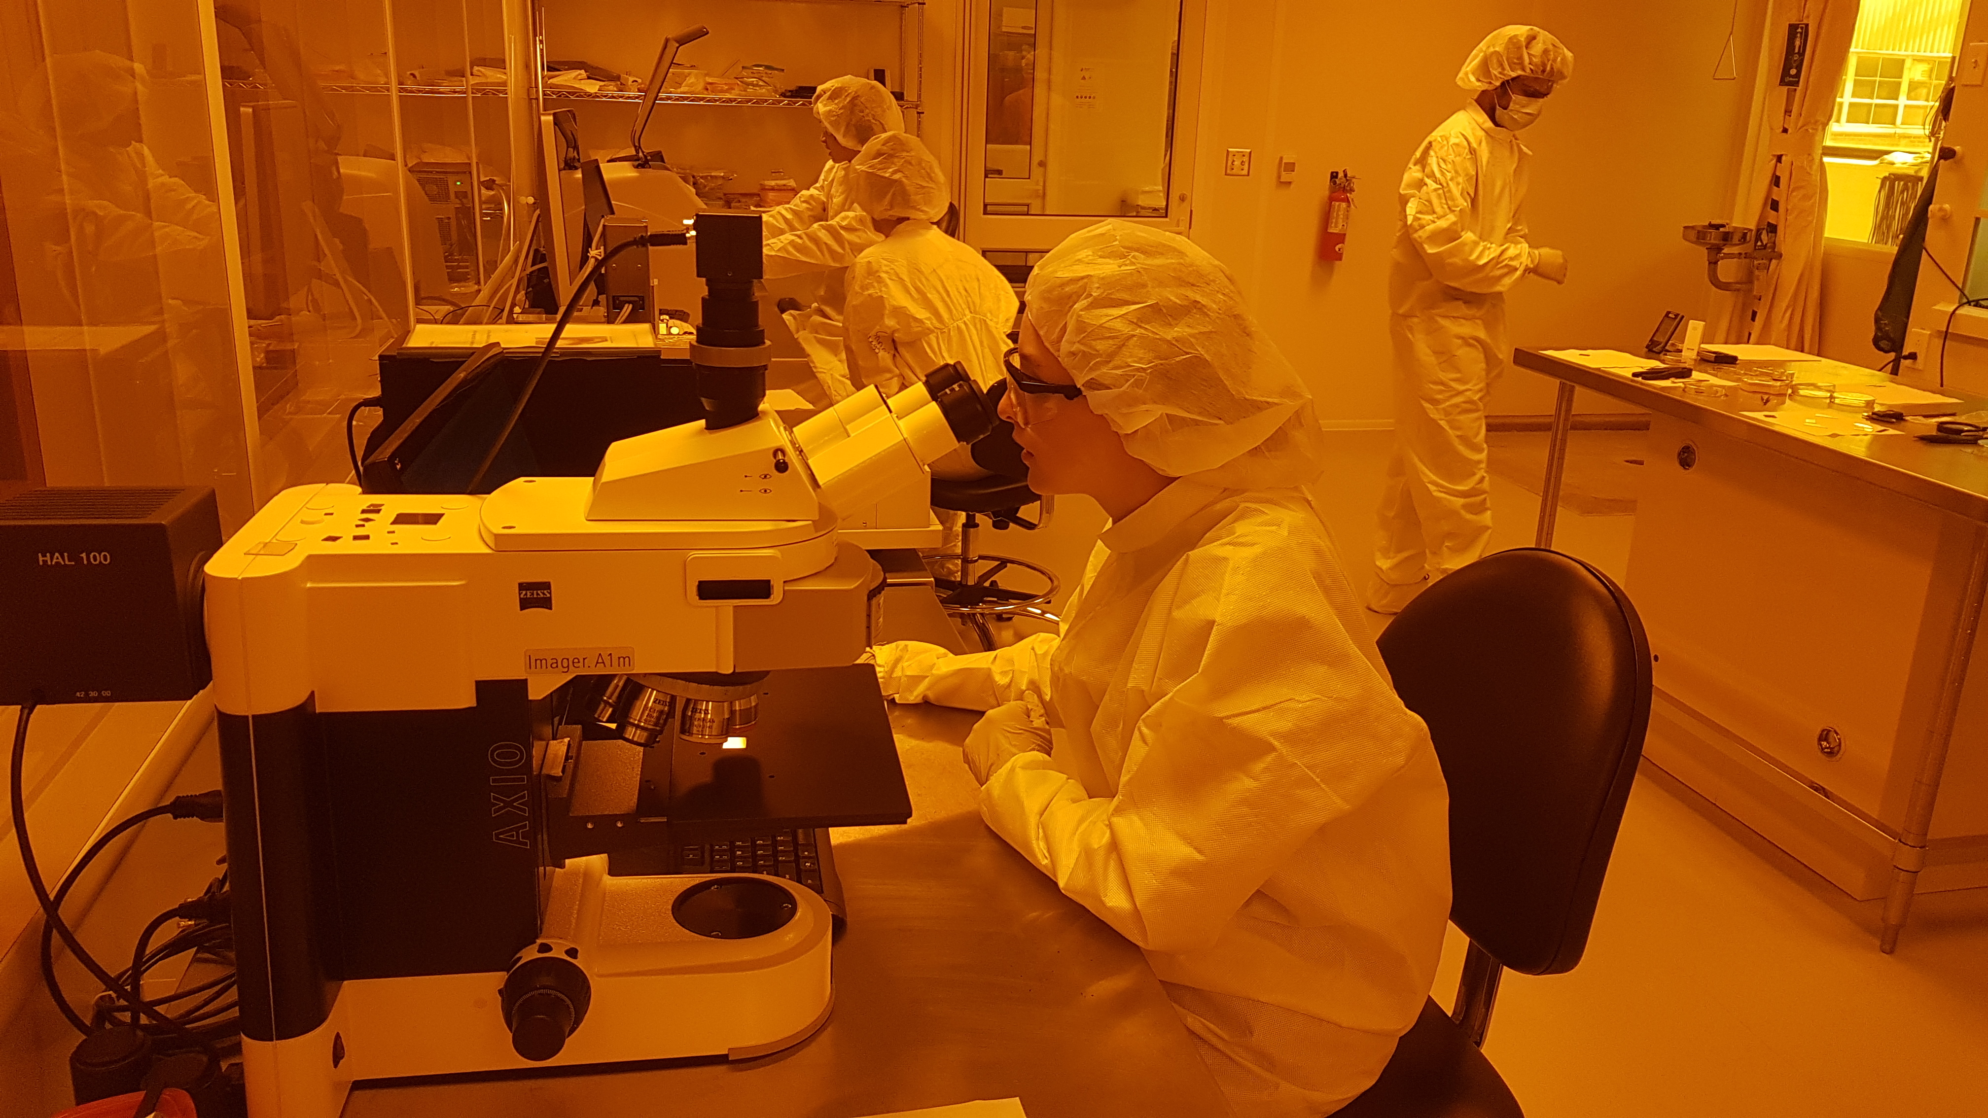
NanoFabrication Kingston (NFK) – Queen’s University
Facilities Metrics
Built in 2015 @ a cost of $2M
3,250 gross sft, ISO 6 and 7
1 staff (manager, technical, marcom, etc.)
Chem. Dept. support (HR, finance, admin, IT)
15 major tools
50 unique internal users/year
10 unique external users/year
Tool usage 2500 hours / year (20% external)
25 new users/year (5 external)
Internal Base varied (Science and Engineering); almost no biosciences
External Base varied; mainly regional and via partner organizations
$300k operating budget (including rent)
20% internal, 20% external,
15% grant funding, 45% subsidy
Avian
Outdoor Seating
Yoga Studio
Main Entrance

Slide 2
Key Capabilities & Features
Optical and electron-beam lithography
PVD (sputter, e-beam evaporation)
ICP-RIE
Laser micromachining
Recent Tool Additions
Spectroscopic ellipsometer
Sheet resistance probe station
Plasma cleaner
Critical point dryer
Strengths
Accommodating
Personal touch
Weaknesses:
Lack of support, leading to slow growth
Top-5 Equipment/Capability Wishlist
Higher throughput EBL
Dedicated ICP-RIE for III-V’s
Dicing saw
ALD
Wire bonder
Exploring Novel Anti-gravity Paperclips
Talk to me about…
TMAH alternatives
Managing a university nanofab with limited resources

