Slide 1
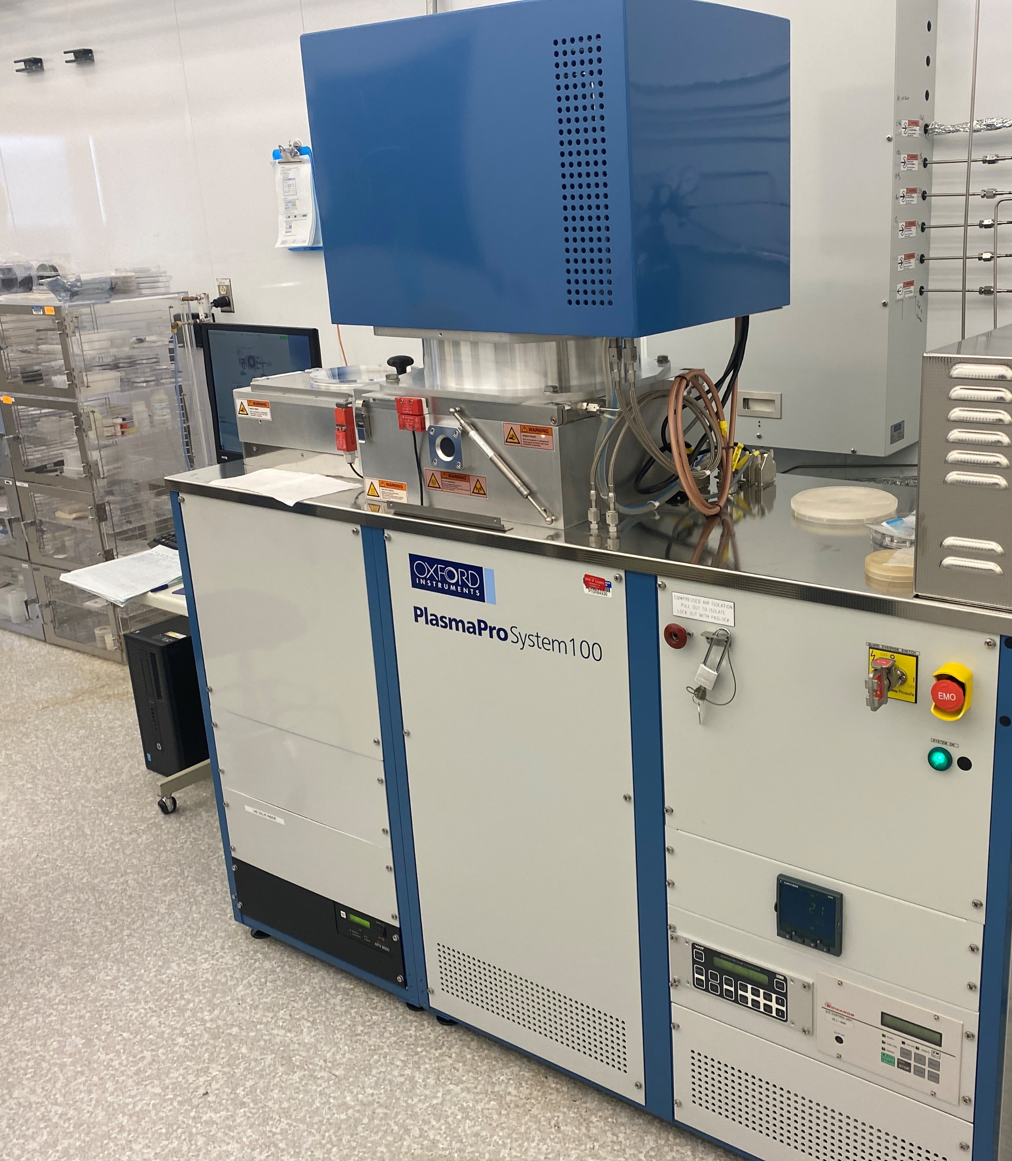
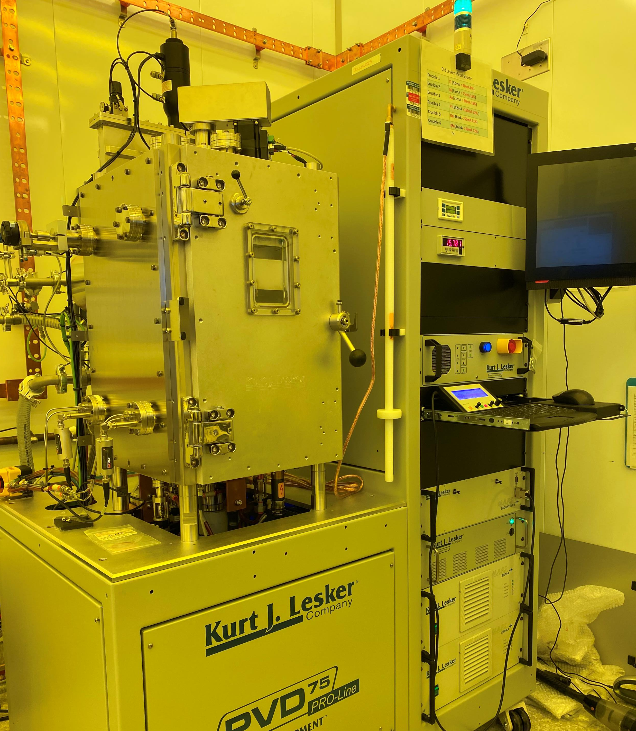
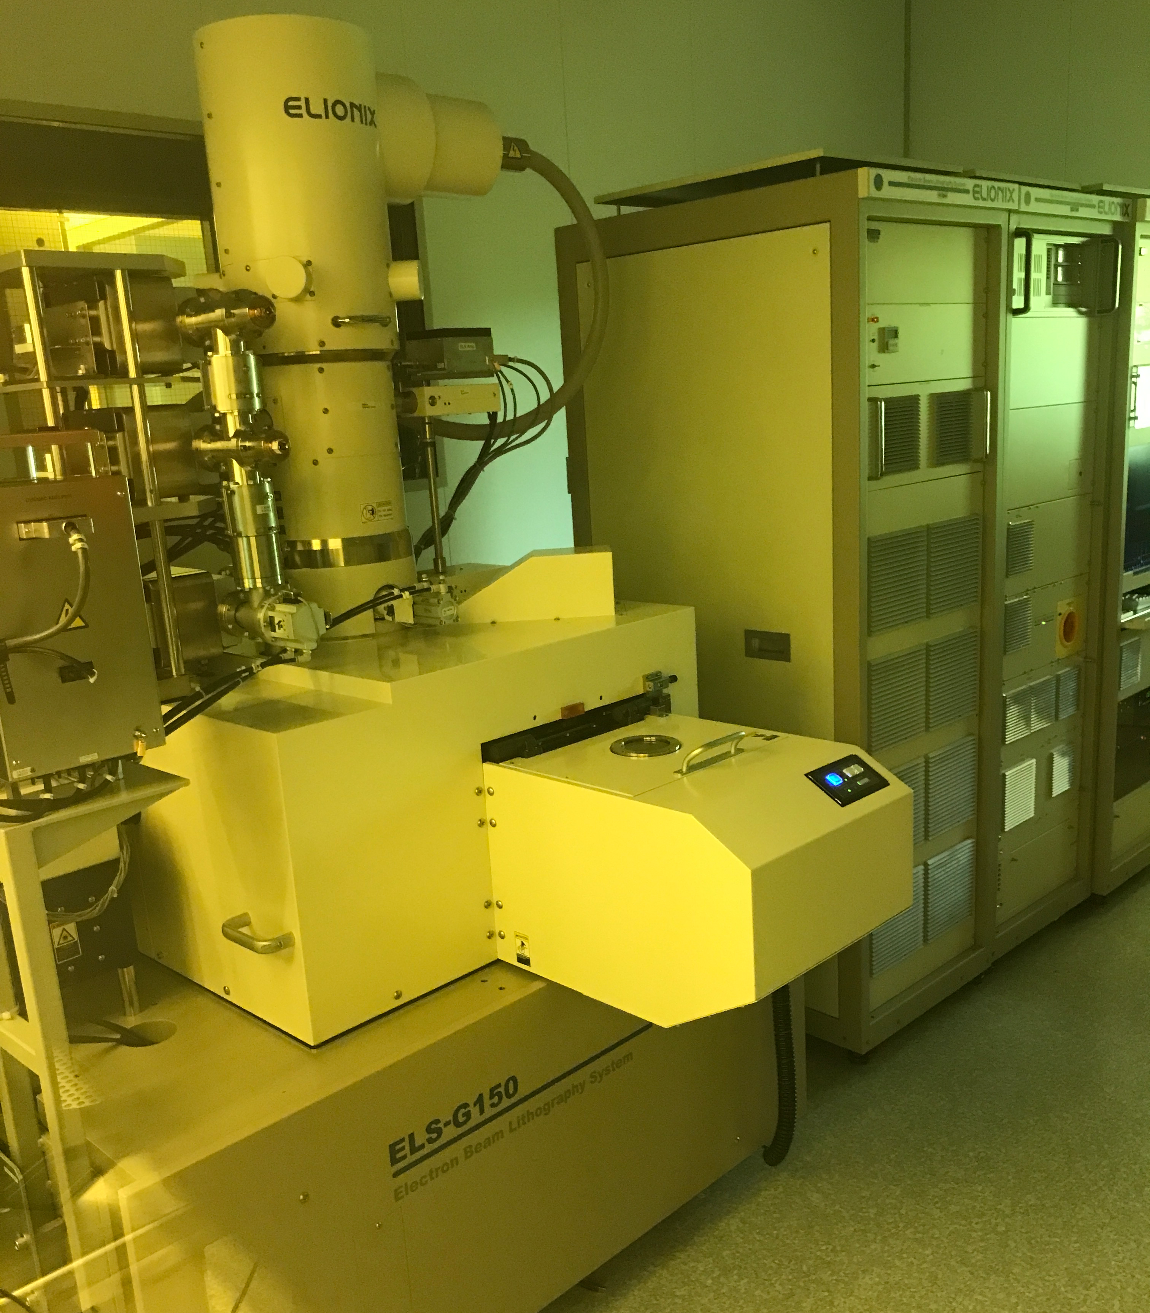
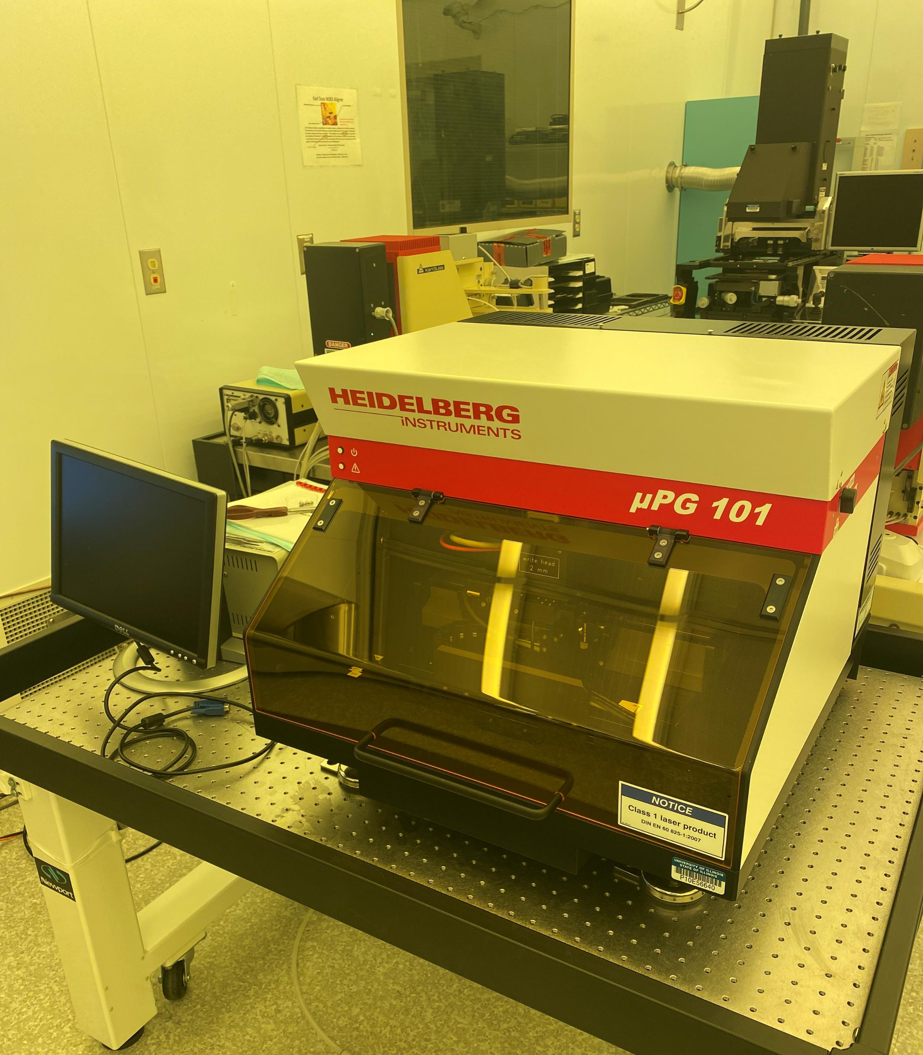
Holonyak Micro and Nanotechnology Lab (HMNTL)
University of Illinois @ Urbana-Champaign
Facilities Metrics
9,500 sq. ft. (Bay & Chase & Suite) class 100 and 1000
40+ reservable tools
6 engineering staff
3 support staff
Bio-lab with shared lab space

Slide 2
Key Capabilities & Features
Electron Beam Lithography
  Elionix, 150kV, sub 10nm range
Optical Lithography
  EVG 620 (4” and 6”)
  MJB 3 Suss mask aligners (pieces up to 3”)
  Heidelberg maskless writer
Physical Vapor Deposition
  Metal - Lesker sputterer, and Lesker ebeam
  Dielectric - Lesker sputterer, Denton ebeam
Chemical Vapor Deposition
  Aixtron MOCVD (GaN)
  Oxford PECVD (SiO2, SiNx, SiON)
  Veeco ALD (Al Oxide, Si Oxide, Zr Oxide, Hafnium Oxide)
Etch
  Oxford ICP RIE Freon, ICP RIE Chlorine, ICP RIE Mixed, RIE Freon (SF₆, CHF₃, Cl₂, BCl₃, CHF_{3,} CH_{4,} CF₄, H₂, N₂, O₂, Ar)
Future Tool Additions (coming 2024)
EVG 301 Megasonic Cleaner
EVG 810 Plasma Activation
Suss Bonder
Fineplacer Flip Chip Bonder
PELCO® LatticeAx® 420 Scribing and Cleaving
MBE
MOCVD
Strengths
III-V Materials
Micro and nano fab in the same building
Weaknesses:
Half of the staff engineers are new
Top-5 Equipment/Capability Wishlist
Optical Profilometer
Automatic scribing + breaking tool
Another ICP + RIE Etch tool
Dielectric Sputter
Ellipsometer
Exploring Novel Anti-gravity Paperclips
Talk to me about…
What was the last book you read?

