Slide 1
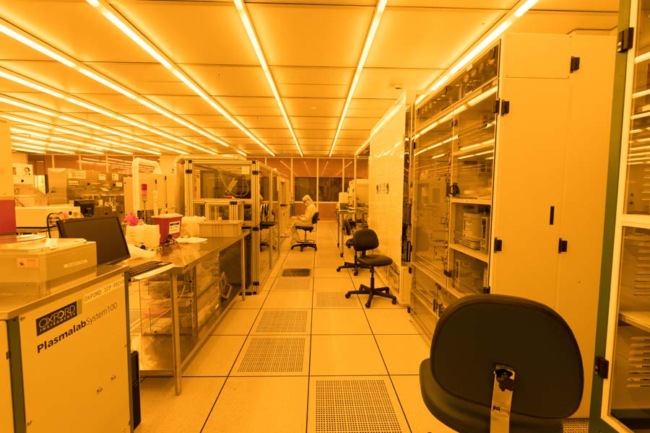
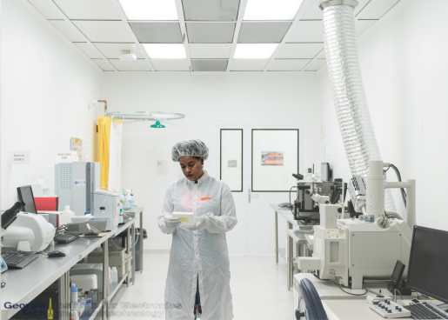
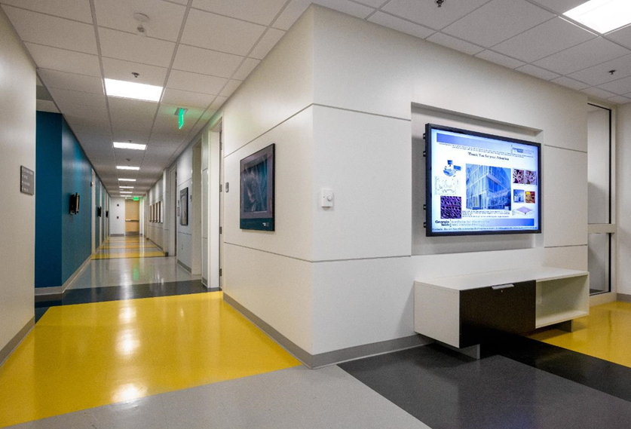
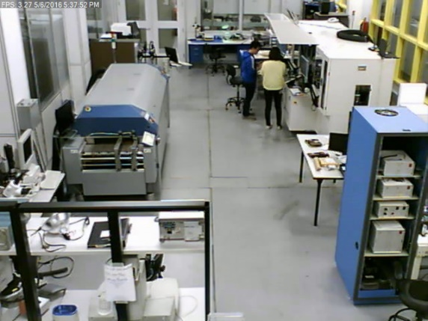
Georgia Tech - Institute for Electronics and Nanotechnology (IEN) Facility
Facilities Metrics
  Pettit Cleanroom Built in 1990 and Marcus Cleanroom Built in 2009 @ a cost of $80M
  3 buildings with 225,000 ft² of cleanrooms, research, fabrication Labs
  28,500 ft² ISO 5 cleanroom space
  30 Technical Staff
  >200 Major Tools
  1,000+ users/year
  350+ new users/year
  100+ Industry users
  79,000 hours of usage (cleanroom and lab)
  249 Faculty Accessibility
  >$400M supported research
Marcus Inorganic Cleanroom
Marcus Bio Cleanroom
Material Characterization Facility
Packaging Research Facility

Slide 2
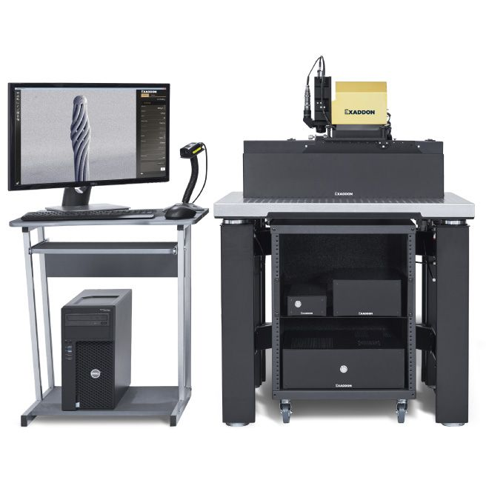
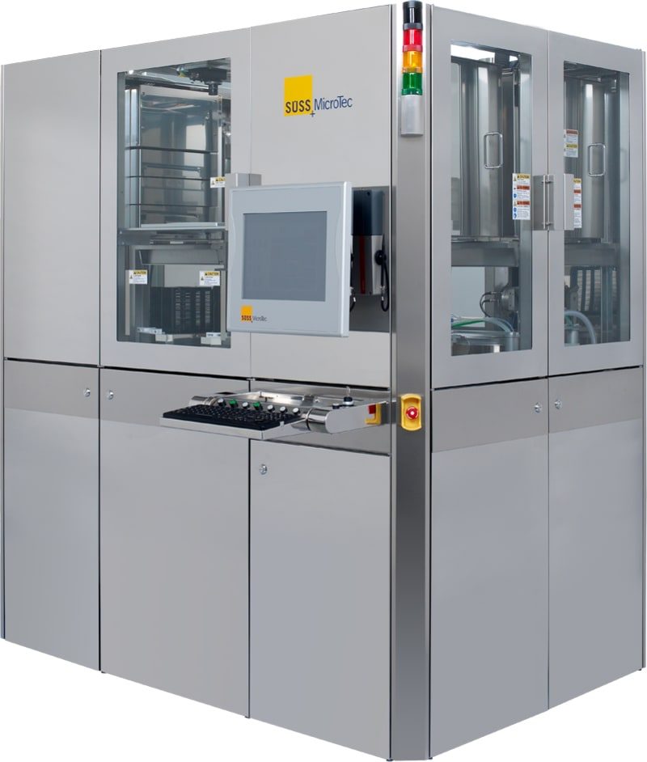
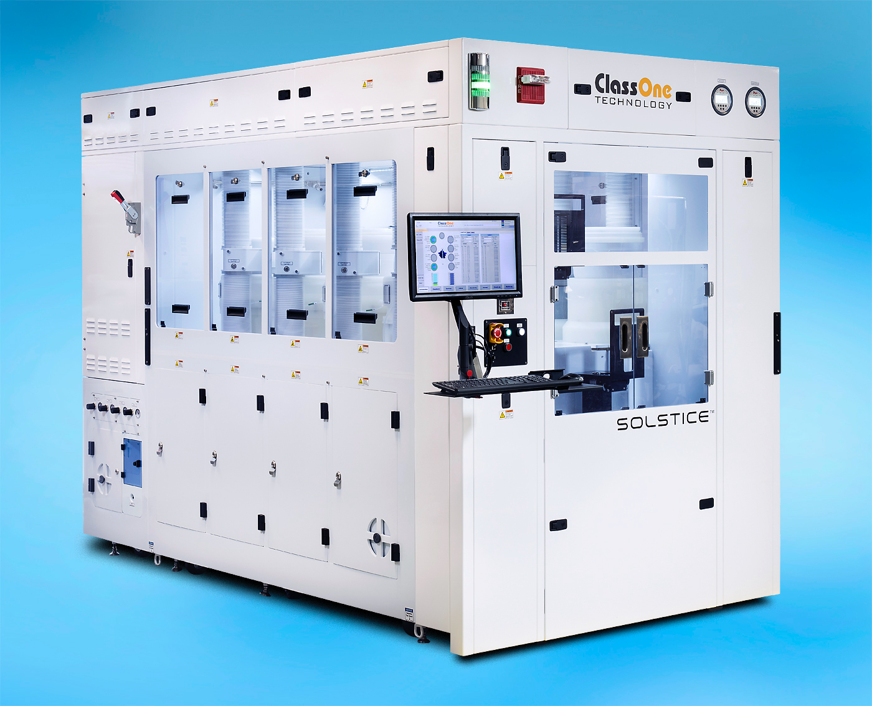
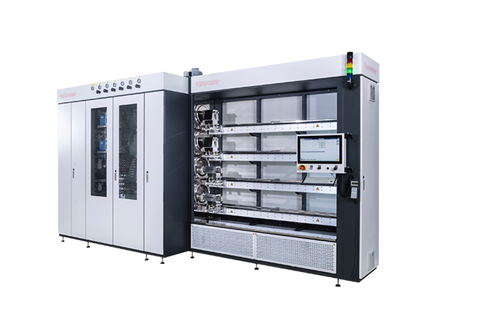
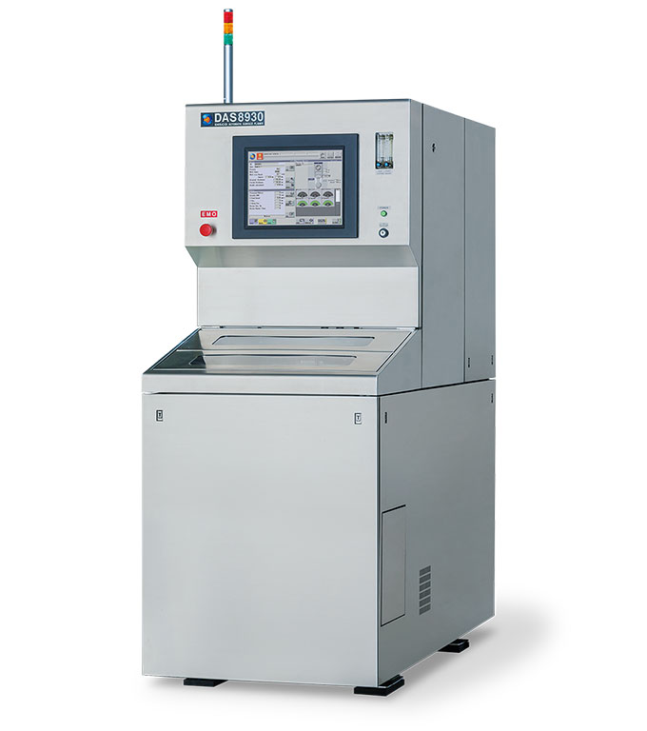
Georgia Tech - Institute for Electronics and Nanotechnology (IEN) Facility
Key Capabilities & Features
  One-Stop Shop for Nanotechnologies
  State-of-Art Microelectronics Packaging Capabilities
  Femtosecond Laser Micromachining Capabilities
  Comprehensive Micro/Nano Additive Manufacturing (3D Printing) Capabilities
  Top Material Characterization/Imaging Capabilities
Recent Tool Additions
  Suss ACS200 G3 Coating System
  Exaddon CERES Metal 3D Printer
  ClassOne Solstice S8 Electroplating System
  Tempress TS8603 PECVD/LPCVD Furnace
  Disco DAS8930 Surface Planer
Top-5 Equipment Wishlist
  ALD/CVD/PVD Cluster System
  High Resolution EBL System
  Atomic Layer Etch (ALE) System
  Ion Beam Etch (IBE) System
  Furnace for Large Substrate
More About IEN
  IEN will merge with IMat into IMS (Institute of Matter and Systems) on July 1st
  Cleanroom Expansion is underway
  Participating site and coordinating office of NNCI (National Nanotechnology Coordinated Infrastructure)
  Extensive K-graduate Educational and Outreach Programs

