Slide 1

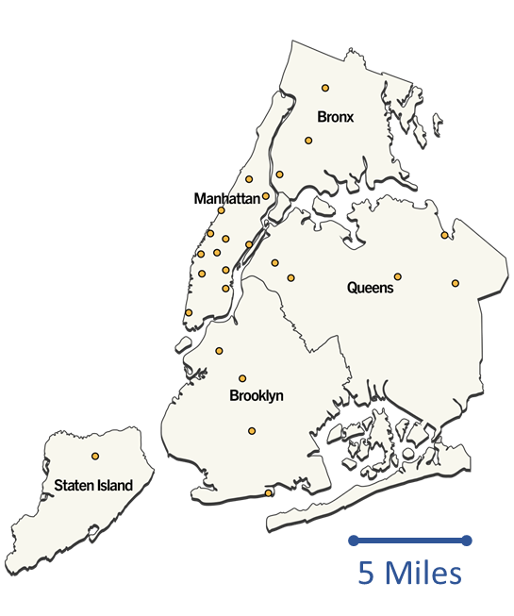

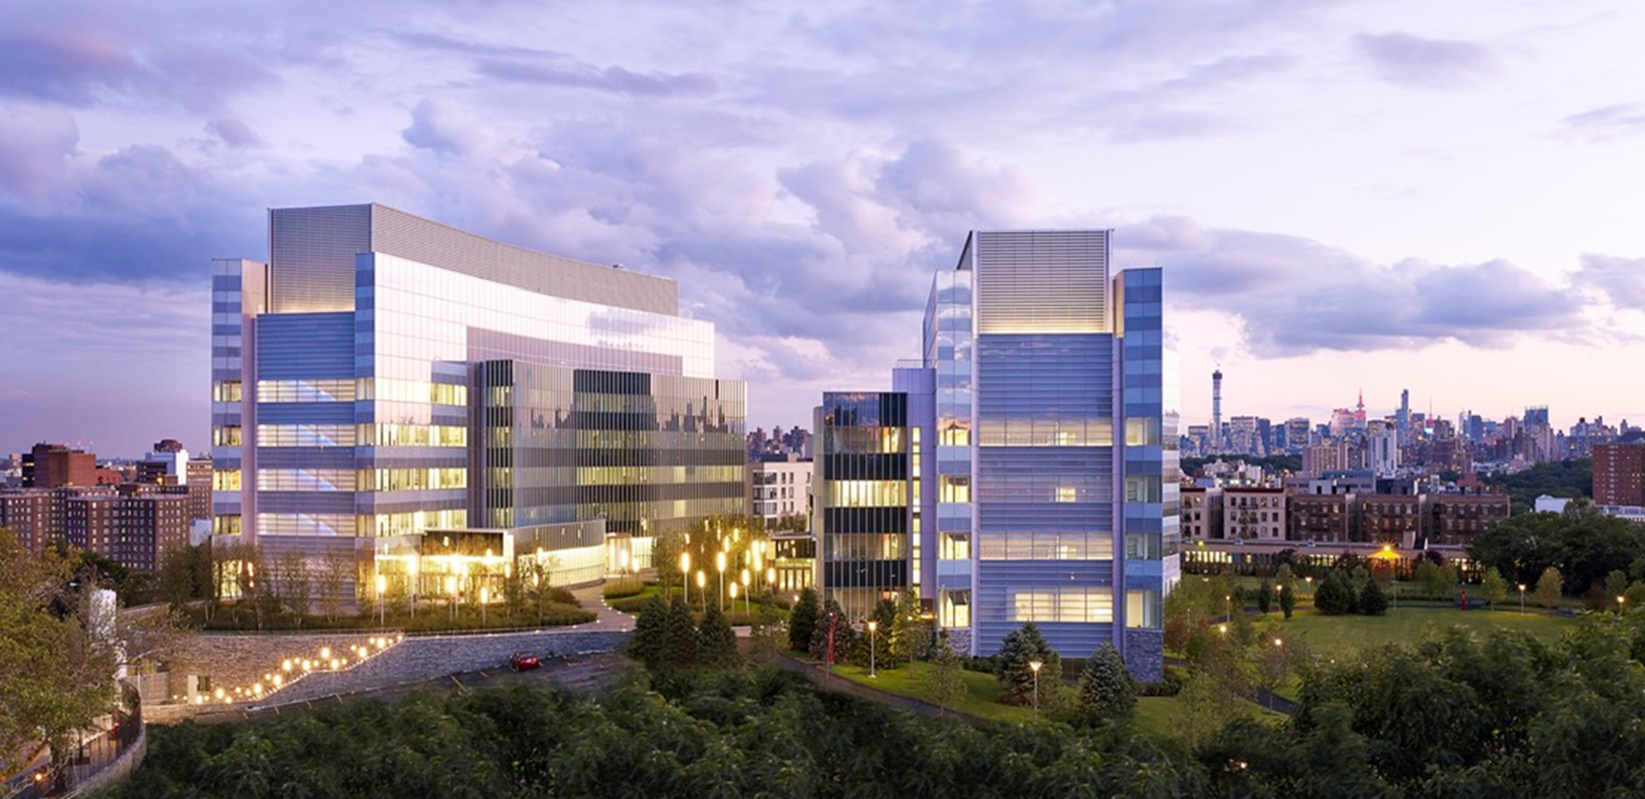
CUNY—Advanced Science Research center (ASRC)
Largest Urban University in the US
25 Colleges (mostly 2 and 4 year schools)
~250,000 Students
Public: State and City funded
Completed in 2014
~ $1 Billion (NYS and NYC)
A NYC tech hub for:
  CUNY
  External Academic
  Start-ups
  Industry
16 Core facilities
5 initiatives
  Nanoscience
  Photonics
  Structural Biology
  Neuroscience
  Environmental Science
ASRC
Avian
Outdoor Seating
Main Entrance

Slide 2

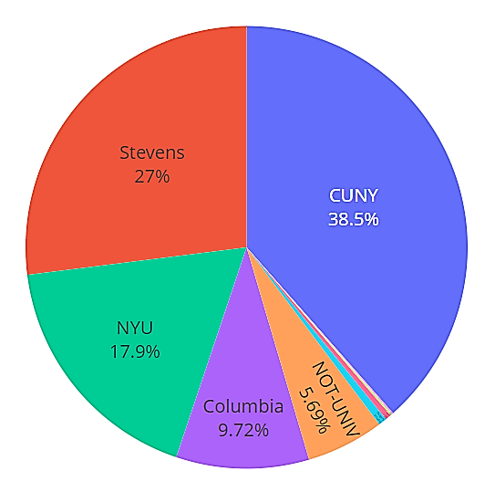
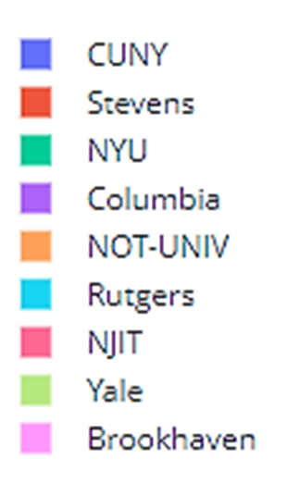
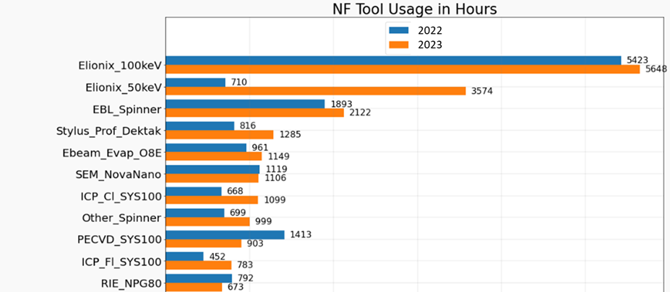
5,000 sq. feet CR and chase areas
5 staff members
  (2) technicians (1) staff scientist
  Lab Manager and Director
40 interlocked tools (10+ not interlocked)
~170 users/year
~ 60 pi’s represented per year
Over 50% of users are external academic
Photonics is the dominant field
E-Beam Lithography drives lab usage
$1.3M budget for tools and staff
  ~ 40% tool revenue, Staff: NYS Tax Levy, ASRC subsidizes the remainder
Exploring Novel Anti-gravity Paperclips
Wishlist: $$, Etchers, Redundant backup systems,
Nanofab Research Support
Talk to me about: AI in shared-user Nanofabs Samantha Roberts (sroberts@gc.cuny.edu)

