Slide 1
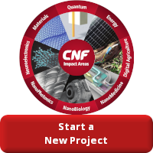
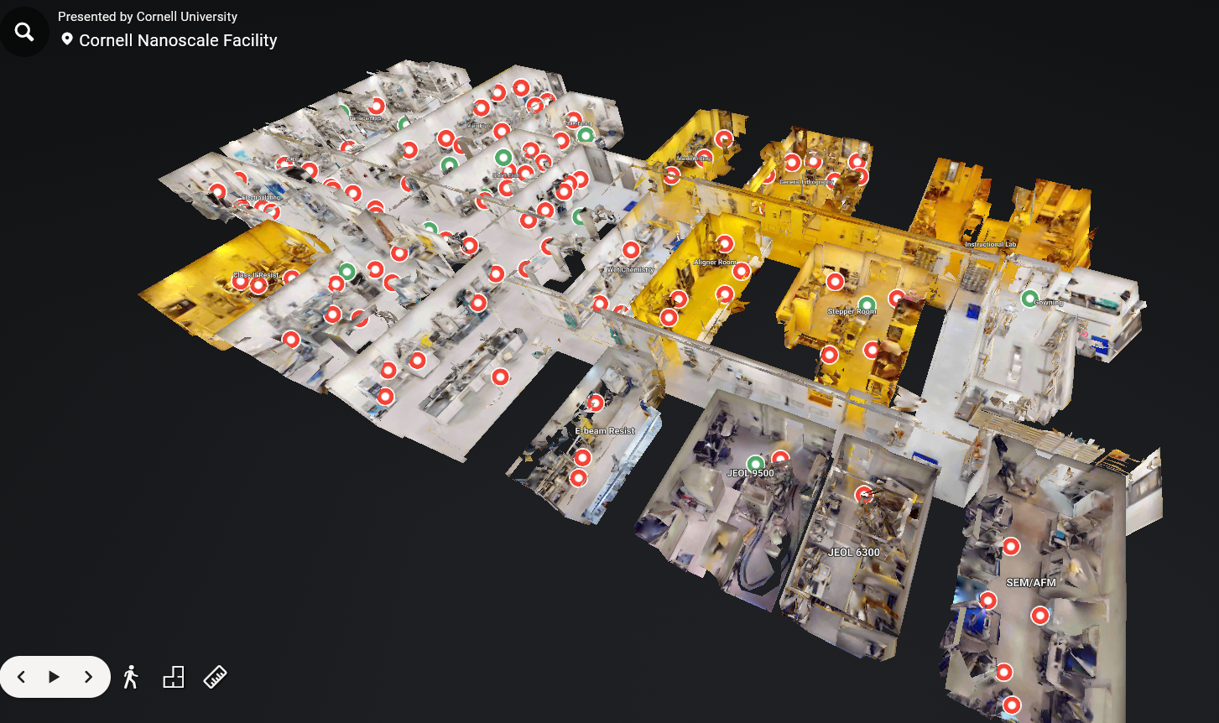
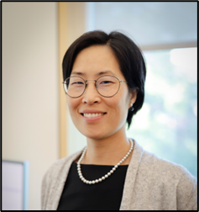
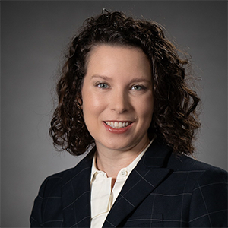
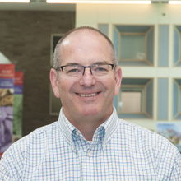
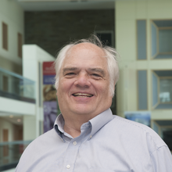
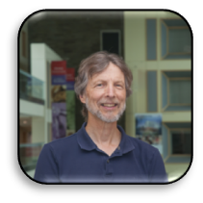
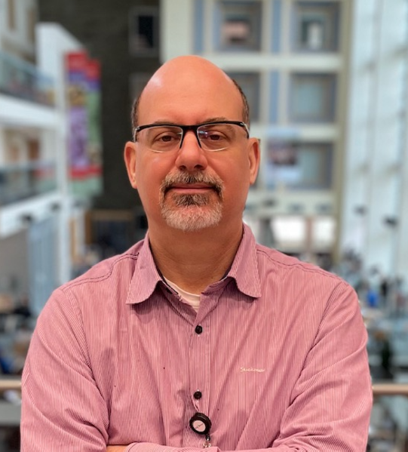
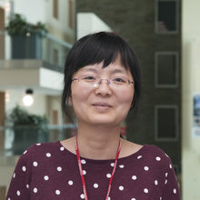
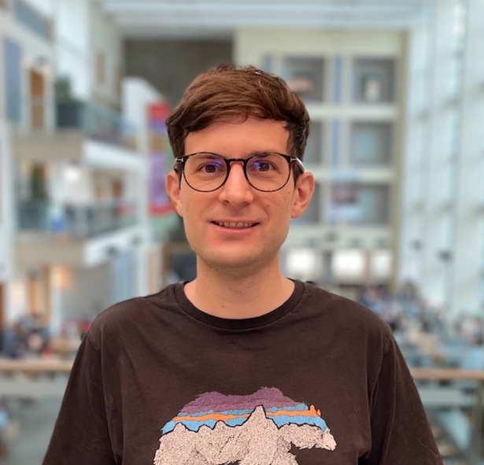
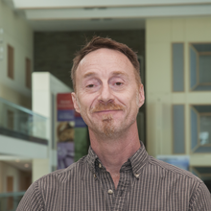
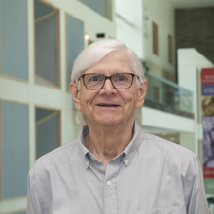
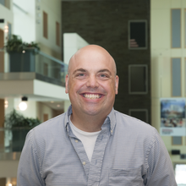
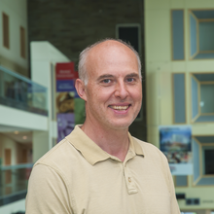
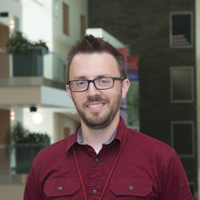
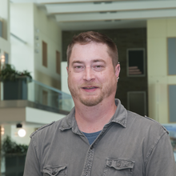
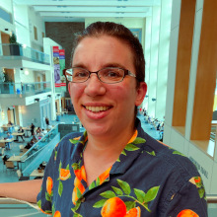
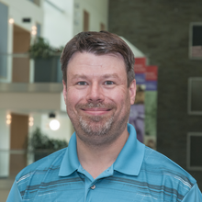
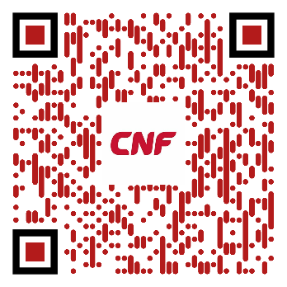
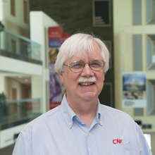
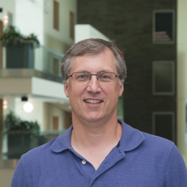
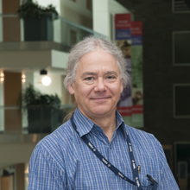
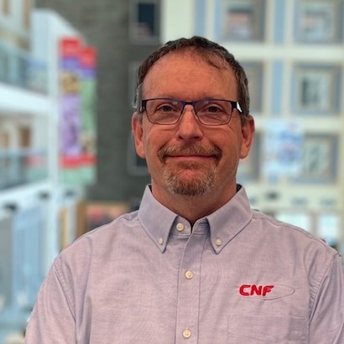
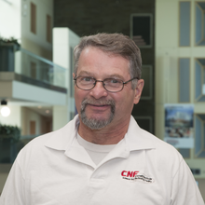
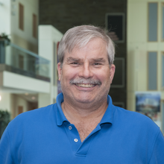
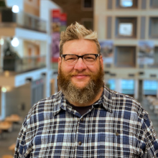
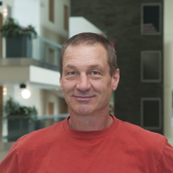
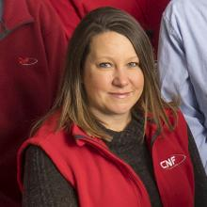
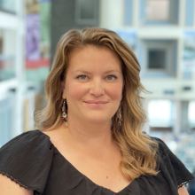
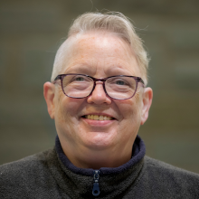
OUR MISSION- is to enable rapid advancements in science, engineering and technology at the nanoscale by providing efficient access to nanotechnology infrastructure and expertise. CNF operates as a flexible open user facility and is proud to be a member of the National Nanotechnology Coordinated Infrastructure (NNCI).
Getting Started
CNF Cleanroom
Staff
1700 sq ft
Class 1000
Over 180 - advanced fabrication and characterization tools
userprogram@cnf.cornell.edu
olson@cnf.cornell.edu
Notes:
The Cornell NanoScale Facility is world class open user facility for Micro and Nanofabrication assisting users from across the country and around the world
Projects range from pure university research to product development and prototyping for small and large companies
CNF have developed an effective streamlined entry process. In most cases, projects can be reviewed, screened, and approved within 2 weeks of initial contact.
Additional information is available on our website at Start a New Project.
Prospective users first contact the User Program Managers to discuss CNF capabilities, materials considerations, projected costs, alternative approaches, and, most importantly, project feasibility. Once these preliminary steps are completed, the PI will be invited to submit:
• A brief (1-2 page) Project Proposal describing the proposed structures, materials, and proposed fabrication approach
• User Project Agreement: A brief (2 page) agreement between Cornell/CNF and the PI and their institution
• User Applications for each prospective user (2 pages)
The Project Agreement and User Applications cover the entirety of the legal agreement between institutions and persons, and cover liability, intellectual property, export control, and billing. These steps are similar for both internal and external users. These documents can be submitted and signed online.
At this point users can come to Cornell for orientation, training, and laboratory use.
CNF has 17,000 sq ft of class 1000 cleanroom space and over 180 advanced fabrication and characterization tools
The QR code that you see …will take you to a virtual tour of our cleanroom
Our most important asset is our great staff
The staff’s main objective is to support our users, provide process engineering advice, training and …maintain equipment …--next slide please

Slide 2
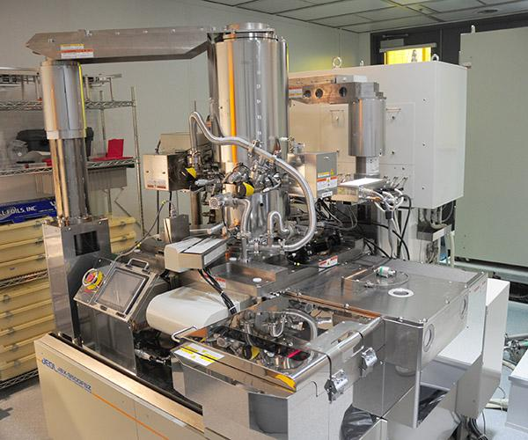
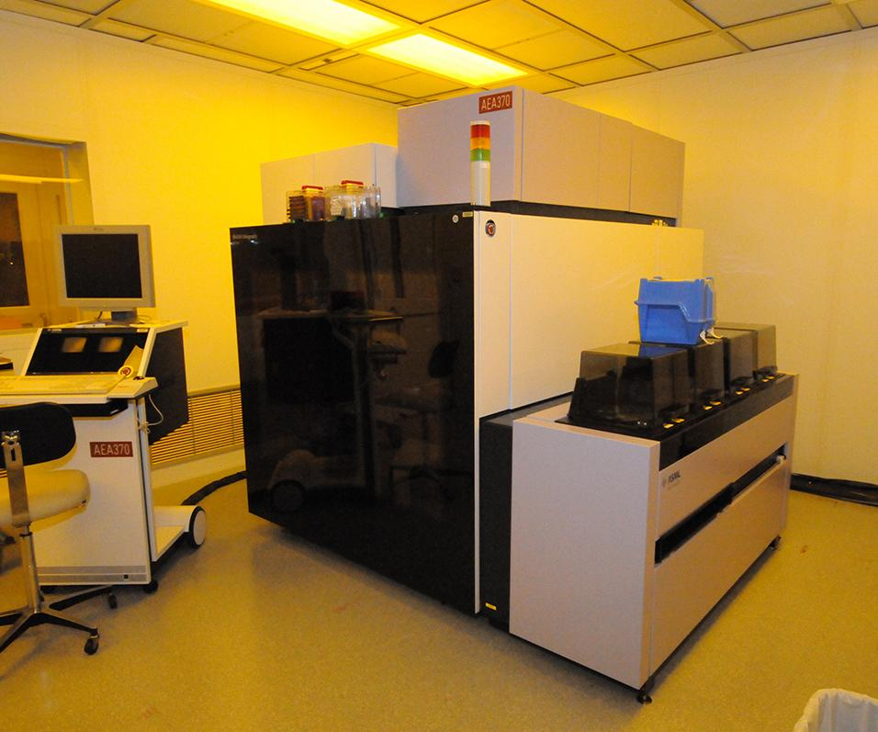
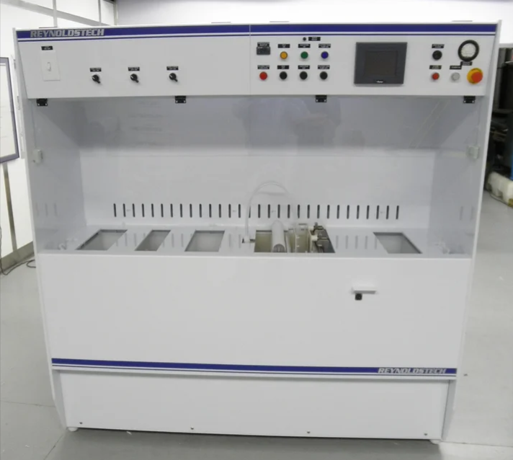
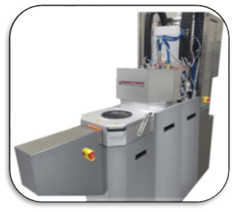
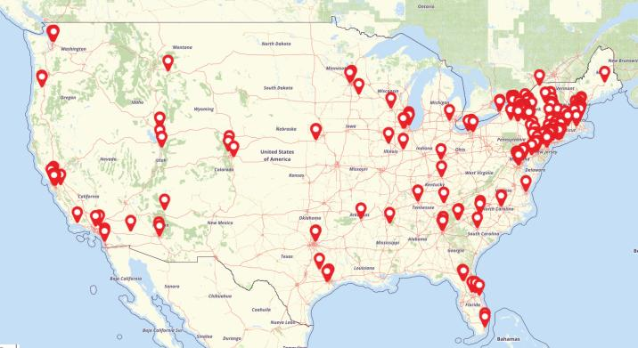
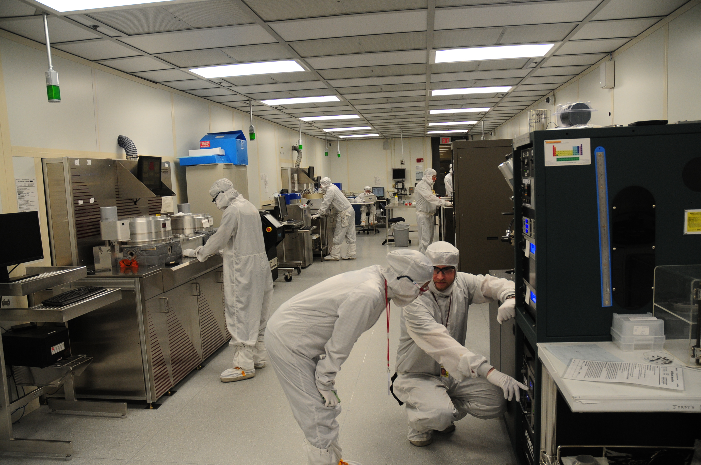

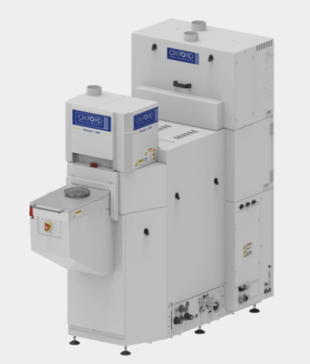
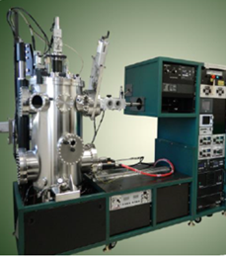

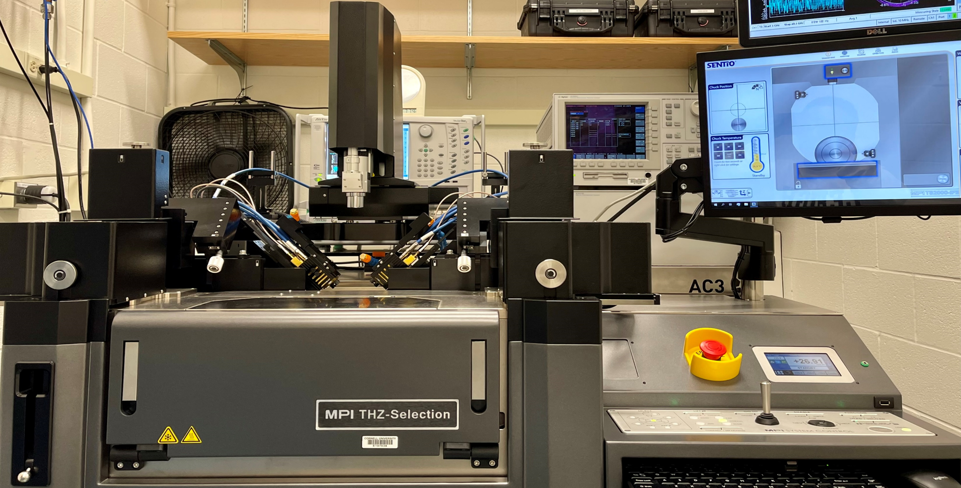
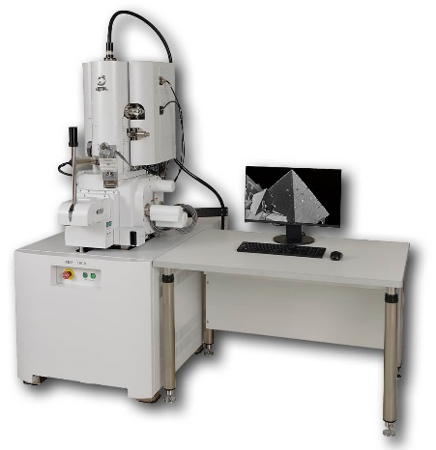
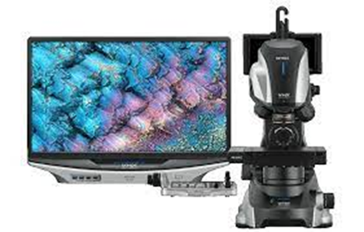
Equipment Resources
Expanding Equipment
User Breadth and Data
EWD
Advanced Lithography
Heterointegration
REU
ATLAS
Workforce Development
Nanooze
TCN Short Course
4-H
ATLAS
IREU
BOCES
Broad Process Support
Quantum Science and Technology
Over 1000 Users/ year
171 different companies (127 small/startup and 44 large) have used CNF for research/prototyping (under NSF NNCI)
19 new startups (under NSF NNCI)
Etch
Characterization
Metrology
Thin films
Test
olson@cnf.cornell.edu
Notes:
We have very comprehensive set of equipment that provides start to finish device fabrication including simulation software, backend processing capability, packaging and test
Through the Microelectronics (ME) Commons’ funds, CNF is upgrading its tool base considerably, with new capabilities and more modern instruments specifically to support, quantum science & technology, hetero-integration, and 200 mm wafer capability.
Last year CNF served 1315 unique users, with monthly average of 397 users
The CNF supports a broad range of educational and outreach (E&O) activities at all levels:
This past year we hosted or participated in at least 116 outreach events with well over 4054 visitors —
This included Micron chip camps, REU and International REU programs and various collaborations with out local community college TC3

