Slide 1

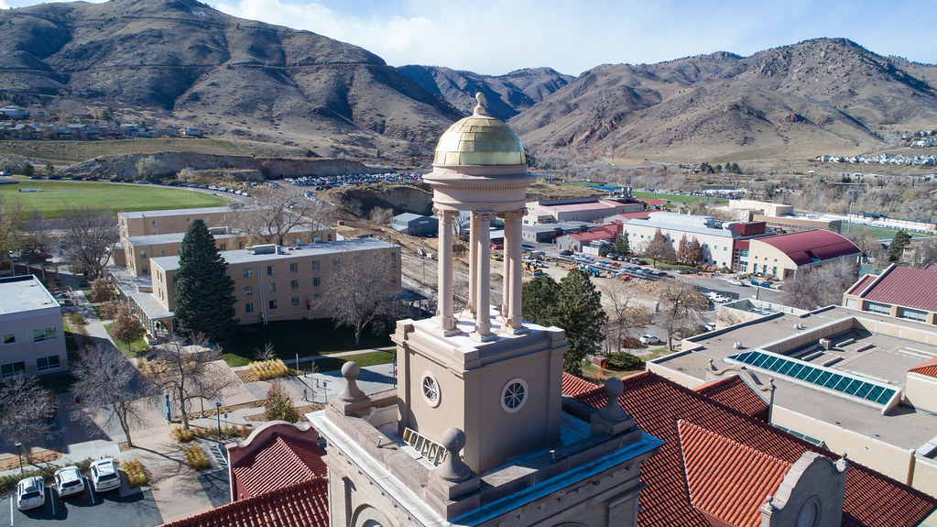
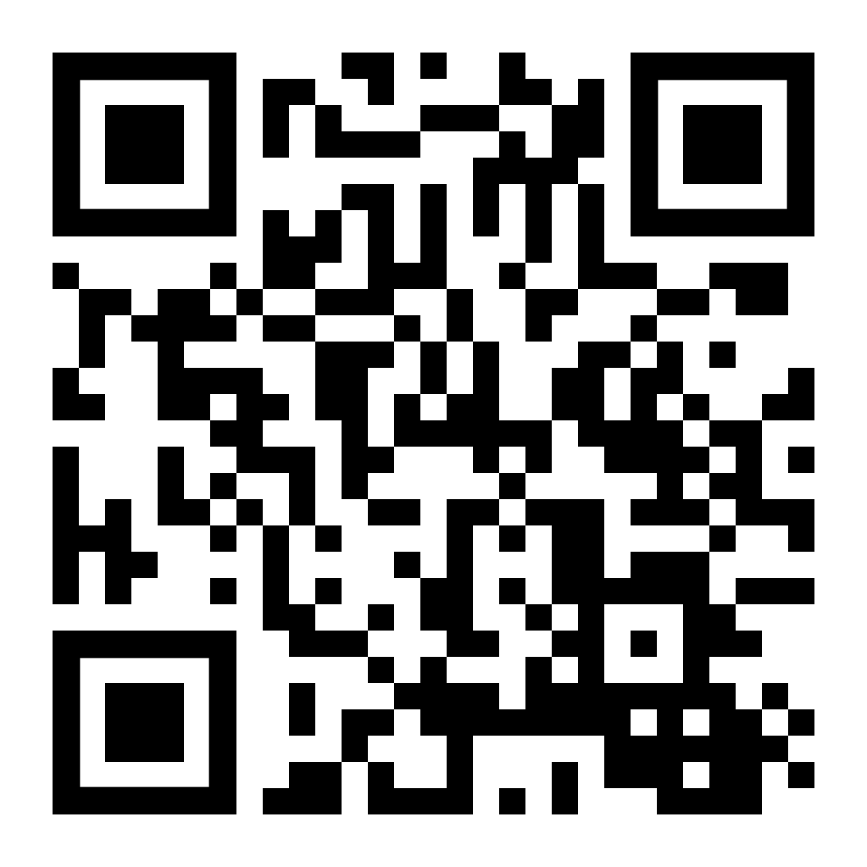
Mines is a public R1 research university focused on applied science and engineering
~5,500 Undergrads, ~2000 Grad students
Shared Facilities Launched 2021
>60 instruments housed in multiple labs across campus, w/ 12 dedicated staff
800 unique users across
  12 departments – 300 projects
  19 external universities
  3 government laboratories
  71 industrial companies
mines.edu/shared-facilities
Scanning and Transmission Electron Microscopy
Mass Spectrometry, Atom Probe, and TOF-SIMS
Atmospheric X-ray Photoelectron Spectroscopy
X-ray Diffraction & CT
Scanning Probe & Optical Microscopy
Mechanical Testing
Water Quality Analysis
Nanofabrication
Thin Film Deposition
Optical & Electrical Surface Characterization

Slide 2
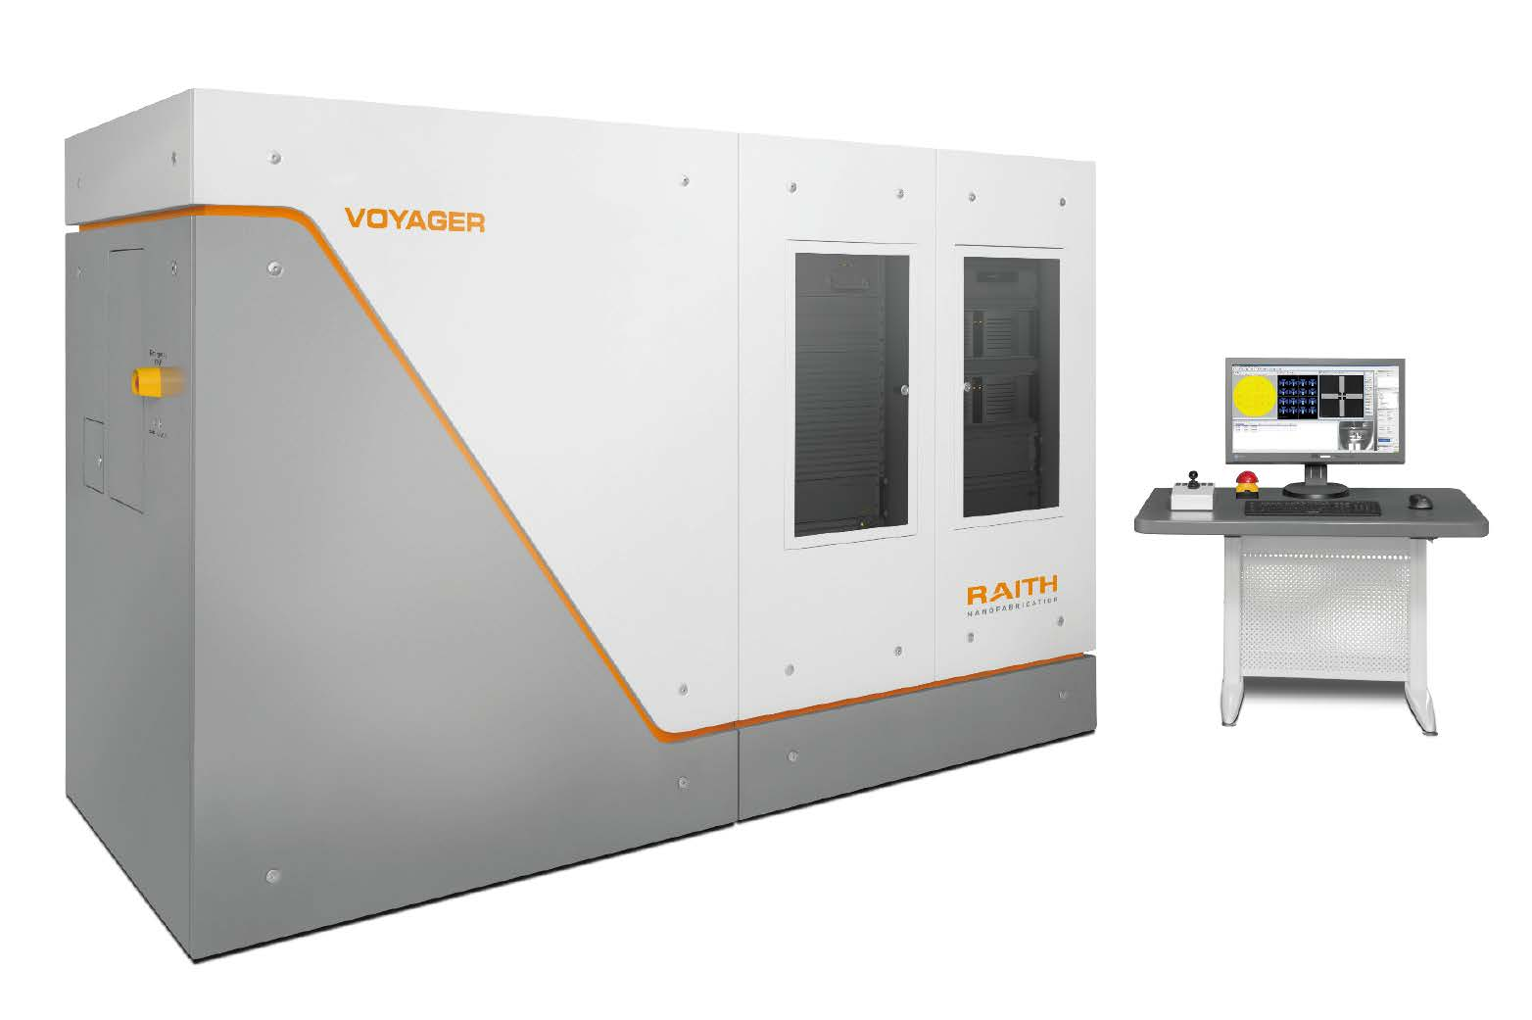
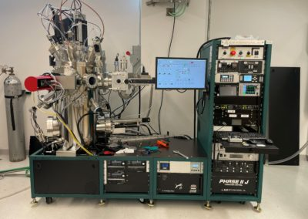
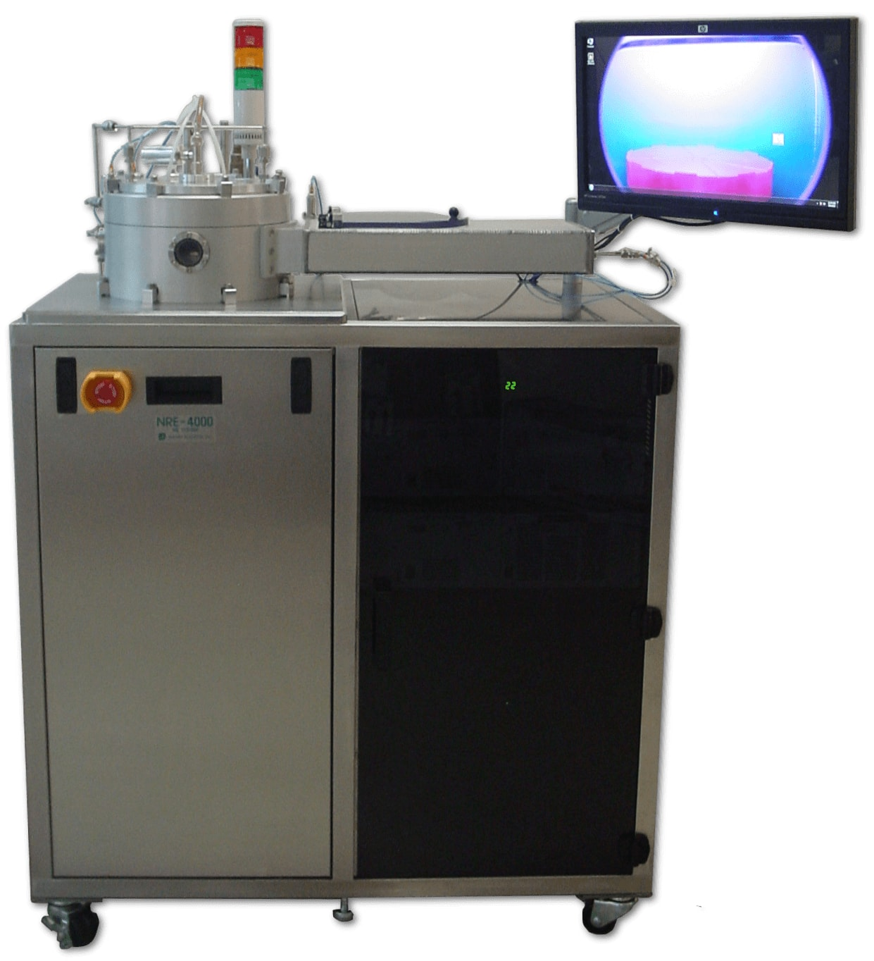
mines.edu/shared-facilities
SIF - Nanofab
Two ISO-6, ISO-7 cleanrooms
PVD
  3 Sputter chambers (12 guns)
  2 Thermal evap chambers
  e-beam evaporation (6 pocket)
Lithography
  3 Contact Mask Aligners
  UV Laser Lithography
  Electron Beam Lithography
Etching
  SF6, CF4, Ar, O2 etching
  ICP RlE system – adding CL2, BCL
  DRIE
  Argon Ion mill
Furnaces
  Oxide Growth up to 1400C
  Atmospheric/ vacuum controlled
Ellipsometry, profilometry
Electrical testing, Solar sim, Cryo testing
Recent Nanofab Acquisitions:
  ABM-USA 6” UV- Mask Aligner
  Nanyte Bean UV-Laser Lithography
  Raith Voyager EBL
  AJA UHV Multidep e-beam & sputter system
  Nanomaster NDR-400 ICP-RIE system
  Keyence VHX-970 Digital Microscope
Wishlist:
  ALD to CVD system
  Optical Profilometry
  Electron energy loss spectroscope
  Cryo-Plasma FIB

