Slide 1


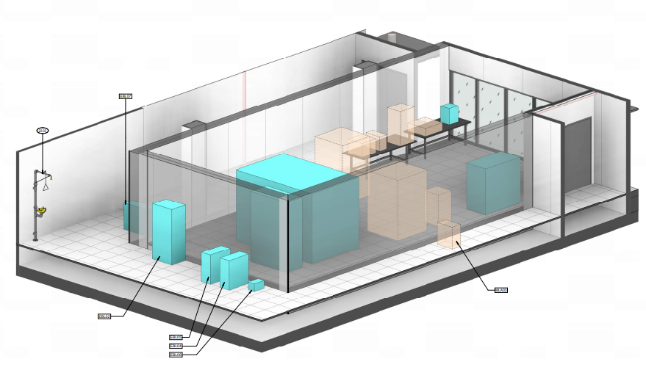
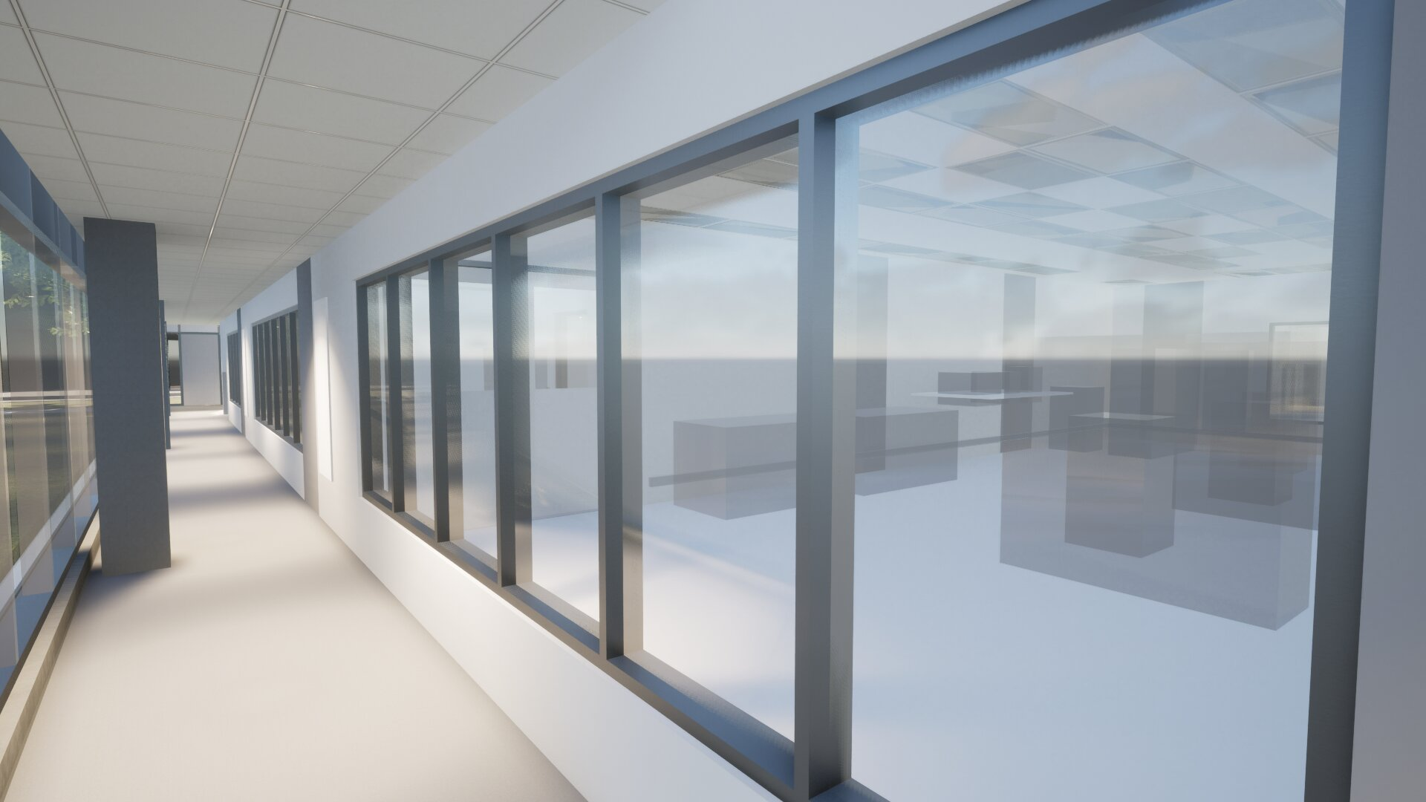
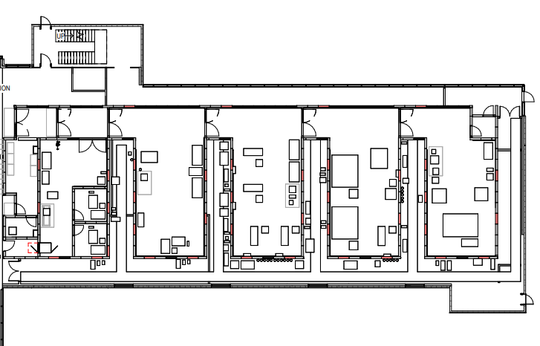
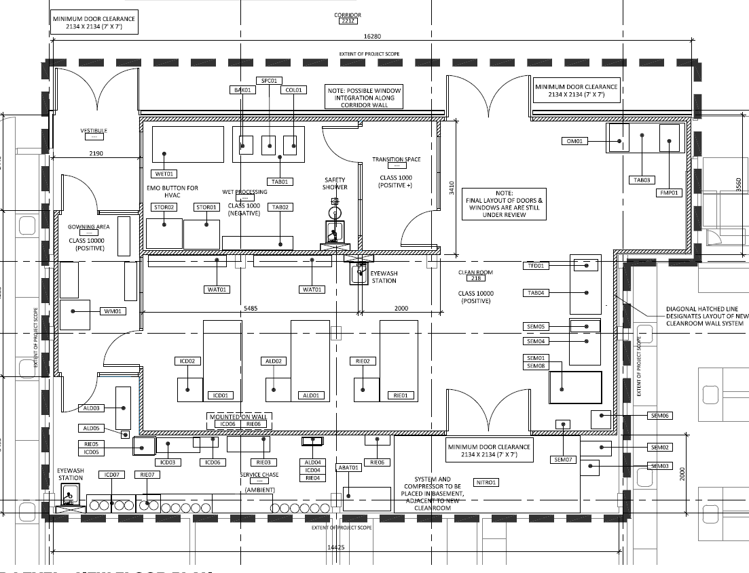
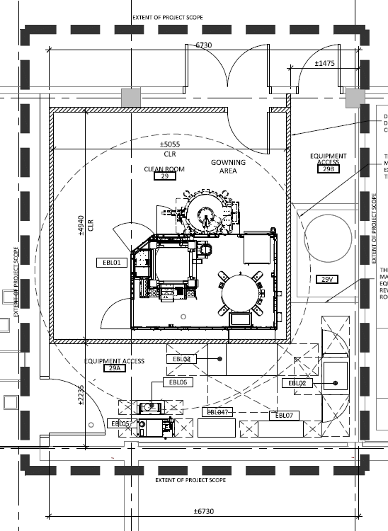
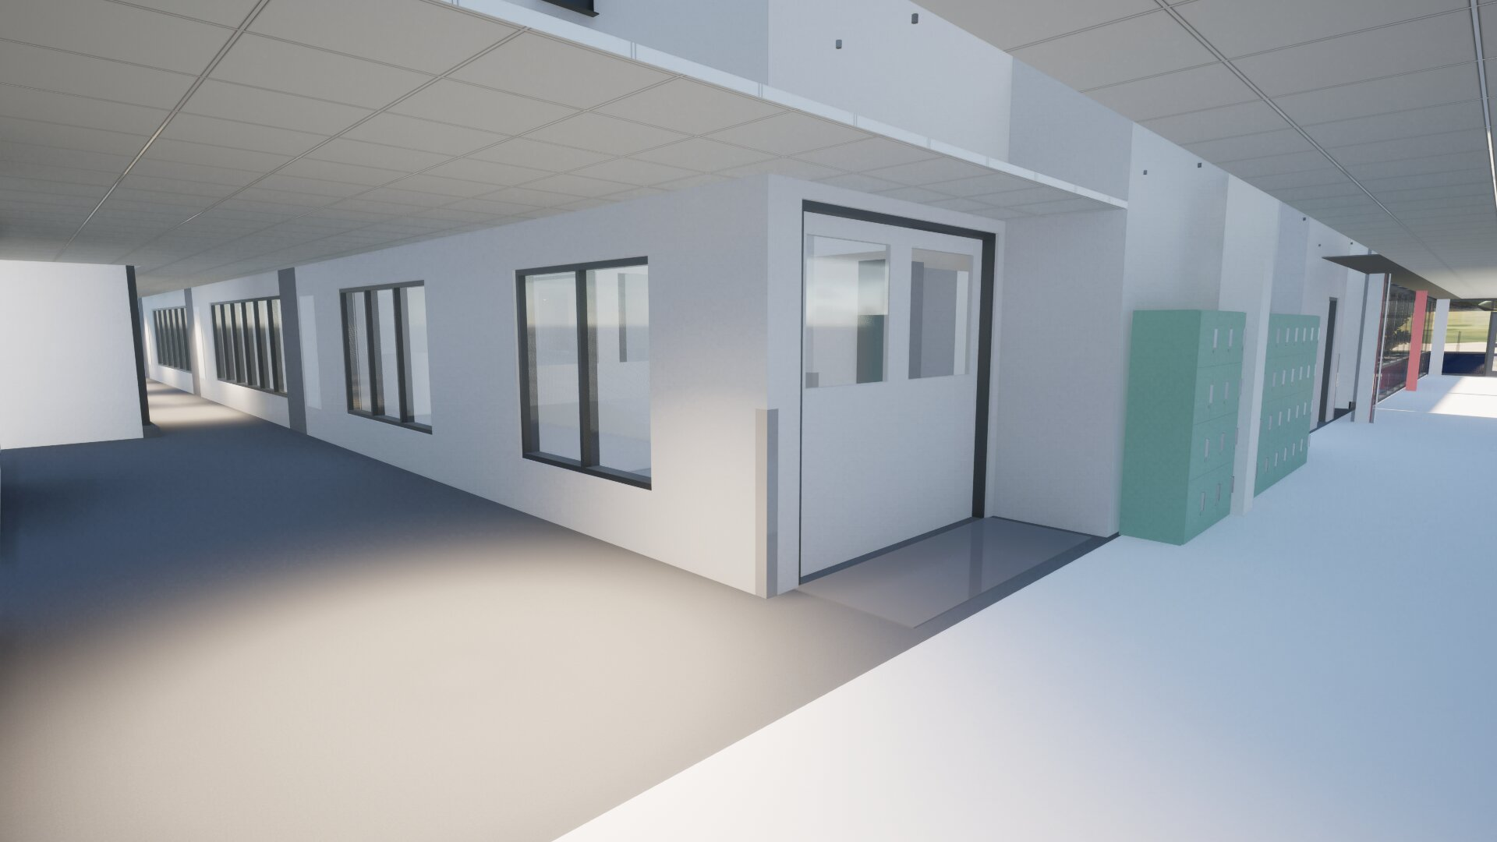
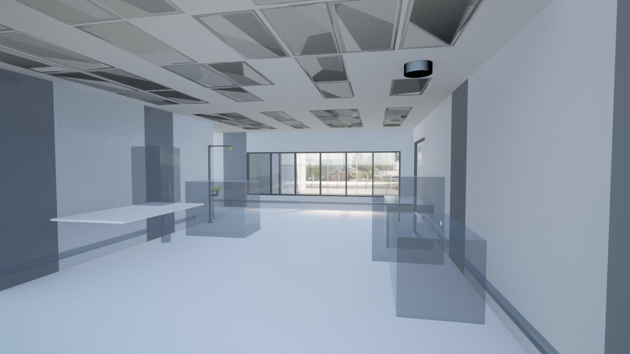
Quantum-nanofabrication cleanroom facility (qLab)
Joseph Losby (operations manager)
The University of Calgary and Quantum City are building two cleanroom facilities with about 6000 sq ft of cleanroom space (Class 10k to 100) and an additional 4000 sq ft of shell space.
Capabilities will include lithography, etching, materials deposition, wet processing, packaging, and characterization
qLab
Gowning
Cleanroom bay 1
Cleanroom bay 2
Cleanroom bay 3
Cleanroom bay 4
service chase
qLab North
Completion early 2027
qLab South
Completion early 2025
qLab Conceptual designs

Slide 2







Joseph.Losby@ucalgary.ca
We’re Hiring!
Cleanroom Technical Specialist (current posting)
Application Scientist (posting in late 2024)
  careers.ucalgary.ca

