Slide 1


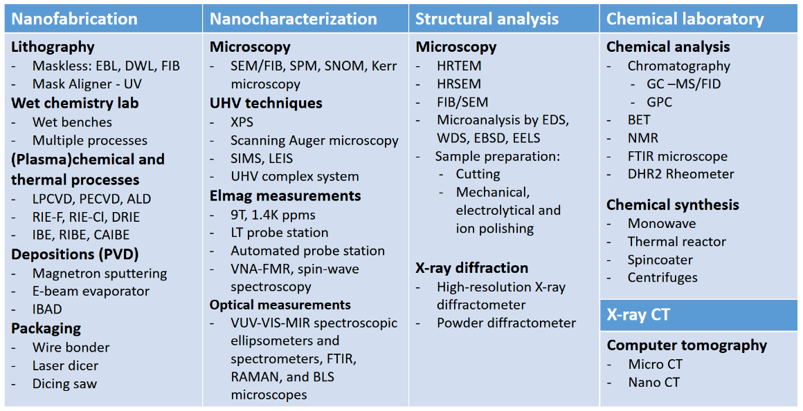
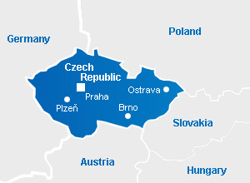
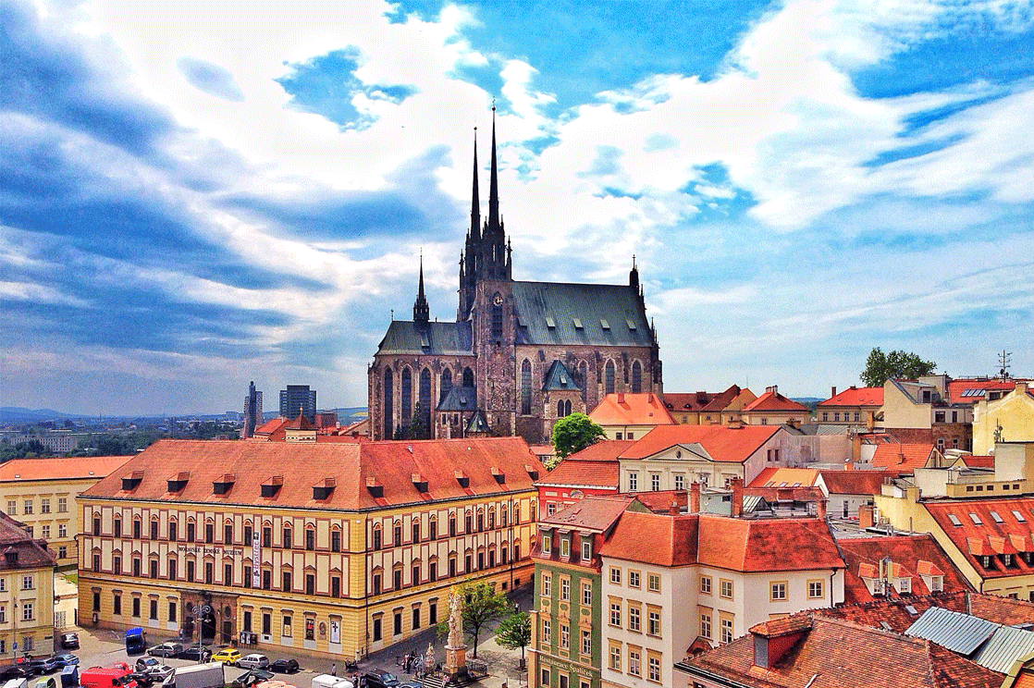
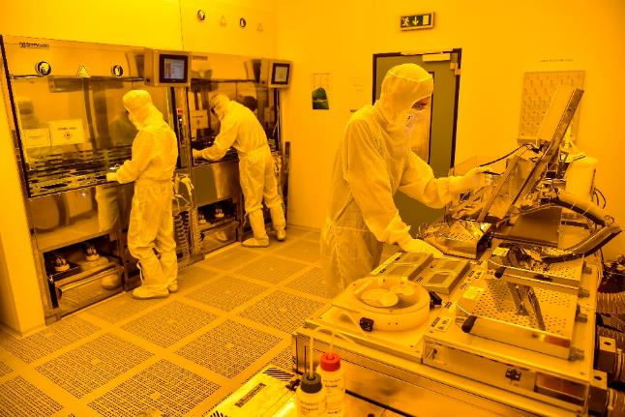
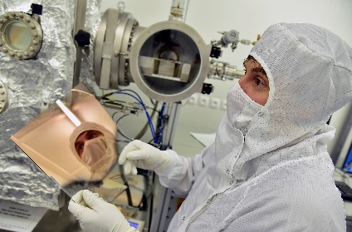
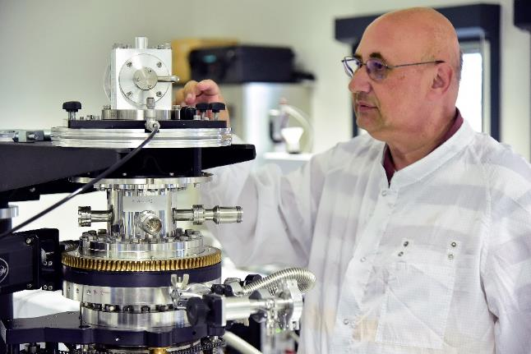
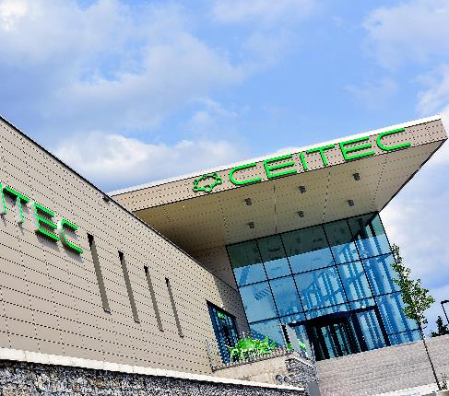
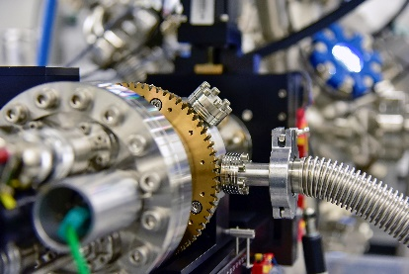
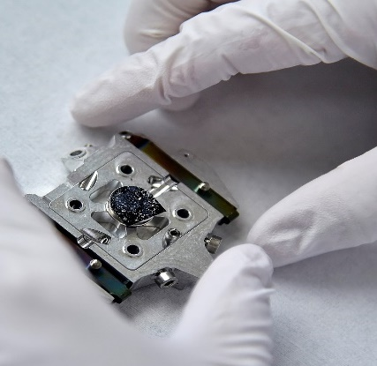
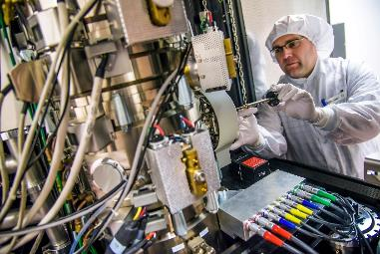
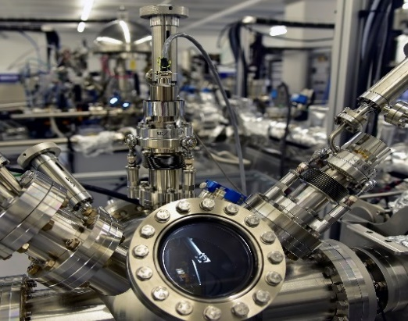
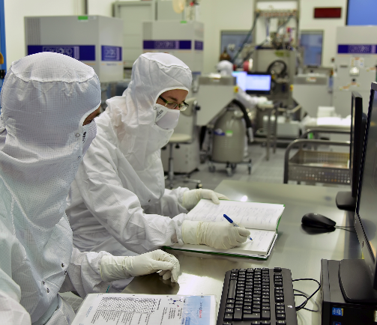




CEITEC Nano - BRNO, Czech Republic open access user facility (established in 2015)
Access conditions:
Self-service
Academia: yearly fee 1,600 € /user/year
Industry: yearly fee + hourly charges (100 € /hour)
Full-service
Fee based on the time spent on the project
(60-130 € /hr. academia, 100-300 € /hr. industry)
2023 Statistics
Specific technology: Nanophotonics,
plasmonics, MEMS, sensors, thin films,
material science
Equipment: 80 large-scale instruments / 32 M€
Cleanroom size: 2,000 m² = 350m² ISO5 + 1,650m² ISO8
Staff count: 41 employees / 29 FTE
User count: 384 persons / 93 research groups
User institutions: 29% CEITEC
24% Brno University of Technology
29% External academic
10% Startups & SME
8% Large companies
Full service projects: 81 full-service projects
(53% industry, 47% academic)
  400 000 inhabitants​
100 000 students​
R&D and high-tech industry
700 researchers
400 PhD students
excellent infrastructure
+

Slide 2
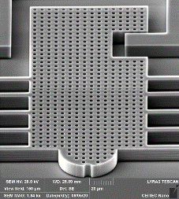
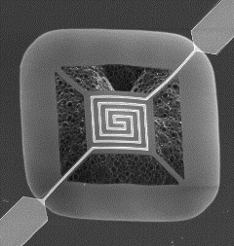
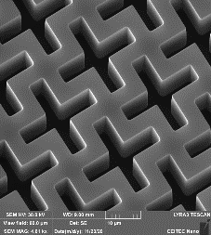
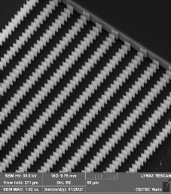
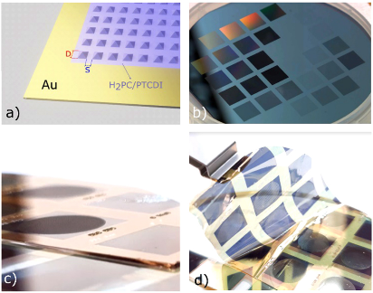
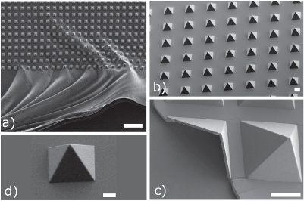
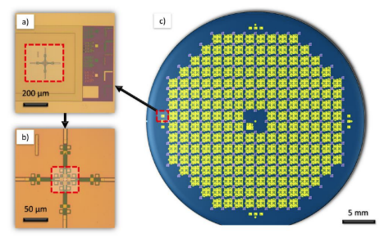
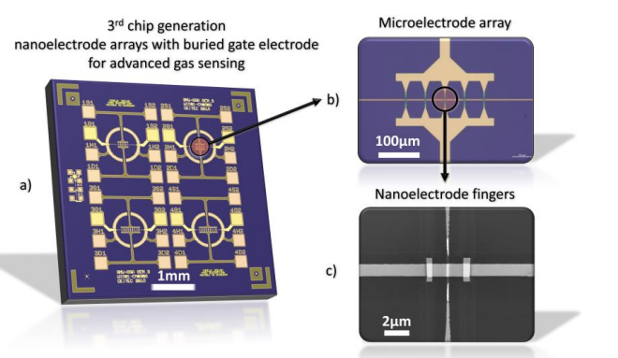
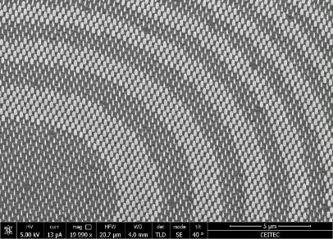
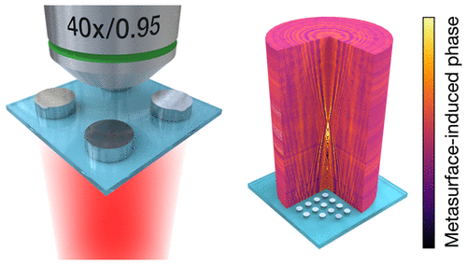
Examples from CEITEC Nano users
MEMS and microfluidic structures
3D-structured flexible opto-bioelectronic devices
Single nanowire gas-sensing chips
Photonic metasurfaces for phase manipulation
https://doi.org/10.1021/acsphotonics.7b00022

Slide 3
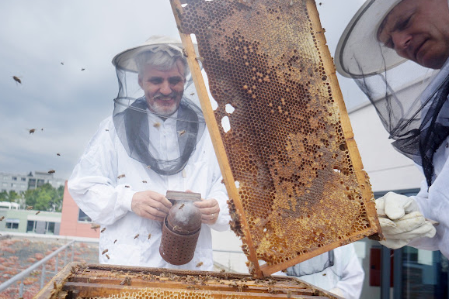
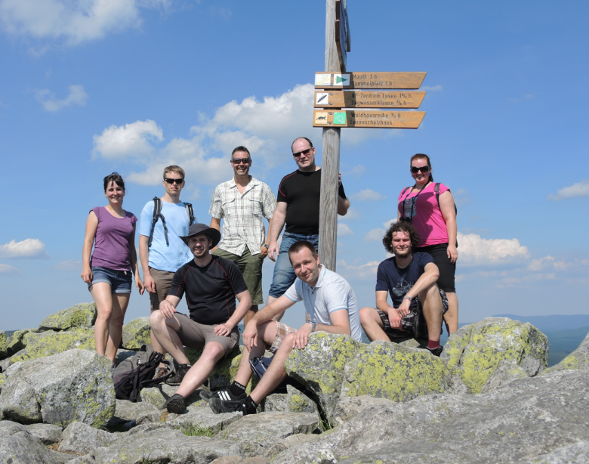
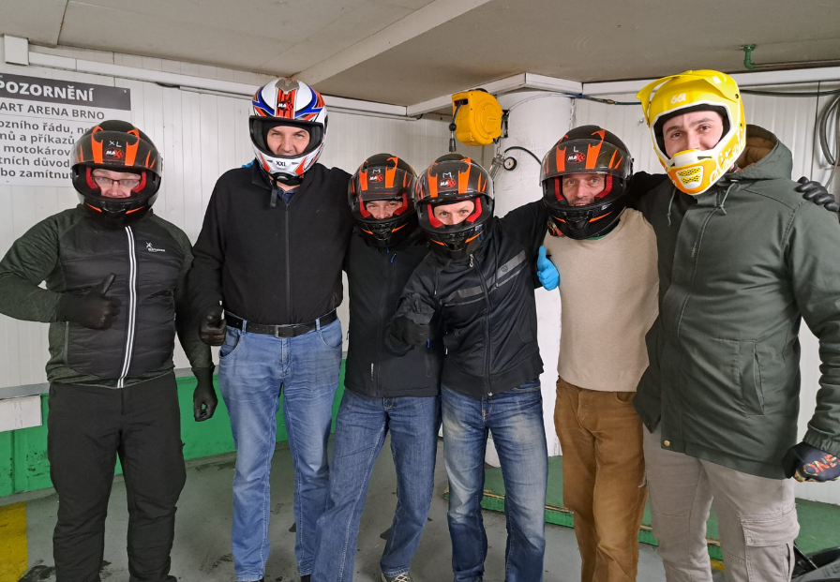
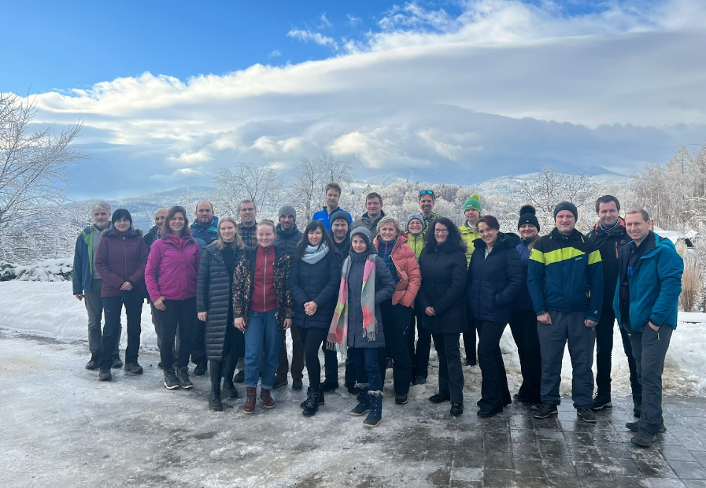
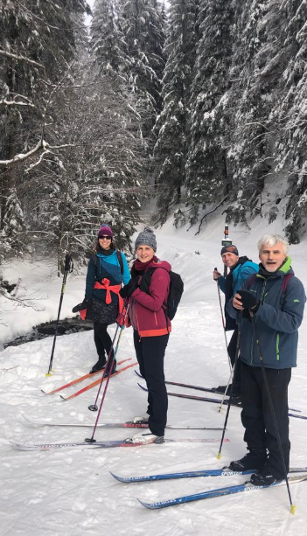
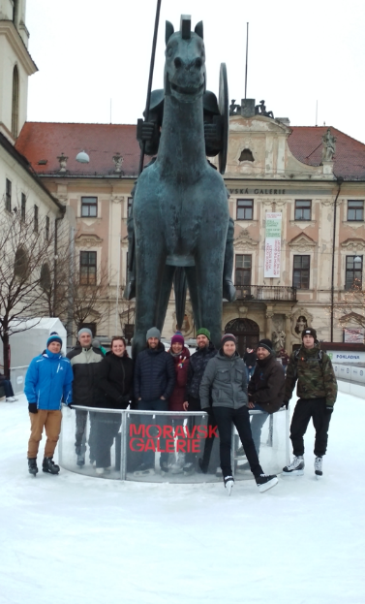

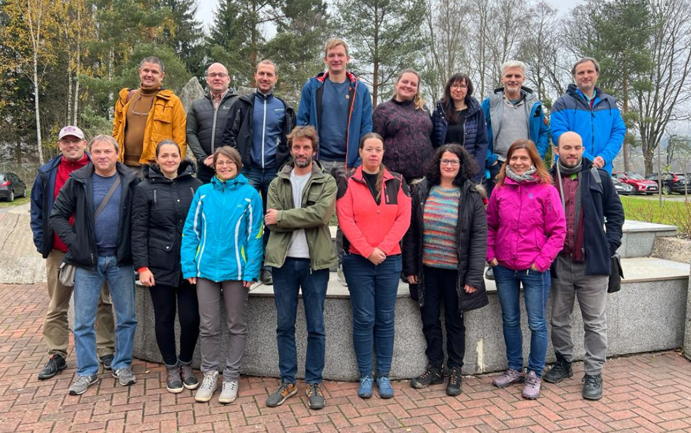
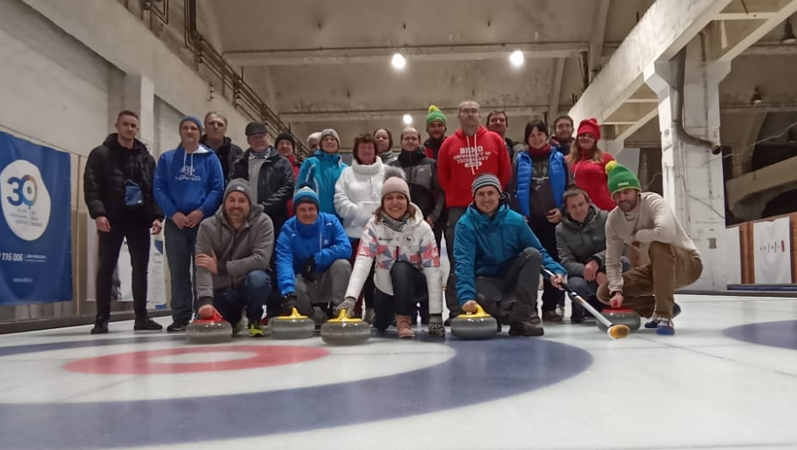
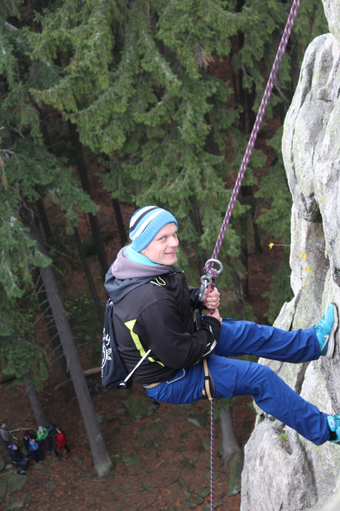
CEITEC Nano - Team spirit
Short/long-term internship
We offer short- and long-term internships in our research
infrastructure to technicians/experts from other laboratories.
Our international team is open to new collaborations
and sharing experiences.
If interested, contact us: nano@ceitec.vutbr.cz
Machines can be bought or repaired.
But the most important are the people you work with.
4 administration staff
11 nanofabrication specialists
15 analytical methods specialists
4 chemical lab specialists
3 technicians
3 ICT staff
12 women
Beekeeping
Hiking trip in Bavaria
Xmas cart arena
Internal winter workshop on the ski
Ice skating
Boat trip on the river
Internal workshop at Highlands
Xmas curling
Rock-climbing

