Slide 1






Australian National Fabrication Facility
(ANFF)
What is ANFF?
National Network of open-access labs
8 Node / 21 Institutions
25+ years
>170 ANFF staff
>500 tools across Australia
> 200,000 hrs of tool usage
How?
NCRIS Funding from Federal Govt
Co-funding from State Government, CSIRO, & Host Institutions
Total investment >> $400 m

Slide 2
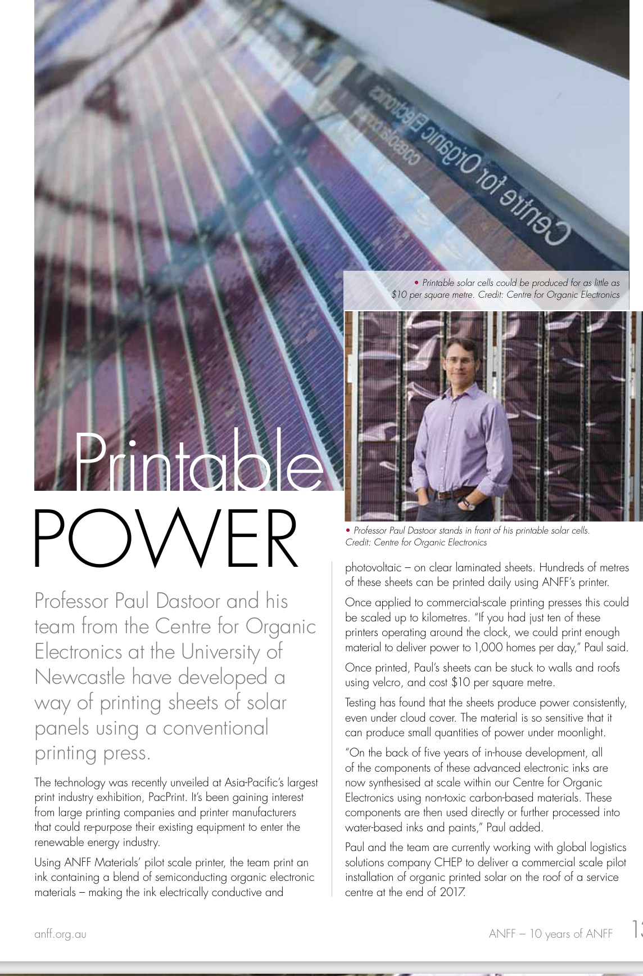
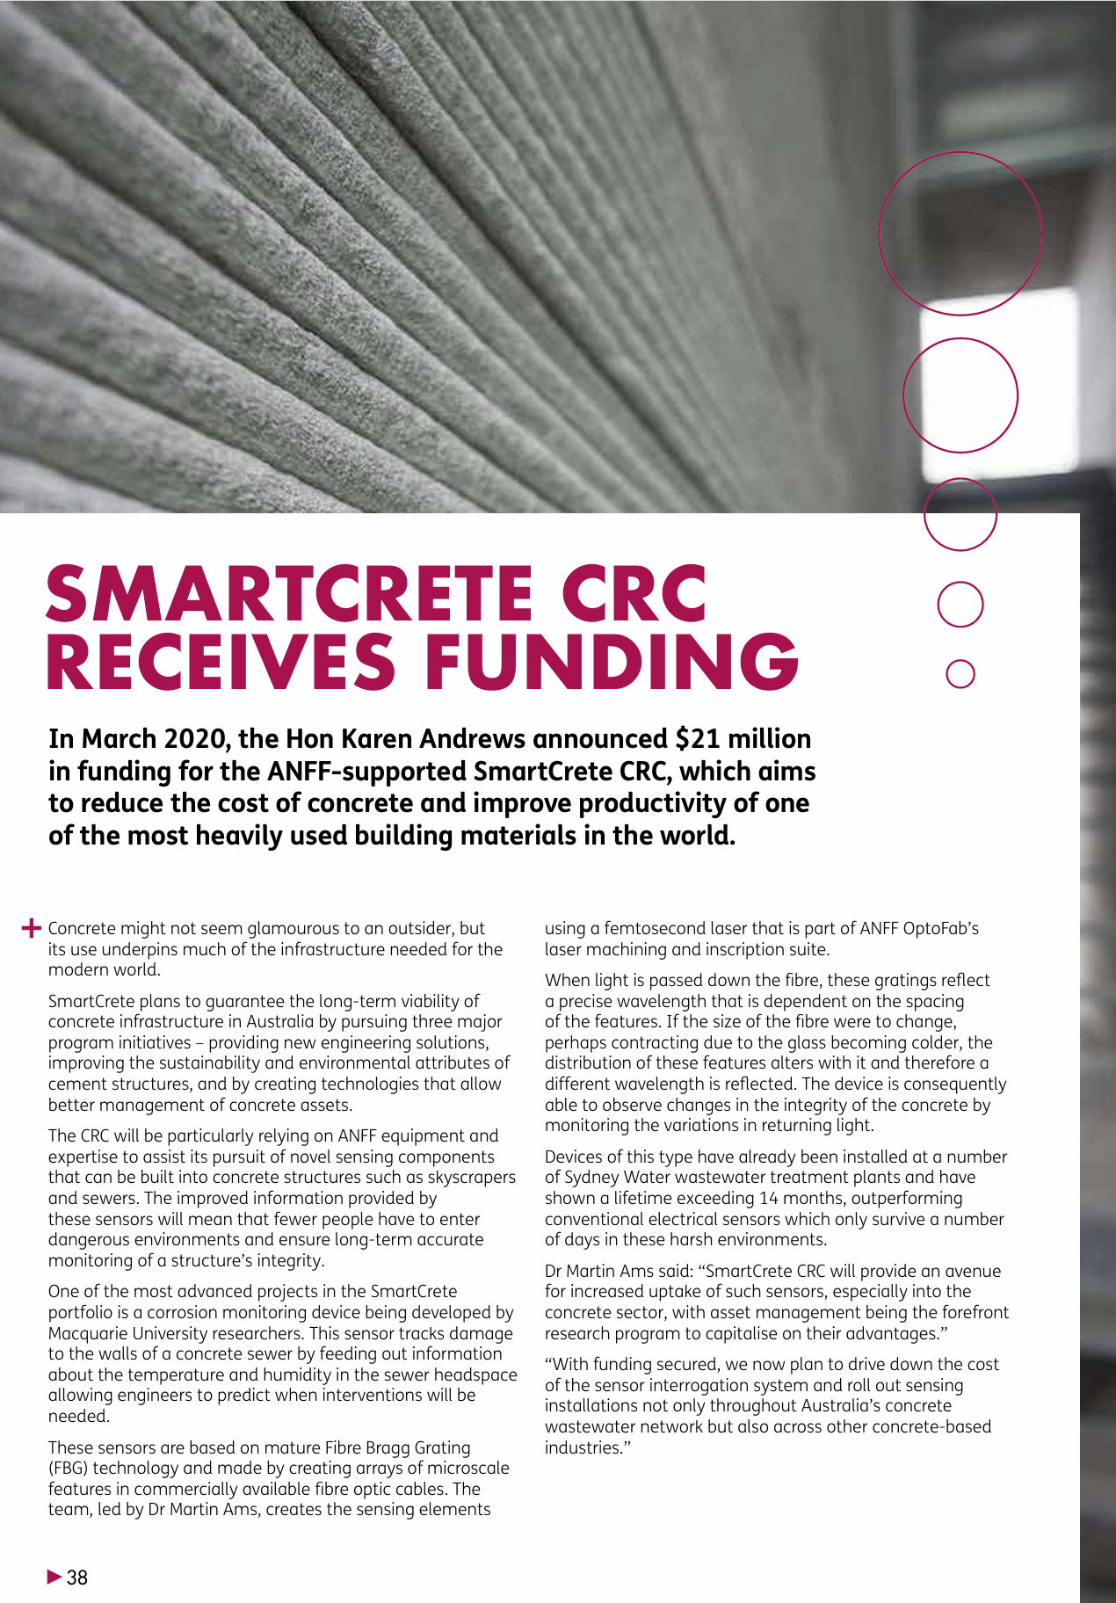
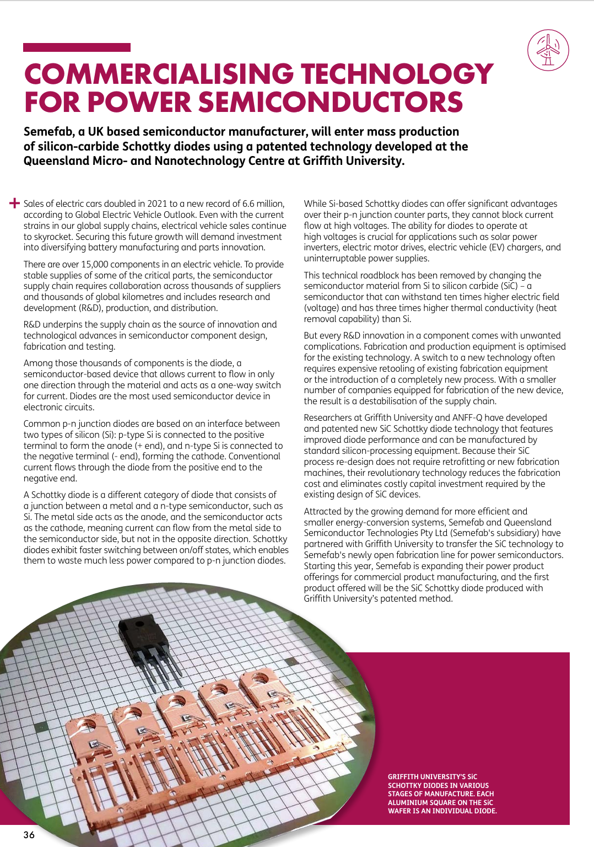
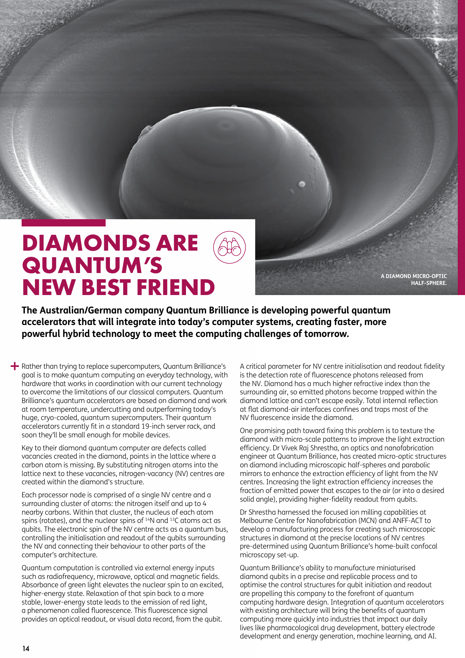
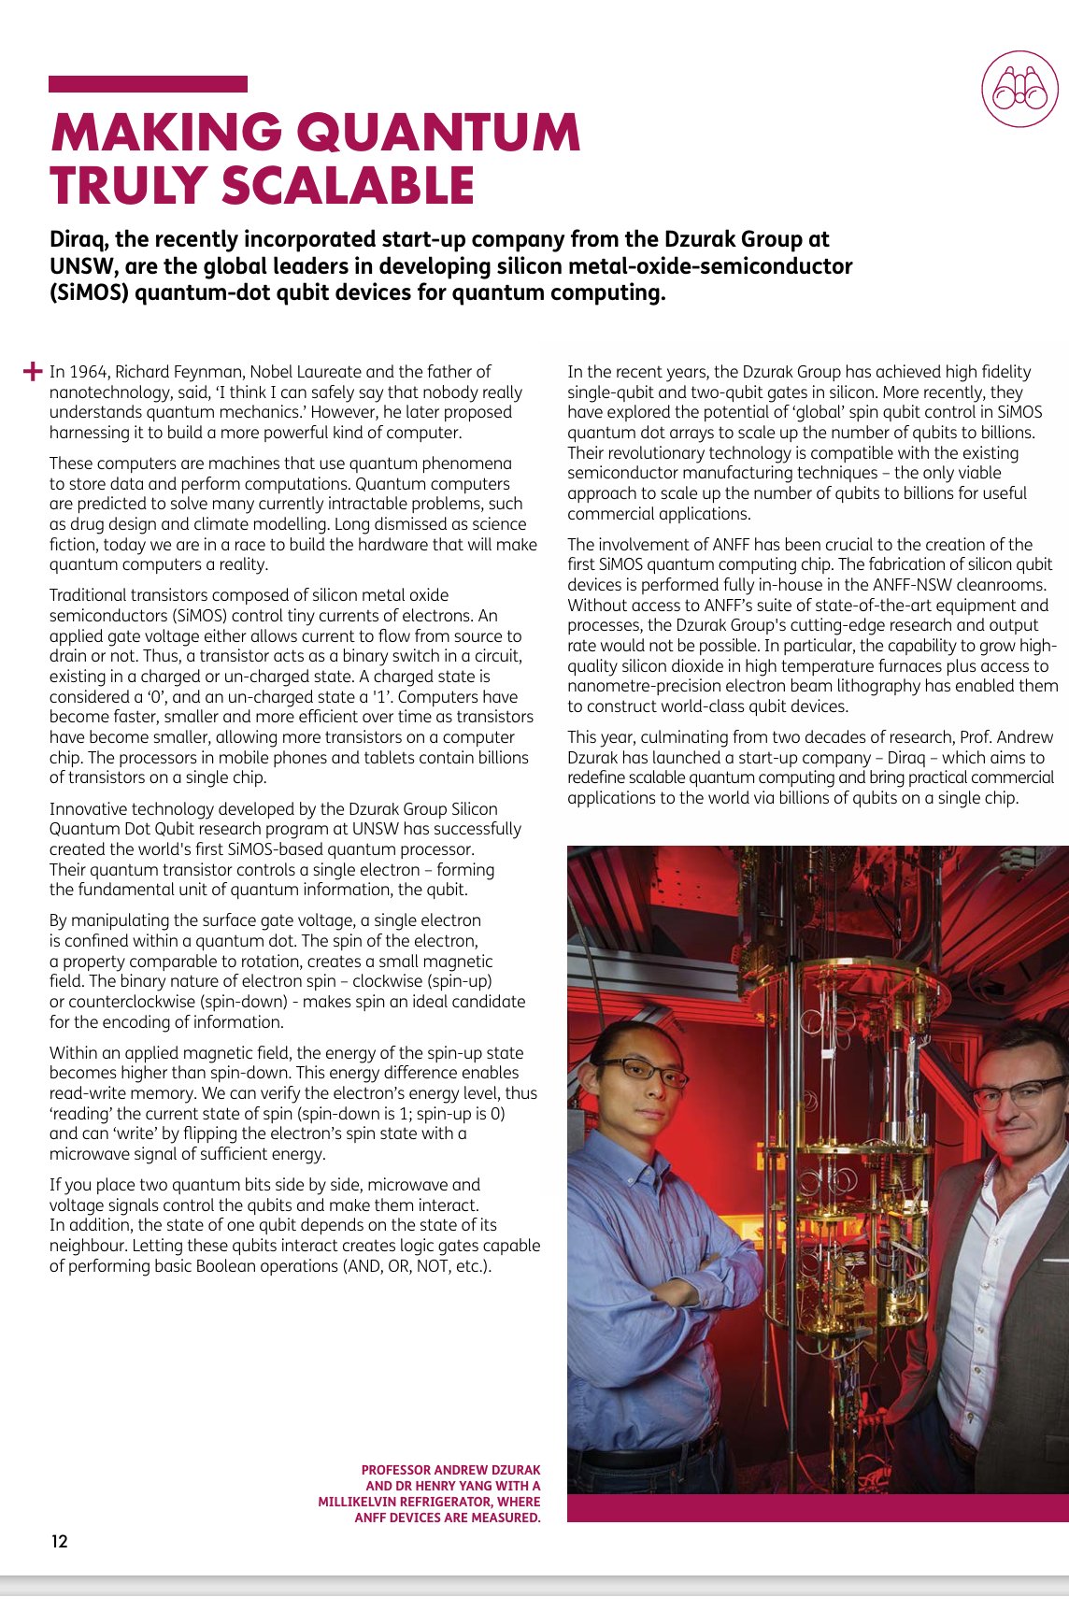

Slide 3

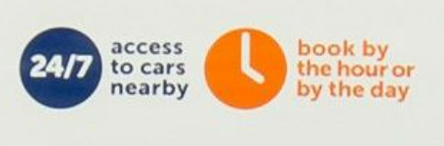

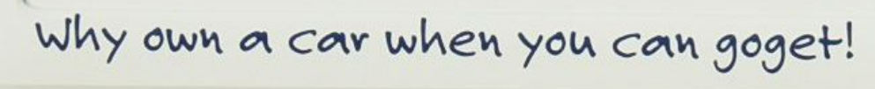
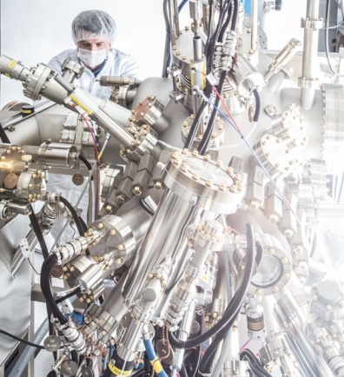
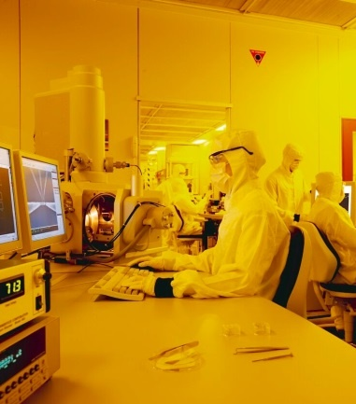
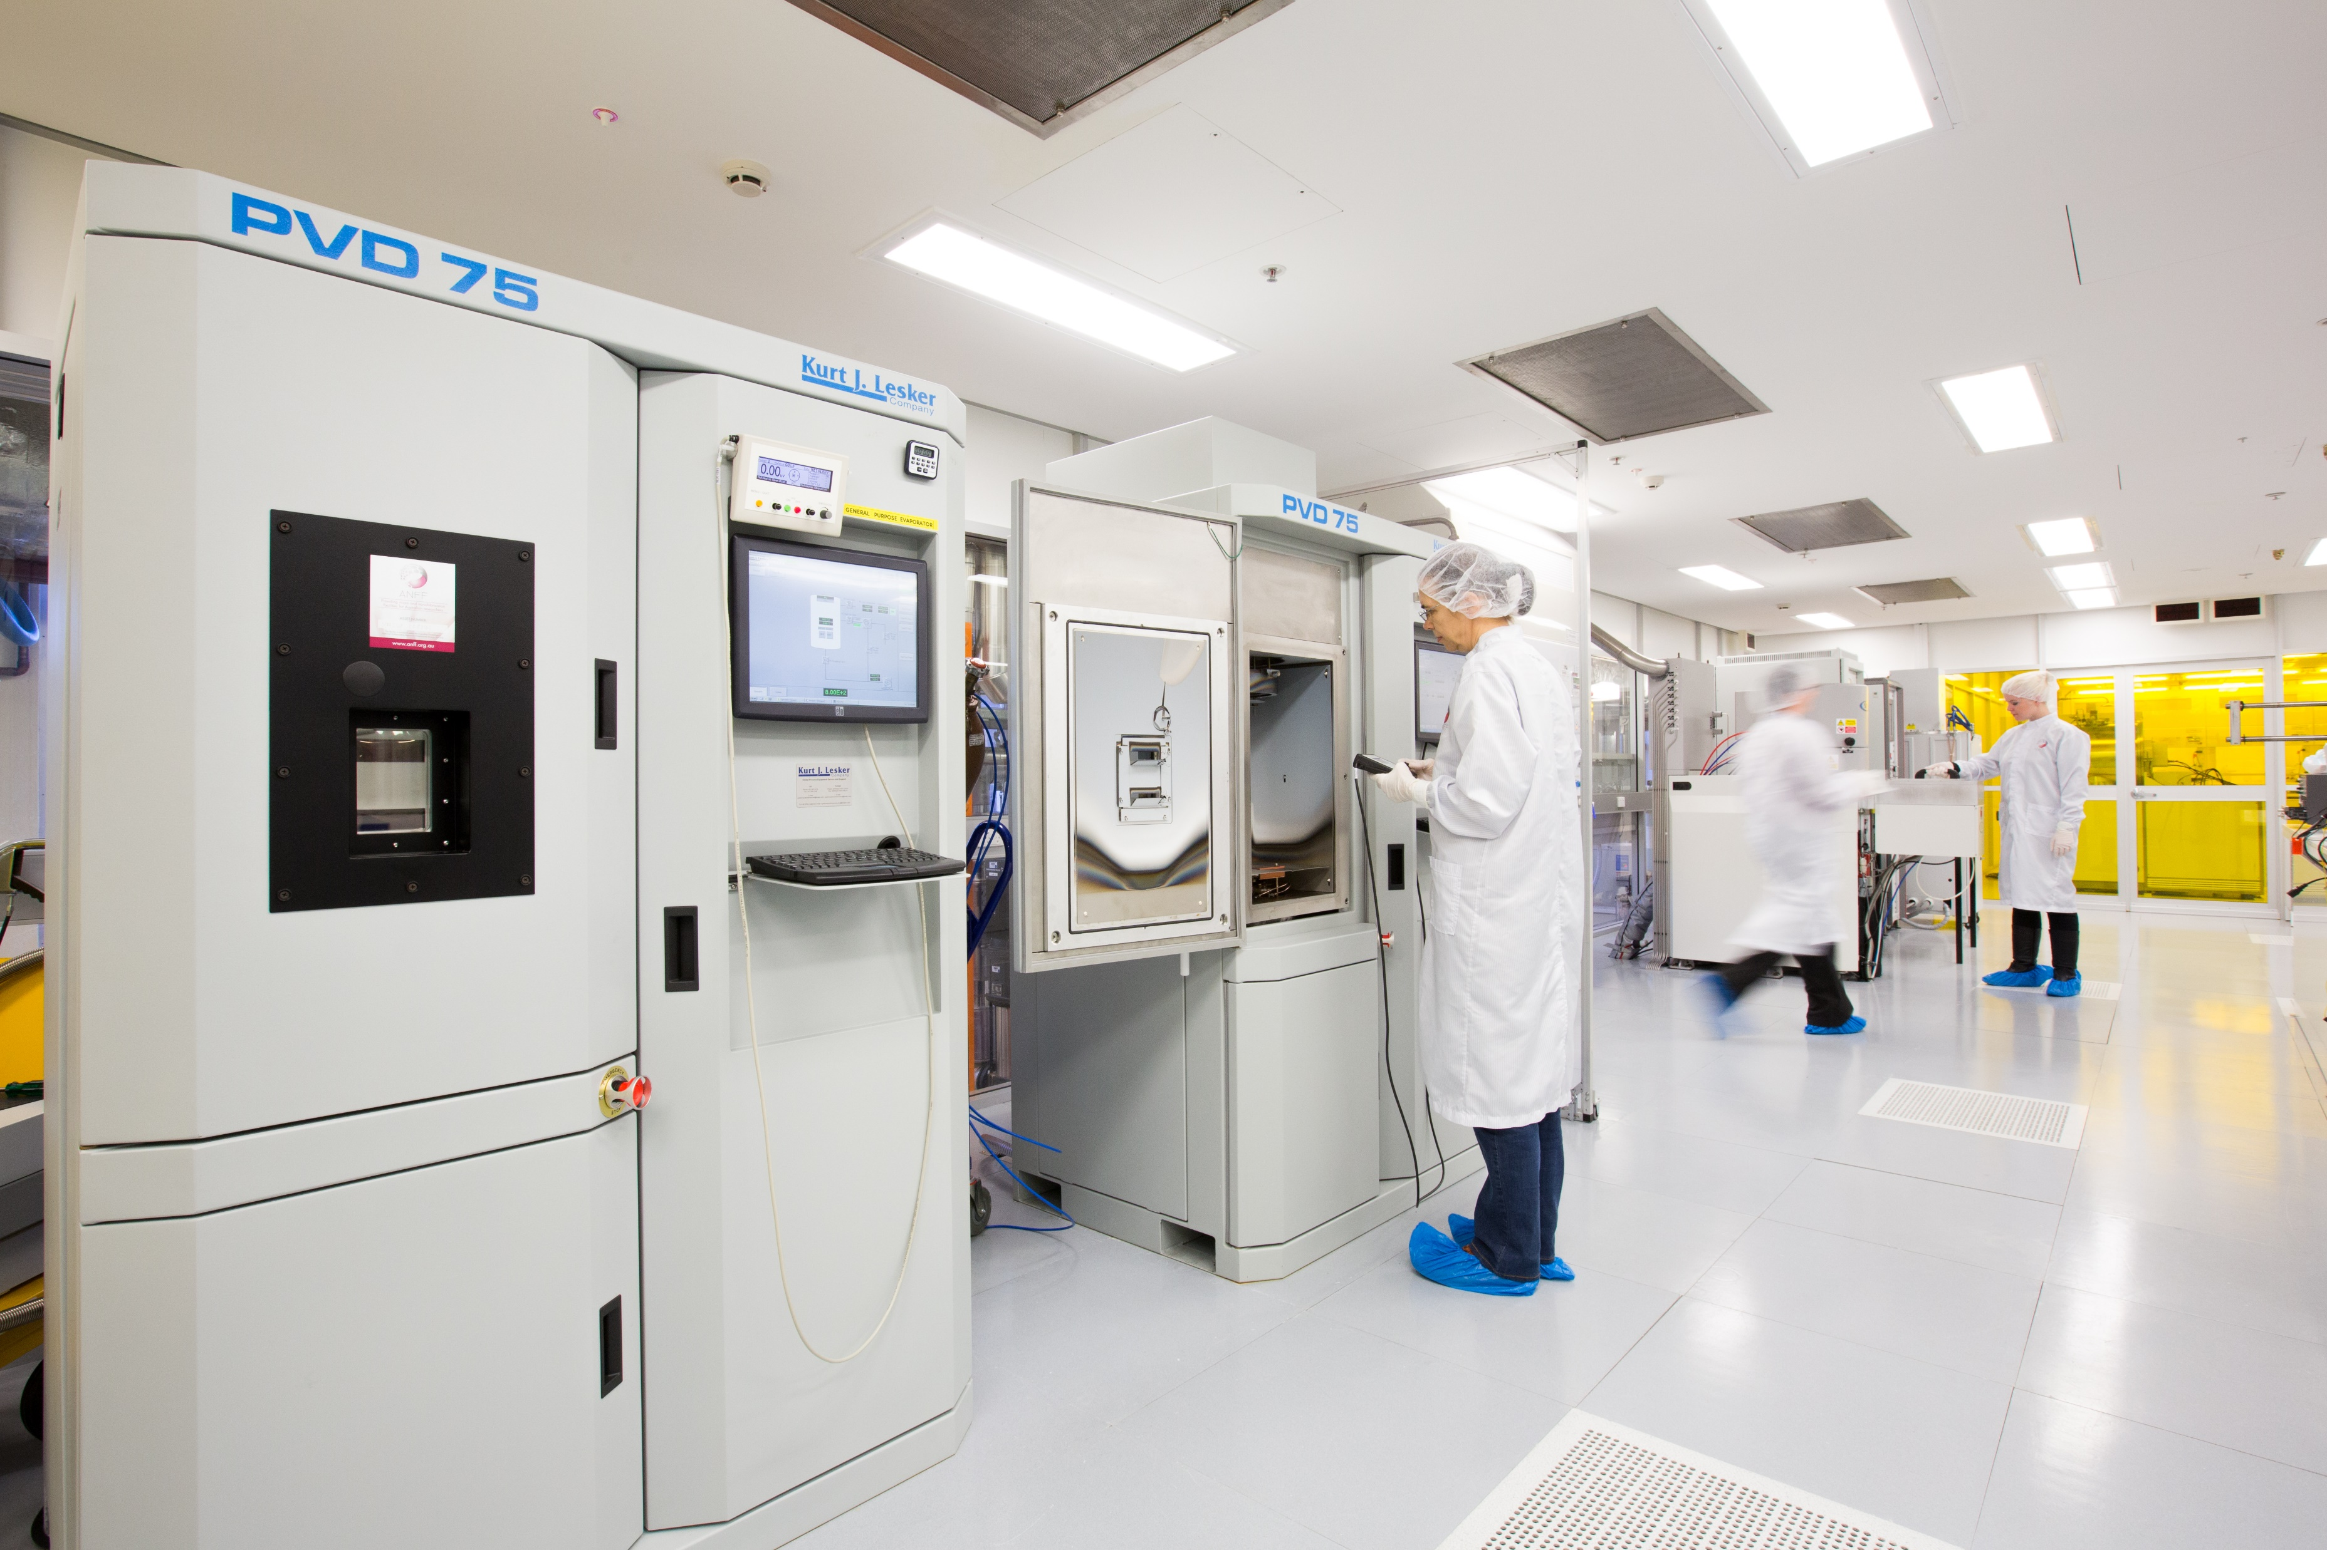
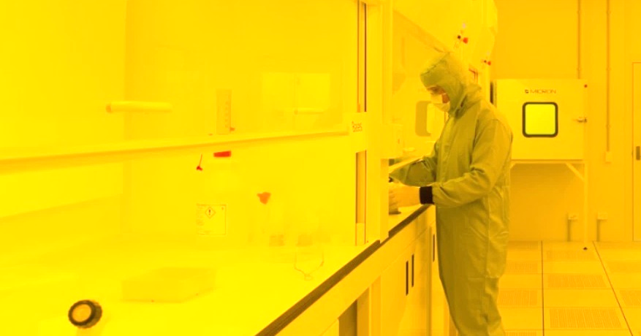
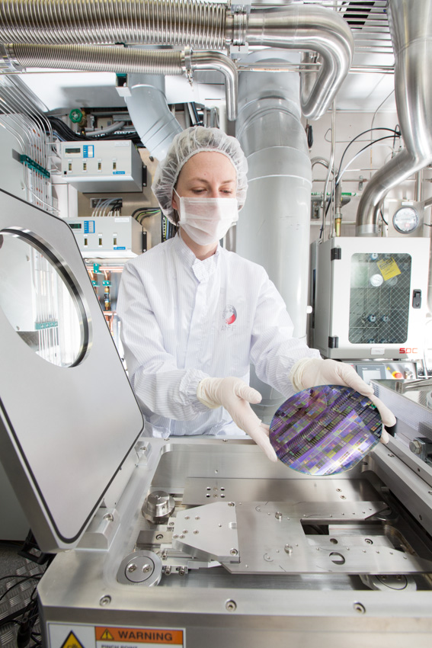
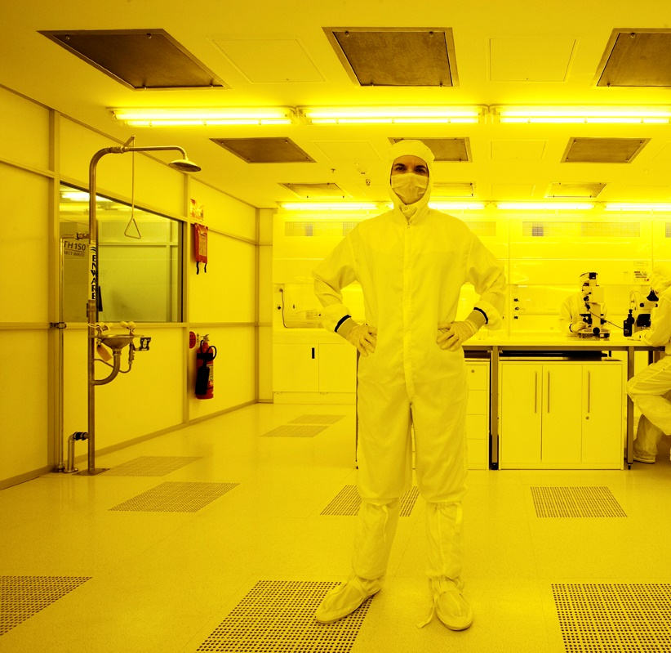


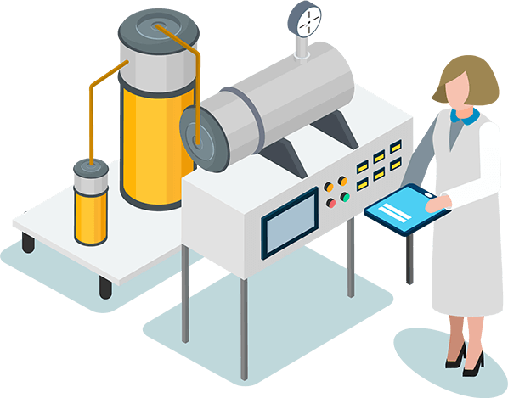


ANFF: Share Economy for Innovation
goget
A
drives from A to B
B
ANFF
experts
experts
experts
experts
experts
experts
it’s all taken care of…
book by
the hour
labs
safety
R&D tools
support
Why own a lab when you can ANFF
TRL1
TRL2
TRL3
TRL4
TRL5
TRL6
TRL7
TRL8
TRL9
drives innovation

