Slide 1
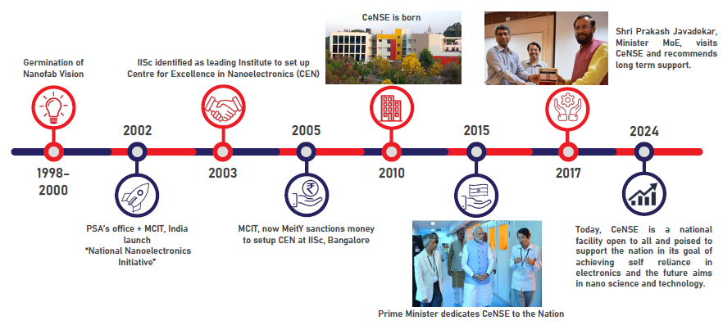
National Nano Fabrication centre (NNfC)
CeNSE – IISc
Lab showcase: Presented at the UGIM-2024 Symposium
By Sabiha Sultana
Technology Manager – Process Integration

Slide 2
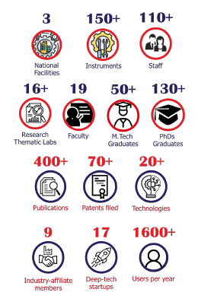
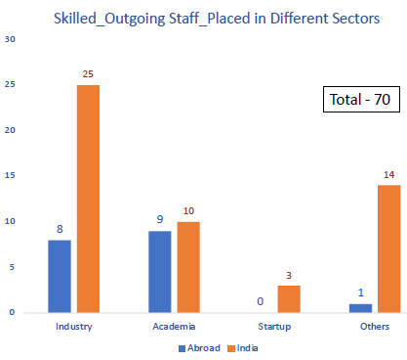
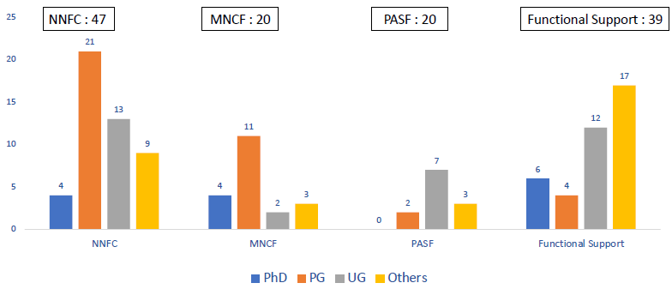
CeNSE IISc – Key metrics (Dec – 2023 data)
National Nano-fabrication Centre
(NNfC) – 84 tools
Micro and Nano Characterization Facility
(MNCF) – 55 tools
Packaging and Systems Facility
(PASF) – 40 tools
NNfC
  Built in 2010 at a cost of $65M
  Upgraded in 2023 at a cost of $3M
  Cleanroom 10,000 gross sft (2000sqft ISO 5 and 8000sqft ISO 6)
  47 technical staff + 8 Support Staff
  Unique 429 internal +125 external users/year
  Tool usage average 2400 hours / year (40% external)
  198 new users/year (external)
Internal Base user profile – UG, PG, PhD, Post Doc Students
External Base user profile – Academic, Industry, Startups, Strategic
$2M operating budget
10% internal, 30% external,
50% Government Program, 10% subsidy

Slide 3
Recent Tool Additions
(past 12 or 24 months)
GEECI fab line - 27 tools
Etch - 2
Dep – 2
Litho – 1
Benches - 2
Key Capabilities & Features
Largest integrated academic foundry in India
Facility is open to anyone
Facility is operated by a cadre of professional staff
24 thematically specialized research labs
20+ diverse training programs every year for external customers
NSQF Certification in Semiconductor Technology
Top-5 Equipment/Capability Wishlist
Dedicated line for MEMS
Material specific RIEs
More lithography tools
More dep tools
Duplicating every critical tool
Strengths
Inhouse tool upkeep and utilities
Weaknesses:
High volume usage
Old tools with less vendor support
Talk to me about…
... how awesome our jobs are!

