Slide 1
Instructions for Lab Quick-Intro Slides
From Jorg Scholvin, MIT (June 4, 2024).
These instructions and templates used for UGIM Website “Facility Summaries”
This UGIM, we will host a “Lab/Facility Quick-Intro" session, to help showcase/introduce your lab to the UGIM community (and initiate discussions between participants)
The format is:
  2-minutes (strict!)
  2-slides (a hypothetical example is in the next slides)
  You can structure the 2 slides in whatever works best for your situation, but we attached a framework in the following slides that you may choose to follow.
  For example: Slide 1 = metrics and some images/graphs/data; Slide 2 = capabilities & recent tool additions/tool wishlist
It would be great if your slides would:
  Introduce your lab (regardless of its size or focus), with some images or graphs
  Overview core metrics (for example: lab & user statistics, focus areas, key capabilities, recently added tools, tool wishlists, …)
  Highlight key capabilities or features of your facility, as well as subjective strength and weaknesses
  Show recent tool additions (helpful to anyone contemplating similar tools, and for everyone to see trends in equipment).
  Similarly, show a “top-5 tool wishlist” – which will help highlight trends and may stimulate discussions (e.g. someone else may have the tool already)
  For fun, have a “talk to me about...” for any non-technical conversations…
Logistics:
  We will have a Monday & a Tuesday session, each lasting 40 mins and covering 18 labs/session. That means: 2 mins per presentation, 9.5 seconds buffer for overruns, and 4 seconds to switch speakers.
  The only way to make it work is to have speakers already lined up ahead of time. We’ll pass a handheld microphone.
  It’s important for us to be strict (even ruthless?) about the time limit. You’ll see a 120 second timer, and after 5 seconds running over, we will blank out the slides and move on to the next speaker :-) That will keep us on time for lunch (right after the session)
  Slides will be posted electronically to the attendees. It’s expected that you won’t discuss every single point on your slides – the benefit is to provide others with the information and interesting data to contemplate and discuss.

Slide 2
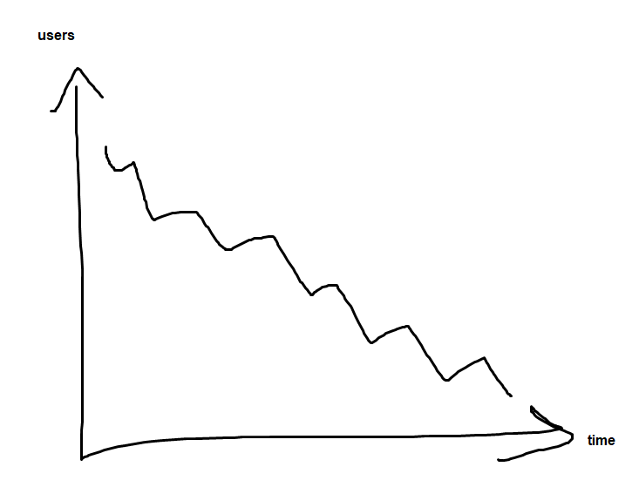
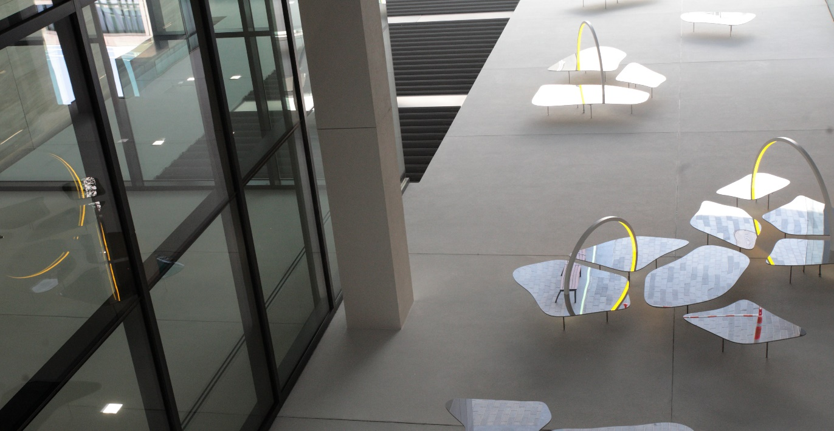
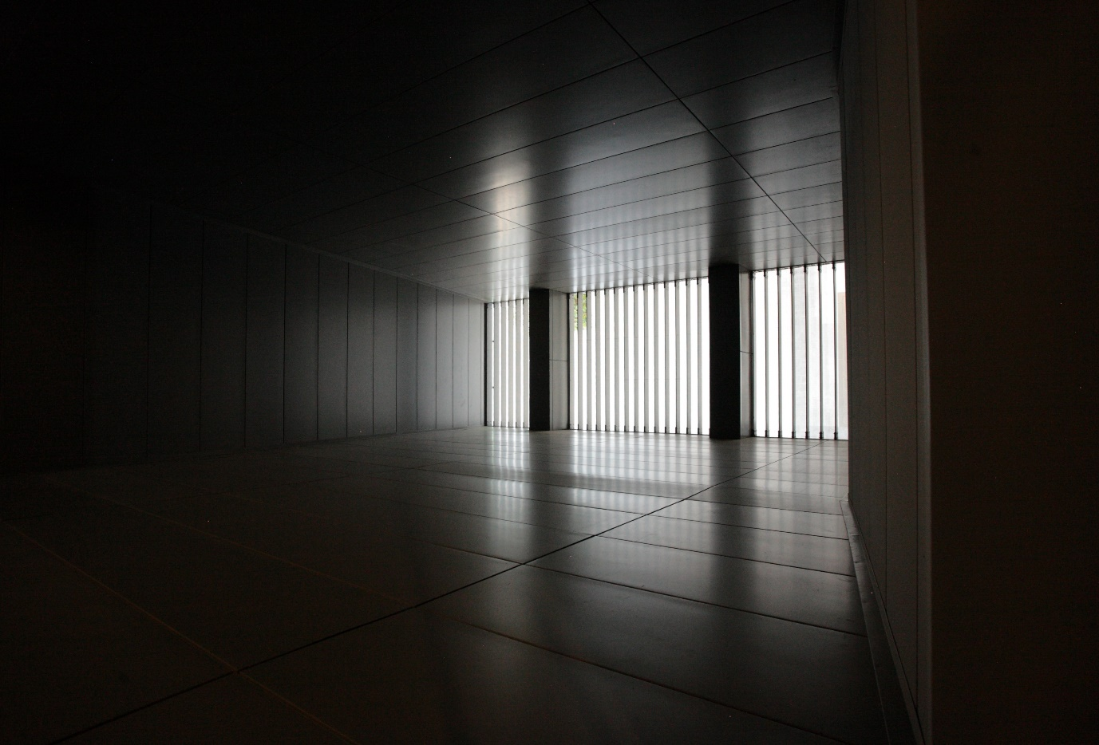
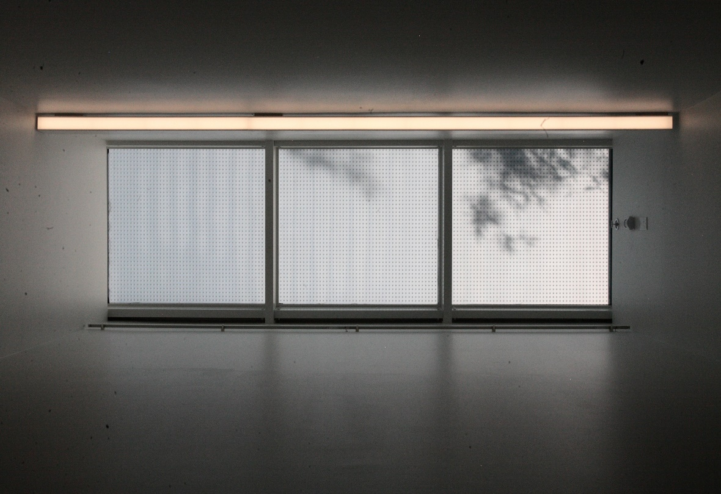
Hi-Tech Center for Office Supplies & Technology (Hi-COST)
Facilities Metrics
Built in 1982 @ a cost of $10M
Renovated in 2000 @cost of $50M
10,000 gross sft (bay & Chase & Suite) ISO 5
25 technical staff
4 Support Staff
4 major tools
10 unique internal users/year
3 unique external users/year
Tool usage 210 hours / year (40% external)
3 new users/year (1 external)
Internal Base user profile
External Base user profile
$1.2M operating budget
10% internal, 10% external,
10% Lemonade Stand fundraisers, 70% subsidy
Avian
Outdoor Seating
Yoga Studio
Main Entrance

Slide 3

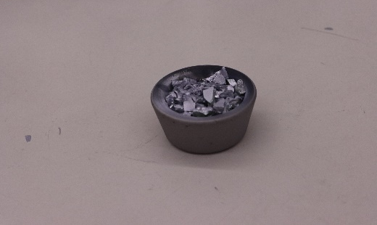
Key Capabilities & Features
Cleanroom paper
Sharp tweezers
No windows
Paper recycling
Recent Tool Additions (past 12 or 24 months)
Colored sharpies
Extra sharp tweezers
Cardboard compatible etcher
Single page shredder
Strengths
Modeling vs practice of papercuts
Weaknesses:
Unable to handle paper jams
Top-5 Equipment/Capability Wishlist
Green and blue pencils
Scissors
Wooden chairs
Stapler with 100 page capacity
Shredder with auto-feed
Exploring Novel Anti-gravity Paperclips
Talk to me about…
Building (and flying) paper airplanes

